Slide 1
Fitbit Users Behaviour Analysis
Guiding Marketing Strategy
Presented by: Muhammad Abdullah
Last Updated: September 24th , 2025

Slide 2
Scenario
You are a junior data analyst working on the marketing analyst team at Bellabeat, a high-tech manufacturer of health-focused products for women. Bellabeat is a successful small company, but they have the potential to become a larger player in the global smart device market. Urška Sršen, cofounder and Chief Creative Officer of Bellabeat, believes that analyzing smart device fitness data could help unlock new growth opportunities for the company. You have been asked to focus on one of Bellabeat’s products and analyze smart device data to gain insight into how consumers are using their smart devices. You will present your analysis to the Bellabeat executive team along with your high-level recommendations for Bellabeat’s marketing strategy.

Slide 3
Objective
To gain insight into how consumers use Fitbit smart devices
Time period: April 12, 2016 – May 12, 2016
Focus: Segmenting Fitbit’s users by activity level, correlating their behavior with key metrics like calories burned, and identifying weekly patterns

Slide 4
Data Summary
Data source: Fitbit Dataset from Kaggle
Size: ~ 1000 rows , 16 columns
Prepared in R : Using readr , janitor , dplyr , and ggplot2 libraries
Columns used : Total Steps , Calories , Spend minutes types and more…
The analysis was based on a dataset of 33 users, with each user's data collected over a 31-day period
Data was cleaned before importing into Tableau for visualization

Slide 5
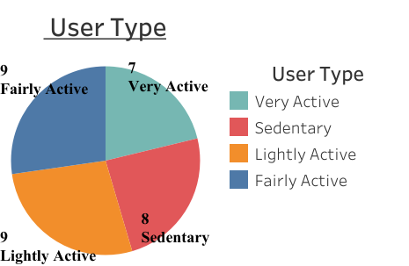
User Segmentation
INSIGHTS :
The majority of users are not very active .
The largest user segments are “Lightly Active” and “Fairly Active”.

Slide 6
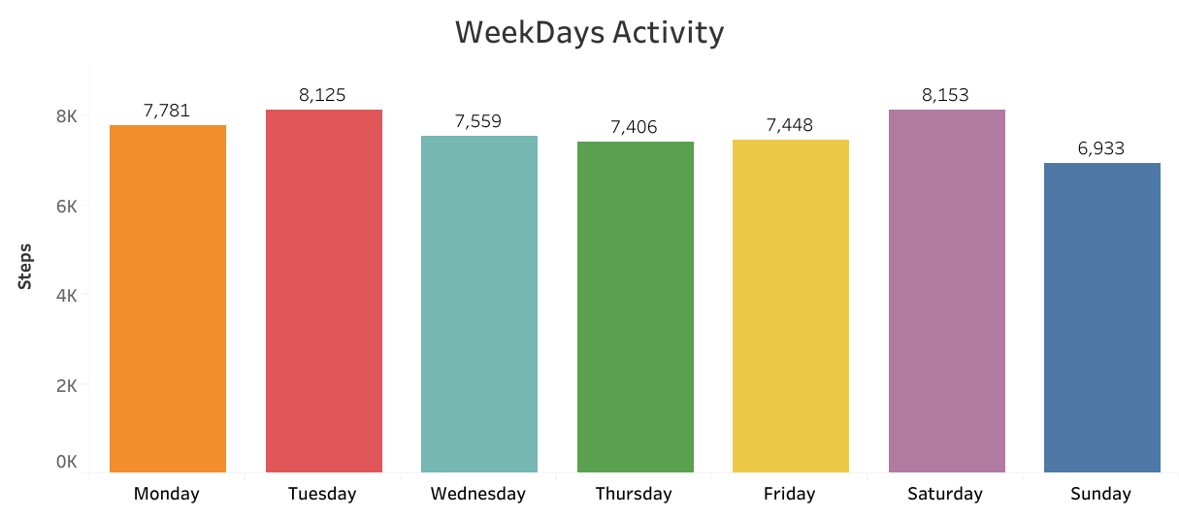
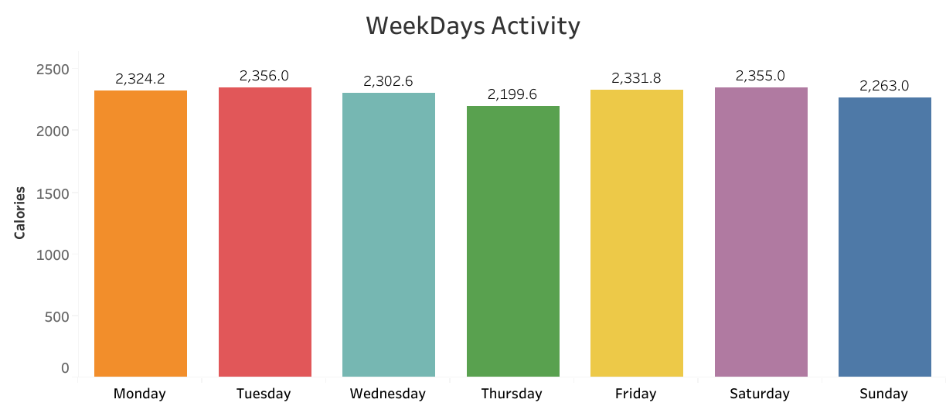
Weekly Activity Patterns
INSIGHTS :
Tuesday and Saturday are the most active days for users, with over 8,100 steps.
There is a significant drop in activity on Sunday , with taking of only 6,933 steps , making it least active day of week
INSIGHTS :
Average calories burned remains remarkably stable throughout the entire week.
Thursday and Sunday show a small dip in calories burned compared to the other days.

Slide 7
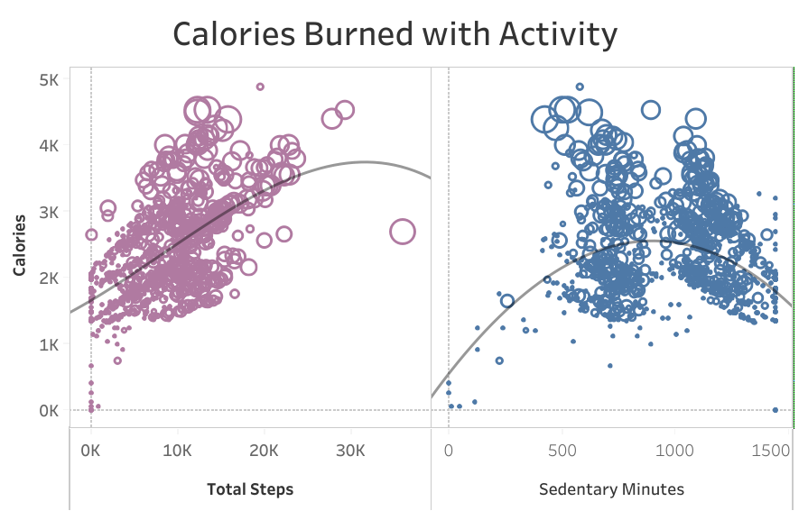
Relationship Between Activity and Calorie Burn
INSIGHTS :
There is a strong positive correlation between total steps and calories burned. As steps increase, so do calories.
In contrast, there is a weak or slightly negative correlation between sedentary minutes and calories burned.
Physical movement, such as taking steps, directly increases calorie burn, while a sedentary lifestyle does not.

Slide 8
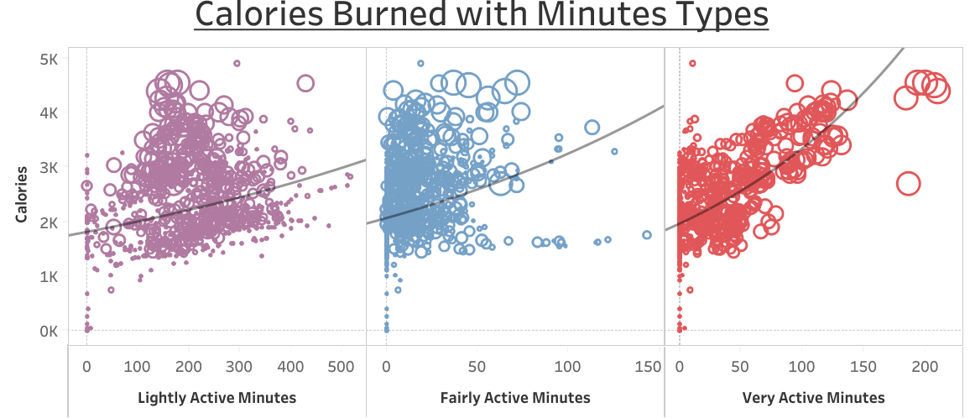
High-Intensity Activity Drives Calorie Burn
INSIGHTS :
The relationship between calories burned and minutes of activity is directly tied to the intensity of the activity
While light and fair activity contribute to calorie burn, very active minutes show the steepest increase in calories burned.
This visualization provides clear evidence that high-intensity activity is the most efficient way to burn calories.

Slide 9
Recommendations For Bellabeat
Shift marketing focus to "wellness," not just "fitness." The majority of users are "Lightly Active" or "Sedentary“, presenting a prime opportunity to market to a broader audience focused on overall well-being.
Implement a targeted "Sunday Motivation" campaign. With user activity consistently dropping on Sundays, Bellabeat can use the app to send targeted reminders and challenges to encourage engagement on the least active day of the week.
Enhance the in-app experience to reward high-impact activity. Since "Very Active Minutes" have the strongest correlation with calories burned, the app's interface should prioritize and reward high-intensity efforts over simple step counts.

Slide 10
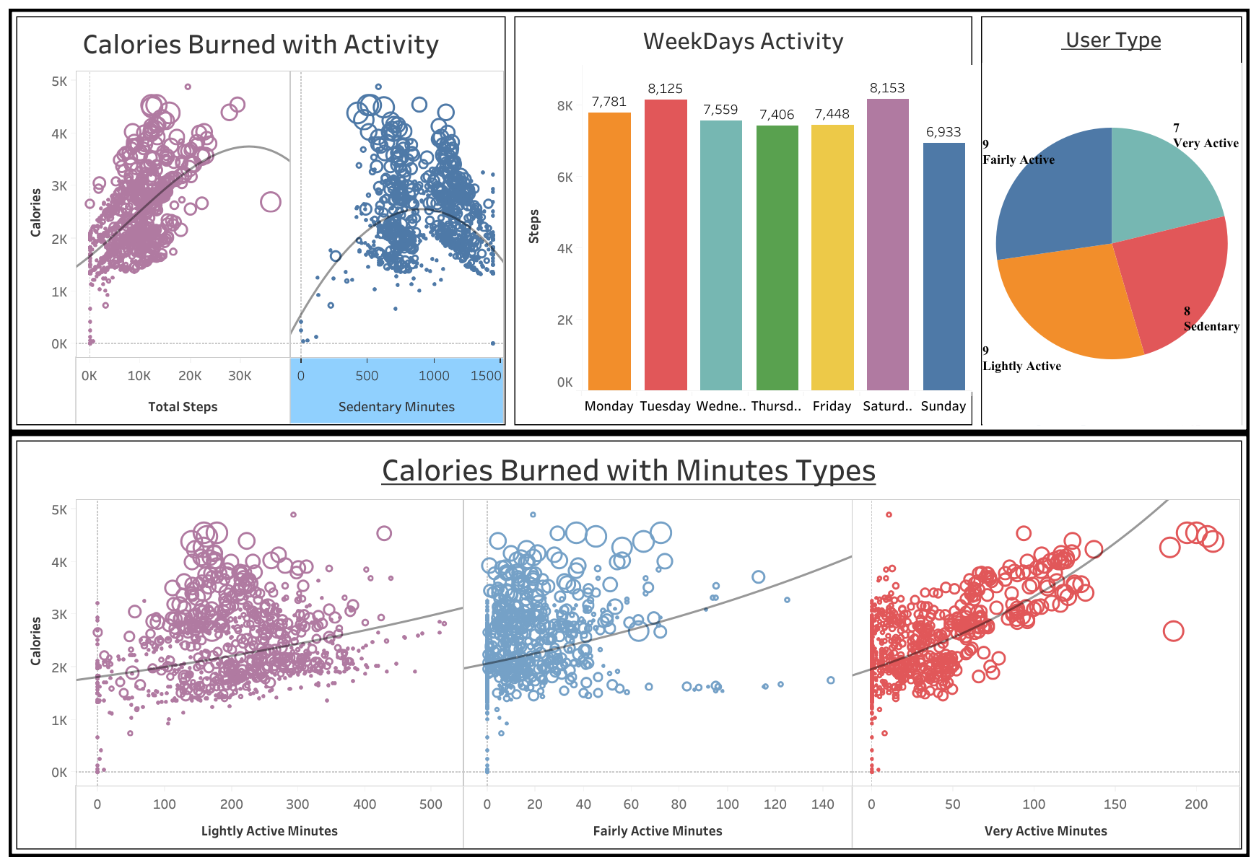
Dashboard

Slide 11
Thank you!

