Slide 1




PUBG PLAYERS PERFORMANCE ANALYSIS
UNDERSTANDING THE FACTORS THAT INFLUENCE WIN RATE AND RANK POINTS
PRESENTED BY
M ABDULLAH

Slide 2
OBJECTIVE
To deliver actionable, data-driven strategies derived from the analysis to improve the audience's understanding of PUBG player performance, winning factors, and rank progression.
FOCUS : Establishing the true relationship between raw player performance metrics and achieving high ranks/wins, leading to the creation of actionable, data-driven strategy guides.

Slide 3
DATA SUMMARY
DATA SOURCE : Pubg Dataset From KAGGLE
SIZE : ~4.4 Million Rows , 29 Columns
PREPARED IN R : Using readr , janitor , dplyr , ggplot and patchwork
COLUMNS USED : win_place_per , kills , damage_dealt , match_type and more…
Data was cleaned before importing into TABLEAU for visualization

Slide 4
METHODS USED
Grouping and Aggregation
Correlation Analysis
Outlier Filtering
Player Segmentation (based on damage dealt)
Visualization : Bar , Box and Scatter Plots

Slide 5
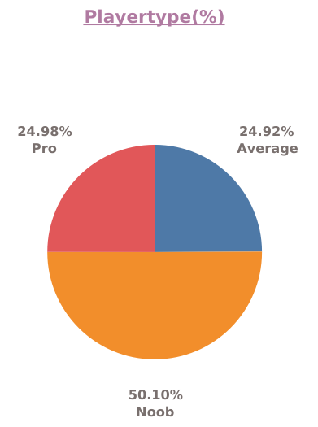
PUBG PLAYERS SEGMENTATION
Segmentation :
Noobs : Damage (<85)
Average : Damage (85-187)
Pro : Damage(187+)
Insights :
Majority of players are Noobs : 50.10%
Average players make up to 24.92%
Pro players from 24.98% of total
Notes:
Only 1 in 4 players reach Pro level — keep grinding, your chicken dinner crown awaits!" 🏆🐔

Slide 6
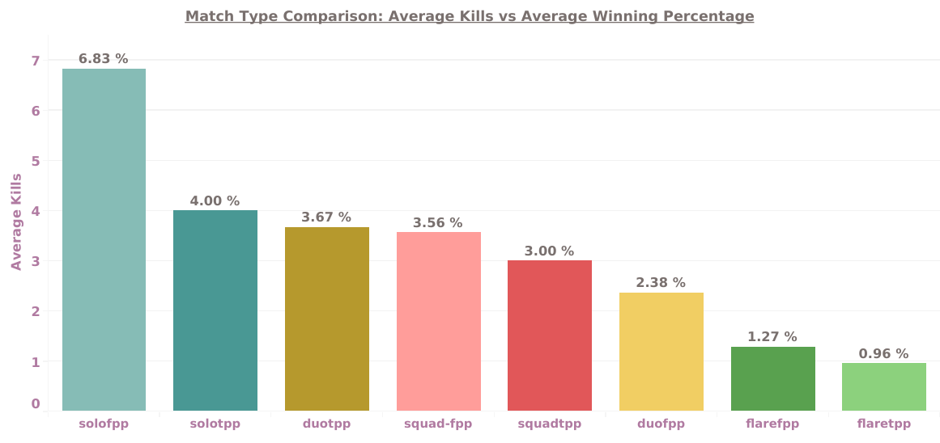
BLUEPRINTS FOR CHICKEN DINNER
Insights :
Solo FPP is peak combat intensity (6.83 kills average).
Team modes require less per-player combat (around 3.00 to 3.56 kills).
Flare modes are the least competitive intensity (0.96 to 1.27 kills average).
Notes:
Only 1 in 4 players reach Pro level — keep grinding, your chicken dinner crown awaits!" 🏆🐔

Slide 7
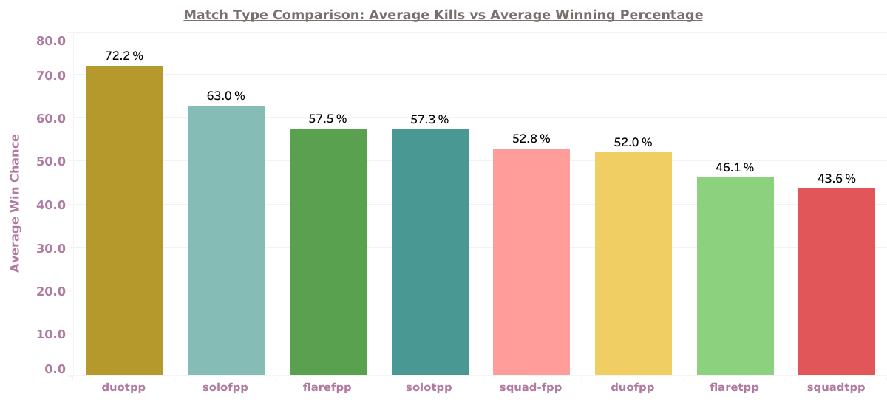
BLUEPRINTS FOR CHICKEN DINNER
Insights :
Duo TPP offers the best win potential (72.2%).
SOLO FPP is the top solo win mode (63.0%).
SQUAD TPP has the lowest win chance (43.6%)
TPP generally yields better win probability than FPP.

Slide 8
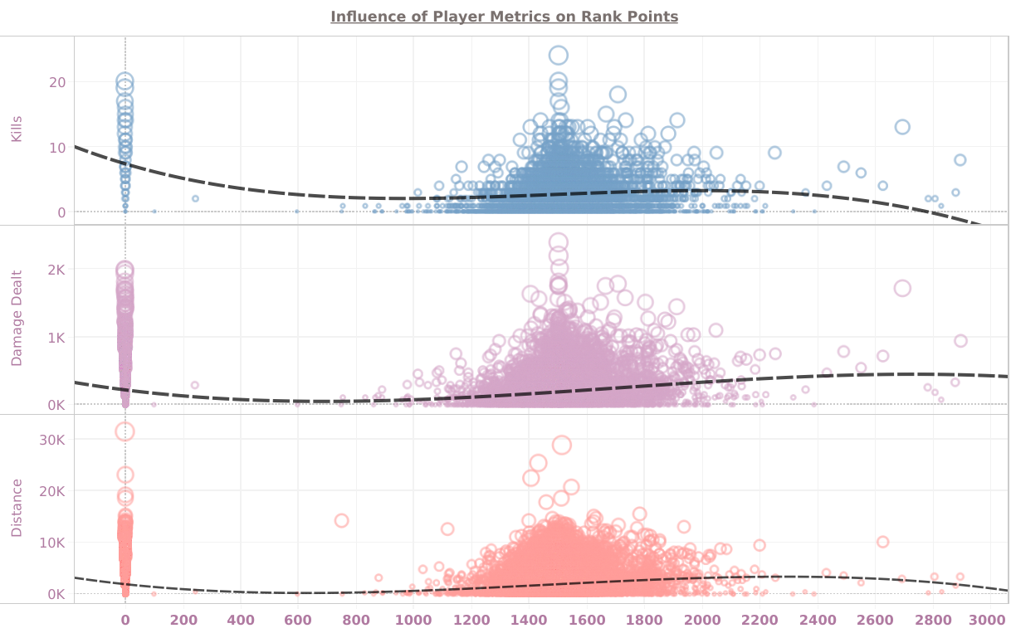
INFLUENCE OF MATRICES ON RANK POINTS
Insights :
Rank is not driven by combat performance metrics.
Kills, Damage, Distance show negligible correlation with Rank.
Survival and placement are the true scoring factors.
Most player activity clusters strongly in mid-to-high ranks.
Notes:
Only 1 in 4 players reach Pro level — keep grinding, your chicken dinner crown awaits!" 🏆🐔

Slide 9
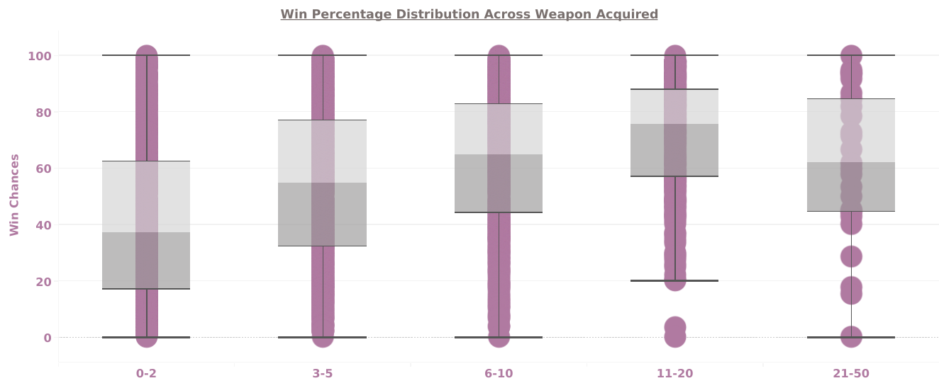
The 11-20 Weapon Advantage
Insights :
Acquiring 11-20 weapons yields the highest median win chance
Above range balances looting time with fighting capability
Collecting 21-50 weapons sees a slight drop in win consistency
Players with 0-2 weapons have the lowest median win chance
Notes:
Only 1 in 4 players reach Pro level — keep grinding, your chicken dinner crown awaits!" 🏆🐔

Slide 10
RECOMMENDATIONS
Prioritize Survival for Rank : Focus efforts on high placement and consistency as Kills/Damage show negligible correlation with Rank Points
Optimize Looting Time : Acquire 11−20 weapons quickly, as this range yields the highest median win chance; stop over-looting
Target the Average Tier : Implement strategies to push players past 187 damage to join the Pro Tier, which boasts a 68.42% win rate
Mode Strategy : Choose Duo TPP (72.2% win chance) for maximizing wins, but use Solo FPP (6.83 avg kills) for combat practice
Notes:
Only 1 in 4 players reach Pro level — keep grinding, your chicken dinner crown awaits!" 🏆🐔

Slide 11
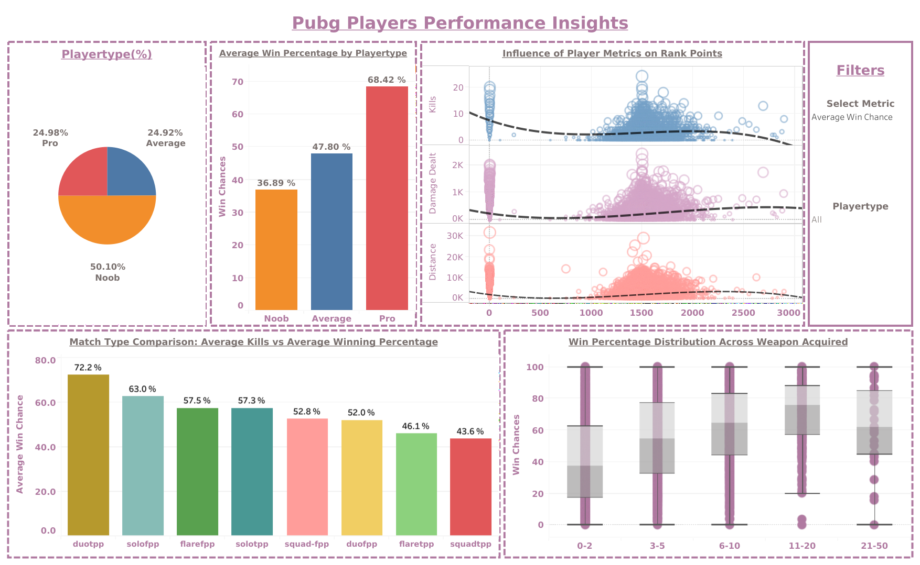
DASHBOARD
VISIT : Tableau Dashboard
Notes:
Only 1 in 4 players reach Pro level — keep grinding, your chicken dinner crown awaits!" 🏆🐔

Slide 12


THANK YOU!

