Slide 1
ONE SHOP
POS MANAGEMENT SYSTEM
Notes:
Download more minimal templates here: https://crmrkt.com/GK9Dwa

Slide 2
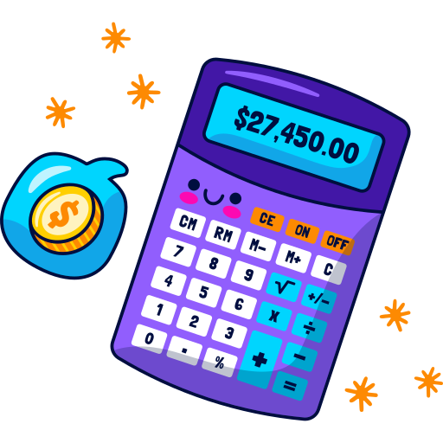
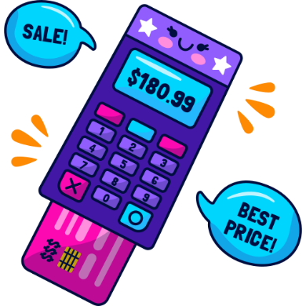
Overview
What is POS?
Why POS?
A point of sale system, or POS, is the place where customer makes a payment for products or services at a store. Simply put, every time a customer makes a purchase, they’re completing a point of sale transaction.
Every POS system comprises of software and hardware components that make running the daily operations of a business easier and faster.
Programming language
One Shop – POS Management System is based on C Programming language.
Notes:
Download more minimal templates here: https://crmrkt.com/GK9Dwa

Slide 3

Features
One Shop
Notes:
Download more minimal templates here: https://crmrkt.com/GK9Dwa

Slide 4
Features
One Shop is a department store management system. In general, a POS system helps you improve operations for customers. This includes reducing waiting time, quicker generate invoices, etc.
01
02
Add Product
Display Product List
03
04
Update Product
Sales Reporting
05
06
Delete Product
Generate Invoice
07
08
Update product quantity
Update product Rate
Notes:
Download more minimal templates here: https://crmrkt.com/GK9Dwa

Slide 5
Motivation
One of the biggest benefits of using a point of sale (POS) system is that it provides detailed reports of transactions, and it provides them in real-time. Point of sale systems issue sales reports for every transaction.
Notes:
Download more minimal templates here: https://crmrkt.com/GK9Dwa

Slide 6
Timeline
Week
1
Week
2
Week
3
Week
4
Design App Layout
Pseudocode
Coded The App
Working On Update
Notes:
Download more minimal templates here: https://crmrkt.com/GK9Dwa

Slide 7
Notes:
Download more minimal templates here: https://crmrkt.com/GK9Dwa

