Slide 1


Grocery Store Market Basket Analysis Project
By Abdullah Al Khamyasi

Slide 2
CONTENTS
Executive Summary
Exploratory Analysis & Insights
Market Basket Analysis
Associations Identified
Recommendation

Slide 3
Executive Summary
Data Span: 1st January 2018 to 26th February 2020
Purpose: The primary aim of this study is to delve into the Point of Sale (POS) data to extract actionable insights. These insights are intended to guide a grocery store in boosting its revenue through strategic combination offers and customer-centric discounts.
Dataset Information: The dataset comprises 20,641 records across three columns. It is free from missing values but contains 4,730 duplicate entries.
Analytical Approach and Insights: A comprehensive exploratory data analysis was conducted to gain a deep understanding of the dataset. This analysis illuminated key trends and patterns in the sales data, providing a solid foundation for further investigation.
Application of Market Basket Analysis: The study employed market basket analysis, leveraging association rules to unearth relationships between various products bought by customers. This approach was instrumental in identifying products that are often purchased together. These insights are crucial for designing attractive combo offers, thereby enhancing customer satisfaction and driving sales.

Slide 4
Assumptions
• This dataset contains a record of items bought at a grocery store, documented over different dates.
• Every record in the dataset corresponds to an individual item that was bought.
• It's possible for the same item to be bought by various customers on distinct dates.
• Details regarding the quantity or cost of each item are not included in this data.
• Duplicate values in the dataset have not been removed or altered.
• The initial column of the dataset denotes the purchase date of the item.
• The second column identifies the customer who bought the item.
• The third column details the specific item that was purchased.

Slide 5
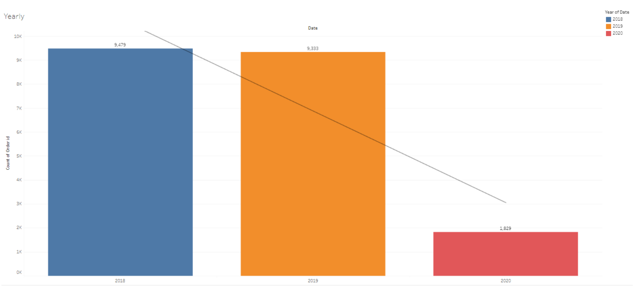
EDA: Yearly Count of Product Sales

Slide 6
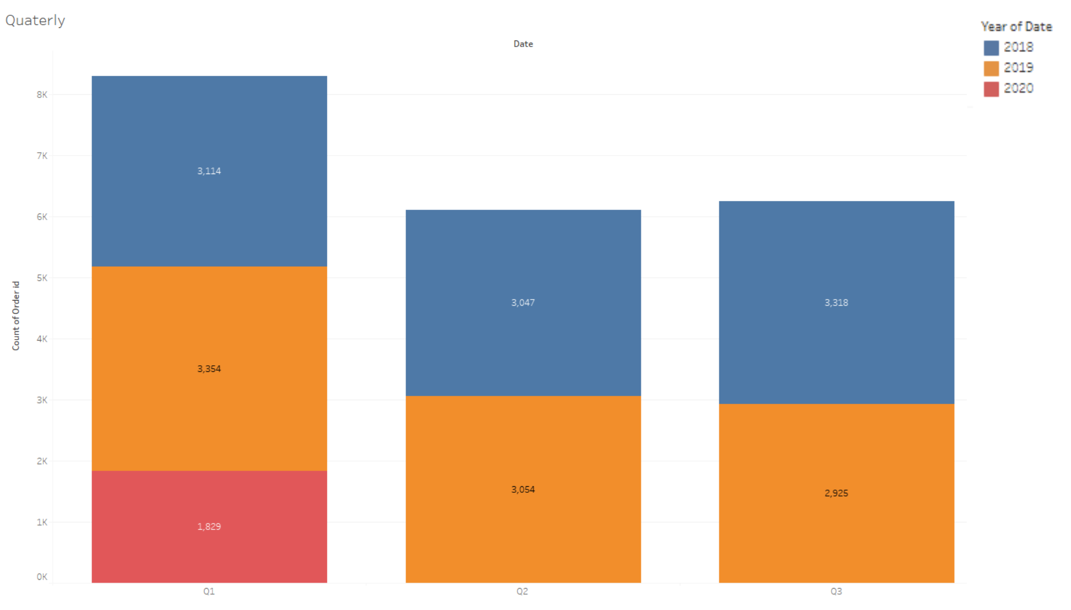
Quarterly Count of Product Sales

Slide 7
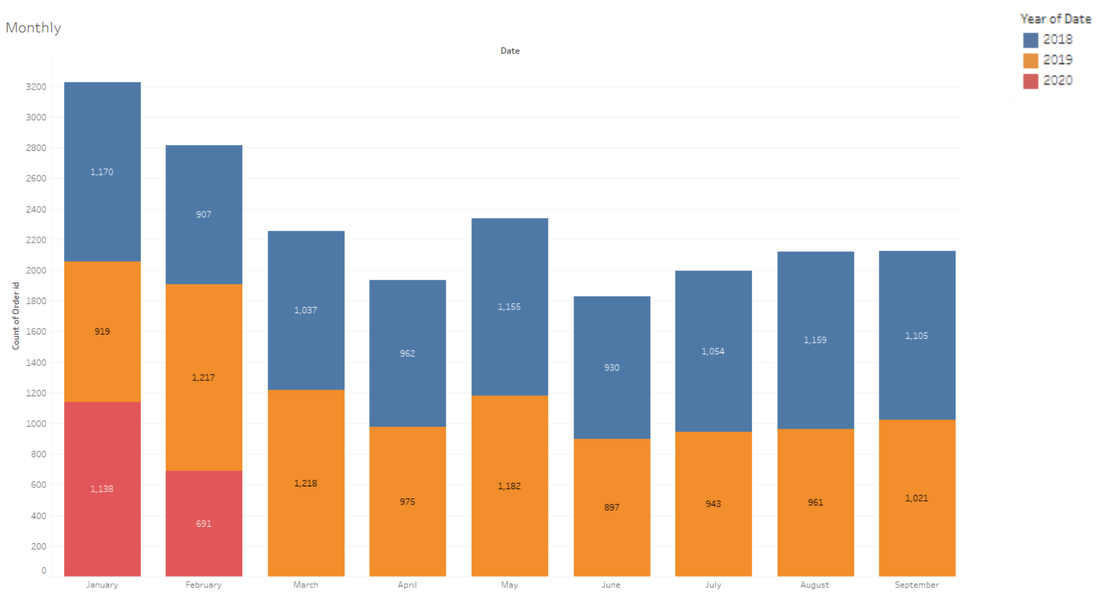
Monthly Count of Product Sales

Slide 8
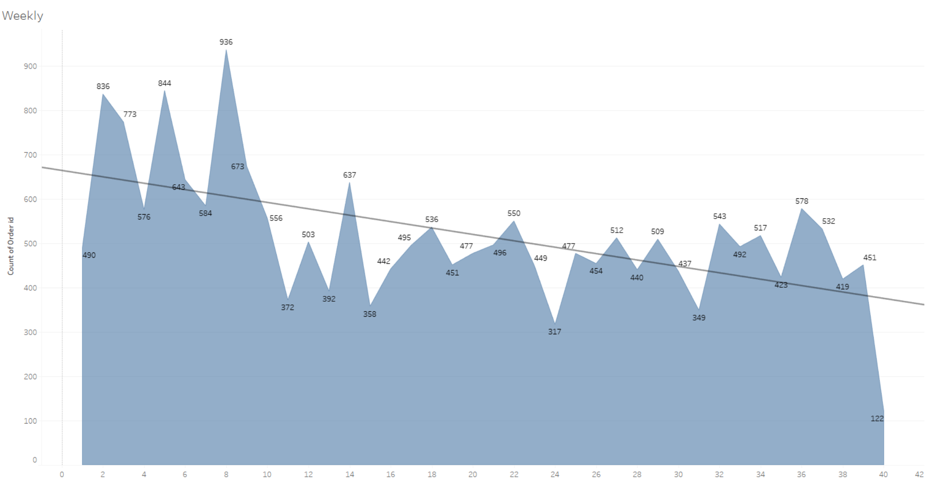
Weekly Count of Product Sales

Slide 9
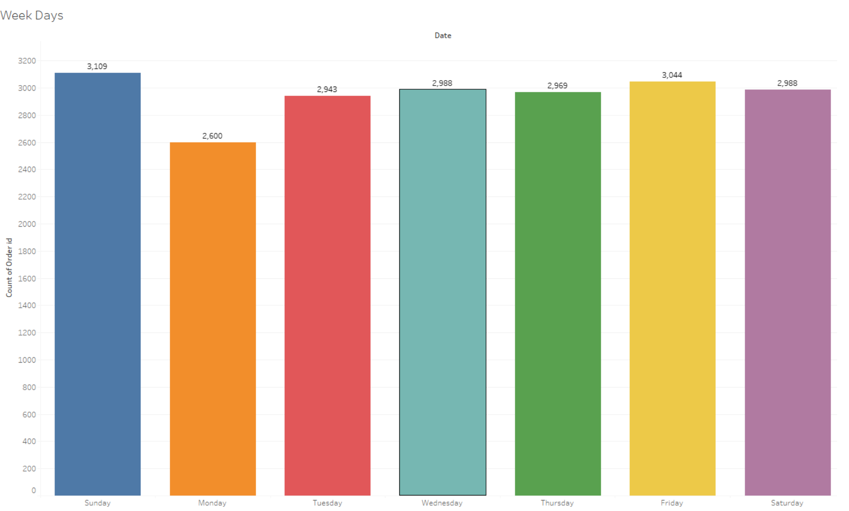
Daily Count of Product Sales

Slide 10
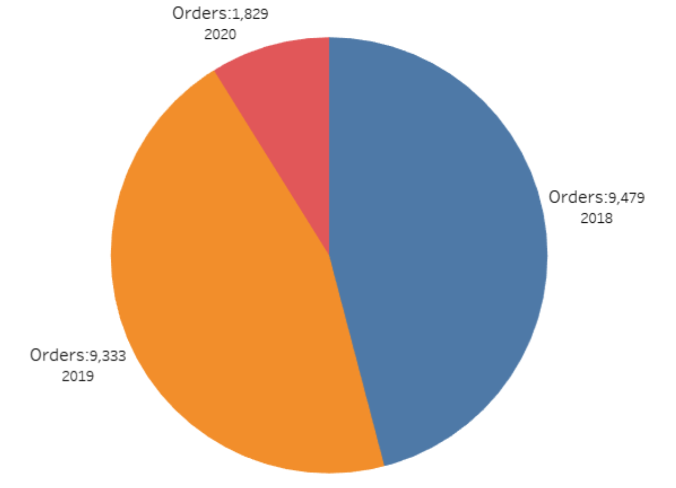
Yearly Share of Product Sales

Slide 11
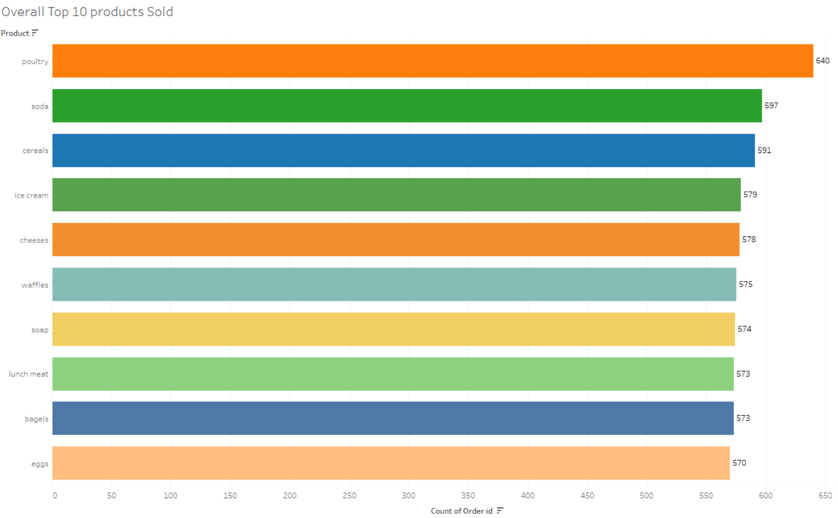
Overall Top 10 Products Sold

Slide 12
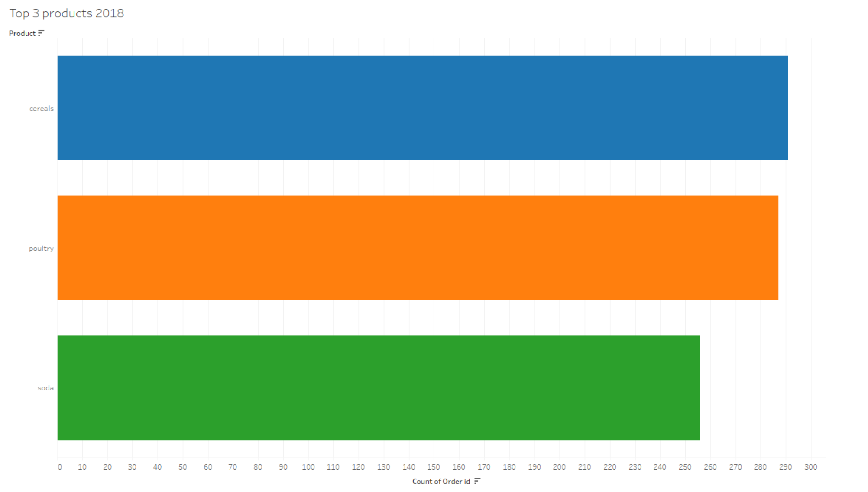
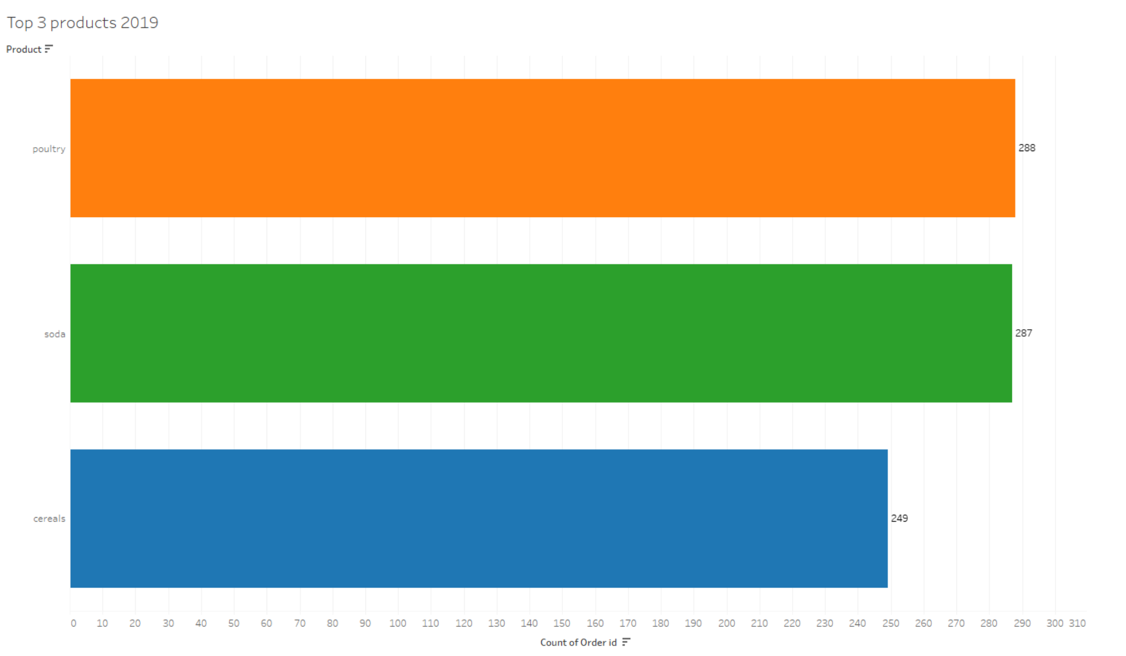
Top 3 Products Sold in 2018 & 2019

Slide 13
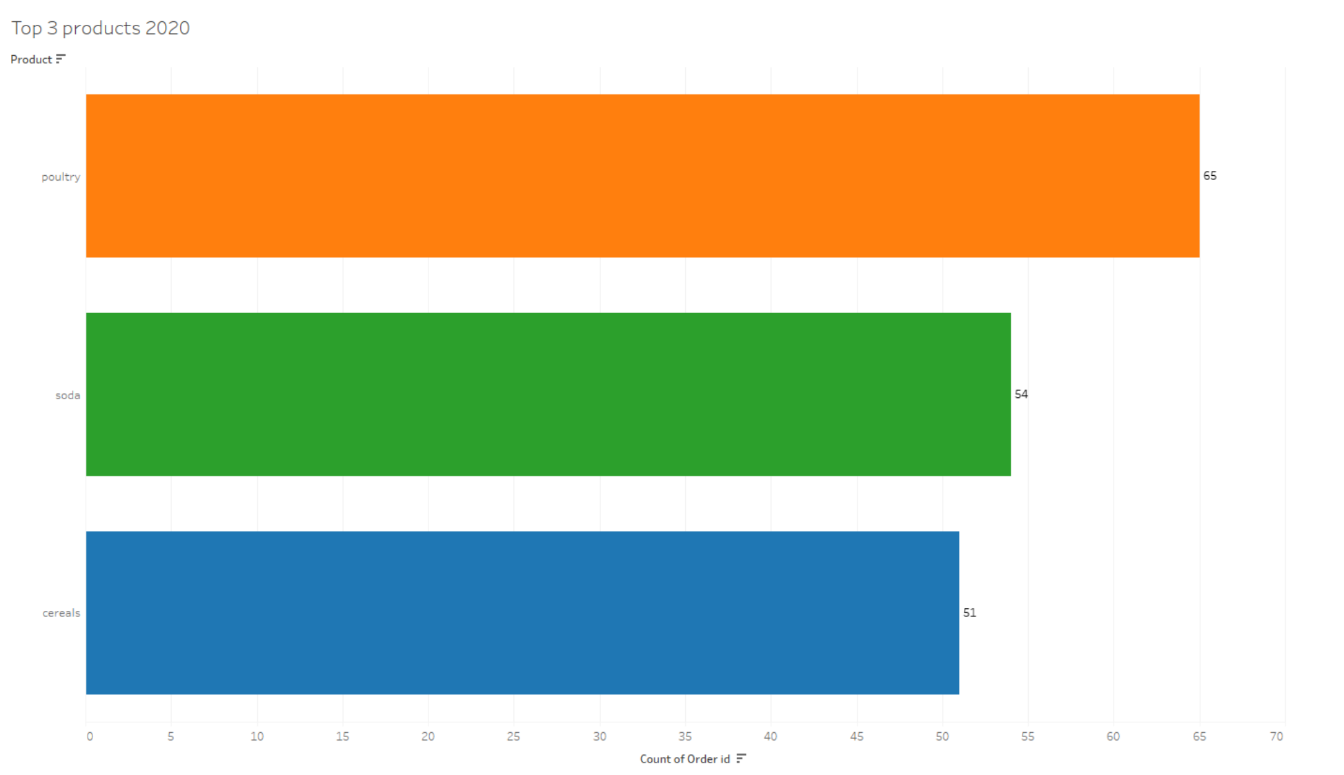
Top 3 Products Sold in 2020

Slide 14
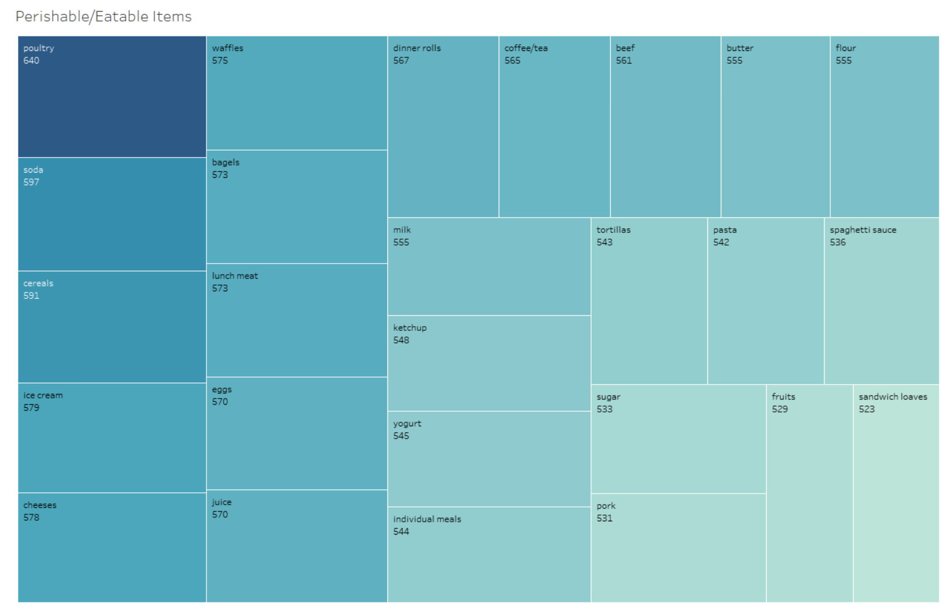
Perishable Items

Slide 15
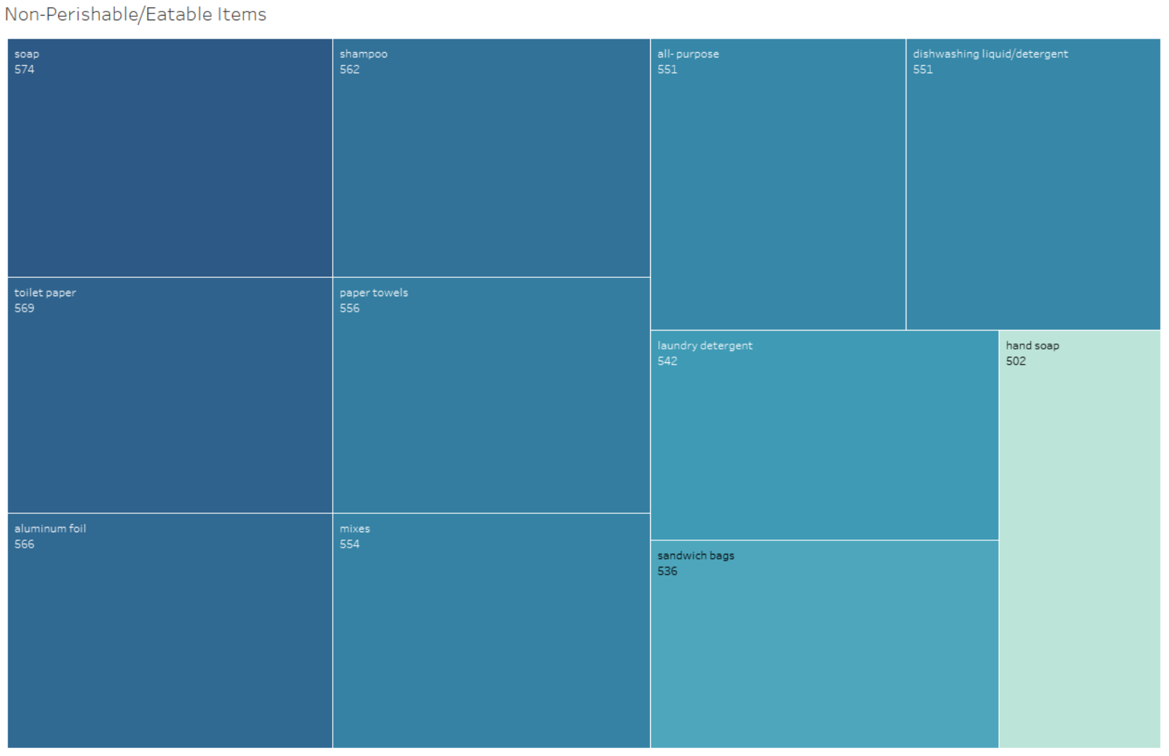
Non-Perishable Items

Slide 16
Insights
The sales data for the grocery store reveals notable trends and patterns over the years:
Yearly Sales Trends:
There was a decrease in the total number of products sold in 2019 compared to 2018. Data for 2020 is limited to only two months.
Quarterly Sales Analysis:
The highest sales in 2018 occurred in Q3, while in 2019, they peaked in Q1.
The sales volume for Q2 in both 2018 and 2019 remained approximately the same.
Monthly Sales Insights:
January 2018 saw the highest sales, with February being the lowest.
In contrast, March 2019 experienced the most sales, with January being the least productive month.
Weekly Sales Trends:
A gradual decline in sales was observed on a week-by-week basis.
Sundays were the most lucrative sales days, whereas Mondays experienced the least sales. Sales on other days of the week were relatively consistent.
Product Sales Overview:
The top-selling items for both 2018 and 2019 were Cereals, Poultry, and Soda, with a shift in dominance to Poultry and Soda in 2019. This trend continued into the first two months of 2020.
Within the perishable category, which includes 26 products, Poultry, Soda, and Cereals were the highest-selling items. Pork, fruits, and sandwich loaves were at the lower end of the sales spectrum.
In the non-perishable category, comprising 11 products, Soap and Toilet Paper were the bestsellers, with Hand soap being the least sold.

Slide 17
Recommendations
• Increase the stock levels of Poultry, Soda, and Cereals due to their consistent high demand.
• Ensure a steady supply of Soap and Toilet paper, as these items are in regular demand and are non-perishable.
• Organize special deals and promotions for Sundays to leverage the highest sales volume on that day.
• Introduce extra discounts on Mondays to attract more customers and improve sales figures for the start of the week.
• Aim to replicate the sales patterns seen in the first quarter of 2019 and the third quarter of 2018.

Slide 18
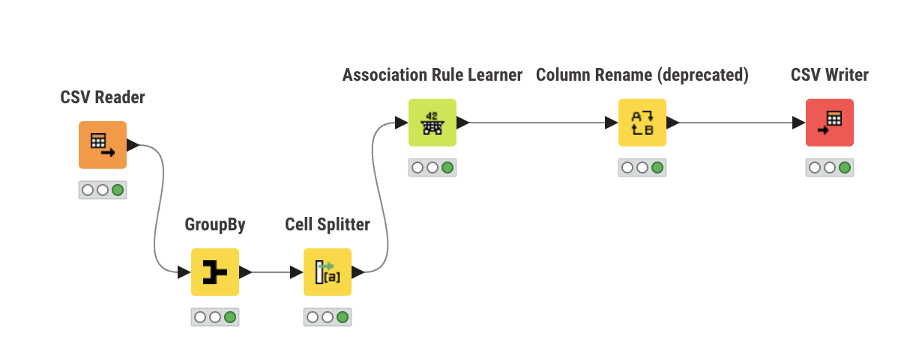
Market Basket Analysis KNIME Workflow
• The file dataset_group.csv is imported using a CSV Reader, after which it is transferred to the GroupBy node.
• The GroupBy node organizes the items by Order ID and forwards them to the Cell Splitter node.
• The Cell Splitter divides the items into segments, which are then sent to the Association Learner Node.
• The Association Learner Nodes create rules that are relayed to the Column Replace function.
• Column Replace modifies the column names to make them more comprehensible.
• Finally, the process generates a CSV file output for subsequent analysis and discussion.

Slide 19
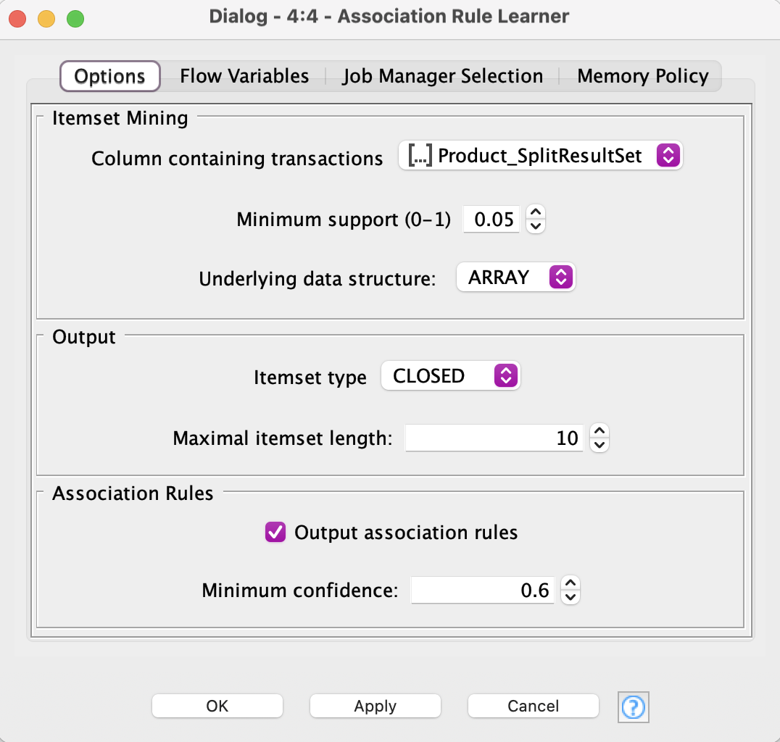
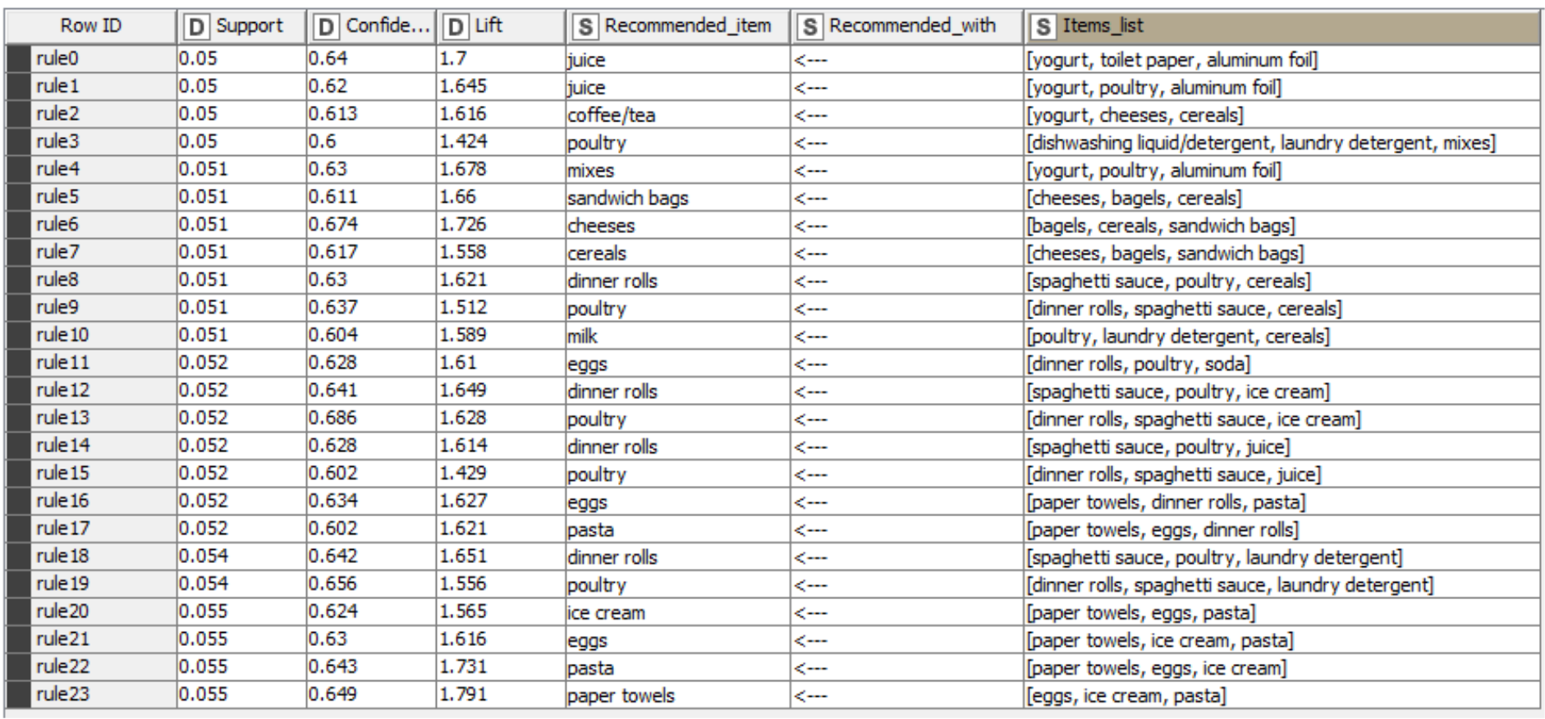
Association Rule Parameters & Rules
To maintain simplicity in our Market Basket Analysis (MBA), we have established 24 rules based on the following criteria:
A minimum support threshold of 0.05
A maximum item set length of 10
A minimum confidence level of 0.6

Slide 20
Recommendation
• Introduce a special combo deal that combines cereals, bagels, and sandwich bags at a reduced price, offering customers a unique blend at a bargain.
• Offer discounts on versatile mix items when bought with yogurt, poultry, or aluminum foil, enhancing the overall shopping journey.
• Provide an additional discount on delicious dinner rolls when purchased with spaghetti sauce or poultry, giving customers a more rewarding experience.
• Launch a "Buy Two, Get One Free" promotion on yogurt, poultry, and aluminum foil to encourage larger and more value-driven purchases.
• Create a "Paper Products Bundle" deal, including paper towels, toilet paper, and tissues at a promotional price.
• These innovative offers and strategic product pairings are designed to boost sales by providing customers with not only products but also a memorable shopping experience.
• To maximize exposure, prominently display these promotions in-store, and actively promote them through engaging advertising and dynamic social media campaigns.

Slide 21
END

