Slide 1


Automobile RFM Analysis Project
By Abdullah Al Khamyasi

Slide 2
CONTENTS
Executive Summary
Exploratory Analysis & Insights
RFM Analysis
Recommendations

Slide 3
Executive Summary
Background: An automotive parts manufacturer has compiled transaction data over a three-year period. Lacking an in-house data science team, they have engaged our services to derive meaningful insights from this data.
Data Overview: The dataset comprises 2,747 entries across 20 columns, with a diverse range of data types including datetime64, float64, int64, and object. The dataset is comprehensive, with no missing values, and provides a detailed view of customer purchasing behavior in various categories. The company's product lines encompass a wide range, including classic cars, motorcycles, planes, trains, ships, buses, trucks, and vintage cars.

Slide 4
Executive Summary
Key Data Points:
Order Information: Each transaction is uniquely identified by an ORDERNUMBER. An order may contain multiple entries with different product codes.
Customer and Product Details: The dataset records detailed customer information and product specifics like price, quantity, product code, and sales figures for each customer.
Pricing Analysis: A notable observation is the discrepancy between the Manufacturer's Suggested Retail Price (MSRP) and the actual price of each item, indicating inconsistencies in pricing strategies.
Summary: The data provides a comprehensive snapshot of the company's sales operations and customer engagement over the past three years. It reveals the diversity of the company's product line and highlights the need for a closer examination of pricing strategies, given the observed inconsistencies with MSRP. Our analysis aims to uncover deeper insights into customer behaviour, sales trends, and areas for operational improvement.

Slide 5
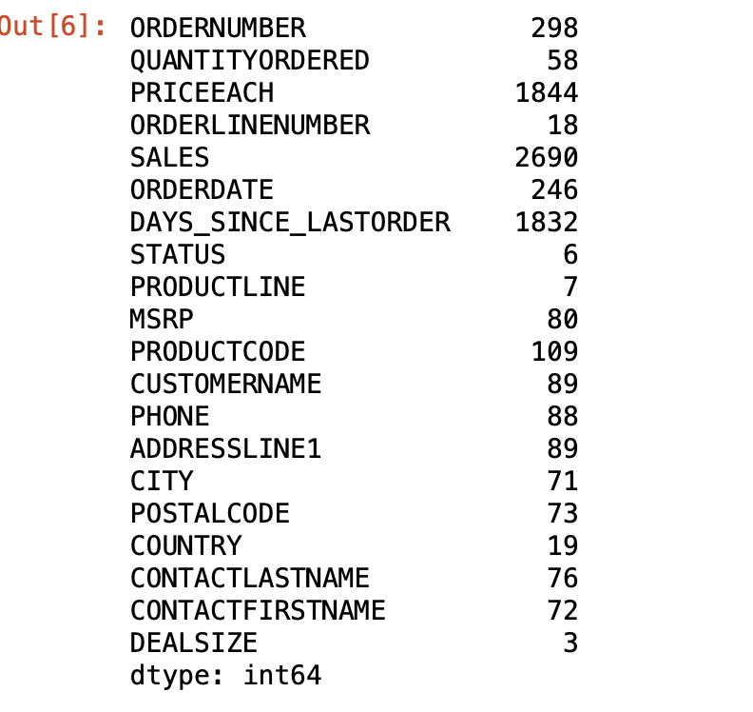
EDA: Univariate Analysis Data

Slide 6
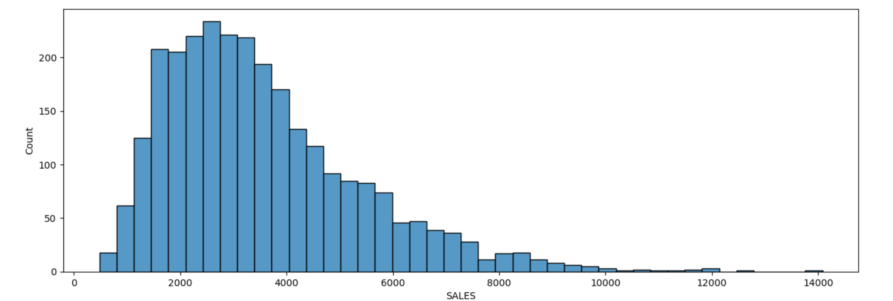
Sales

Slide 7
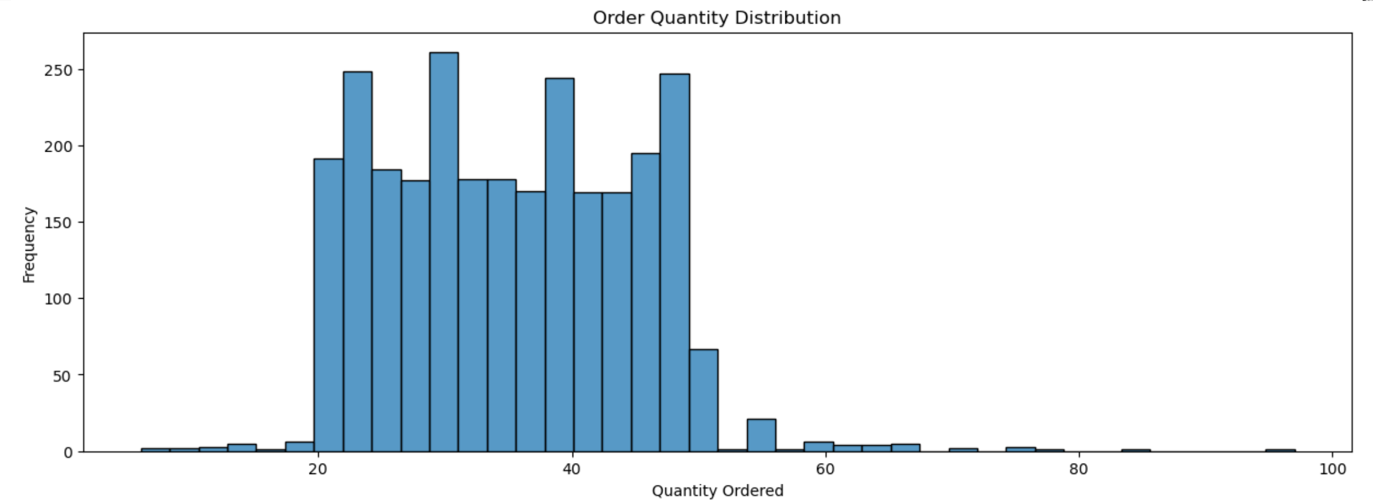
Quantity

Slide 8
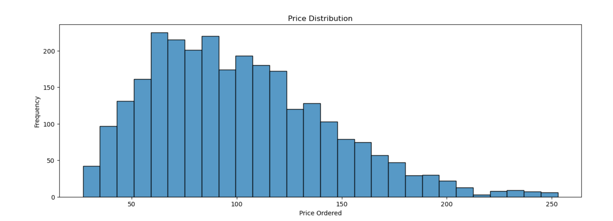
Price

Slide 9
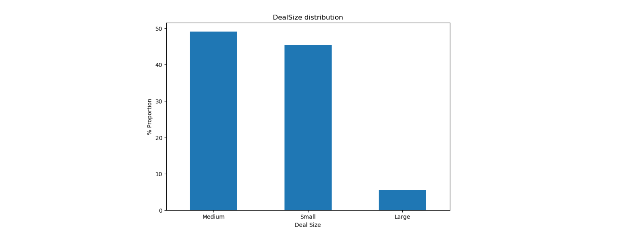
Deal Size

Slide 10
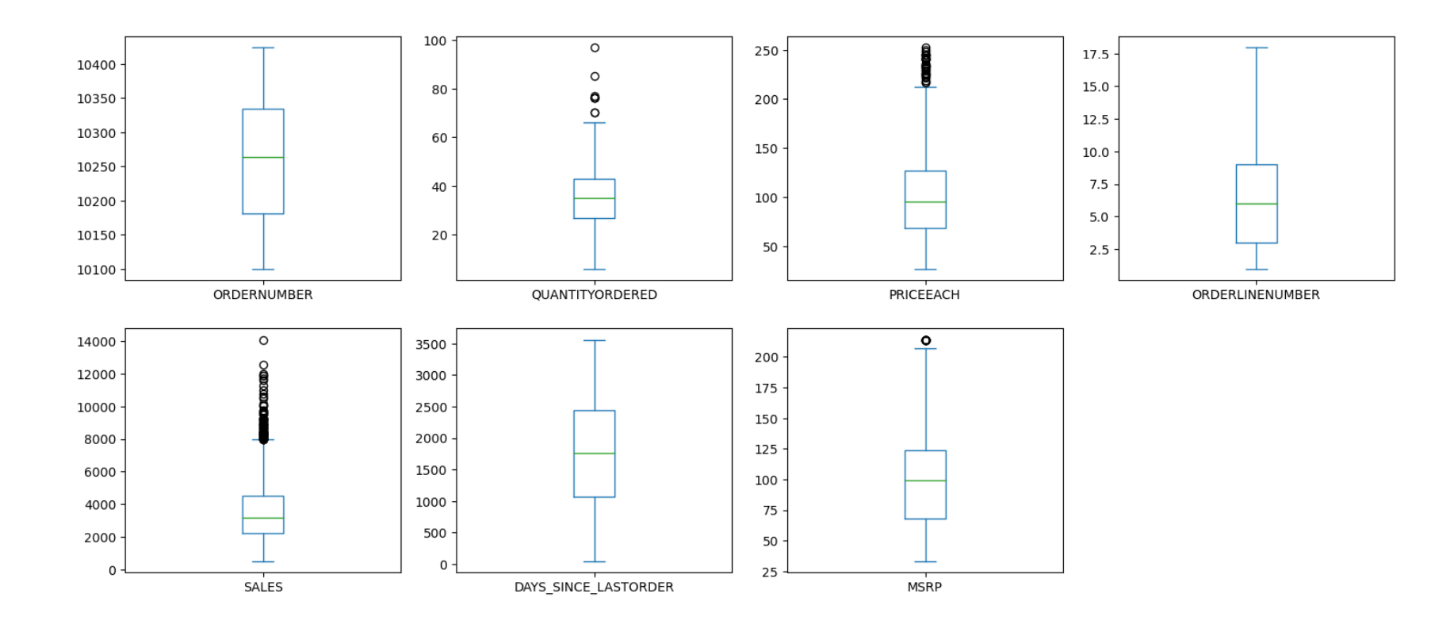
Outliers

Slide 11
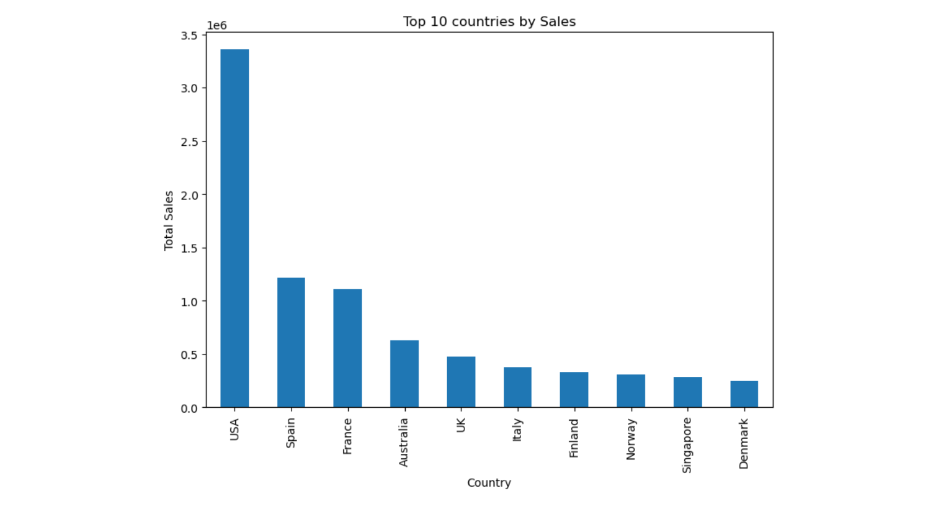
Bivariate Analysis Top 10 Countries

Slide 12
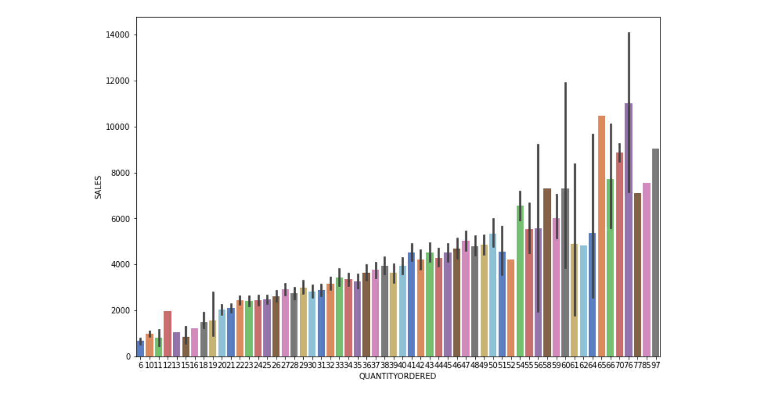
Quantity vs Sales

Slide 13
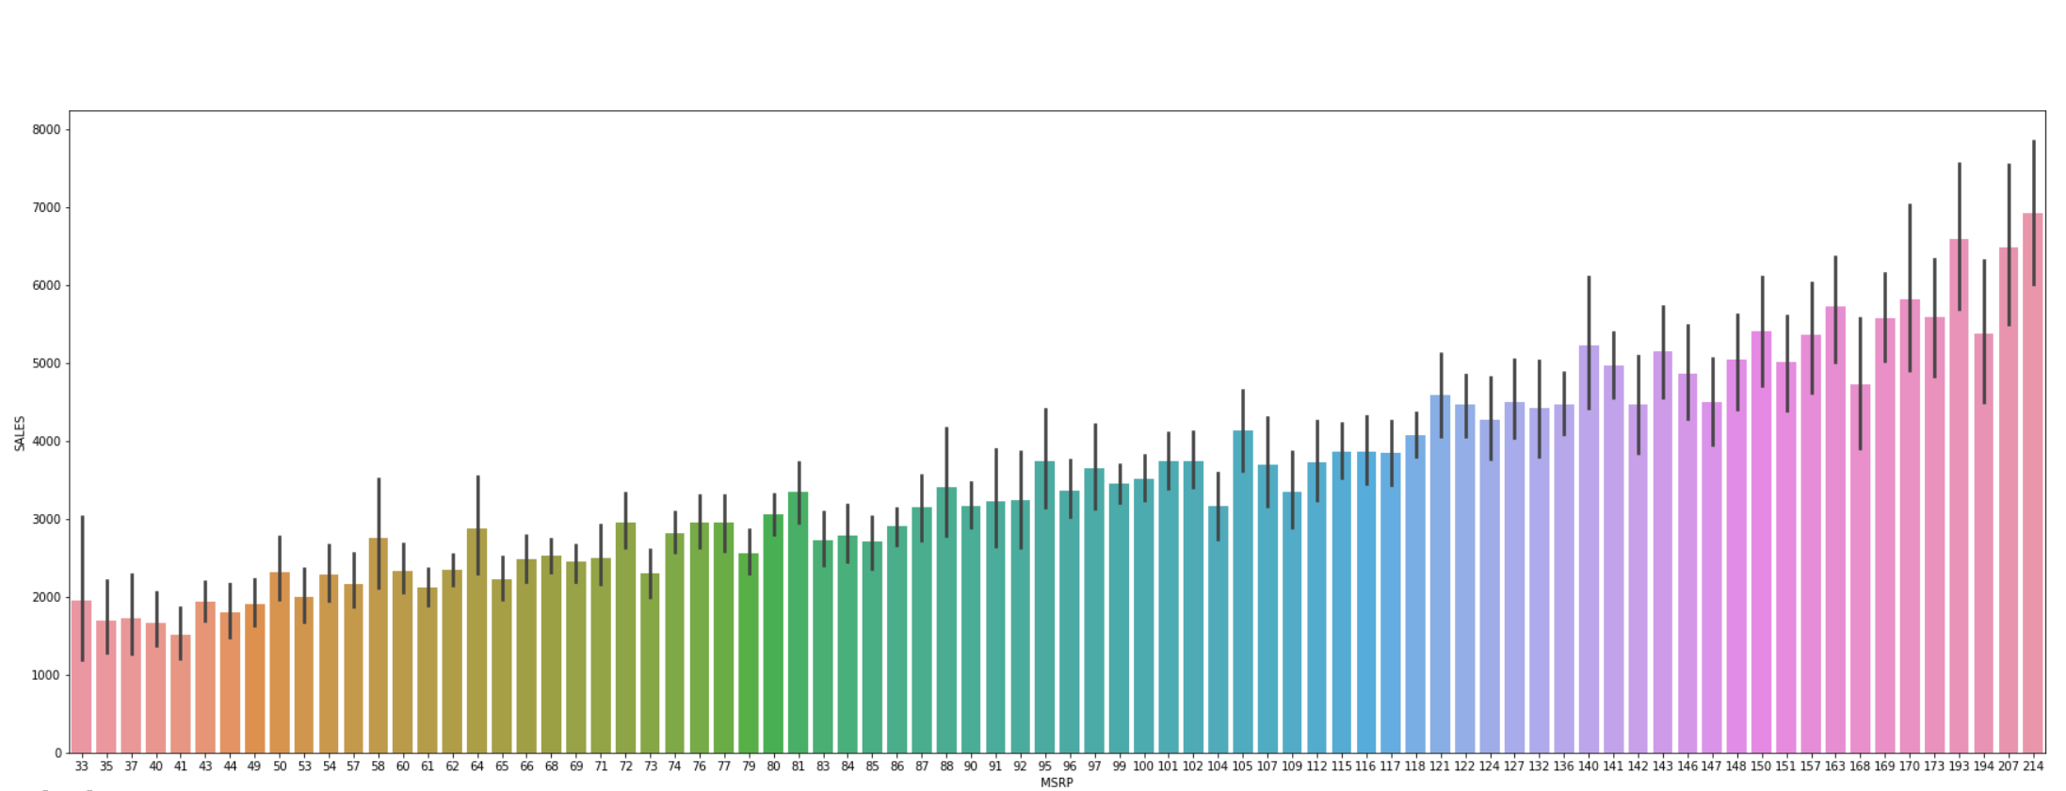
MSRP vs Sales

Slide 14
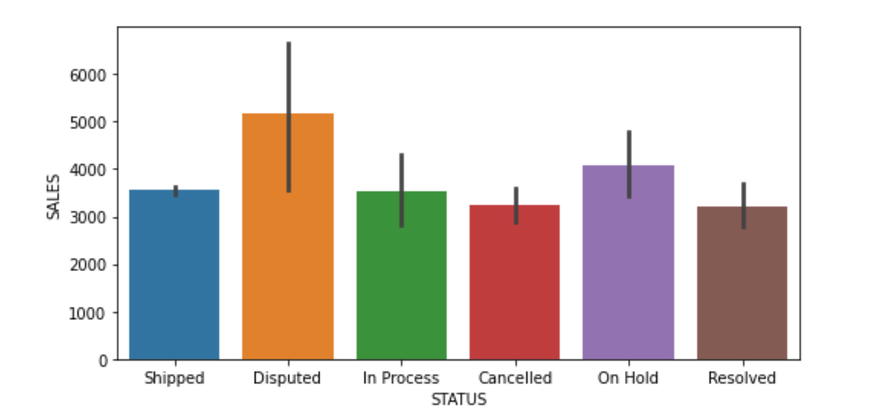
Status vs Sales

Slide 15
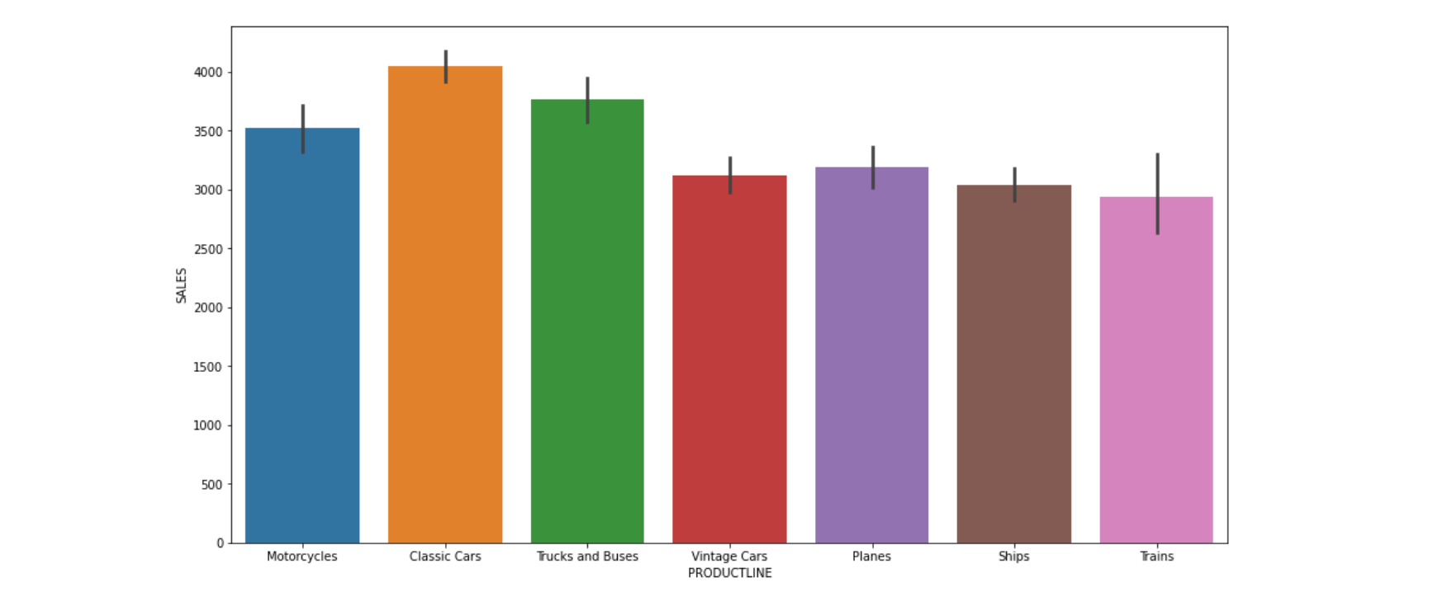
Product Line vs Sales

Slide 16
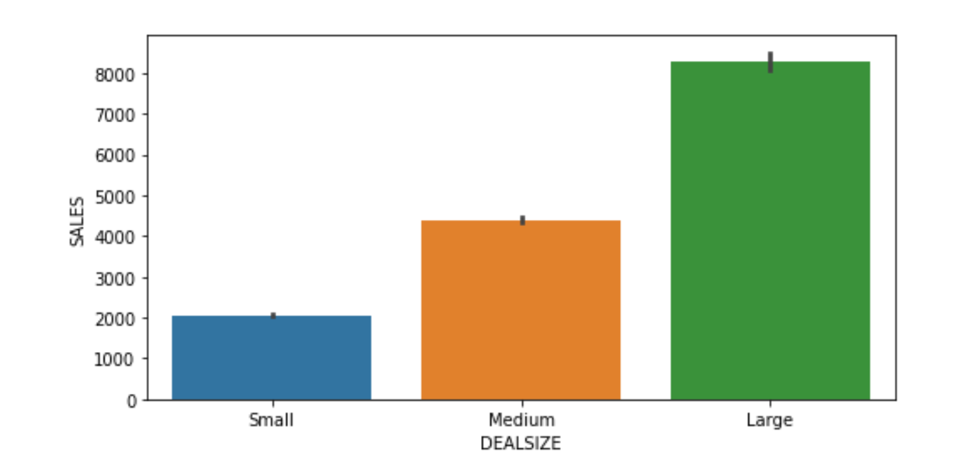
Deal Size vs Sales

Slide 17
Insights
Order and Customer Overview:
The dataset encompasses 298 orders.
Products are categorized into 7 distinct lines.
The customer base is spread across 71 cities in 19 countries, totalling 89 customers.
Three types of deal sizes are observed in the transactions.
Sales Trends and Distribution:
The Sales Data exhibits a right-skewed distribution, indicating that a majority of sales are clustered towards the lower end of the spectrum.
Most sales range between $1,000 and $4,000.
The quantity distribution suggests that the orders are predominantly in bulk, with most ranging between 20 to 50 units.
Pricing and Order Patterns:
In the right-skewed price distribution, most prices are on the lower end, with a maximum price of $250. The median price, where most orders are concentrated, is $95.55.
Sales dynamics show a predominance of medium-sized deals, accounting for nearly half of all sales, followed by small-sized deals. Large deals are less frequent.
Outliers and Market Analysis:
Box plots reveal outliers in Quantity Ordered, Price Each, and Sales.
The USA emerges as the largest market, followed by Spain and France.
Sales are higher in the 60-75 order quantity range.
Product and Sales Correlations:
Higher MSRP is correlated with increased sales.
The most sales are seen in the 'Disputed' status, which is concerning given its low percentage overall, indicating potential issues in order fulfilment or customer satisfaction.
Classic cars lead sales among product lines, followed by trucks and buses, with trains being the least popular.
Although large deal sizes record high sales values individually, the majority of total sales come from small and medium-sized deals.

Slide 18
Recommendations
Inventory and Product Focus: Increase stock of top-sellers like classic cars, trucks, and buses, and re-evaluate the strategy for less popular items like trains.
Pricing Strategy: Address discrepancies between MSRP and actual prices and consider dynamic pricing to boost profits.
Customer Satisfaction: Resolve issues related to 'Disputed' orders and implement a feedback system to enhance customer relationships.
Market Expansion: Concentrate efforts in key markets like the USA, Spain, and France, and explore new markets for expansion.
Promotions for Bulk Orders: Introduce incentives for large quantity purchases and tailor promotions for different deal sizes.
Sales and Marketing Synergy: Align sales strategies with marketing efforts, especially targeting high-selling product lines.
Efficient Order Processing: Streamline order processing and logistics to reduce disputes and improve delivery times.
Data-Driven Insights: Continuously analyse sales data for informed decision-making and future trend forecasting.

Slide 19
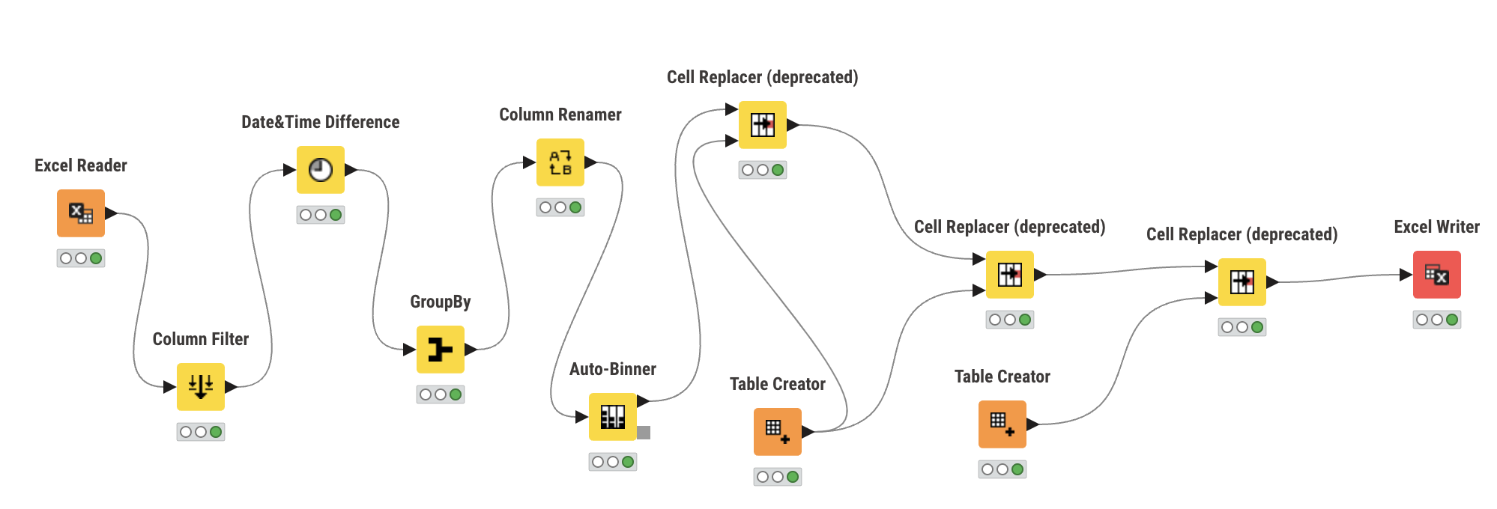
RFM Analysis
• We utilized the Knime tool and focused on four columns: customer name, order number, order date, and sales.
• A new 'recency' column was created, calculated as "[max(order date) - order date)]", using 31st May 2020 as the last order date for reference.
• The frequency of orders was inferred by counting the occurrences of each order number, considering repeated order numbers for different product codes.
• For transactional value, we used the 'sales' column, aggregating sales amounts to form a new 'monetary' column.
• We categorized recency, frequency, and monetary values into three bins - high, medium, and low - using percentile ranges (0, 0.25, 0.75, 1.00) for segmentation.
• Loaded and filtered the Sales_data.xlsx dataset for customer name, order number, order date, and sales.
• Generated a new recency column and grouped data by customer name to calculate Recency, Monetary, and Frequency.
• Applied Auto binner to classify these metrics into High, Medium, and Low bins.
• Compiled the result in an Excel sheet.

Slide 20
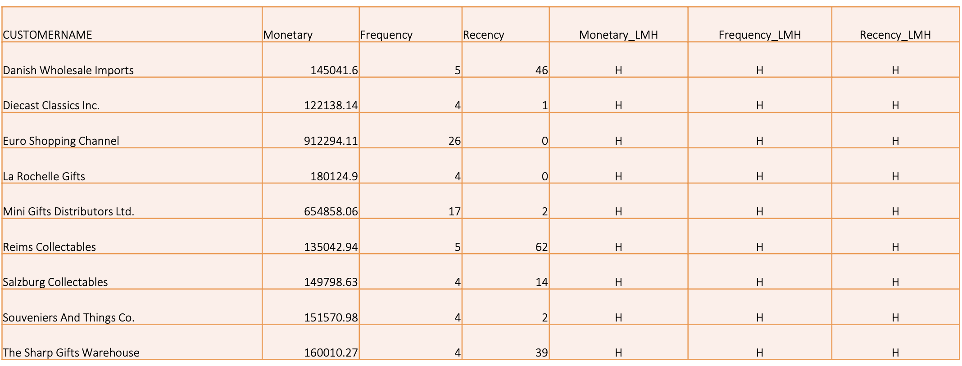
Best Customers

Slide 21
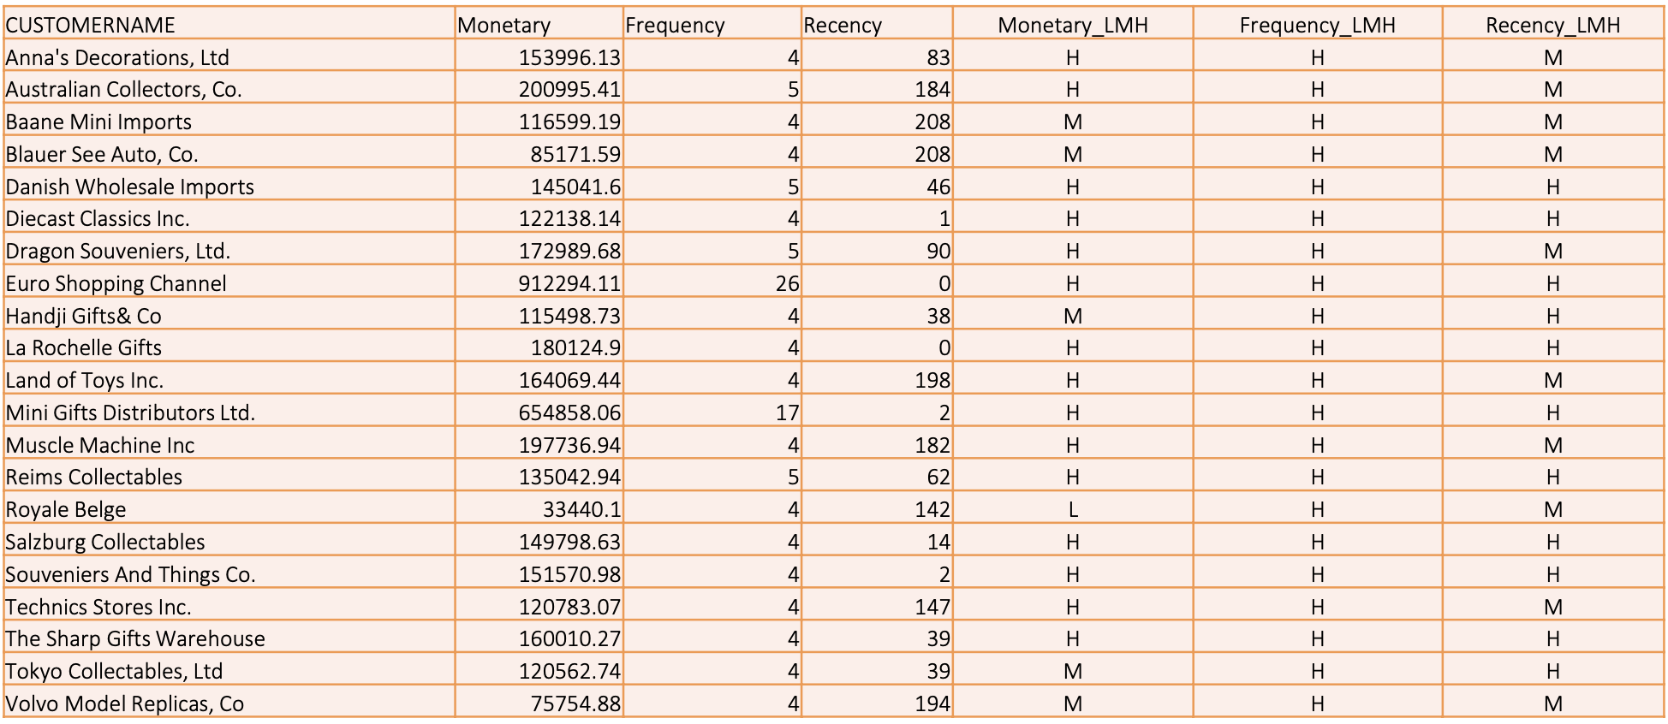
Loyal Customers

Slide 22
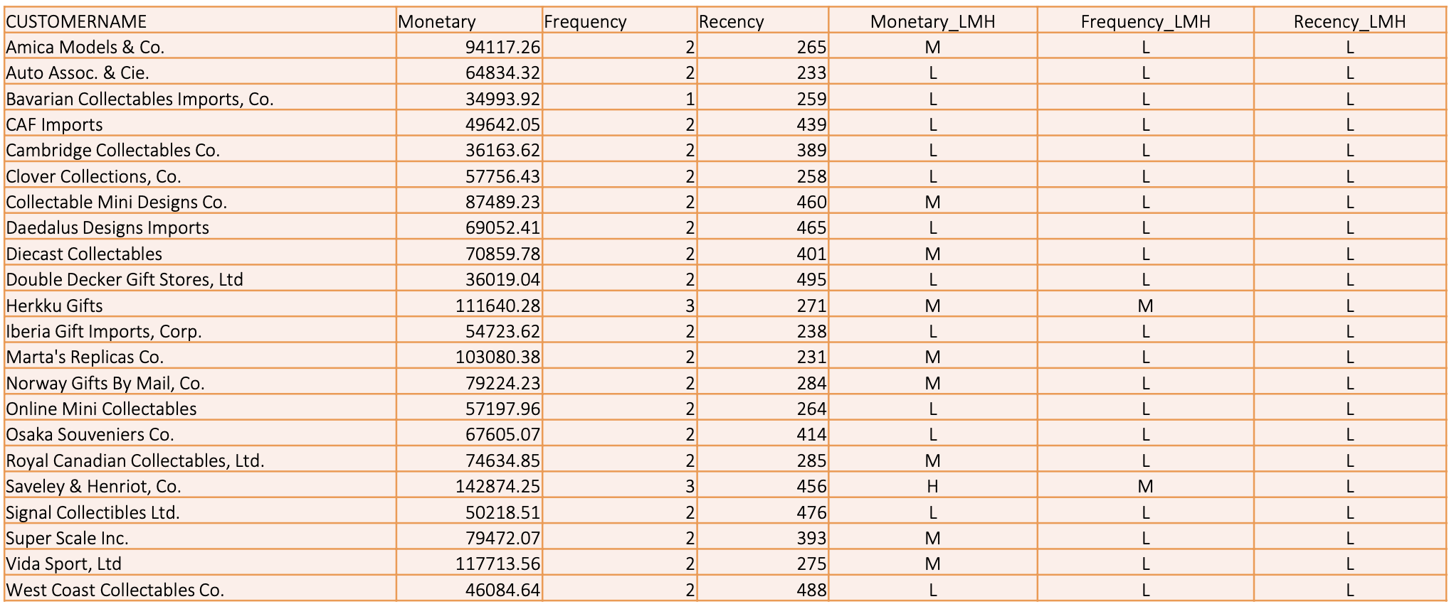
Customers about to Churn

Slide 23
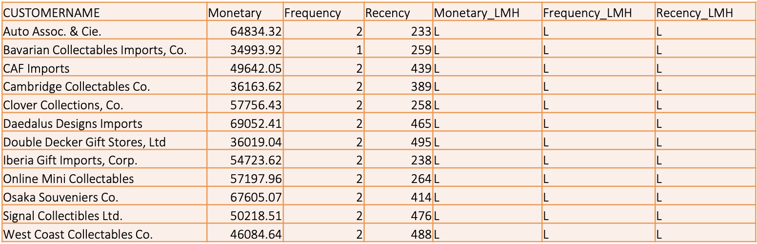
Lost Customers

Slide 24
Recommendations
Best Customers
Engagement & Appreciation: Regularly engage with these customers through personalized communication and exclusive offers. Consider implementing a loyalty program or rewards for continued patronage.
Feedback & Improvement: Actively seek their feedback on products and services. This group's insights can be invaluable for improving offerings and customer experience.
Upselling & Cross-selling: Introduce them to premium products or services and provide personalized recommendations based on their purchase history.
Loyal Customers
Recognition & Rewards: Acknowledge their loyalty with special discounts, early access to new products, or exclusive events. This recognition fosters a deeper emotional connection with the brand.
Consistent Quality & Service: Ensure they consistently receive high-quality products and exceptional customer service to maintain their loyalty.
Referral Incentives: Encourage them to refer friends or family by offering referral bonuses or rewards, leveraging their satisfaction to attract new customers.
Customers About to Churn
Re-engagement Strategies: Reach out with special offers, reminders of the value they find in your products, or personalized messages to rekindle their interest.
Address Pain Points: Identify any issues or challenges they might have faced and address them promptly. Surveys or direct communication can be effective in understanding their concerns.
Incentives for Continued Business: Offer incentives or loyalty points for their next purchase to encourage them to stay.
Lost Customers
Win-back Campaigns: Implement targeted campaigns with attractive offers or new product announcements that might appeal to their previous interests.
Understand Reasons for Churning: Conduct exit interviews or surveys to understand why they left. This information is crucial for improving your offerings and reducing future churn.
Keep the Door Open: Even if they have left, maintain a line of communication through newsletters or updates, keeping them informed and making it easy for them to return.

Slide 25
END

