Slide 1
Fake Job Predictor
Name Abdullah Alqahtani
Email a.m.q.5@Hotmail.com

Slide 2
Table of Content
Abstract
Problem Statement
Design
Data
Algorithms
Benchmark
Tools
Communication
Conclusion

Slide 3
Abstract
Employment scams are on the rise. According to CNBC, the number of employment scams doubled in 2018 as compared to 2017. The current market situation has led to high unemployment. Economic stress and the coronavirus’s impact have significantly reduced job availability and job loss for many individuals. A case like this presents an appropriate opportunity for scammers. Many people are falling prey to these scammers using the desperation that is caused by an unprecedented incident. Most scammers do this to get personal information from the person they are scamming. Personal information can contain addresses, bank account details, social security numbers, etc. The scammers provide users with a very lucrative job opportunity and later ask for money in return. Or they require investment from the job seeker with the promise of a job. This is a dangerous problem that can be addressed through Machine Learning techniques and Natural Language Processing (NLP).

Slide 4
Problem Statement
This project aims to create a classifier that will have the capability to identify fake and real jobs. The final result will be evaluated based on two different models. Since the data provided has both numeric and text features one model will be used on the text data and the other on numeric data. The final output will be a combination of the two.
The final model will take in any relevant job posting data and produce a final result determining whether the job is real or not

Slide 5
Design
This project uses data provided from Kaggle. This data contains features that define a job posting. These job postings are categorized as either real or fake. Fake job postings are a very small fraction of this dataset. That is as excepted. We do not expect a lot of fake jobs postings. This project follows five stages.
The five stages adopted for this project are:
Problem Definition (Project Overview, Project statement and Metrics)
Data Collection
Data cleaning, exploring and pre-processing
Modeling
Evaluation

Slide 6
Data
The data for this project is available at Kaggle - https://www.kaggle.com/shivamb/real-or-fake-fake-jobpostingprediction. The dataset consists of 17,880 observations and 18 features.
The dataset is highly unbalanced with 9868 (93% of the jobs) being real and only 725 or 7% of the jobs being fraudulent. A count plot of the same can show the disparity very clearly.

Slide 7
Algorithms
The algorithms and techniques used in project are:
1-Natural Language Processing
2-Naïve Bayes Algorithm
3-SGD Classifier
Naïve Bayes and SGD Classifier are compared on accuracy and F1-scores and a final model is chosen. Naïve Bayes is the baseline model, and it is used because it can compute the conditional probabilities of occurrence of two events based on the probabilities of occurrence of each individual event, encoding those probabilities is extremely useful.

Slide 8
Benchmark
The benchmark model for this project is Naïve Bayes. The overall accuracy of this model is 0.971 and the F1-score is 0.744. The reason behind using this model has been elaborated above. Any other model’s capabilities will be compared to the results of Naïve Bayes.

Slide 9
Tools
1-Numpy and Pandas for data manipulation
2-Scikit-learn for modeling
3-Matplotlib and Seaborn for plotting
4-Tableau for interactive visualizations

Slide 10
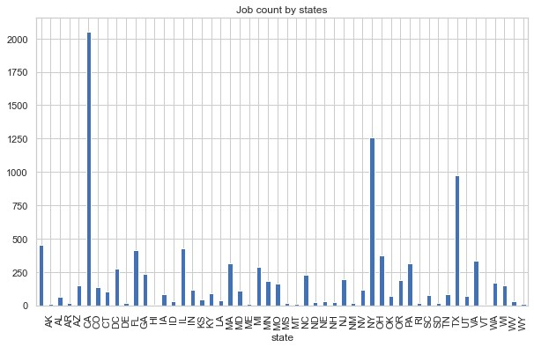
Communication
The graph here shows which states produces the greatest number of jobs. California, New York and Texas have the highest number of job postings. To explore this further another bar plot is created. This barplot shows the distribution of fake and real jobs in the top 10 states

Slide 11
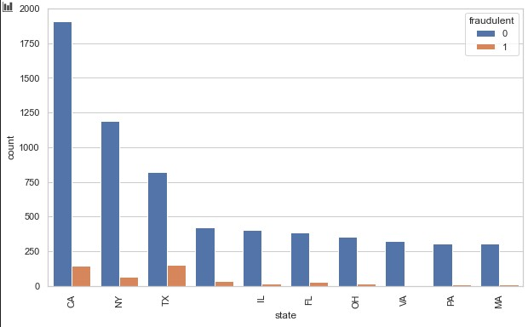
Communication
The graph here shows that Texas and California have a higher possibility of fake jobs as compared to other states. To dig one level deeper into and include states as well a ratio is created. This is a fake to real job ratio based on states and citifies.

Slide 12
Conclusion
Fake job postings are an important real-world challenge that require active solutions. This project aims to provide a potential solution to this problem. The textual data is pre-processed to generate optimal results and relevant numerical fields are choosing as well. The output of Multiple models is combined to produce the best possible results.

