Slide 1
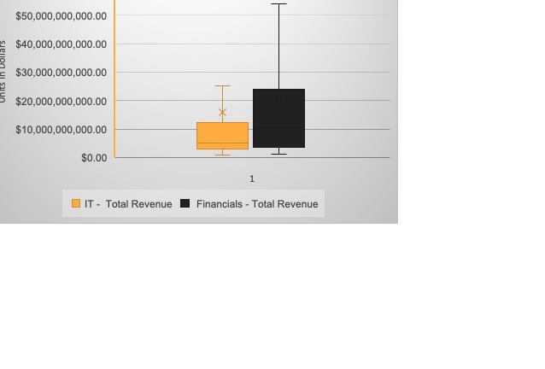
Does Information Technology sector have higher EBIT than Financials sector?
Box Plot chart on the lift displays the EBIT for Total Revenue for IT sector and Financials sector for all sub-industries in all years.
From the box plot chart, we notice the Financials sector’s mean was more than IT sector’s, both of them are right-skewed because both of them have mean higher than median.
Which is Financials sector’s EBIT made more than IT sector’s EBIT.
Financials Mean is $20.8 billion and for IT is $15.9 billion, However the Standard Deviation for Financials is $26.4 billion but for IT is $32 billion, that means Financials sector has higher revenue than IT sector but IT sector is more spread than Financials.

