Slide 1
CSS3
Cascading Style Sheet 3
E-Business Department

Slide 2

Table of Contents
What is CSS 3?
Selectors
Fonts
Colors
Backgrounds
Borders
Box Model
Animations

Slide 3
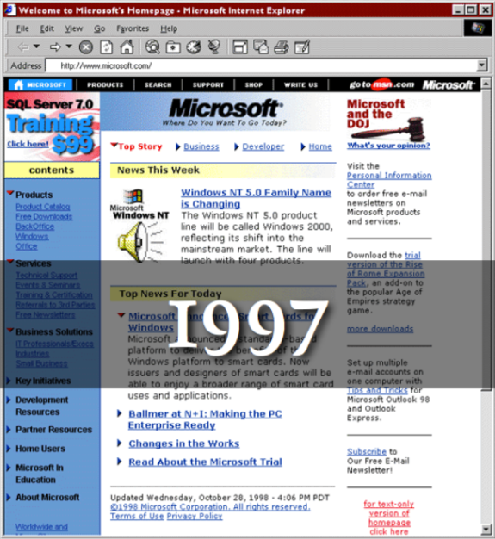

What is CSS3

Slide 4

What is CSS3
Cascading Style Sheets level 3 is the most recent iteration of CSS
It is divided into several separate
documents called "modules"
CSS 3 has not been approved as a specification,
but there are already a lot of properties that are
supported in various browsers.
The earliest CSS 3 drafts were published in June 1999

Slide 5
Vendor Prefix
Some CSS rules won’t work without the vendor prefix.
  Mozilla Browsers (Firefox)
  -moz
  Webkit Browsers (Safari, Chrome)
  -webkit
  Opera
  -o
  Internet Explorer
  -ms

Slide 6

New Selectors!

Slide 7

Attribute Selectors
[attribute^=value]
  Represents an element with the attribute whose value begins with the prefix value.
  Example: a[src^="https://"]
[attribute$=value]
  Represents an element with the attribute whose value ends with the prefix value.
[attribute*=value]
  Represents an element with the attribute whose value contains the prefix value.

Slide 8

Structural Pseudo-classes
  E:nth-child(n)
  An E element, the n-th child of its parent
  E:nth-last-child(n)
  An E element, the n-th child of its parent, counting from the last on
  E:last-child
  An E element, last child of its parent

Slide 9

Other CSS3 Selectors
  E:not(s)
  An E element that does not match simple selector
E:empty
  An E element that has no children (including text nodes)

Slide 10



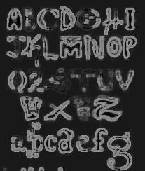

Fonts

Slide 11
Font Embeds
Use @font-face to declare font
Call font with font-family
Currently not supported in IE
Use font embedding instead of images
@font-face {
font-family: SketchRockwell;
src: url('SketchRockwell-Bold.ttf');
}
.my_CSS3_class {
font-family: SketchRockwell;
font-size: 3.2em;
}

Slide 12


Text Shadow
Applies shadow to text
Syntax:
text-shadow:<horizontal-distance> <vertical-distance> <blur-radius> <shadow-color>;
Do not alter the size of a box
text-shadow: 2px 2px 7px #000000;

Slide 13

Colors

Slide 14



Opacity
Sets the opacity level for an element
Syntax: opacity: <value>;
Value from 0.0 (fully transparent) to 1.0
The opacity is supported in all major browsers.
Note: IE8 and earlier supports an alternative, the filter property: filter: Alpha(opacity=50).
Example:
<img src="img.jpg" style= " opacity: 0.4;
filter: alpha(opacity=40)" />

Slide 15


RGBA
Standard RGB colors with an opacity value for the color (alpha channel)
Syntax: rgba(<red>, <green>, <blue>, <alpha>)
The range for red, green and blue is between integers 0 and 255
The range for the alpha channel is between 0.0 and 1.0
Example:
  rgba(255, 0, 0, 0.5)

Slide 16
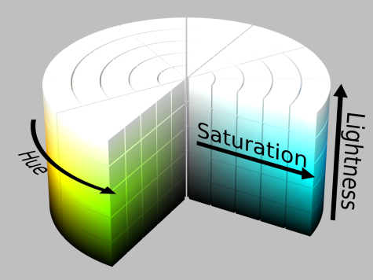
HSL Colors
Hue is a degree on the color wheel
  0 (or 360) is red, 120 is green, 240 is blue
Saturation is a percentage value
  100% is the full color
Lightness is also a percentage
  0% is dark (black)
  100% is light (white)
  50% is the average

Slide 17
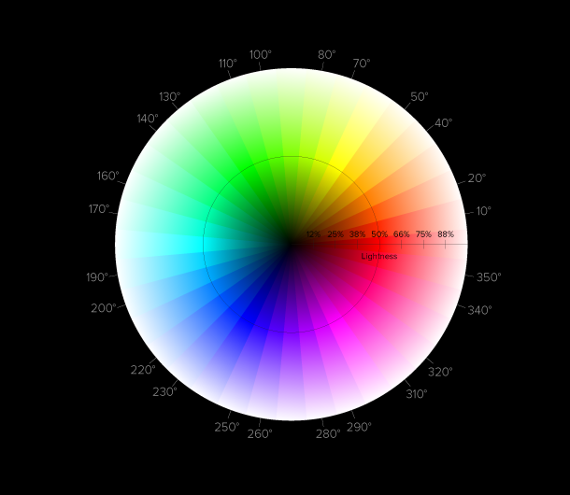
HSLA
HSLA allows a fourth value, which sets the Opacity (via the Alpha channel) of the element.
As RGBA is to RGB, HSLA is to HSL
Supported in IE9+, Firefox 3+, Chrome, Safari, and in Opera 10+
Example:
  hsla(0, 100%, 50%, 0.5)
Result:

Slide 18

Backgrounds

Slide 19

Gradient Background
Gradients are smooth transitions between two or more specified colors
Use of CSS gradients can replace images and reduce download time
Create a more flexible layout, and look better while zooming
Supported in all major browsers via different keywords
This is still an experimental feature

Slide 20

Gradient Background
/* Firefox 3.6+ */
background: -moz-linear-gradient(100% 100% 90deg,FFFF00, #0000FF);
/* Safari 4-5, Chrome 1-9 */
background: -webkit-gradient(linear, 0% 0%, 0% 100%, from(#0000FF), to(#FFFF00));
/* Safari 5.1+, Chrome 10+ */
background: -webkit-linear-gradient(#FFFF00, #0000FF);
/* Opera 11.10+ */
background: -o-linear-gradient(#2F2727, #0000FF);

Slide 21
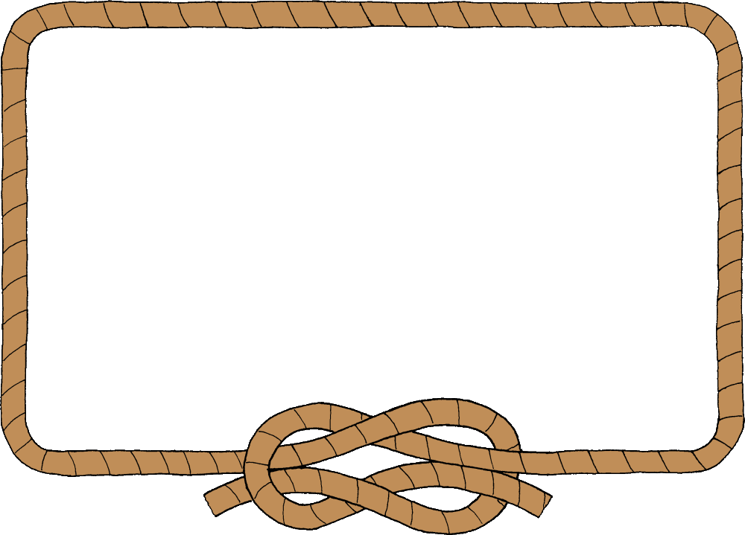
Borders

Slide 22

Border radius
Allows web developers to easily utilize rounder corners in their design elements
Widespread browser support
Example:
-moz-border-radius: 15px;
border-radius: 15px;
background-color: #FF00FF;

Slide 23

Box shadow
Allows to easily implement multiple drop shadows (outer or inner) on box elements
Specifying values for color, size, blur and offset
Example:
-moz-box-shadow: 10px 10px 5px #888;
-webkit-box-shadow: 10px 10px 5px #888;
box-shadow: 10px 10px 5px #888;

Slide 24
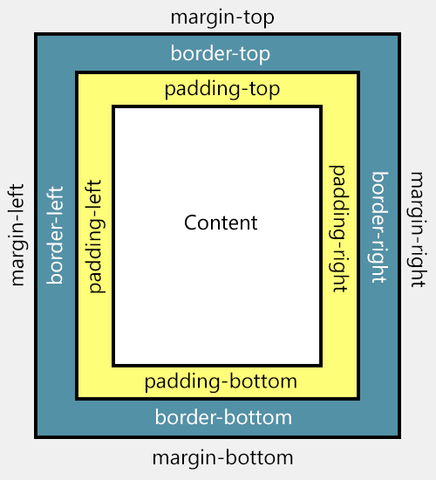
Box Model

Slide 25
Box Sizing
Determine whether you want an element to render it's borders and padding within its specified width, or outside of it.
Possible values:
  box-sizing: content-box (default)
  box width: 288 pixels + 10 pixels padding and 1 pixel border on each side = 300 pixels
  box-sizing: border-box
  box width: 300 pixels, including padding and borders

Slide 26

Animations

Slide 27
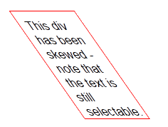

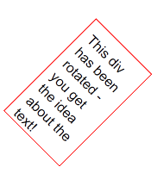
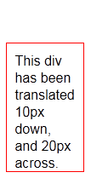
2D Transformations
2D transforms are widely supported
Skew – skew element
  transform: skew(35deg);
Scale – scale element
  transform: scale(1,0.5);
Rotate – rotates element
  transform: rotate(45deg);
Translate – moves element
  transform: translate(10px, 20px);

Slide 28
Transitions
Add an effect when changing from one style to another
Different timing functions:
  ease, ease-in, ease-out, ease-in-out, linear
#id_of_element {
-webkit-transition: all 1s ease-in-out; - -moz-transition: all 1s ease-in-out;
-o-transition: all 1s ease-in-out;
-ms-transition: all 1s ease-in-out; transition: all 1s ease-in-out;
}

Slide 29
Keyframes
@keyframes myAnimation{
0% {...}
50% {...}
100% {...}
}
#box {
animation-name: myAnimation;
animation-duration: 1s;
animation-iteration-count: 4;
animation-direction: alternate;
animation-timing-function: ease-in-out;
}

Slide 30
Thank you

