Slide 1
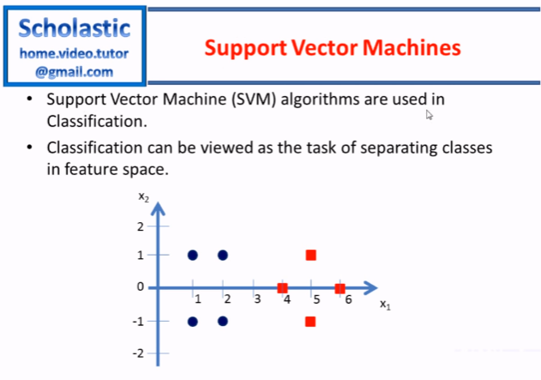

Slide 2
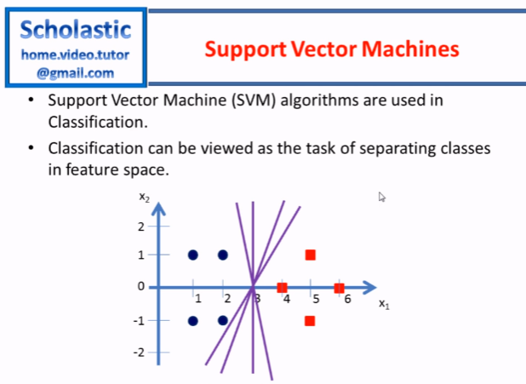


Slide 3
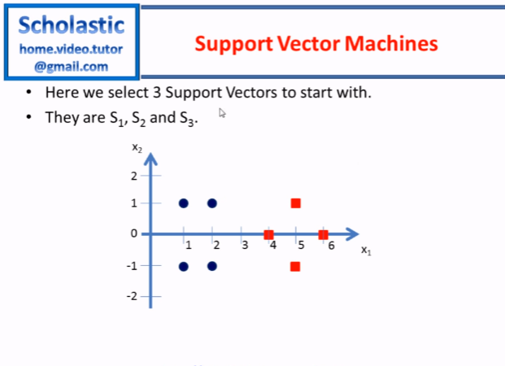

Slide 4
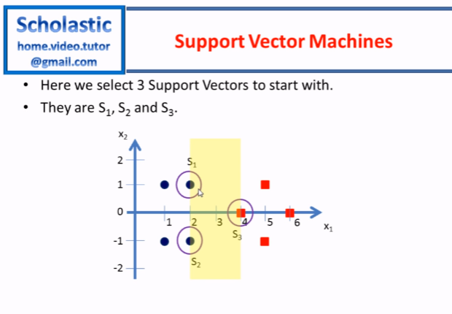

Slide 5
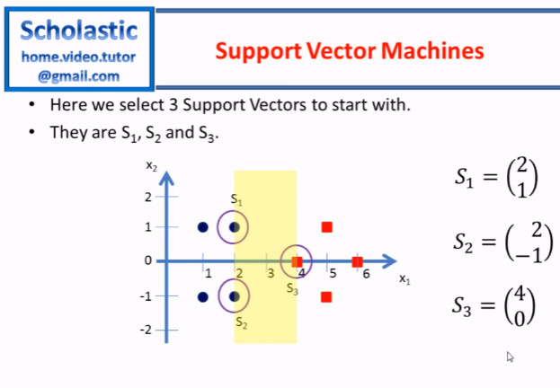

Slide 6


Slide 7
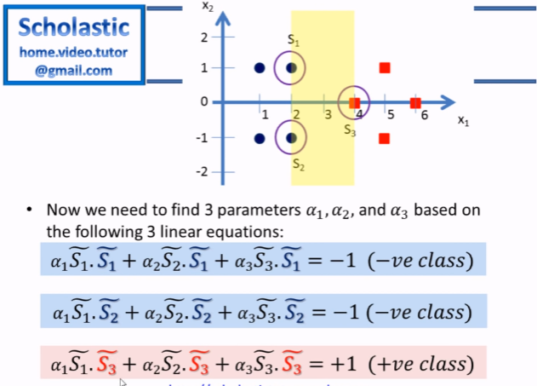

Slide 8
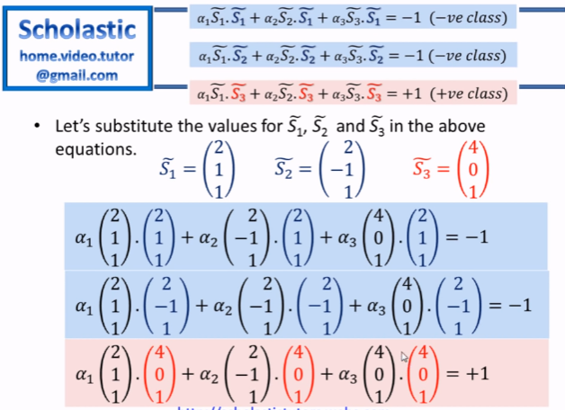

Slide 9
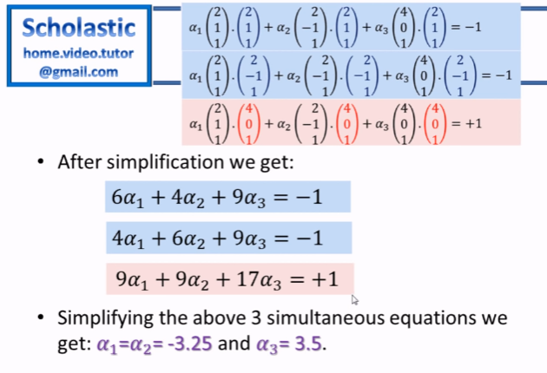

Slide 10
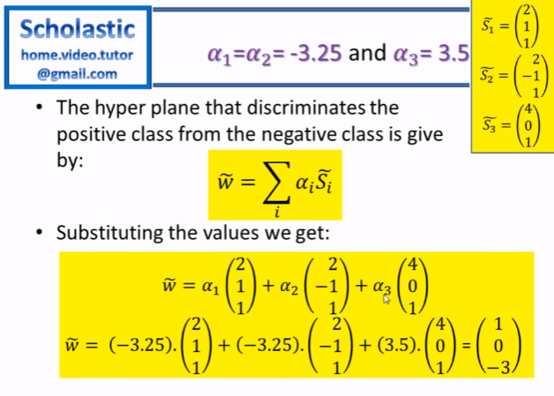

Slide 11
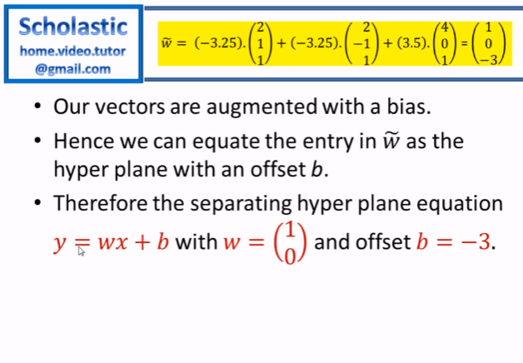

Slide 12
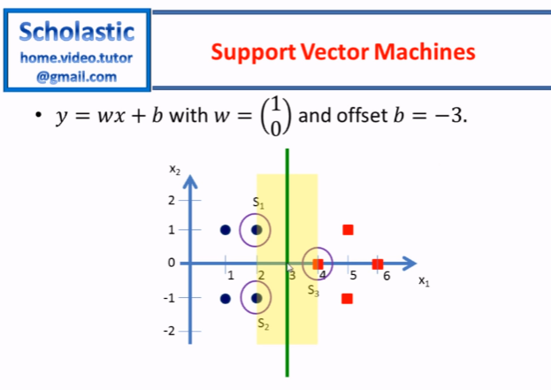

Slide 13
Second Example

Slide 14
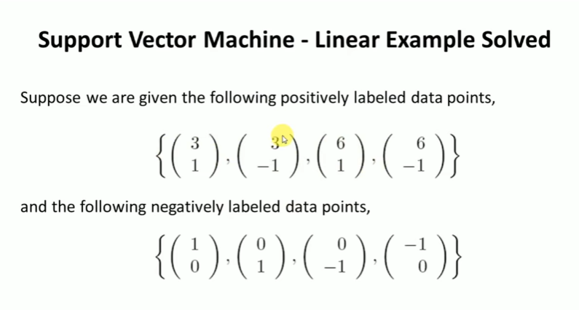

Slide 15
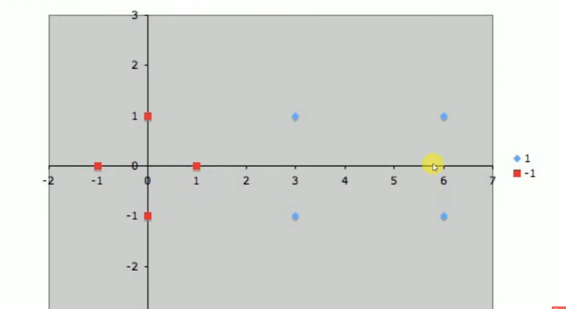

Slide 16
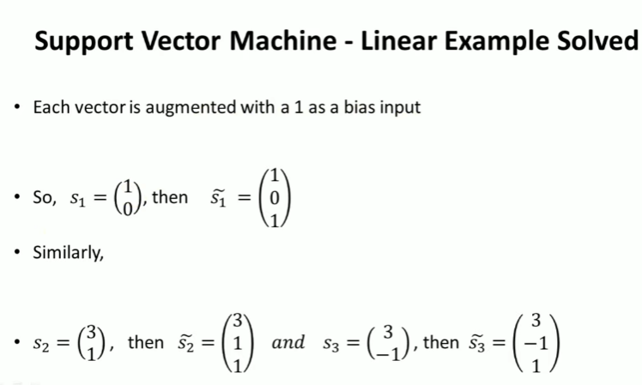

Slide 17


Slide 18


Slide 19
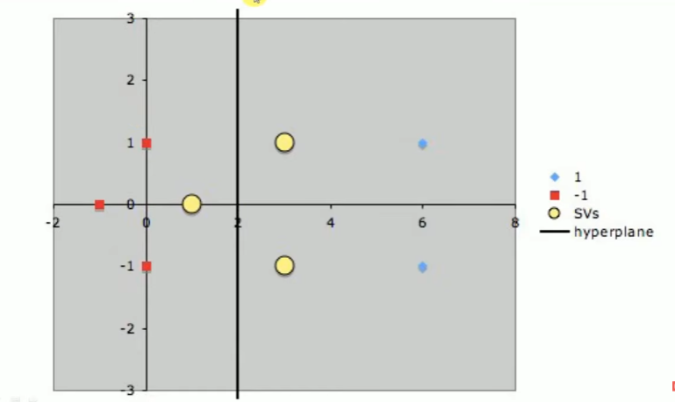

Slide 20

1. Import Required Libraries
from sklearn.svm import SVC
Imports the Support Vector Classifier (SVC) from scikit-learn.
SVM is a powerful algorithm used for classification and regression tasks.
from sklearn.model_selection import train_test_split
Used to split the dataset into training and testing sets.
This ensures we train the model on one part of the data and test its performance on unseen data.
from sklearn.metrics import accuracy_score
This function calculates the accuracy of our SVM model.
Accuracy = (Correct Predictions) / (Total Predictions).
from sklearn.datasets import load_iris
Loads the Iris dataset, a famous dataset used in machine learning.
It contains 150 flower samples from three species:
Setosa (0)
Versicolor (1)
Virginica (2)

Slide 21

2. Load the Dataset
data = load_iris() → Loads the Iris dataset into a variable.
X = data.data → Extracts the features (independent variables).
Features include:
Sepal length
Sepal width
Petal length
Petal width
y = data.target → Extracts the labels (target variable).
Labels are 0, 1, or 2, representing the flower species.

Slide 22
3. Split the Dataset into Training and Testing Sets
train_test_split(X, y, test_size=0.2, random_state=42)
Splits the dataset into 80% training data and 20% testing data.
test_size=0.2 → 20% of the dataset is used for testing.
random_state=42 → Ensures we get the same split every time we run the code.
X_train, y_train → Training data (used to train the SVM model).
X_test, y_test → Testing data (used to evaluate the SVM model).

Slide 23

4. Initialize the SVM Classifier
SVC() → Creates an instance of the Support Vector Classifier.
kernel='linear' → Specifies the kernel type for SVM.
'linear' → Uses a linear decision boundary (works best for linearly separable data).
'rbf' → Uses a non-linear boundary (good for complex datasets).
'poly' → Uses a polynomial boundary.

Slide 24


5. Train the SVM Model
.fit(X_train, y_train) → Trains the SVM model using the training dataset.
The model learns how to differentiate flower species based on feature values.
6. Make Predictions on Test Data
.predict(X_test) → Uses the trained SVM model to predict the species for test data.
y_pred → Stores the predicted labels for the test samples.

Slide 25

7. Evaluate the Model
accuracy_score(y_test, y_pred)
Compares actual labels (y_test) with predicted labels (y_pred).
Calculates the accuracy (fraction of correct predictions).
Formula for Accuracy:
Accuracy=Correct PredictionsTotal Predictions
Accuracy=Total PredictionsCorrect Predictions​
print(f'Accuracy: {accuracy:.2f}') → Displays accuracy rounded to 2 decimal places.

Slide 26
Complete code
from sklearn.svm import SVC
from sklearn.model_selection import train_test_split
from sklearn.metrics import accuracy_score
from sklearn.datasets import load_iris
# Load dataset
data = load_iris()
X, y = data.data, data.target
# Split dataset into training and testing sets
X_train, X_test, y_train, y_test = train_test_split(X, y, test_size=0.2, random_state=42)
# Initialize SVM classifier
svm_classifier = SVC(kernel='linear') # You can change kernel to 'rbf', 'poly', etc.
# Train the model
svm_classifier.fit(X_train, y_train)
# Make predictions
y_pred = svm_classifier.predict(X_test)
# Calculate accuracy
accuracy = accuracy_score(y_test, y_pred)
print(f'Accuracy: {accuracy:.2f}')

