Slide 1

ManageHub
SUPERVISOR
Mr. Shahrukh Riaz
Muhammad Nassar–59849
Abdullah Khalid–59873
Muhammad Rayan Sarfaraz–59552

Slide 2
Outline
Introduction
Problem Statement
Objectives
Literature Review
Methodology
Results
Project Workload
Gantt Chart

Slide 3
Introduction
The Problem:
Small shops still run on notebooks, memory, and guesswork
Stock, sales, and staff records are scattered, not in one place
Existing software is costly and stops working without internet
Our Solution: One simple system for a shop's daily work:
All-in-one dashboard - products, billing, staff, and suppliers in one place
Works without internet - a desktop app keeps billing running, then syncs later
Talks in plain language - an AI assistant answers questions and helps with billing
Safe for every shop - each shop's data stays private and separate
Impact: Any shop owner can run their business from a browser - no installation, no IT staff needed

Slide 4
Problem Statement
Critical Gaps in Current Shop Management:
Everything Scattered, Nothing Connected
Stock, sales, customers and suppliers live in separate notebooks or spreadsheets
No single view of what is really happening in the shop
Manual Work, Frequent Mistakes
Stock runs out with no warning until the shelf is empty
Cash totals and handovers are slow and easy to get wrong

Slide 5
Problem Statement
Critical Gaps in Current Shop Management:
Existing Software Doesn't Fit
Ready-made ERP or POS tools are too costly or too complex to set up
Not built for Urdu, local pricing, or how small shops really work
No Internet, No Business
Most systems assume the internet never drops
A lost connection at the till can stop sales completely
Missing: a plain-language assistant that answers questions and helps with billing

Slide 6
Objectives
Primary Goal: Build one web-based, cloud-hosted system that brings inventory, sales, customers, suppliers, staff, and finance together for small shops - with an offline mode and a plain-language AI assistant
Specific Objectives:
Multi-Tenant Web Platform
Let many shops run on one platform, each with fully private data
Open and use in any regular browser - nothing to install
Complete Retail Operations
Track inventory, low-stock alerts, and purchase orders
Run point-of-sale billing that updates stock automatically

Slide 7
Objectives
Role-Based Access Control
Give owners, managers, and cashiers access to only what they need
Keep sensitive actions restricted to the right roles
Offline-First Desktop App
Keep billing and stock updates working even without internet
Auto-sync everything back to the cloud once reconnected
Agentic AI Assistant
Answer questions and help with billing in plain English or Urdu
Always ask a human to confirm actions that touch money or stock

Slide 8
Literature Review
Research Landscape
Manual & Paper-Based Records
A notebook, calculator, or spreadsheet - free, but does not scale
No automatic stock tracking or low-stock alerts
Reports and totals have to be built by hand
Off-the-Shelf ERP & POS Systems
Odoo, ERPNext, Square, QuickBooks - built for large, global markets
Powerful, but need a developer to set up and localise
Not built for Urdu, cash-first sales, or Pakistan's pricing needs

Slide 9
Literature Review
Cloud & SaaS Delivery Models
A monthly subscription means no server for the shop to maintain
Shared infrastructure keeps the cost low for each shop
Server-rendered pages stay simple and consistent on old hardware
AI in Retail & Offline-First Design
Machine learning is often used to forecast demand and suggest reorders
Agentic assistants pair a large language model with specialised tools
Offline-first apps write locally, then sync a queue once back online

Slide 10
Literature Review
Common Design Patterns
Keyword matching first, then a language model for unclear requests
A shared router hands each request to a specialised agent
Research gaps + Our Contributions
Gap Area | Current State | Limitations
Offline Support | Rare in affordable systems | Most fail the moment internet drops
Local Language & Pricing | Rarely a first-class feature | Not built for Urdu or local tax norms
Conversational AI | Found mainly in big enterprise tools | Too costly for a small shop's budget
AI on Money/Stock | No human-confirmation step | Risky, fully-automated decisions
Access Model | Web OR installed, not both | Forces owners into one trade-off

Slide 11
Literature Review
Our Contributions
✓ Multi-Tenant SaaS: one platform, many shops, fully separate data
✓ Truly Offline-First: desktop app with local storage and auto-sync
✓ Role-Based Access: owners, managers, and cashiers see only their tools
✓ Human-in-the-Loop AI: 7 agents, but money and stock always need approval
✓ Web-First, Zero Install: runs in any browser, updates instantly for every shop
✓ Built for Local Shops: Urdu support and Pakistan-specific pricing

Slide 12
Methodology
Development Approach
Built module by module: products and billing first, then HR, offline sync, and AI
Each module tested before moving to the next one
Code organised into routes, controllers, views, and helpers
Technology Stack
Backend: Node.js, Express, and MySQL (SQLite for offline mode)
Frontend: server-rendered EJS templates and Chart.js dashboards
AI service: FastAPI, LangChain, and Groq's Llama 3.3 model
Desktop: Electron, plus Stripe for subscription billing

Slide 13
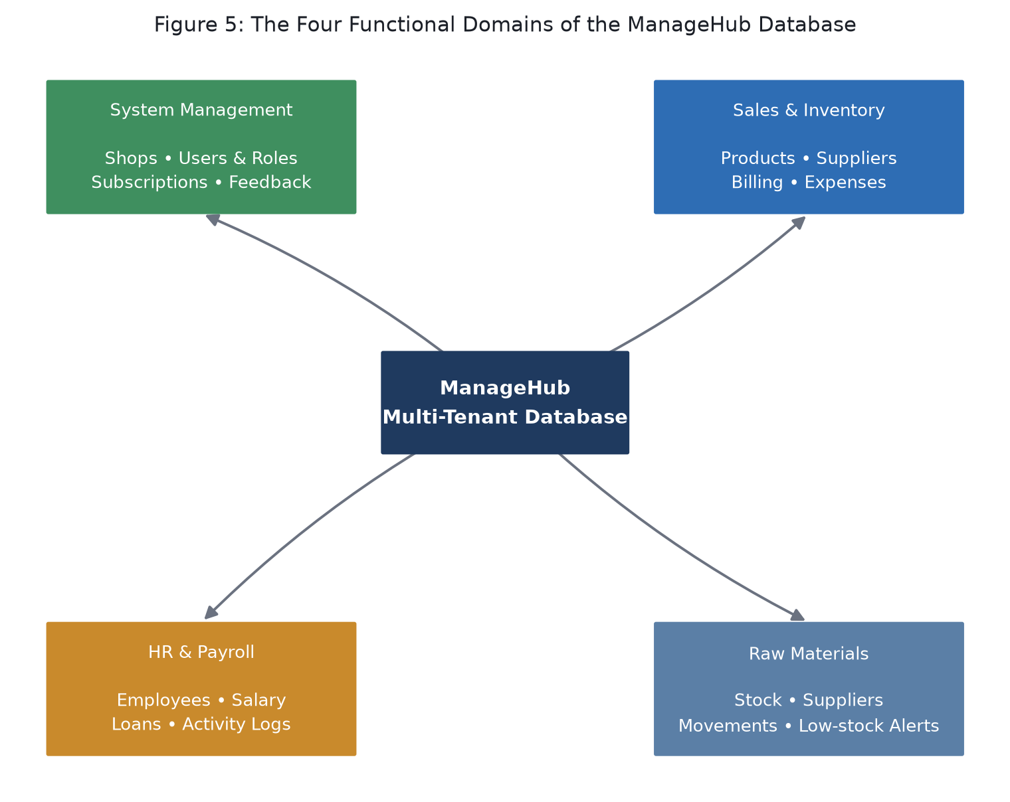
Methodology
Database Design
Multi-tenant model: every table carries a shop_id, so data never crosses shops
Keys are UUIDs, not auto-increments
Lets records made offline merge in later without ID clashes
Four functional domains, shown in Figure 1
Confidence in data integrity: one shop's mistake can't affect another
The Four Domains
System management: shops, users, roles, subscriptions
Sales & inventory, HR & payroll, and raw materials
Figure 1: The Four Functional Domains of the ManageHub Database

Slide 14
Methodology
Customer-Facing Modules
Inventory & Products - SKUs, stock levels, low-stock alerts
Point-of-Sale Billing - scan, discount, auto-updates stock
Customers (CRM) - purchase history and credit limits
Suppliers - purchase orders and running balances
Back-Office Modules
Employees & Payroll - salaries, loans, and activity logs
Reports & Dashboards - charts, PDF and Excel export
Roles, Feedback & Subscription Billing via Stripe

Slide 15
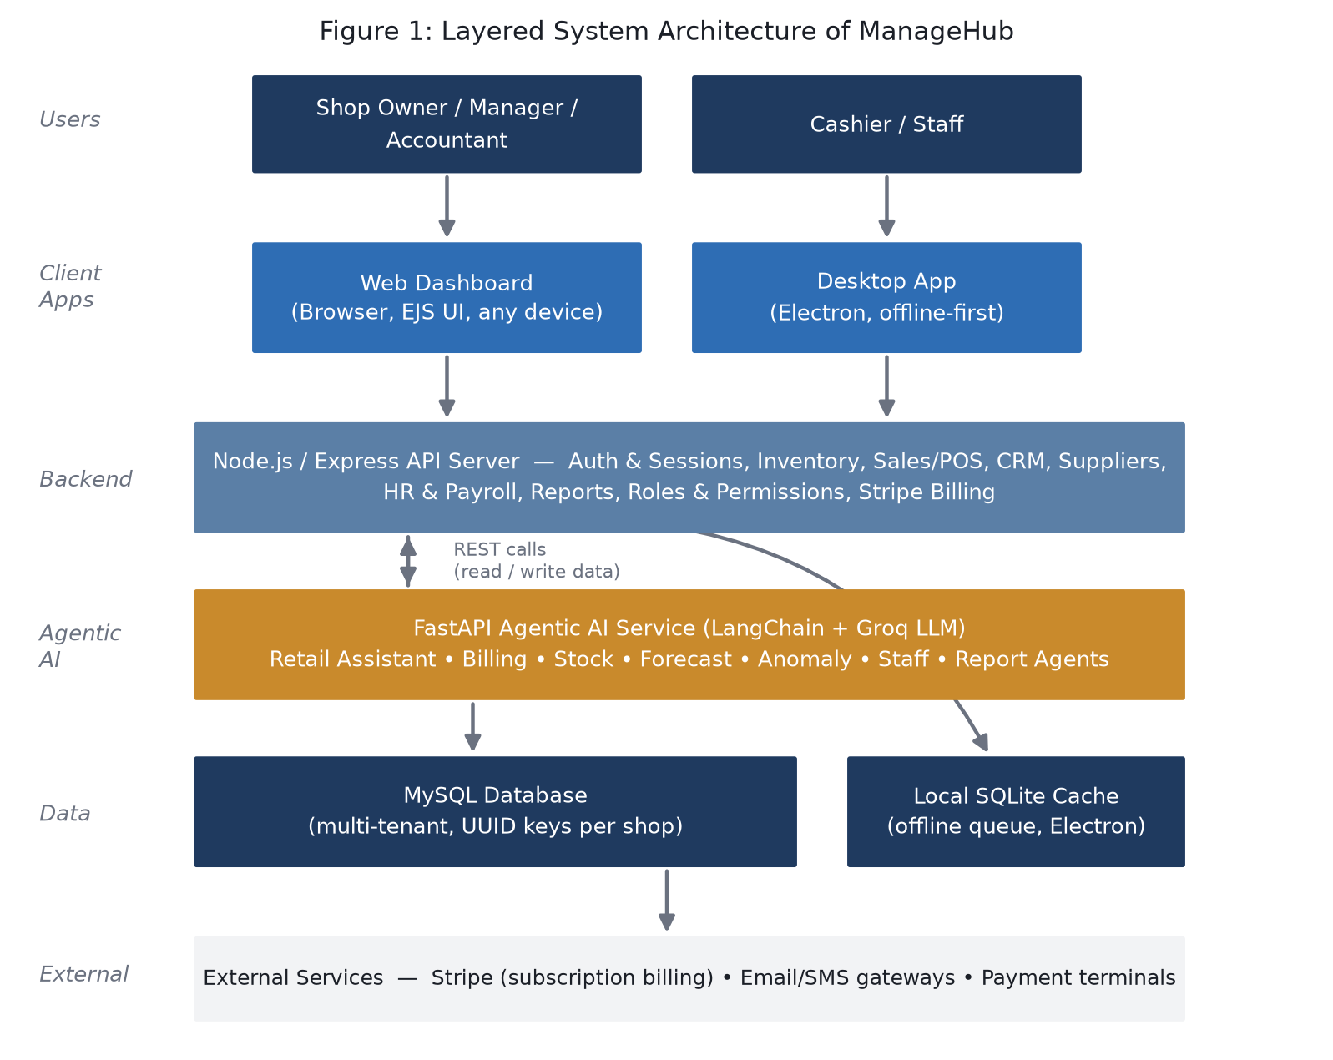
Methodology
System Architecture

Slide 16
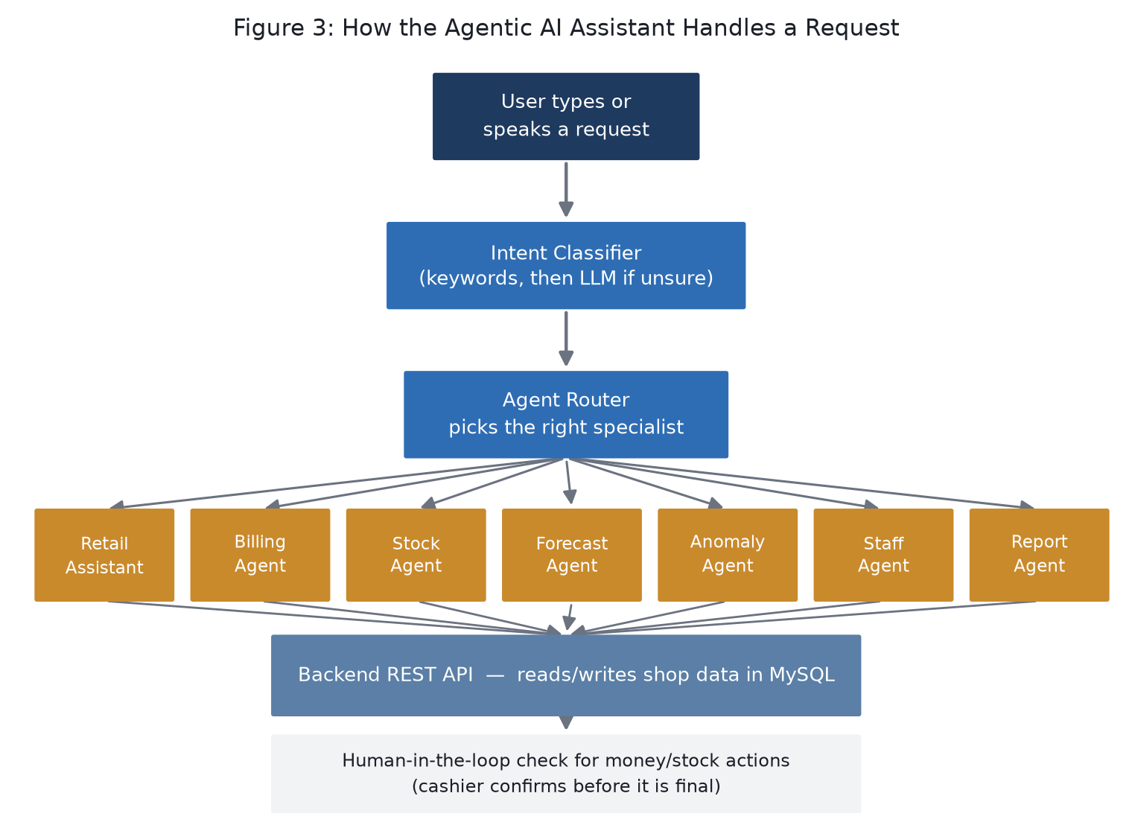
Methodology
Agentic AI Request Flow

Slide 17
Results
Data Quality Filtering
Detection Accuracy
Raw detections: 61 Recent events (30 min): 19 Consensus-validated events: 8 False positives filtered: 86.9%
Average initial confidence: 87.4% Post-consensus confidence: 100% Event distribution:
Potholes — 62.5%
Speed bumps — 37.5%
Aggressive filtering ensures only high-confidence events persist.
All validated events confirmed by ≥2 independent devices.

Slide 18
Results
Real-Time System Performance
GPS updates: 100 ms Backend response: < 1 s Auto-refresh cycle: 30 s Platforms tested: Android
Real-world deployment: Quetta, Pakistan
Key Outcome
Reliable, real-time, crowd-validated road hazard detection using mobile sensors

Slide 19
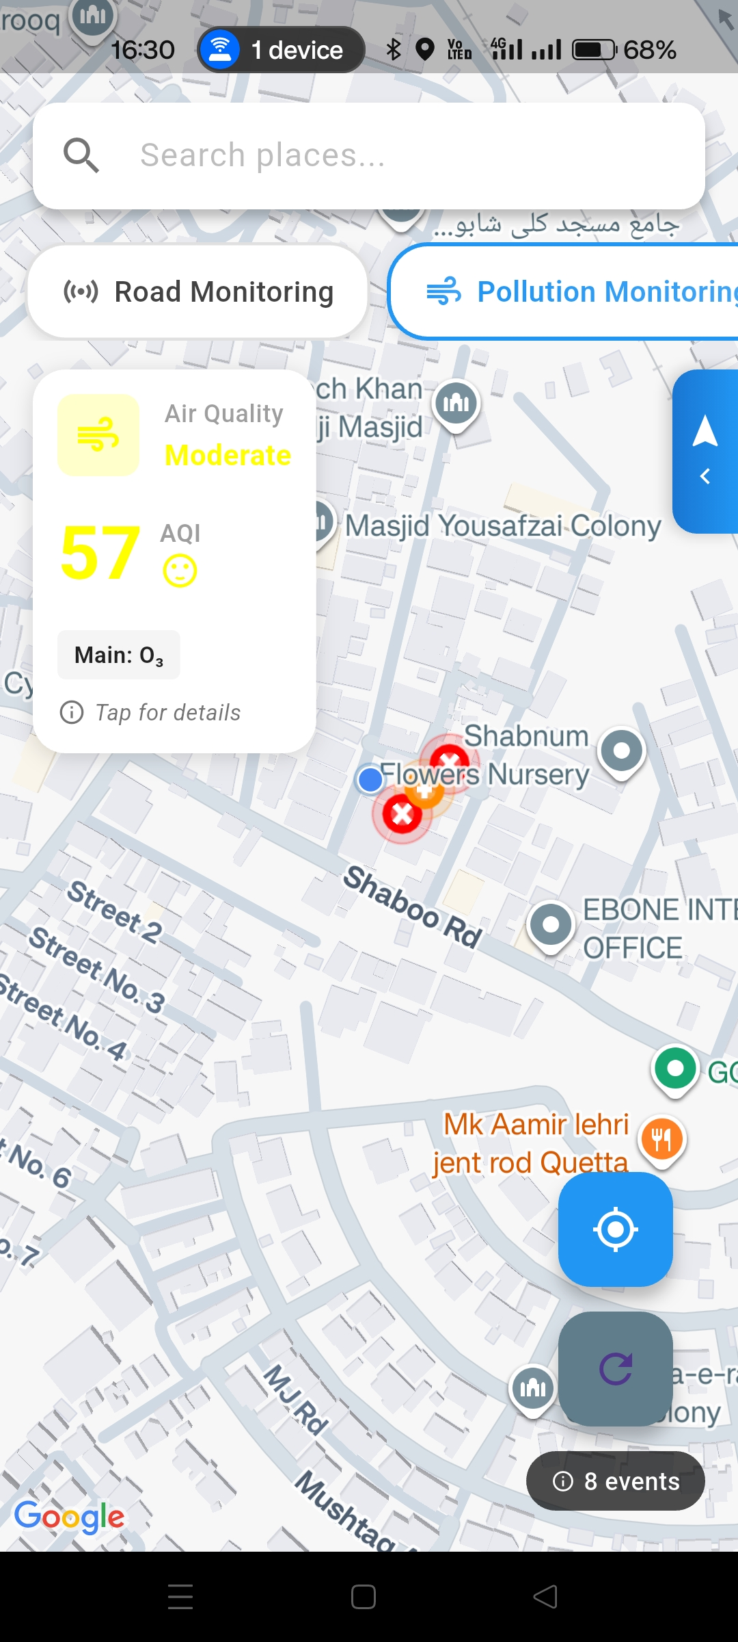
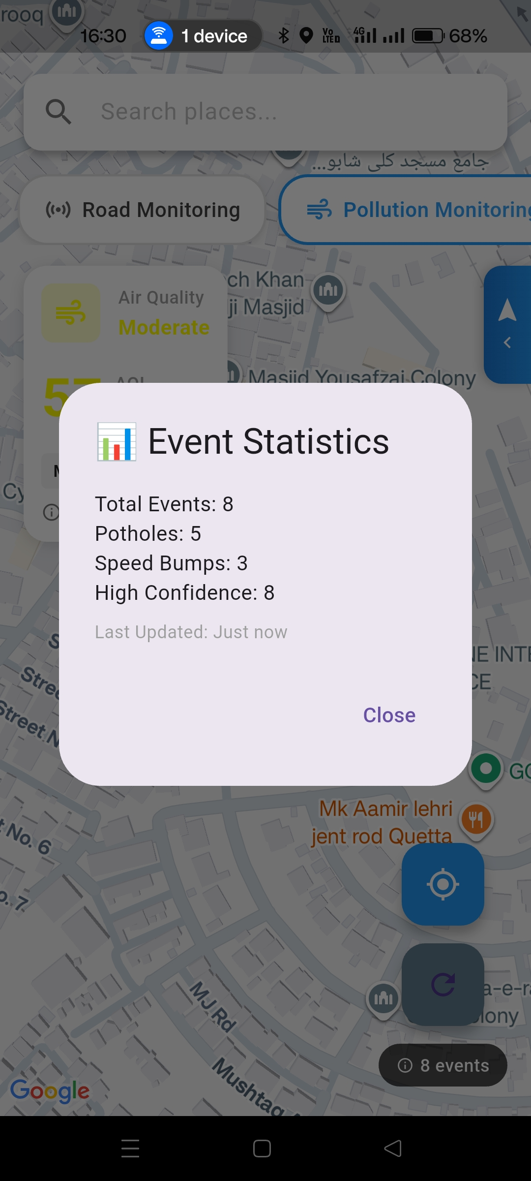
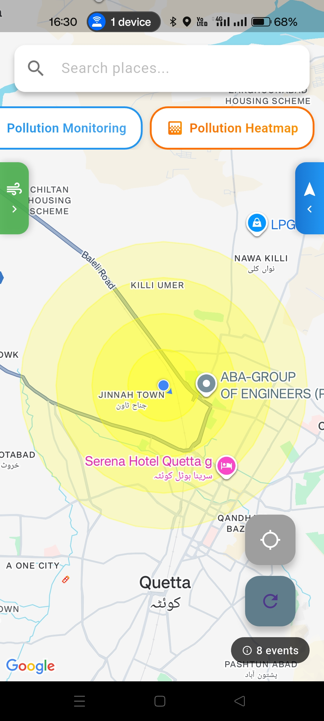
Results
System in
Operation

Slide 20
Project Workload
Abdul Ahad — Core System & Intelligence
Umer Bin Ibrar — UI, Maps & User Interaction
System architecture & service-layer design
Sensor data processing (accelerometer, gyroscope)
Road anomaly detection logic
Consensus validation & noise filtering
GPS tracking and real-time location handling
Backend integration (event upload & sync)
Performance optimization & result analysis
Flutter UI development & screen flows
Google Maps integration & visualization
Hazard markers & pollution overlays
Navigation interface & user alerts
Cross-platform consistency (Android & iOS)
UI/UX improvements and usability testing
Focus: core logic, data reliability, system performance
Focus: user experience, visualization, interaction design

Slide 21
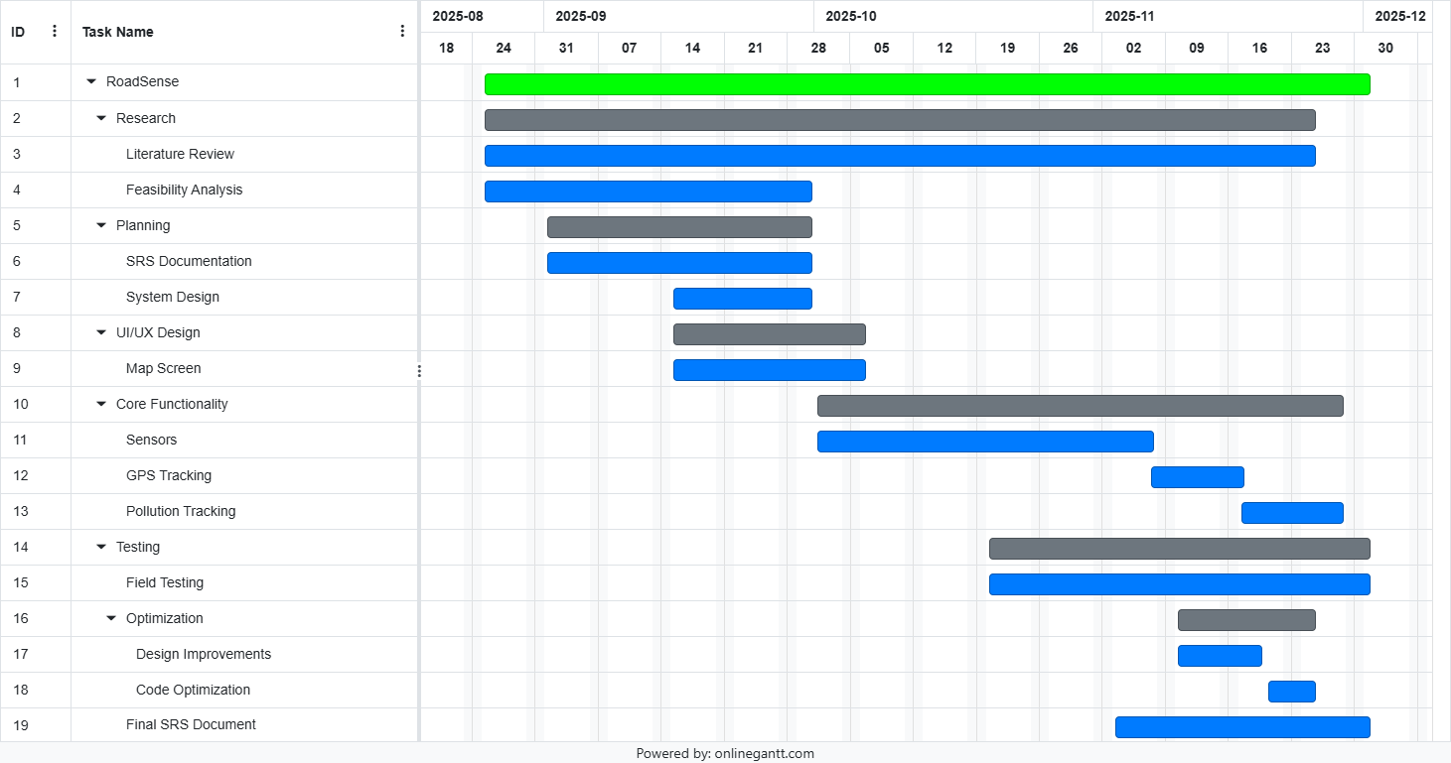
Gantt Chart

Slide 22
References
[1] M. Zareei et al., "Machine Learning Model for Road Anomaly Detection Using Smartphone Accelerometer Data," IEEE Access, 2025. (98% accuracy, CNN-based, adaptive thresholding)
[2] P. Mohan et al., "TrafficSense: Rich monitoring of road and traffic conditions using mobile smartphones," Microsoft Research, 2008. (Foundational work, virtual reorientation)
[3] F. Seraj et al., "RoADS: A road pavement monitoring system for anomaly detection," Big Data Analytics, 2014. (Envelope demodulation, 90% accuracy)
[4] A. Allouch et al., "ManageHub: Smartphone application to estimate road conditions," IEEE Sensors J., 2017. (98.6% accuracy, C4.5 Decision Tree)
[5] O. Mazari Abdessameud & W. Cherifi, "Federated road surface anomaly detection," DATA Conf., 2024. (LSTM + federated learning)

Slide 23
Thank You!

