Slide 1

RoadSense
SUPERVISOR
Arsalan-ul-haq
Abdul ahad–59882
umer bin ibrar–61072

Slide 2
Outline
Introduction
Problem Statement
Objectives
Literature Review
Methodology
Results
Project Workload
Gantt Chart

Slide 3
Introduction
The Problem:
1.19 million road deaths annually (WHO, 2021)
Lack of real-time hazard awareness
Preventable accidents due to poor road conditions
Our Solution: Transform smartphones into intelligent road monitoring devices:
Sensor-driven detection - Accelerometer + Gyroscope for hazard identification
AI-powered prediction - Hybrid ML model for accident risk assessment
Environmental awareness - Real-time pollution tracking
Community intelligence - Crowdsourced safety data
Impact: Proactive safety through passive monitoring - no additional hardware required

Slide 4
Problem Statement
Critical Gaps in Current Road Safety Systems:
Reactive, Not Proactive
Users only aware of hazards after encountering them
No advance warning system for road anomalies
Fragmented Information
Separate apps for navigation, traffic, pollution
No unified safety intelligence platform

Slide 5
Problem Statement
Critical Gaps in Current Road Safety Systems:
Limited Hazard Detection
Expensive infrastructure required (sensors, cameras)
Poor coverage in developing regions
No real-time community-based reporting
Accident Prevention Gap
Existing systems alert during accidents (airbags, ABS)
Missing: predictive warnings before dangerous situations

Slide 6
Objectives
Primary Goal: Develop a cross-platform mobile app that enhances road safety through intelligent monitoring and predictive analytics
Specific Objectives:
Real-Time Hazard Detection
Detect potholes, bumps, and road damage using smartphone sensors
Achieve ≥85% detection accuracy
Accident Risk Prediction
Implement machine learning prediction system
Alert drivers before dangerous situations occur

Slide 7
Objectives
Environmental Awareness
Integrate real-time pollution and air quality data
Enable health-conscious route planning
Unified Safety Platform
Combine navigation, hazard alerts, and environmental monitoring
Single app solution for comprehensive road intelligence
Community-Powered Intelligence
Build crowdsourced hazard database
Leverage collective data to improve safety for all users

Slide 8
Literature Review
Research Landscape
Sensor-Based Road Monitoring
Accelerometer/gyroscope for vibration analysis
50-100 Hz optimal sampling rate
Z-axis primary, tri-axial improves accuracy 10-20%
Detection Approaches Evolution
Threshold-based: Simple, 74-78% accuracy
Machine Learning: SVM, RF, CNN → 85-98% accuracy
Deep Learning: LSTM, ETLNet → 95-99% F1-score

Slide 9
Literature Review
Key Methodologies
Signal preprocessing: High-pass filters, envelope demodulation
Feature extraction: Time-domain, wavelet (SWT), spectral
Virtual reorientation: Euler angles for orientation independence
Datasets & Benchmarks
Pothole Lab Dataset (standard reference)
US-Accidents (2.25M records)
RDD2020 (road damage classification)

Slide 10
Literature Review
Deployment Strategies
TensorFlow Lite for mobile optimization
Model quantization (32-bit → 8-bit)
Research gaps + Our Contributions
Gap Area | Current State | Limitations
Detection Scope | Road surface only | No accident prediction
Processing | Cloud or offline | Limited real-time capability
Approach | Pure ML or pure rules | Lack of hybrid intelligence
Integration | Single-purpose apps | No environmental awareness
Platform | Native per OS | Maintenance overhead

Slide 11
Literature Review
Our Contributions
✓ Hybrid Architecture: Rule-based + ML for reliability + adaptability
✓ Real-Time On-Device: <200ms processing latency
✓ Dual Prediction: Road anomalies + accident risk assessment
✓ Multi-Sensor Fusion: Accelerometer + Gyroscope + GPS
✓ Environmental Integration: Pollution data via Google Maps API
✓ Cross-Platform: Flutter for Android + iOS from single codebase

Slide 12
Methodology
Data Acquisition
Smartphone sensors: Accelerometer + Gyroscope (50 Hz)
GPS positioning with timestamp synchronization
Real-time location tracking (100ms update intervals)
Signal Processing
Exponential smoothing filter (α=0.3)
Feature extraction: 238-sample window (~4.76s)
Multi-modal trigger: acceleration + rotation variance
Speed-adaptive thresholds (5 tiers: 2-150 km/h)

Slide 13
Methodology
Classification Algorithm
Weighted scoring system (5 features):
Peak sharpness, gyro variance, vertical dominance
Impact duration, frequency analysis (FFT)
Pothole vs Speed Bump discrimination
Confidence calculation (≥60% minimum threshold)
Pollution Monitoring
Google Air Quality API integration
Heat map visualization with concentric zones

Slide 14
Methodology
Navigation System
Google Maps Directions API with route alternatives
Turn-by-turn guidance with lane assistance
Off-track detection (30m threshold)
Automatic rerouting (10s cooldown)
Route Risk Analysis
Hazard proximity detection (50m threshold)
Multi-criteria scoring: hazards + pollution + distance
Safest route recommendation

Slide 15
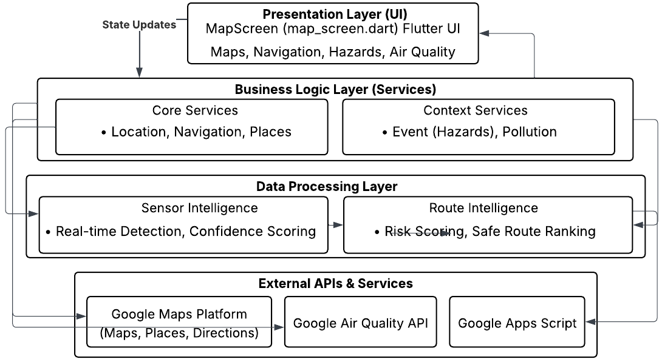
Methodology
System Architecture

Slide 16
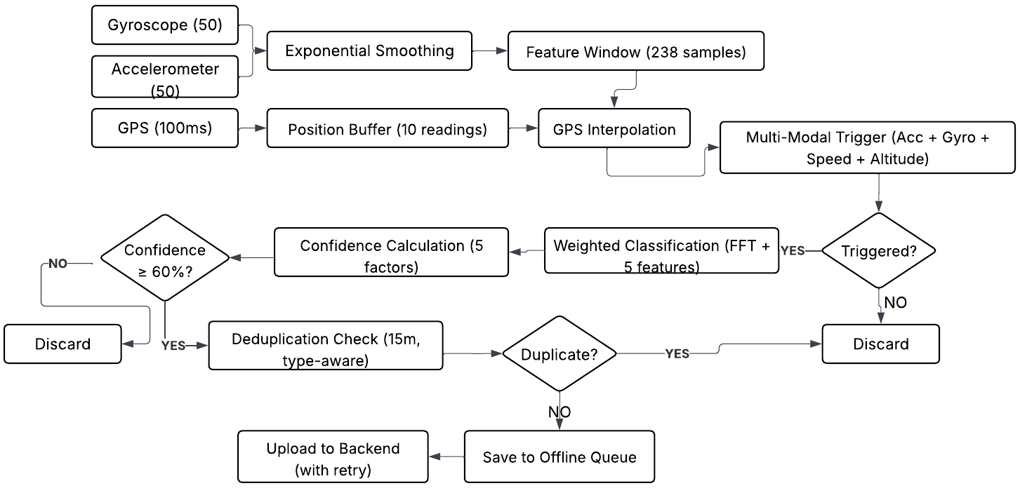
Methodology
Event Detection Flow

Slide 17
Results
Data Quality Filtering
Detection Accuracy
Raw detections: 61 Recent events (30 min): 19 Consensus-validated events: 8 False positives filtered: 86.9%
Average initial confidence: 87.4% Post-consensus confidence: 100% Event distribution:
Potholes — 62.5%
Speed bumps — 37.5%
Aggressive filtering ensures only high-confidence events persist.
All validated events confirmed by ≥2 independent devices.

Slide 18
Results
Real-Time System Performance
GPS updates: 100 ms Backend response: < 1 s Auto-refresh cycle: 30 s Platforms tested: Android
Real-world deployment: Quetta, Pakistan
Key Outcome
Reliable, real-time, crowd-validated road hazard detection using mobile sensors

Slide 19
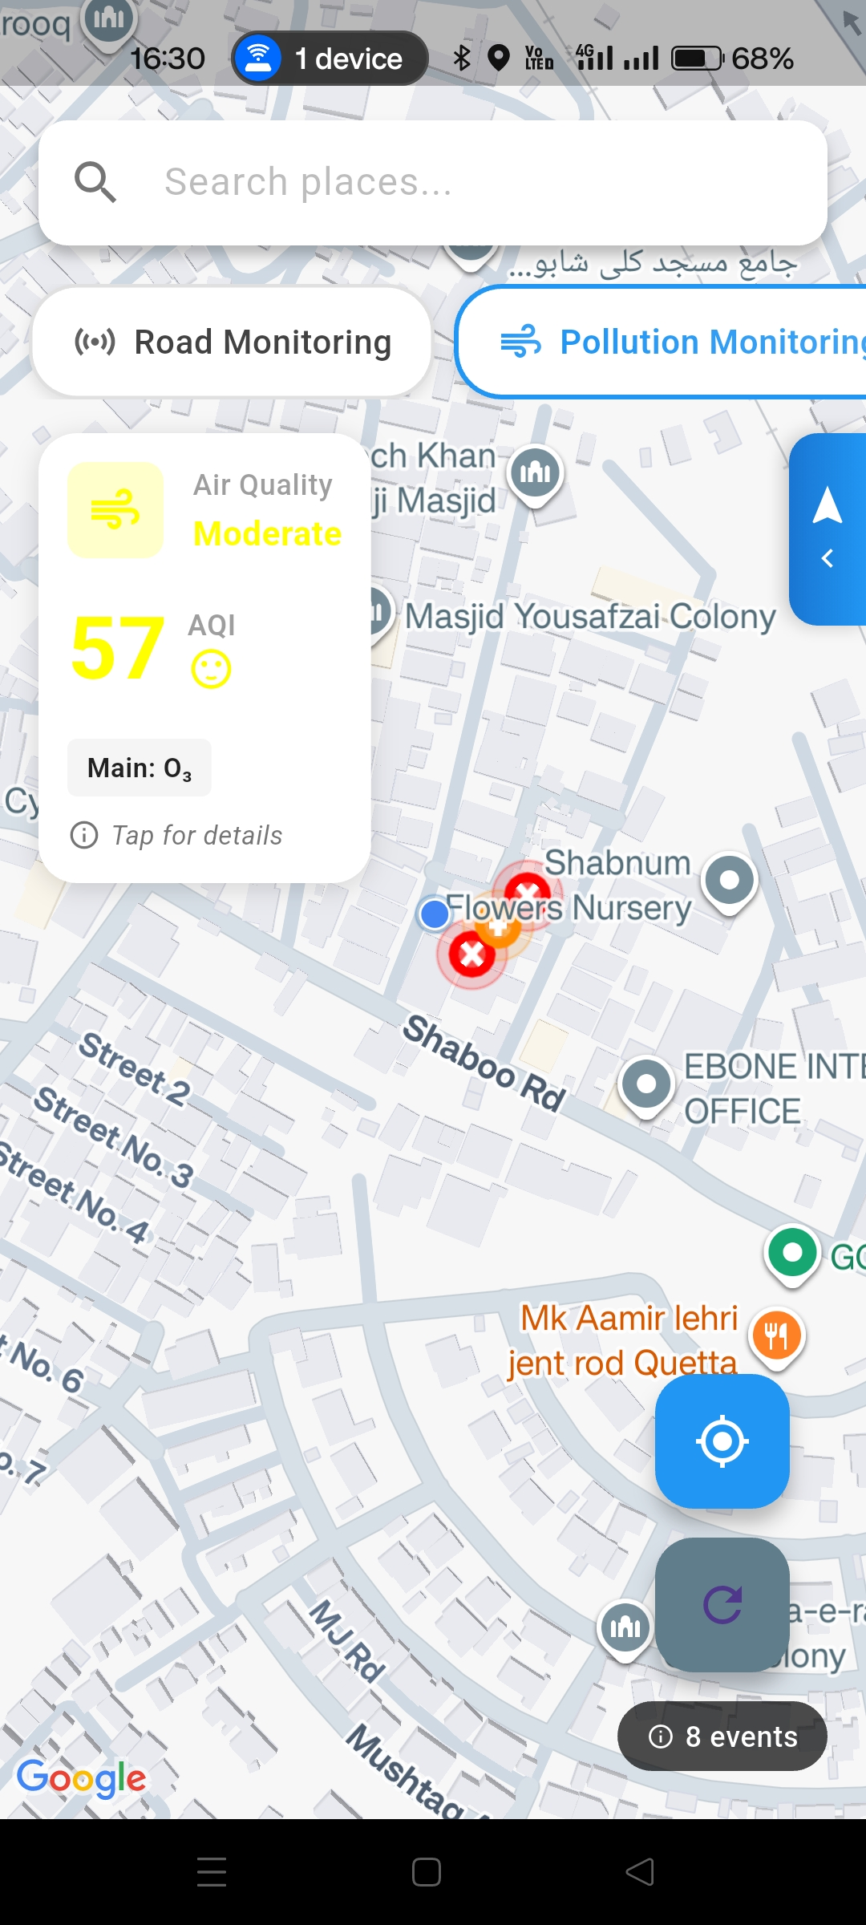
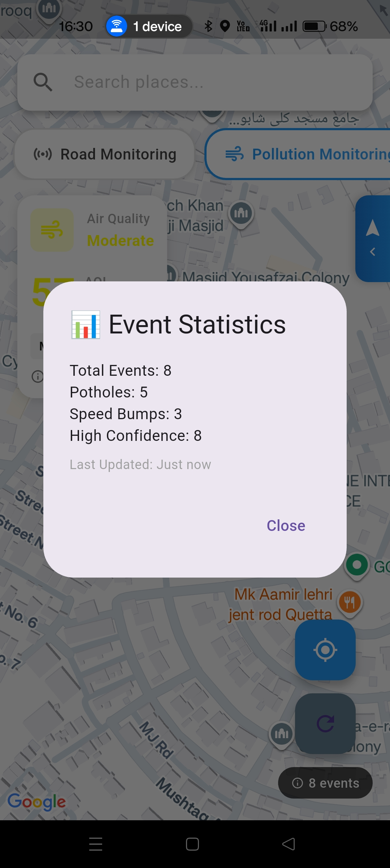
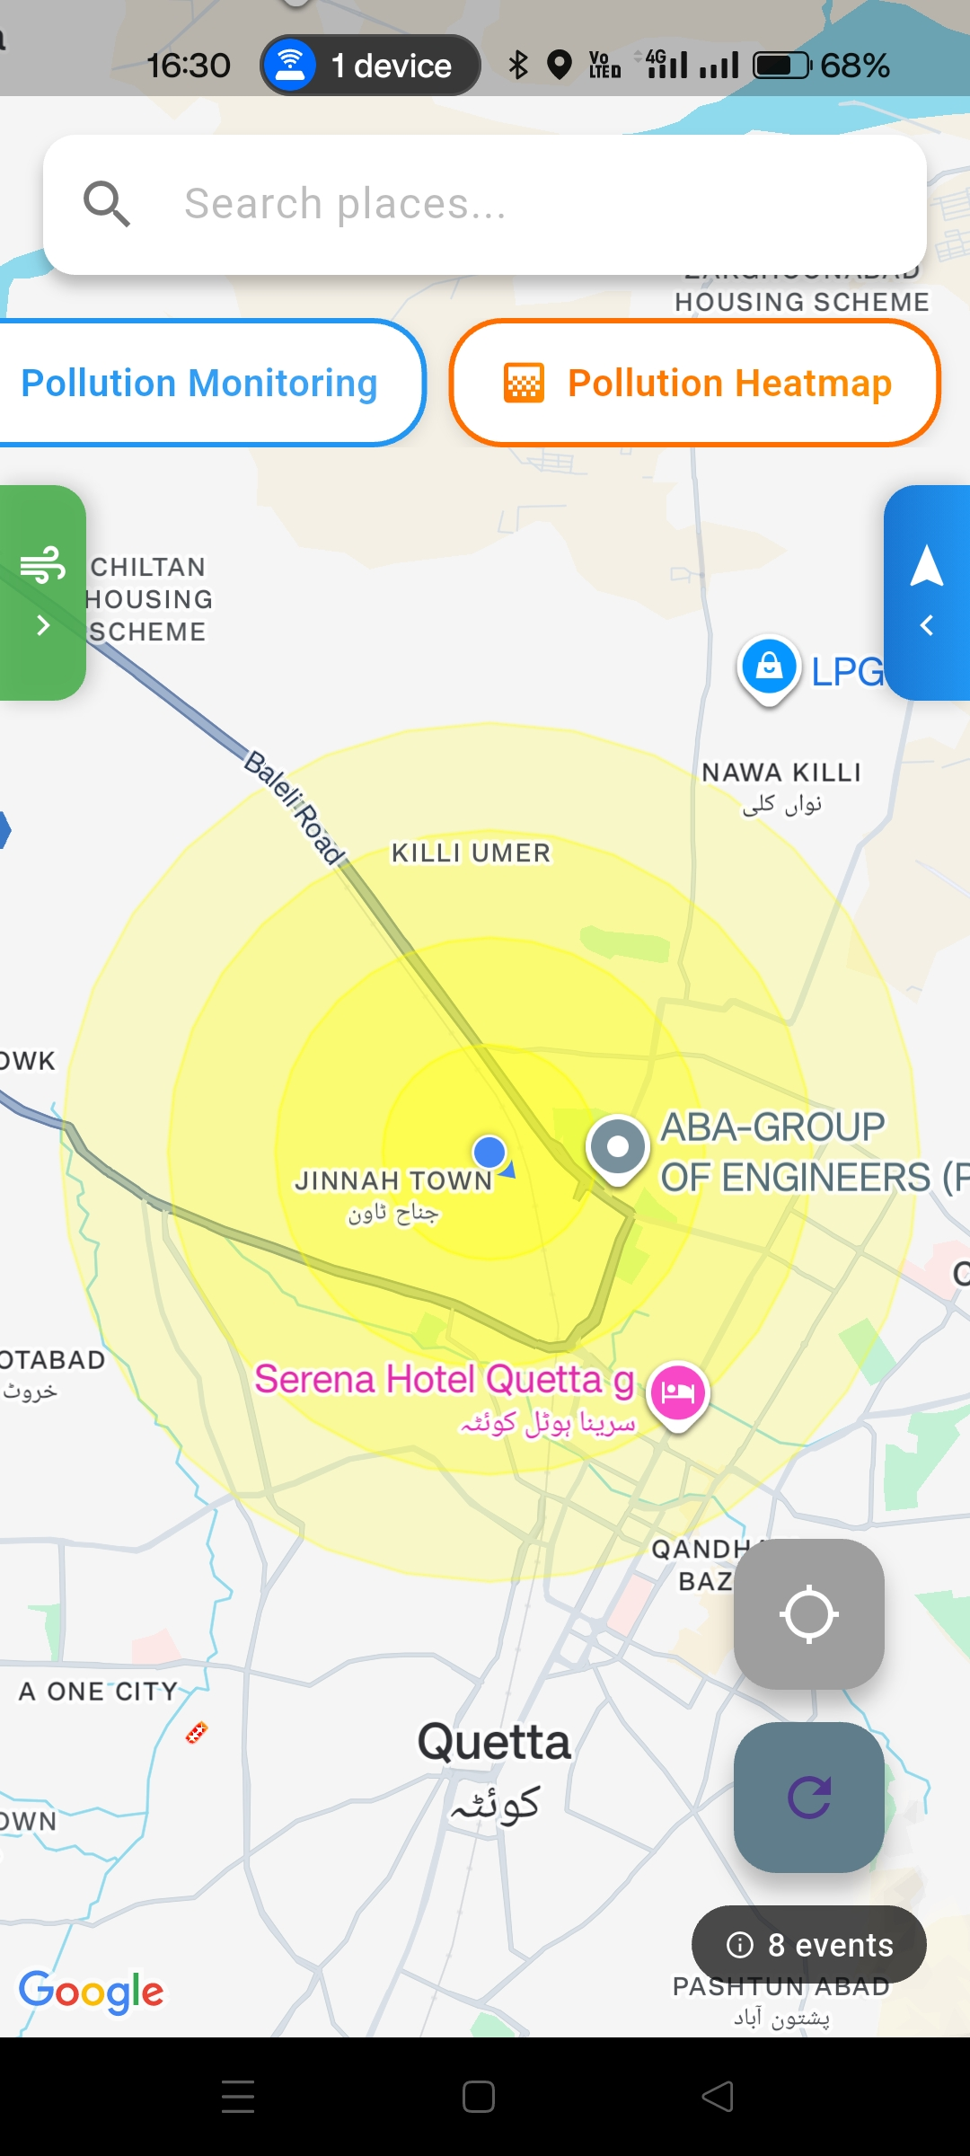
Results
System in
Operation

Slide 20
Project Workload
Abdul Ahad — Core System & Intelligence
Umer Bin Ibrar — UI, Maps & User Interaction
System architecture & service-layer design
Sensor data processing (accelerometer, gyroscope)
Road anomaly detection logic
Consensus validation & noise filtering
GPS tracking and real-time location handling
Backend integration (event upload & sync)
Performance optimization & result analysis
Flutter UI development & screen flows
Google Maps integration & visualization
Hazard markers & pollution overlays
Navigation interface & user alerts
Cross-platform consistency (Android & iOS)
UI/UX improvements and usability testing
Focus: core logic, data reliability, system performance
Focus: user experience, visualization, interaction design

Slide 21
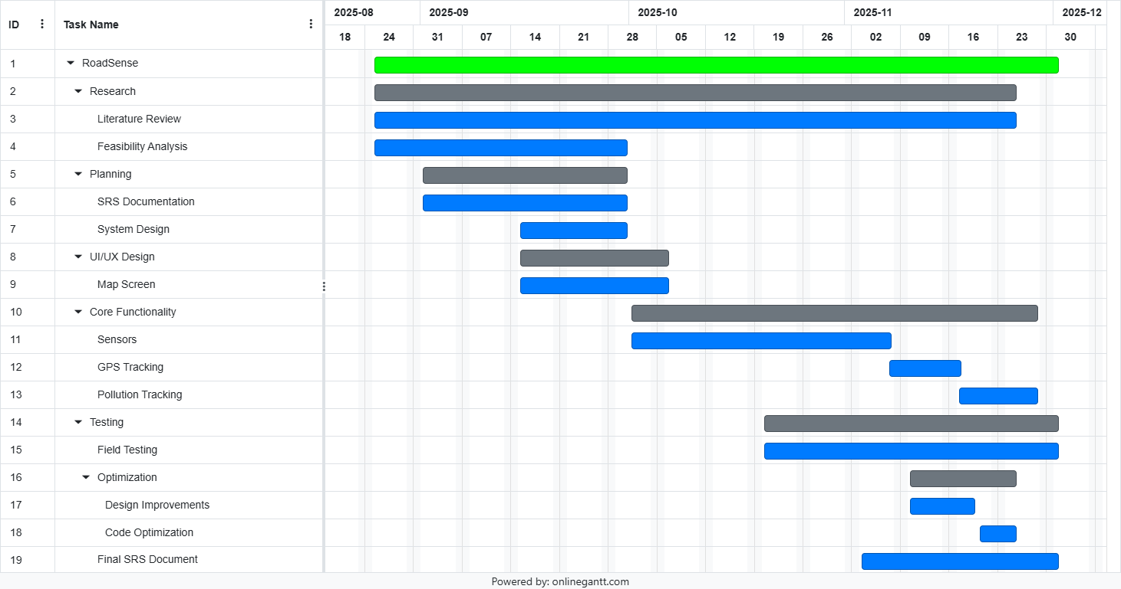
Gantt Chart

Slide 22
References
[1] M. Zareei et al., "Machine Learning Model for Road Anomaly Detection Using Smartphone Accelerometer Data," IEEE Access, 2025. (98% accuracy, CNN-based, adaptive thresholding)
[2] P. Mohan et al., "TrafficSense: Rich monitoring of road and traffic conditions using mobile smartphones," Microsoft Research, 2008. (Foundational work, virtual reorientation)
[3] F. Seraj et al., "RoADS: A road pavement monitoring system for anomaly detection," Big Data Analytics, 2014. (Envelope demodulation, 90% accuracy)
[4] A. Allouch et al., "RoadSense: Smartphone application to estimate road conditions," IEEE Sensors J., 2017. (98.6% accuracy, C4.5 Decision Tree)
[5] O. Mazari Abdessameud & W. Cherifi, "Federated road surface anomaly detection," DATA Conf., 2024. (LSTM + federated learning)

Slide 23
Thank You!

