Slide 1

Project Title
SUPERVISOR
Name of supervisor
Co-SUPERVISOR
Name of co-supervisor
STUDENT Name – CMS ID
STUDENT Name – CMS ID
STUDENT Name – CMS ID
STUDENT Name – CMS ID

Slide 2
Important Points to Follow
Total Length of Presentation is restricted to 25 slides. Total number of slides should not exceed in any case.
Use the layout and design present in this template.
Use the same headings as described in this presentation. If it is absolutely necessary to use your own, use them as sub-headings
Change the Footer from "Project Topic" to your project title by going to the Insert tab
Remove this slide after you’re done making presentation

Slide 3
Outline
Introduction
Problem Statement
Aims/Objectives
Literature Review
Methodology
Main Features of the Project
Logical Diagrams
Results
User Interfaces
Workload of the Project
Gantt Chart

Slide 4
Introduction
In this slide write about what problem is your project trying to address?
What will be the aims and objectives of your project in addressing the above said problem.
2 Slides Maximum

Slide 5
Literature Review
Discuss all the existing work that has been performed similar to your project.
You can add points that are similar to your project or any points that you some other project didn’t do but you’re enhancing it etc. in this section.
2 Slides Maximum

Slide 6
Methodology
What will be the main features of this project?
Add all the logical diagrams of your project that include:
Use Case Diagrams
Activity Diagrams
Context Level DFD
Sequence Diagrams
Entity Relationship Diagrams
12 Slides Maximum

Slide 7
Results
Add screenshots all the interfaces that you have created for your project.
5 Slides Maximum

Slide 8
Workload of the Project
Provide details of workload of project divided among the group members.
1 Slide Maximum

Slide 9
Gantt Chart
Provide a proper Gantt chart, which will present a timeline of your project depicting starting and completion dates of your project.
1 Slide Maximum

Slide 10
References
[1] H. Nadeem et al., “Road Feature Detection for Advance Driver Assistance System Using Deep Learning,” Sensors, vol. 23, no. 9, p. 4466, May 2023, doi: 10.3390/s23094466.
1 Slide Maximum

Slide 11
Outline
Introduction
Problem Statement
Aims / Objectives
Literature Review
Methodology
Main Features of the Project
Logical Diagrams
Results
User Interfaces
Workload of the Project
Gantt Chart

Slide 12
Introduction – Problem Statement
The Problem
Small and medium retail businesses in Pakistan face significant challenges in managing day-to-day operations such as billing, inventory, employee management, and reporting.
Most existing POS solutions are either too expensive for small retailers or too complex for non-technical shop owners.
Shop owners spend hours manually tracking sales, stock levels, and performance leading to human errors, stock shortages, and revenue loss.
There is no affordable system that combines retail management with AI to provide real-time business insights through natural language conversation.
Our Solution: ManageHub
ManageHub is a web-based, AI-powered retail shop management system that automates billing, inventory, employee management, and reporting integrated with a conversational AI assistant that allows shop owners to query business data using plain English or Urdu.

Slide 13
Introduction – Aims & Objectives
Develop a comprehensive retail management platform handling products, billing, inventory, customers, suppliers, employees, payroll, and expenses.
Integrate an AI-powered conversational assistant using a multi-agent architecture for natural language interaction with business data.
Support dual-database architecture (MySQL for cloud + SQLite for offline desktop) with automatic synchronization.
Provide AI-driven analytics: sales forecasting, anomaly detection, staff performance analysis, and automated report narration.
Ensure role-based access control (RBAC) with granular permissions for Admin, Shop Owner, Manager, and Cashier roles.
Enable multi-tenant SaaS architecture with subscription-based pricing via Stripe integration.

Slide 14
Literature Review – Existing Solutions
Existing Systems & Their Limitations
Lightspeed POS Cloud-based, multi-location but expensive ($69+/month), no AI, not for Pakistani market.
Research Gap Identified
None of the existing systems combine retail POS + AI conversational assistant + offline desktop support + multi-agent intelligence in a single affordable platform for the Pakistani retail market.
System | Strengths | Limitations
Lightspeed POS | Cloud-based, multi-location support | Expensive ($69+/month), no AI assistant, not suitable for Pakistani market
Shopify POS | E-commerce integration, modern UI | Focused on e-commerce, limited offline support, no conversational AI
Square POS | Free basic plan, easy billing | No inventory forecasting, no employee payroll, no AI-powered insights
ERPNext | Open-source, comprehensive ERP | Overly complex for small retailers, steep learning curve, no AI chat
Oscar POS (Pakistan) | Local market support, Urdu UI | Limited analytics, no AI integration, no offline desktop mode

Slide 15
Literature Review – Research Areas
Multi-Agent AI Systems
Research on specialized AI agents collaborating to handle different business domains more effectively than a single chatbot. (Park et al., 2023)
LLMs for Business Intelligence
Studies on using Large Language Models (Llama, GPT) for natural language querying of structured business data. (Rajkumar et al., 2022)
Offline-First Architecture
Research on Electron-based desktop apps with sync engines for unreliable internet environments in developing countries. (Nicola et al., 2021)
Our Enhancement
ManageHub combines all three areas into a single production-ready system: 7 specialized AI agents powered by Groq's Llama 3.3 70B, integrated into a full retail management platform with offline sync.

Slide 16
Methodology – System Architecture
Three-Tier Microservice Architecture
1. Client Tier (Frontend)
Server-side rendered EJS templates with vanilla JavaScript
AI Chat Widget for natural language interaction
Chart.js for sales analytics visualization
2. Application Tier (Backend)
Node.js / Express.js — Main web server (Port 3000)
Python / FastAPI — AI microservice with 7 agents (Port 8000)
3. Data Tier (Database)
MySQL — Cloud/production database
SQLite (sql.js) — Offline desktop via Electron
Sync Engine — Automatic offline-to-cloud synchronization

Slide 17
Methodology – Technology Stack
Technologies Used
Frontend: HTML5, CSS3, JavaScript, EJS Templates
Backend: Node.js, Express.js 5.x
AI Engine: Python 3.14, FastAPI, Uvicorn
LLM Provider: Groq Cloud (Llama 3.3 70B Versatile)
Database: MySQL 8.0 + SQLite (sql.js)
Desktop App: Electron.js
Payments: Stripe API (SaaS subscription billing)
Email: Nodemailer + Gmail SMTP
Charts: Chart.js (Sales & analytics visualization)
Reports: PDFKit + ExcelJS (PDF/Excel export)
Version Control: Git + GitHub

Slide 18
Methodology – AI Multi-Agent Architecture
7 Specialized AI Agents
Retail Assistant Agent — General sales & inventory queries
Billing Agent — Voice/text-based billing & checkout
Stock Ordering Agent — Inventory reorder suggestions
Forecast Agent — Sales trend prediction & demand forecasting
Anomaly Agent — Fraud detection & unusual pattern analysis
Staff Agent — Employee performance analysis & revenue tracking
Report Agent — Executive report narration & summaries
Agent Execution Cycle (6 Steps)
Perceive → Reason → Plan → Act → Reflect → Explain
LLM-Powered Intent Classification
Agent Router uses keyword matching + Groq LLM fallback to classify user intent and route to the correct agent.

Slide 19
Methodology – AI Query Flow
How a User Query is Processed
1. User types a question in the AI Chat Widget
2. Frontend sends query to Node.js via POST /api/ai/chat
3. Node.js acts as secure proxy, attaching secret key
4. Node.js forwards to Python FastAPI AI Server (Port 8000)
5. Agent Router classifies intent (keyword match + LLM fallback)
6. Query is routed to the correct Specialized Agent
7. Agent executes 6-step cognitive cycle, calling tools to fetch
data
8. Tools call back to Node.js API for database queries
9. Response flows back and is rendered as formatted Markdown

Slide 20
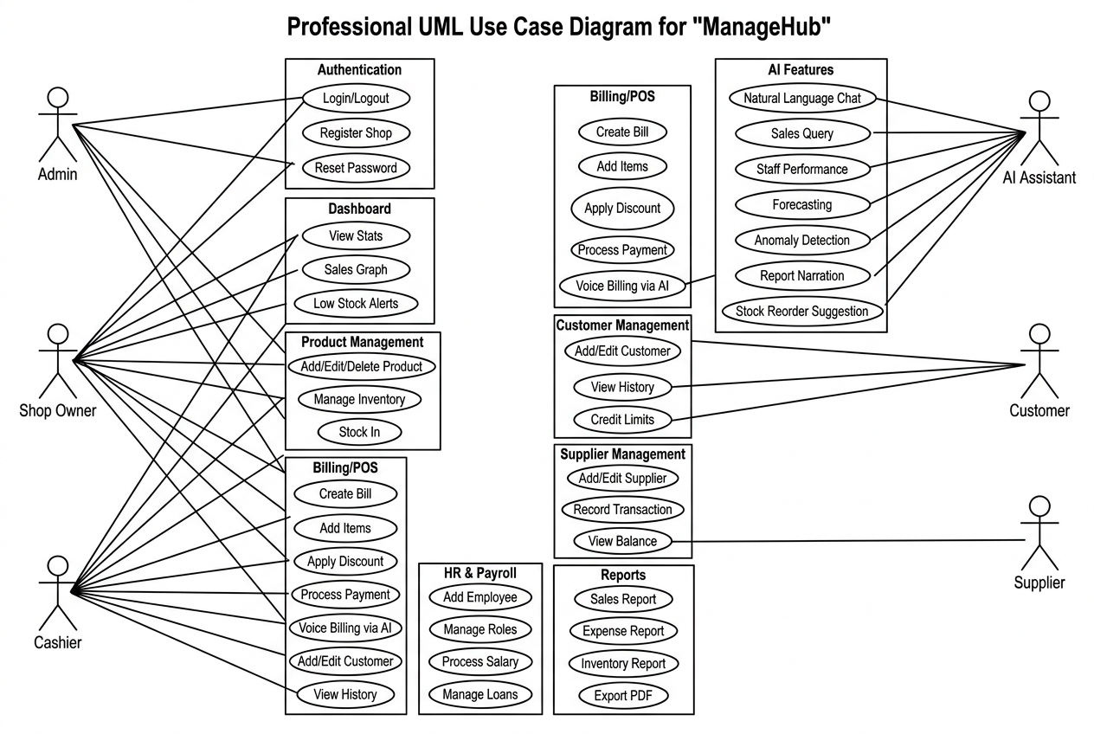
Methodology – Use Case Diagram

Slide 21
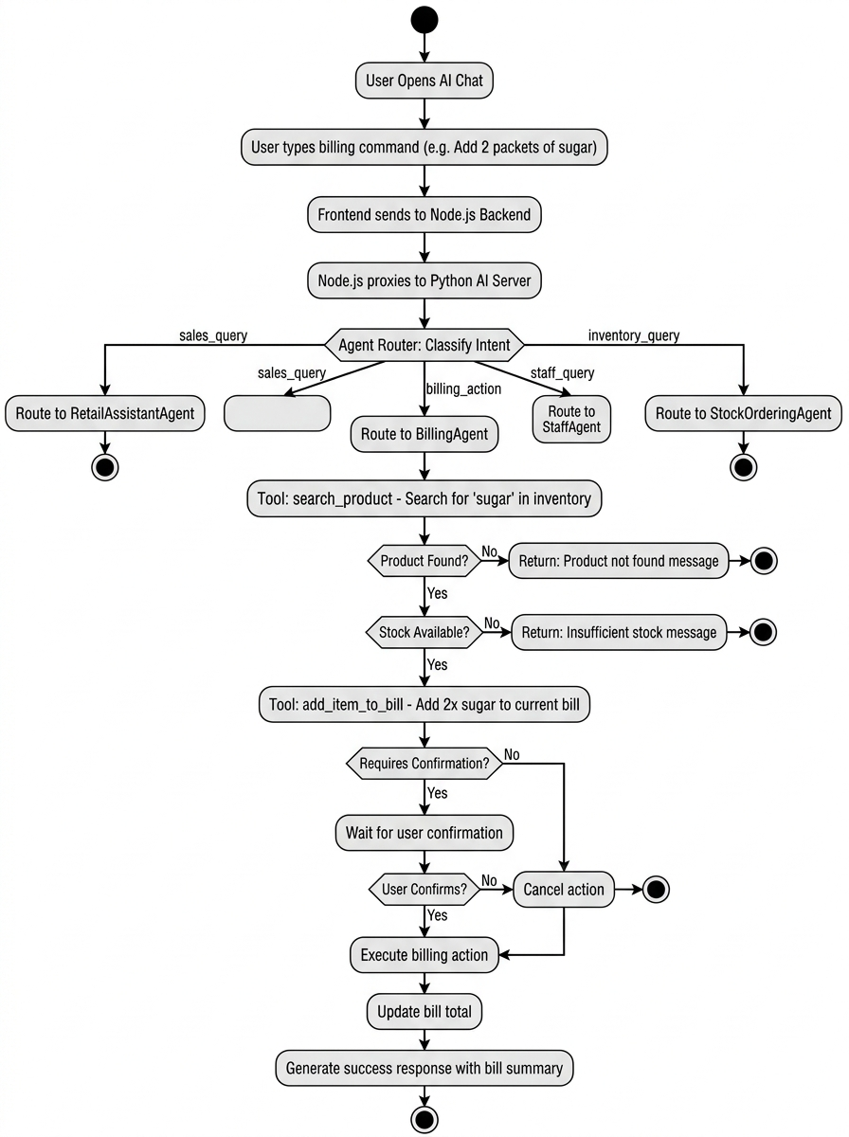
Methodology – Activity Diagram

Slide 22
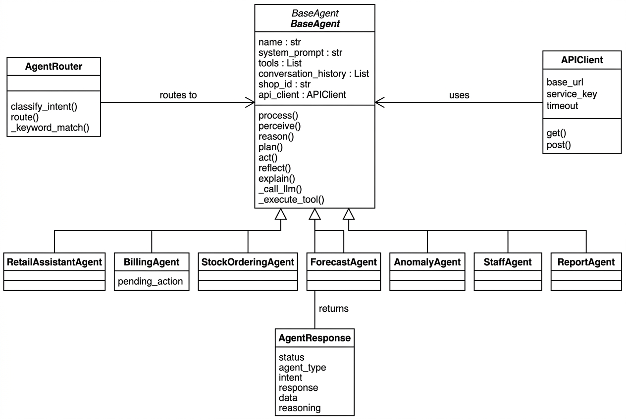
Methodology – Class Diagram

Slide 23
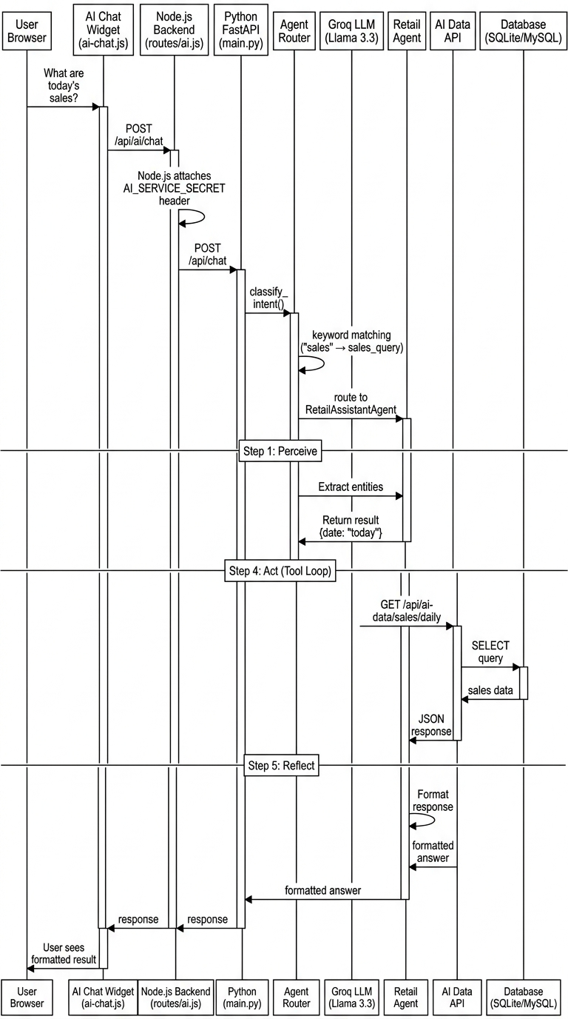
Methodology – Sequence Diagram

Slide 24
Methodology – Database Schema
34 Database Tables Organized by Domain
Core & Auth: shops, users, roles, permissions, role_permissions, user_permissions
Products & Inventory: products, inventory, stock_in
Sales & POS: bills, bill_items, customers
Suppliers: suppliers, supplier_transactions, supplier_balance
HR & Payroll: user_salary, user_loan, user_loan_ledger
Expenses & Cash: expenses, cash_register, user_cash_submission
Raw Materials: raw_materials, ingredients, raw_material_stock_movements
SaaS & Admin: subscriptions, payment_transactions, feedback, admin_actions
Sync Engine: sync_queue, sync_metadata

Slide 25
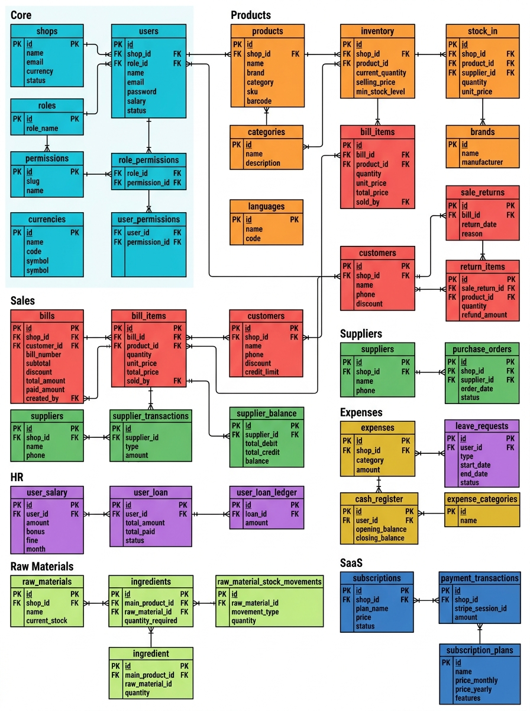
Methodology – ER Diagram

Slide 26
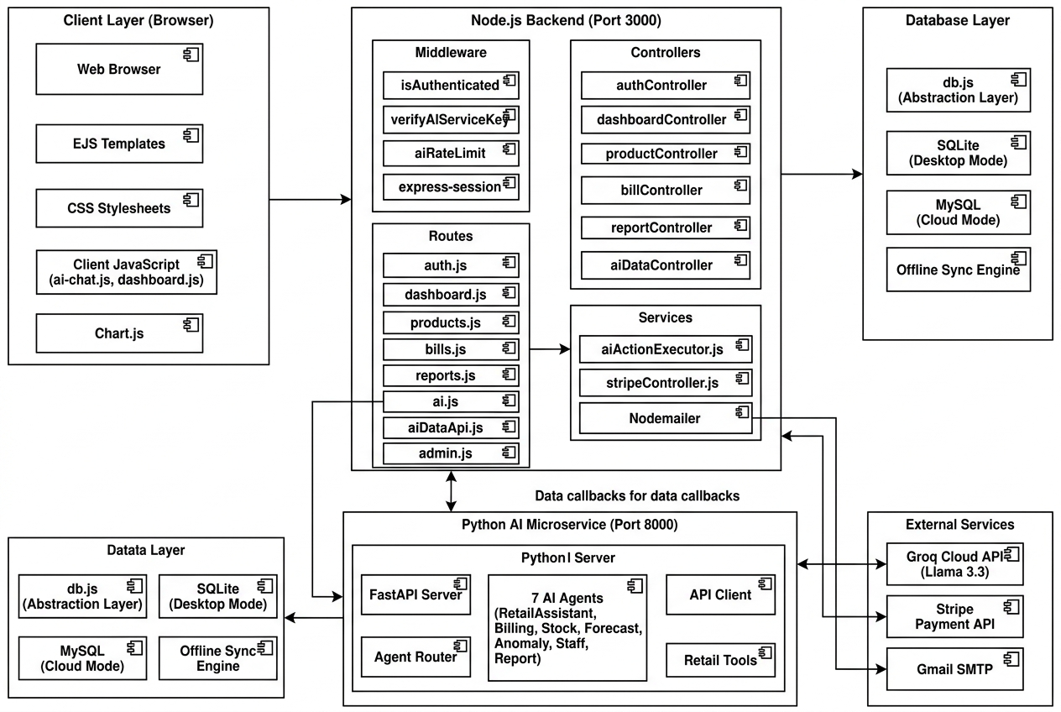
Methodology – Component Diagram

Slide 27
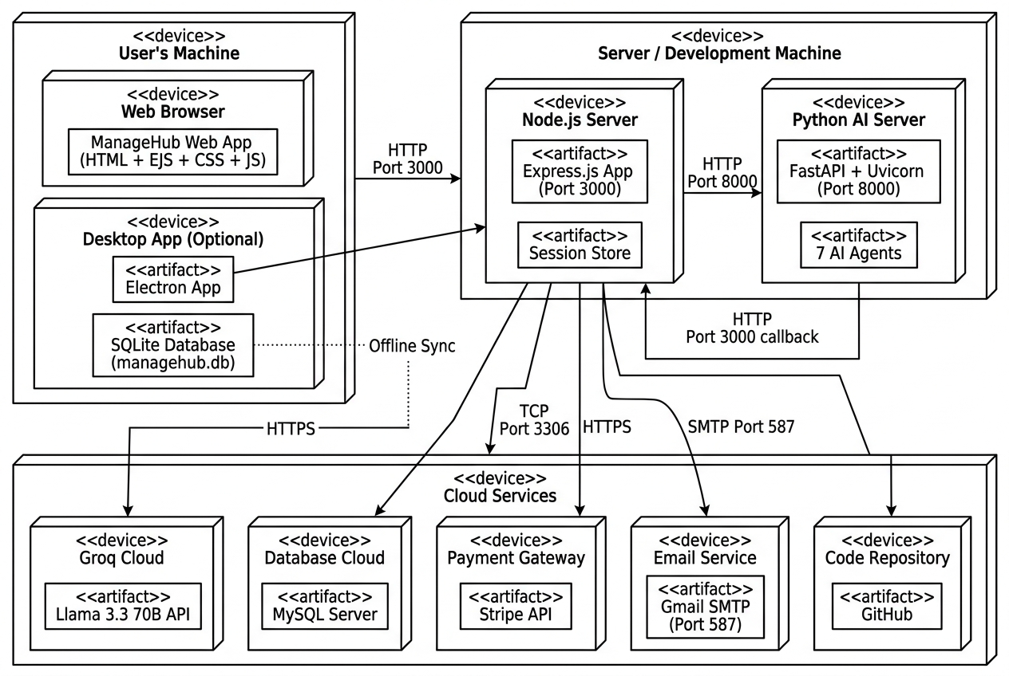
Methodology – Deployment Diagram

Slide 28
Results – Login, Registration & Dashboard
Authentication System
Secure login with session-based authentication
Shop registration with Stripe payment integration
Forgot/Reset password via email OTP
Smart Dashboard
Real-time KPIs: Total Products, Employees, Today's Sales, Low Stock
Interactive sales graph (Chart.js) with daily/weekly/monthly views
Recent sales feed and low stock alerts
AI-powered business suggestions
[INSERT: Screenshots of Login Page and Dashboard]

Slide 29
Results – Product Management & Billing
Product & Inventory Management
Full CRUD operations with barcode/SKU support
Batch stock-in with supplier tracking and purchase prices
Stock ledger, low stock alerts, and inventory reports
Point of Sale (POS)
Create bills, add/remove items, apply discounts
Multiple payment methods (Cash, Card, Credit)
Receipt printing and bill history
AI-powered voice billing through chat
[INSERT: Screenshots of Products Page and POS Page]

Slide 30
Results – Customer, Supplier & Employee Mgmt
Customer Management
Customer profiles with purchase history and credit limits
Supplier Management
Supplier profiles with debit/credit financial ledger
Employee Management & Payroll
Employee CRUD with role-based access control
Salary processing with bonuses and fines
Employee loan management with installment tracking
Cash submission and verification system
[INSERT: Screenshots of Customer, Supplier, and Employee pages]

Slide 31
Results – AI Conversational Assistant
Natural Language Chat Interface
Users can ask questions like: 'What are today's sales?'
Voice billing: 'Add 2 packets of sugar to the bill'
Staff queries: 'Show me revenue generated by each cashier'
Formatted Markdown responses with bold text, tables, and lists
AI-Powered Analytics
Sales forecasting with trend analysis
Anomaly detection for suspicious transactions
Automated executive report narration
Smart stock reorder recommendations
[INSERT: Screenshots of AI Chat Widget with sample conversations]

Slide 32
Results – Admin Panel & Reports
Platform Admin Panel
Manage all shops, users, subscription plans
Roles & permissions management
Platform-wide feedback management
Comprehensive Reporting
Daily/Weekly sales reports with bill details
Expense reports by category
Supplier payment reports
User sales and product sales reports
Export as PDF and Excel
[INSERT: Screenshots of Admin Panel and Reports pages]

Slide 33
Workload Distribution
Team Member Responsibilities
[Student 1 Name]
Dashboard, Product Management, Inventory, Stock Alerts, Shop Settings, Database Design
[Student 2 Name]
Billing/POS, Customer Management, Supplier Management, Cash Register, Reports & Export
[Student 3 Name]
AI Multi-Agent Architecture, Agent Router, All 7 AI Agents, Python FastAPI, Groq LLM Integration
[Student 4 Name]
Authentication, Employee Management, Payroll/Loans, Admin Panel, Stripe, Electron, Offline Sync

Slide 34
Gantt Chart – Project Timeline
Phase 1: Planning (Weeks 1-8)
Requirements gathering, Literature review, System design
Phase 2: Database & Auth (Weeks 9-12)
Database schema design, Authentication system, RBAC
Phase 3: Core Modules (Weeks 13-20)
Products, Billing, Customers, Suppliers, Employees
Phase 4: Advanced Modules (Weeks 21-24)
Reports, Expenses, Cash Register, Raw Materials, Payroll
Phase 5: AI Integration (Weeks 25-32)
Python AI microservice, 7 Agents, Agent Router, Tool System
Phase 6: Desktop, SaaS & Testing (Weeks 33-40)
Electron app, SQLite, Sync, Stripe, Admin Panel, Testing

Slide 35
References
[1] J. S. Park et al., 'Generative Agents: Interactive Simulacra of Human Behavior,' ACM UIST, 2023.
[2] N. Rajkumar et al., 'Evaluating Text-to-SQL Capabilities of LLMs,' arXiv:2204.00498, 2022.
[3] L. Nicola et al., 'Mobile Database Synchronization Strategies,' J. Systems & Software, 2021.
[4] A. Vaswani et al., 'Attention Is All You Need,' NeurIPS, vol. 30, 2017.
[5] Meta AI, 'Llama 3: Open Foundation and Fine-Tuned LLMs,' Meta AI Research, 2024.
[6] S. Yao et al., 'ReAct: Synergizing Reasoning and Acting in LMs,' ICLR, 2023.
[7] Express.js Documentation, https://expressjs.com/
[8] FastAPI Documentation, https://fastapi.tiangolo.com/
[9] Groq API Documentation, https://console.groq.com/docs
[10] Electron.js Documentation, https://www.electronjs.org/docs

