Slide 1
BLOCKCHAIN ENABLES CROSS-BORDER REMITTANCE SYSTEM
Project Supervisor Prof. Dr. Abdullah Lakhan
Project Expert Sir Arz Muhammad
Group members Muhammad Haseeb Nawaz (585) Izan Maqbool (563) Muhammad Jabran Ayub (589)
Batch 9th BSCS
Section “A”

Slide 2
Cross-Border Remittance System Using BLOCKCHIAN
Stack Divisions
Web-Mobile Application
Blockchain
Backend
Frontend

Slide 3
Web-Mobile Application
A fully functioned web-mobile application
Tech Stack
Python Flask is an open-source UI framework created by Armin Ronacher. Flask is based on WSGI(Web Server Gateway Interface) toolkit and Jinja2 template engine. It is a small and lightweight Python web framework that provides useful tools and features that make creating web applications in Python easier. It gives developers flexibility and is a more accessible framework for new developers since you can build a web application quickly using only a single Python file

Slide 4
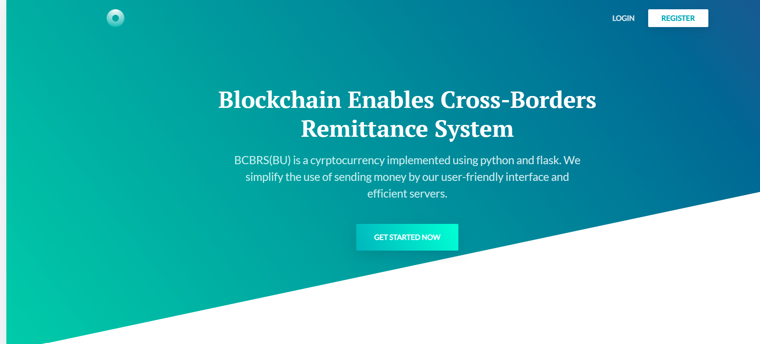
Web Screens:
Welcome Page

Slide 5
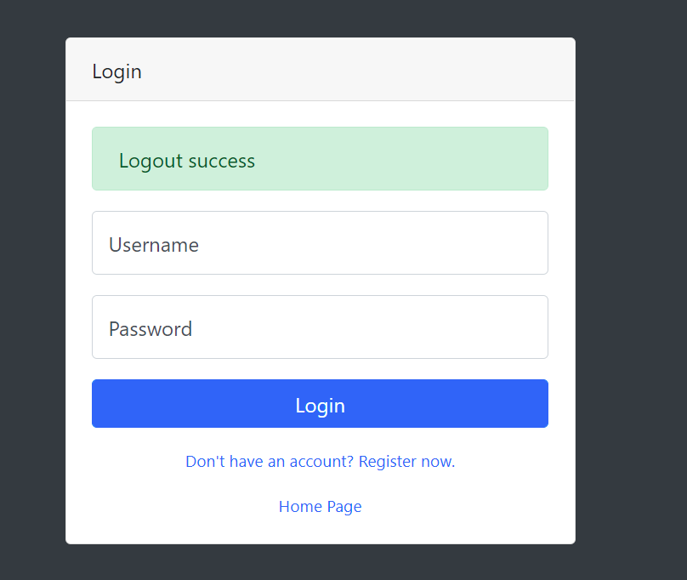
Login Screen

Slide 6
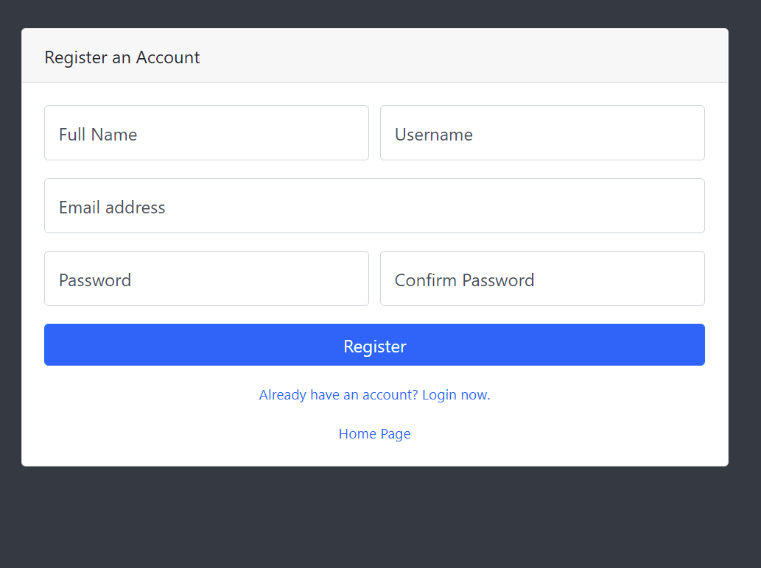
Register Screen

Slide 7
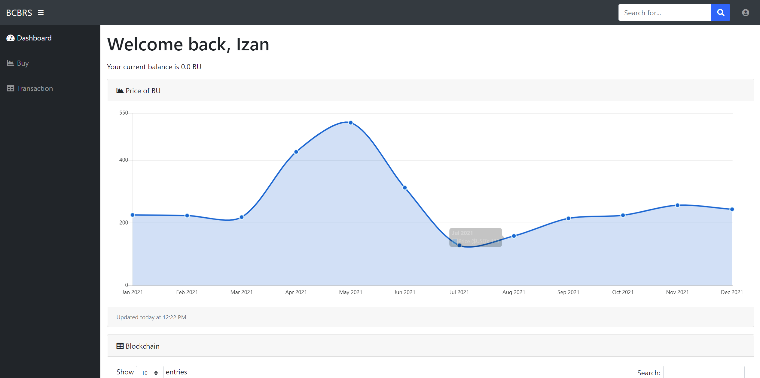
Dashboard Screen

Slide 8
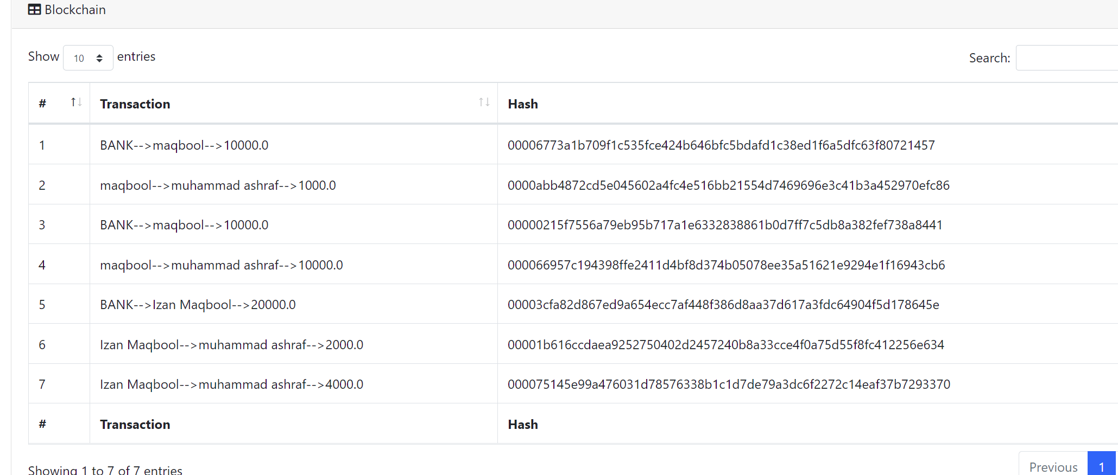
Dashboard Screen
Transaction History

Slide 9

Flask
Flask is a web framework. This means flask provides you with tools, libraries and technologies that allow you to build a web application. This web application can be some web pages, a blog, a wiki or go as big as a web-based calendar application or a commercial website.

Slide 10
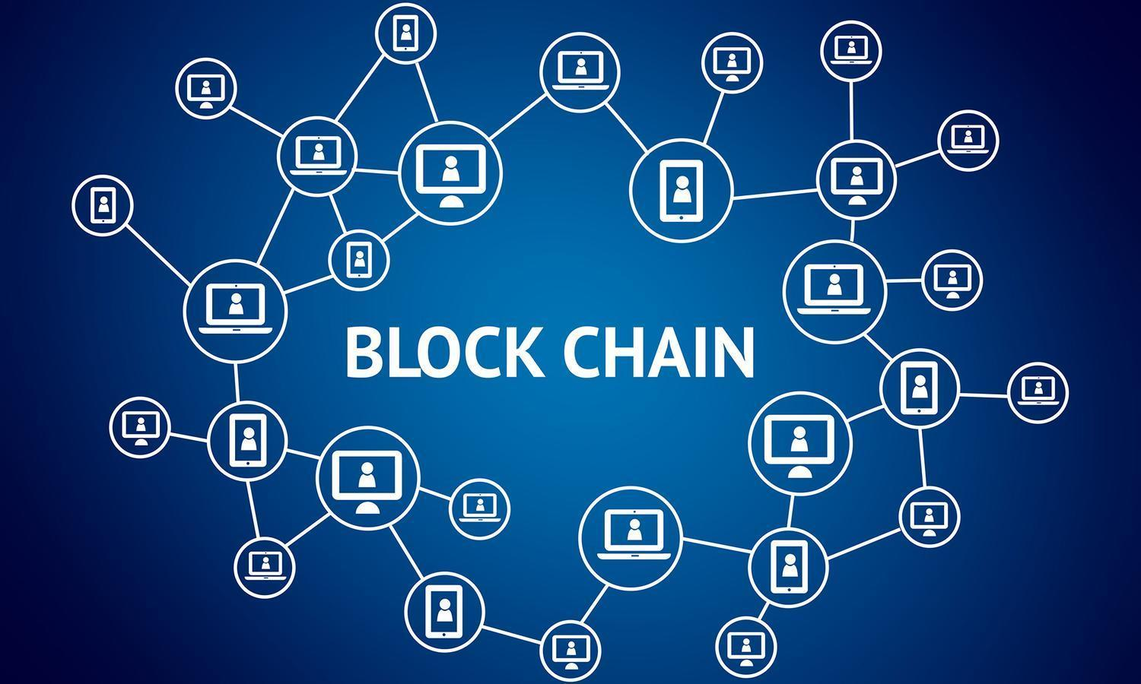
Blockchain
Blockchain is a system of recording information in a way that makes it difficult or impossible to change, hack, or cheat the system. A blockchain is essentially a digital ledger of transactions that is duplicated and distributed across the entire network of computer systems on the blockchain.

Slide 11
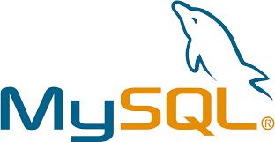
MySQL Databse
MySQL is a popular, free-to-use, and open-source relational database management system (RDBMS) developed by Oracle. As with other relational systems, MySQL stores data using tables and rows, enforces referential integrity and uses structured query language (SQL) for data access.

Slide 12
Thank you!

