Slide 1
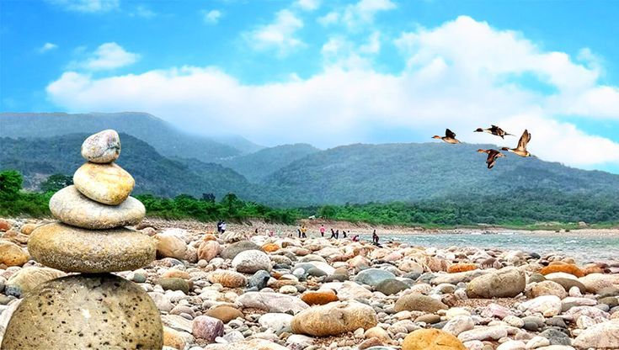
Shadapathor
Sadapathor, a region in Sythet, Bangladesh, known for its natural beauty, stone collection, and serene river landscapes, attracting tourists and nature enthusiasts alike.
S

Slide 2
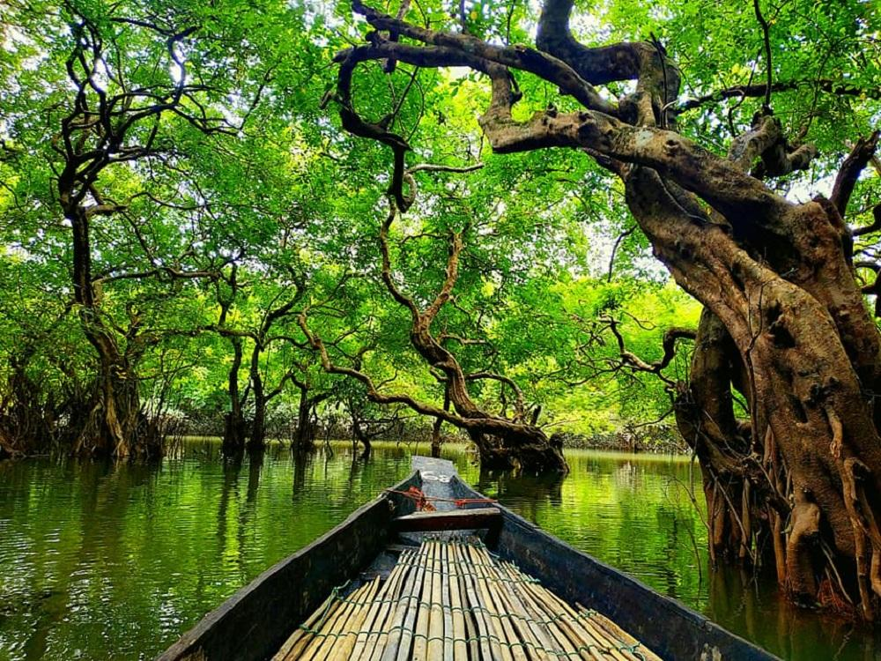
Ratargul
Ratargul, often called the "Amazon of Bangladesh," is a stunning freshwater swamp forest in Sylhet, Bangladesh, renowned for its unique biodiversity and serene natural beauty.
R

Slide 3
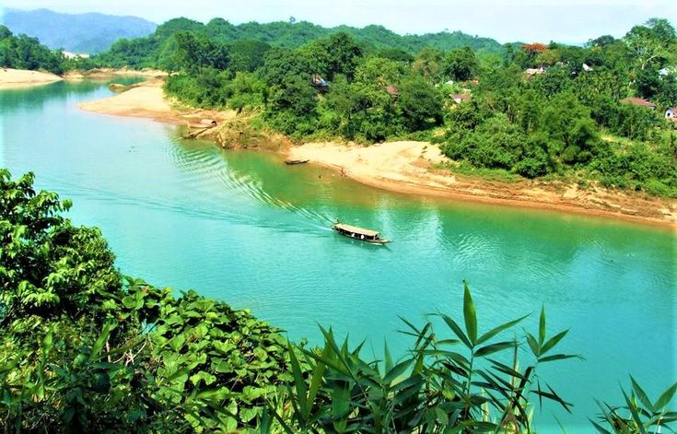
Lalakhal
Lalakhal, located in Sylhet, Bangladesh, is renowned for its mesmerizing blue-green waters and lush surroundings, making it a popular destination for nature lovers and travelers.
L

Slide 4
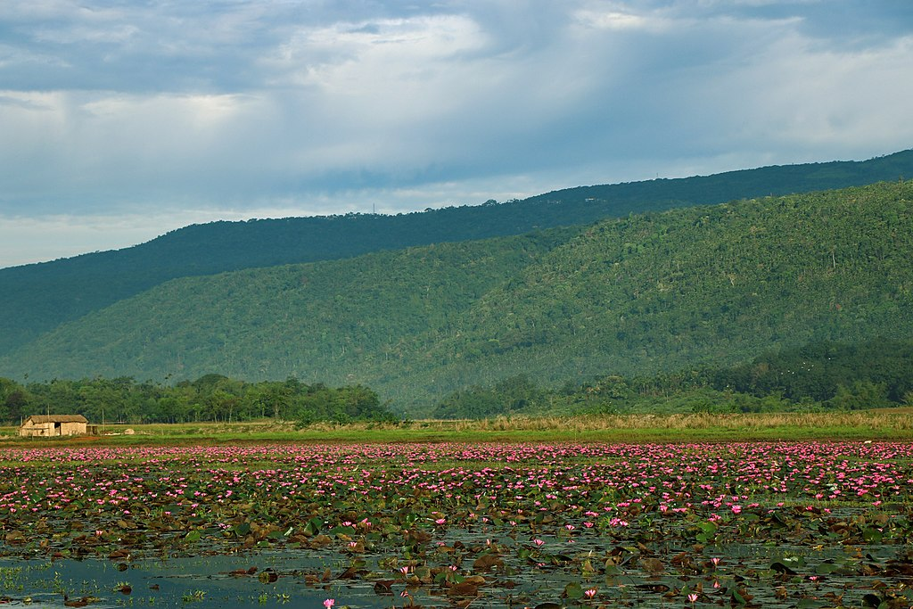
Dibir Haor
Dibir Haor, located in Sylhet, Bangladesh, is a serene wetland known for its rich biodiversity, scenic beauty, and vital role in local fisheries and agriculture.
D

Slide 5
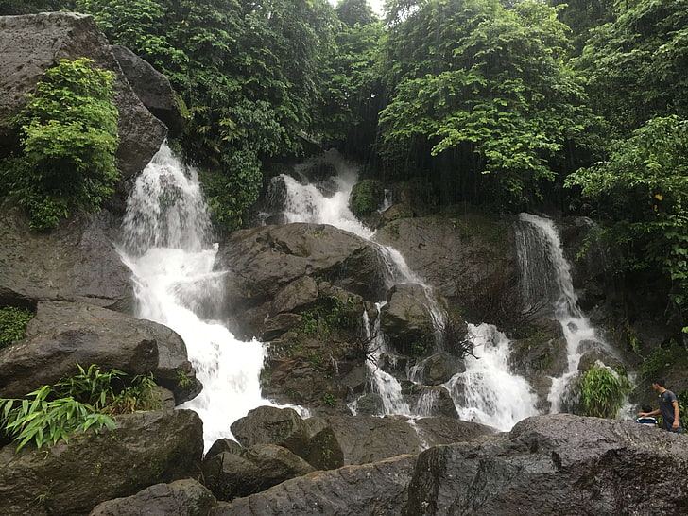
Zaflong
Zaflong, known for its scenic landscapes and tea gardens, is a popular tourist destination in Bangladesh, while Mayabi Jharna, a hidden waterfall in the area, adds to its allure with its serene beauty and tranquil surroundings.
Z

