Slide 1

Fast File Search Tool
Subtitle: High-Performance Information Retrieval for Desktop Systems

Slide 2
Project Name
Subject
Fast File Search Tool
Information Retrieval & Text Mining
Team
Tagline
Ebad Junaid(BSCS22046), Muhammad Shahzaib Hafeez(BSCS22104), Afaq Buzdaar(BSCS22080), Muhammad Yasir Zahid(BSCS22102)
"Bringing Search Engine speeds to the Desktop File System."

Slide 3



The Problem Statement
The Issue:
Slow Native Search
Blocking Operations
Lack of Control
Standard OS tools (Windows Explorer, macOS Spotlight) can be sluggish or resource-heavy when scanning large directories.
Most simple scripts use Linear Search ($O(N)$), scanning files one by one. This causes the "Application Not Responding" freeze on large datasets.
Existing tools are often closed-source or platform-specific (e.g., "Everything" is Windows-only).
The Goal:
Build a cross-platform tool that indexes 100,000+ files instantly and allows for real-time, non-blocking search.

Slide 4
Project Objectives
1
2
3
Performance
Technique
User Experience (UX)
Index 100,000+ files in under 7 seconds.
Apply Information Retrieval (IR) concepts (Inverted Indexing) to file systems, moving away from brute-force scanning.
"Search-as-you-type" functionality.
Return search results in < 100 milliseconds (Real-time).
Hybrid View: Native File Browser + Instant Search List.
Zero UI freezing during heavy indexing.

Slide 5

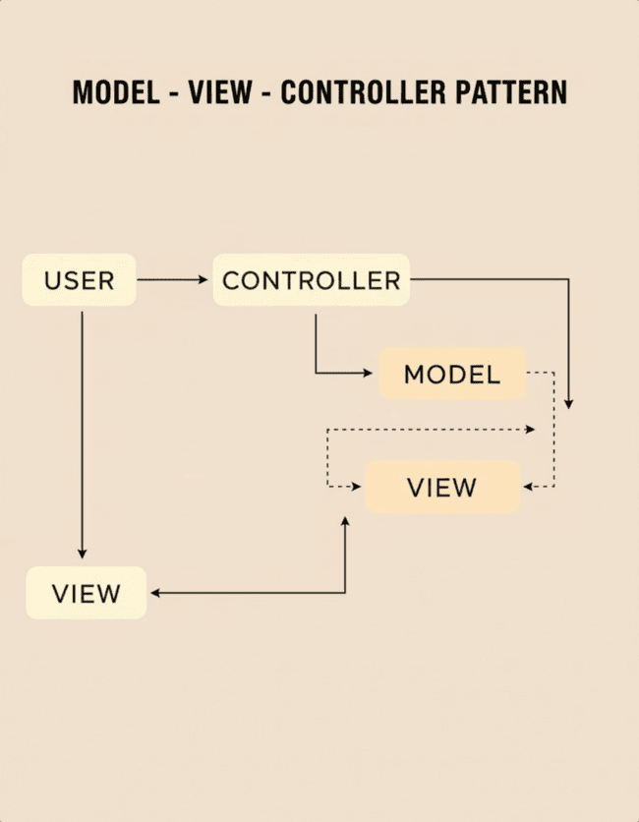
System Architecture (MVC Pattern)
Shutterstock
Model (The Brain)
View (The Face)
Stores the Inverted Index and File Metadata.
Built with PyQt6 for native rendering on macOS/Windows.
Handles the logic of os.walk and data structuring.
Displays the Folder Tree (Browser Mode) and Result List (Search Mode).
Controller (The Glue)
Connects user input to the backend logic.
Multithreading: Uses QThread to run the Indexer on a background thread, ensuring the Main UI Thread remains responsive.

Slide 6


Core IR Concept — The Inverted Index
Definition:
A data structure that maps "terms" to the "documents" that contain them.
Why we use it:
Linear Search
Inverted Index
$O(N)$ complexity. You must open every drawer to find a sock.
$O(1)$ complexity. You look at a manifest that tells you exactly which drawer the sock is in.
Implementation:
We use a Python Dictionary (HashMap) where:
Key: A specific Trigram (e.g., dat).
Value: A "Postings List" of Document IDs (e.g., {1, 5, 20}).

Slide 7
Core IR Concept — N-Gram Tokenization
The Challenge:
Users rarely type full filenames. They type substrings (e.g., "port" for "Report").
The Solution:
We use Trigrams (3-Grams).
Process:
Input: report.pdf
Normalization: Convert to lowercase $\rightarrow$ report.pdf
Tokenization: Break into 3-char overlapping shingles:
rep, epo, por, ort, rt., t.p, .pd, pdf
Benefit:
This allows us to match partial queries instantly without scanning the whole string.

Slide 8
Core IR Concept — Boolean Retrieval Model
Logic:
Our search engine uses Conjunctive Queries (The AND operator).
Scenario:
User searches for data.
Step 1: Decompose query into trigrams $\rightarrow$ dat, ata.
Step 2: Retrieve Postings Lists:
dat $\rightarrow$ {Doc 1, Doc 5, Doc 99}
ata $\rightarrow$ {Doc 5, Doc 20}
Step 3: Perform Set Intersection:
$\{1, 5, 99\} \cap \{5, 20\} = \{5\}$
Result:
Only Document 5 matches both parts of the query.

Slide 9
Core IR Concept — Ranking & Verification
False Positive Elimination:
Trigrams are probabilistic. banana and bandana share many trigrams.
Verification Step: After the index retrieval, we perform a quick exact substring check to ensure 100% precision.
Ranking Strategy:
Exact Match: Files matching the query exactly appear at the top.
Length Normalization: Shorter filenames appear higher (assuming less noise).
Alphabetical: Tie-breaker sorting.

Slide 10
The Workflow (Crawler to Search)
01
02
03
Crawling
Indexing
Searching
The IndexerWorker traverses the directory tree using os.walk.
Assigns a unique DocID to every file.
User input triggers the search_index function.
Generates Trigrams and populates the Inverted Index in memory.
Collects metadata: Path, Size, Date, Extension.
Retrieves candidate IDs via Set Intersection.
UI updates the Result List.

Slide 11
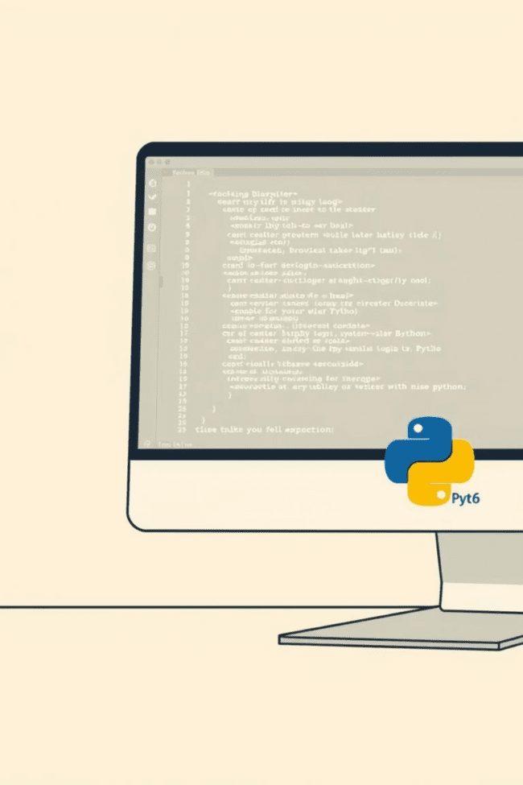
Fast File Search Tool
Technical Stack
Language: Python 3.11+
GUI Framework: PyQt6
Selected over Tkinter to solve macOS Dark Mode issues and support complex widgets like QTreeView.
Data Structures:
defaultdict(set): For the Inverted Index (handling sparse data efficiently).
Counter: For calculating file extension frequencies.
OS Integration:
subprocess: To handle "Reveal in Finder/Explorer" commands natively.

Slide 12
User Experience (UX) Features
Hybrid View Architecture:
Smart Filtering:
Context Menus:
The "File Type" dropdown isn't just alphabetical; it sorts extensions by Frequency (e.g., if you have mostly PDFs, .pdf appears at the top).
Right-click support to "Copy Path" or "Reveal File".
Browser Mode: When idle, the app acts as a native File Explorer with a full folder tree structure.
Search Mode: As soon as typing begins, the view swaps to a flat, prioritized list of search results.

Slide 13
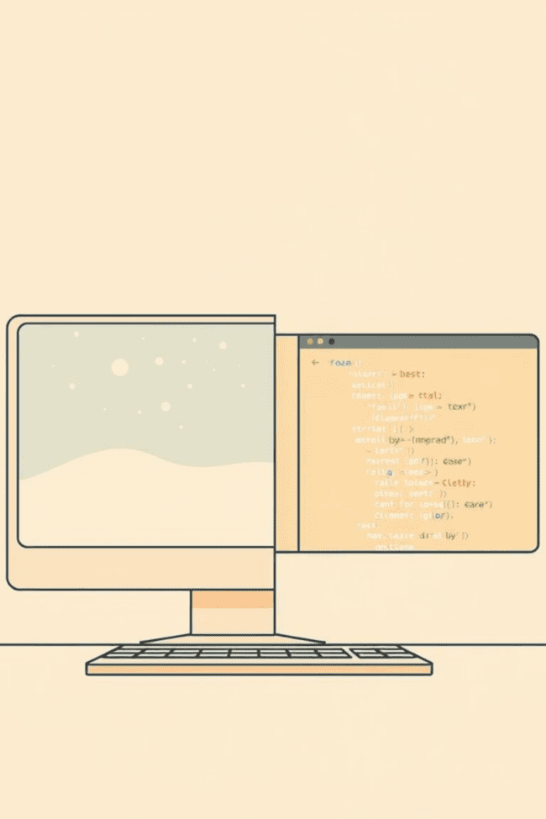
Challenges & Solutions
Challenge 1: The "Frozen UI"
Challenge 2: macOS Dark Mode
Issue: Indexing large folders blocked the main application loop.
Issue: Standard UI libraries rendered invisible text on dark backgrounds.
Solution: Implemented Multithreading. The Indexer runs on a separate worker thread and communicates progress via Signals.
Solution: Migrated to PyQt6, which respects system themes and provides native rendering.
Challenge 3: "Blank Start" State
Issue: The app looked broken when launched without a folder selected.
Solution: Added a "Clean Start" state with clear instructions and a placeholder view.

Slide 14
Live Demo Checklist
(Speaker notes for the live demonstration)
01
02
Launch:
Select Folder:
Show the clean startup screen.
Pick the large "Dataset" folder.
03
04
Browser Mode:
Indexing:
Show navigating the folder tree like a normal Explorer.
Point out the progress bar working in the background.
05
06
Search:
Context Menu:
Type a query (e.g., "rep") and show the instant switch to the Result List.
Right-click a file and choose "Reveal in Finder".

Slide 15

Future Enhancements
Content Indexing: Extend the crawler to read the inside of PDF/TXT files using libraries like PyPDF2.
Persistent Storage: Save the Inverted Index to disk (JSON/Pickle) so the user doesn't have to re-index on every launch.
File Watching: Use watchdog observers to update the index automatically when files are created or deleted.

Slide 16
Conclusion
We successfully built a High-Performance, IR-Based search tool.
We moved beyond simple scripting to a robust MVC Architecture.
We solved real-world usability problems (Freezing, Cross-Platform UI) while maintaining the theoretical rigor of Boolean Retrieval and Inverted Indexing.

Slide 17
Resources
Github link [ https://github.com/EbadJunaid/Fast-file-search-tool ]
Recording link [ https://drive.google.com/drive/folders/1TwvQ0oXWFnkvZXPAOkPVbjp8jbGAwLgu?usp=drive_link ]

