Slide 1
Normalization

Slide 2
The process to eliminate data redundancy and enhance data integrity in the table
Helps to organize the data in the database
A multi-step process that sets the data into tabular form and removes the duplicated data from the relational tables
A systematic technique of decomposing tables to eliminate data redundancy (repetition) and undesirable characteristics like Insertion, Update, and Deletion anomalies

Slide 3
1st Normal Form
A table is in 1NF if atomicity of the table is 1
Atomicity? a single cell cannot hold multiple values. It must hold only a single-valued attribute.
Doesn’t allow: multi-valued attribute, composite attribute, and their combinations.

Slide 4
Patron ID | Borrowed books
C45 | B33, B44, B55
C12 | B56
Flight | Weekdays
UA59 | Mo We Fr
UA73 | Mo Tu We Th Fr

Slide 5
2nd Normal Form – 2NF
To be in 2NF form a table must
Be in First Normal Form
Not possess partial dependency
Partial Dependency? Proper subset of candidate key should give a non-prime attribute

Slide 6
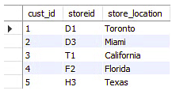
We have a composite primary key here
cust_id + storied
Non-primary attribute is store_location
Does store location depend on whole primary key?
As store_location depends only on storied, the table doesn’t fulfil 2NF
How to solve? Split the table into two parts/tables.

Slide 7
Third Normal Form - 3NF
A table must first be in 2NF
There must be no transitive dependency for non-prime attributes
Non-prime attributes should not depend on other non-prime attributes
If there are three attributes A,B & C.
If A->B and B->C, then A->C indirectly
Ensures reduction in Data Duplication and improves integrity

Slide 8

Is there any transitive dependency here?

Slide 9
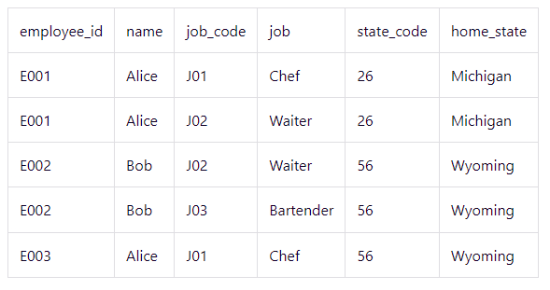
Which Normal Form the table is in?
How a record in this table be uniquely identified?

Slide 10
All attributes are atomic, so the table fulfills the conditions of 1NF
Job depends on job_code (partial primary key attribute), so it is not in 2NF
Also → Name, state and state_code depend on employee_id
Restructure the table to fulfill 2NF

Slide 11
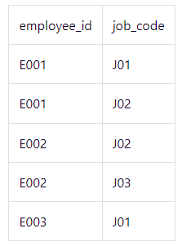
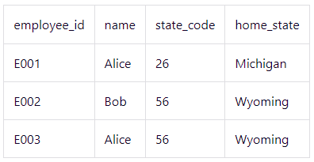
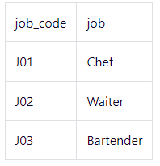
Removed partial dependencies here
Any transitive dependencies??

Slide 12
Reviewing the purpose
Removes duplicates?
Organize data in consistent way?
Avoid Anomalies?

Slide 13
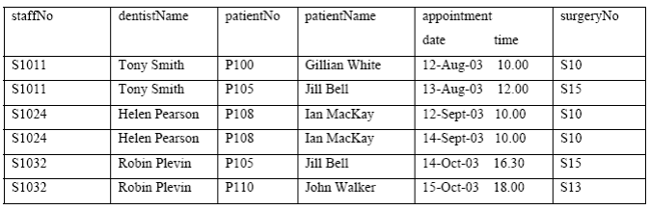
Diving in further
Is this table susceptible to update anomalies?
Can you provide examples of insertion, deletion and modification anomalies?

Slide 14
Inserting a new patient record who hasn’t been assigned a dentist?
Deleting a dentist. E.g. Tony Smith?

Slide 15
How to normalize this table to 3NF?
Note down any assumptions that you make to normalize

Slide 16
Assumptions made include that
a patient is registered at only one surgery and
he/she may have more than one appointment on a given day. All the schedules have been fixed for the whole days and week

Slide 17
1NF | staff_no | Dentist_name | Patient_no | PatientName | Appointment Date | Appointment Time | Surgery no.
2NF |  |  | Staff_no. | Appointment Date | Appointment Time | Patient_no | PatientName
 |  |  | Staff_no. | Dentist name
 |  |  | Staff_no | Appointment Date | Surgery no.
3NF |  |  | Staff_no. | Appointment Date | Appointment Time | Patient_no
 |  |  | Patient_no | PatientName
 |  |  | Staff_no. | Dentist name
 |  |  | Staff_no | Appointment Date | Surgery no.

