Slide 1
Robotics competitions are designed to demystify IoT, embedded systems, and robotics by offering hands-on, accessible learning.
Students gain practical skills like microcontroller programming (e.g., Arduino Nano), sensor integration (analog/digital inputs), and communication protocols (UART, I2C, SPI).
For instance, a Bluetooth-controlled car project teaches UART communication (via HC-05 modules), motor control (using L298N drivers), and power management (12V batteries with voltage regulation).
These competitions bridge classroom theory with real-world applications, preparing learners for industrial tools like CAN bus or IoT gateways.
Why Robotics Competitions?

Slide 2
Beyond building bots, competitions foster problem-solving and collaboration. A student’s Bluetooth car project evolves into expertise with industrial-grade tools (STM32, RTOS) or IoT protocols (MQTT, TLS). By simulating real-world challenges—power management, edge computing—these events cultivate engineers ready to tackle automation, smart grids, or robotics. Communities born from such initiatives drive innovation, proving that today’s hobbyists are tomorrow’s pioneers in tech-driven industries.
Impact & Industry Connection

Slide 3
Arduino Nano Deep Dive
Comprehensive Technical Overview

Slide 4
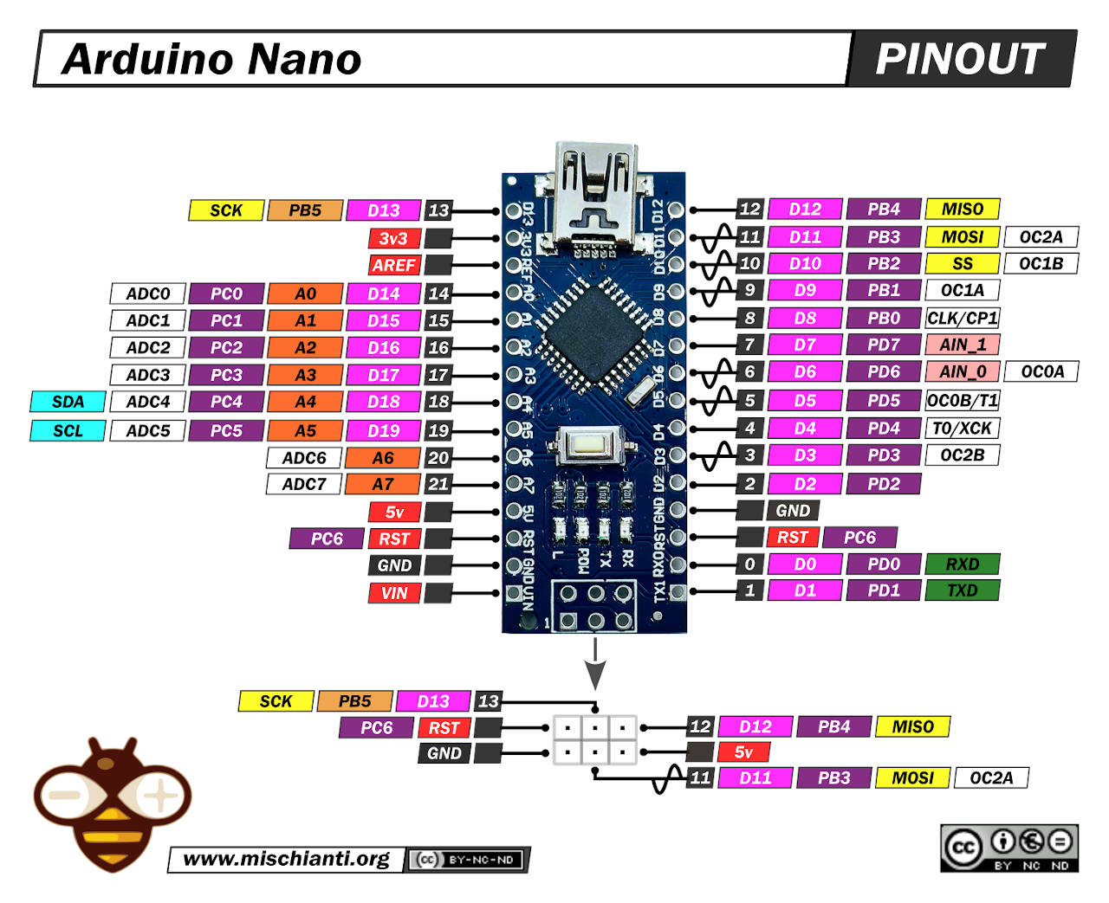
1. Arduino Nano Overview
Key Features: • 18.5 × 43mm compact size • CH340G/FT232RL USB interface • 14 digital I/O (6 PWM) • 8 analog inputs (10-bit ADC) • 32KB flash, 2KB SRAM, 1KB EEPROM

Slide 5
2. Technical Specifications
Microcontroller | ATmega328P (8-bit AVR RISC)
Clock Speed | 16 MHz
Operating Voltage | 5V regulated
Digital I/O | 14 (6 PWM)
Analog Inputs | 8 channels (10-bit ADC)
Flash Memory | 32KB (0.5KB bootloader)

Slide 6
3. ATmega328P Architecture
Core Features: • Harvard architecture • 32 x 8-bit registers • 0.2 mA/MHz power draw Critical Peripherals: • 10-bit ADC (8 channels) • 3 timers (PWM generation) • Watchdog timer + BOD

Slide 7
5. Communication Interfaces
UART (Serial): • Pins: TX(D1), RX(D0) • 115200 baud typical SPI: • Full-duplex @ 8MHz • Pins: MOSI(11), MISO(12) I²C: • 400kHz max speed • Pins: SDA(A4), SCL(A5)

Slide 8
4. Memory Hierarchy
Type | Size | Volatile? | Purpose
Flash | 32KB | No | Program storage
SRAM | 2KB | Yes | Runtime variables
EEPROM | 1KB | No | Persistent data

Slide 9
7. Programming Process
1. IDE compiles to .hex 2. CH340G converts USB→UART 3. Bootloader writes to flash 4. Code executes on reset

Slide 10
12. Board Comparison
Feature | Nano | Uno | ESP32
MCU | ATmega328P | ATmega328P | Dual-core 32-bit
Wi-Fi/BT | No | No | Yes
Analog Inputs | 8 (10-bit) | 6 (10-bit) | 18 (12-bit)

Slide 11
14. Key Takeaways
✓ All-in-one 8-bit MCU solution ✓ Ideal for education & prototyping ✓ Requires external modules for IoT ✓ Cost-effective at $3–$10 ✓ Community-driven ecosystem

Slide 12
Core Technologies:
Theia Framework: Provides a modular and extensible architecture, enabling customization and a rich set of features for the IDE.
Backend Operations:
Arduino CLI: Manages backend tasks like compilation and uploading, allowing the IDE's user interface to remain responsive.
Development Tools and Dependencies:
Node.js: Specifies a version range of >=18.17.0 <21, ensuring compatibility with modern JavaScript features.
TypeScript: Enhances code quality and maintainability through type-safe development.
ESLint and Prettier: Maintain code quality and consistency by enforcing coding standards and improving readability.
Yarn: Provides fast and reliable dependency management.
Electron Framework: Combines Chromium and Node.js to create cross-platform desktop applications, ensuring consistent performance across Windows, macOS, and Linux.
Arduino IDE 2.x: Modern Technologies

Slide 13

Nano–PC Communication Protocols
USB Protocol (CDC):
Enumerates the ESP32 as a USB device.
Presents a virtual COM port on the PC.
Handles device descriptors and packet transfers.
UART Protocol:
Transmits data asynchronously using start/stop bits.
Operates at a predefined baud rate.
Bridges the USB CDC layer with the ESP32’s serial interface.
This layered approach allows seamless programming, debugging, and serial data exchange between the ESP32 and a computer.

Slide 14
USB 2.0 & CH340: Bridging USB to UART
USB 2.0 Connection:
Implements standard USB protocols for high-speed, reliable data exchange.
Enables plug-and-play device recognition on a PC.
CH340 USB-to-UART Bridge:
Converts USB signals into TTL-level serial (UART) data.
Typical pinout includes VCC, GND, TXD, RXD, and often control lines (DTR/RTS) for auto-reset.
Creates a virtual COM port for programming and serial debugging.
Differentiating UART & SPI:
UART: Asynchronous serial communication with start/stop framing.
SPI: Synchronous protocol (MOSI, MISO, SCK, CS) used for high-speed peripheral interfacing.
This setup lets the PC communicate seamlessly with the ESP32 via a simple serial interface.

Slide 15
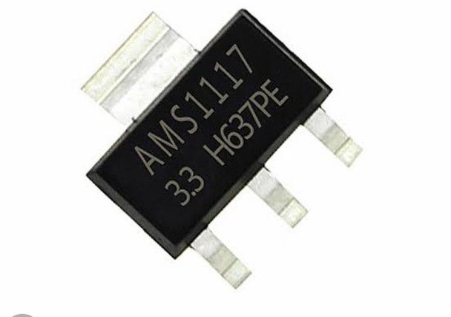
AMS1117 Voltage Regulator
Low Dropout Regulator: • Provides a fixed 5V output with a typical dropout voltage of ~1.3V.
Input Voltage Requirements: • Minimum input of about 6.5–7V to ensure stable regulation. • Maximum input can be up to 15V (thermal limits apply).
Usage Note: • Commonly used on ESP32 boards to supply regulated 5V from higher-voltage sources.

Slide 16
PWM: Simulating Analog Output
What is PWM? • Stands for Pulse Width Modulation—a digital technique to mimic analog behavior.
How It Works: • Rapidly toggles a digital pin on and off. • The duty cycle (percentage of “on” time) determines the average voltage.
Applications: • Controls LED brightness, motor speed, and other analog-like operations.
On ESP32: • Implemented via the LEDC peripheral for high-resolution control.
This technique allows digital outputs to simulate varying voltage levels without true analog hardware.

Slide 17
Bootloader Burning: Serial & Alternative Methods
Serial (Rx/Tx) Method: • Uses a USB-to-UART adapter (e.g. CH340/FT232) connected to RX/TX pins. • Leverages the pre-installed bootloader for sketch uploads or bootloader restoration.
ISP Programming: • Uses an In-System Programmer via the ICSP header. • Ideal for recovering or updating a corrupted bootloader.
Other Techniques: • JTAG for advanced debugging and programming. • OTA updates on supported boards for wireless bootloader flashing.
This overview highlights different approaches to burning or recovering a bootloader, ensuring flexibility in programming and troubleshooting.

