Slide 1
Tajweed AI Tutor
Capstone Topic
RAG-Based Tajweed Education and Audio Recitation Feedback

Slide 2
Problem & Proposed Solution
•
Students need clear, accessible explanations of Tajweed rules and examples.
•
Learning correct pronunciation often requires individual feedback from a teacher.
•
Our proposed Arabic-language application combines a trusted Tajweed knowledge base with assisted recitation analysis.

Slide 3
Main Features
•
Arabic chatbot answering Tajweed questions using RAG and cited educational sources.
•
Upload or record a recitation; receive feedback on selected possible errors.
•
Play verified Quranic recitation examples for comparison.
•
Interactive 2D Makharij al-Huruf illustration with clickable articulation points.

Slide 4
Proposed AI Architecture
•
Knowledge path: Tajweed textbooks → text chunks → multilingual embeddings → vector database → LLM answer with sources.
•
Audio path: selected ayah + student recording → Quranic phoneme recognition (Zipformer) → optional forced alignment (MFA).
•
Evaluation layer: compare recognized sounds and timings with expected recitation rules; explain suspected errors.
•
Application: Python + Streamlit prototype.

Slide 5
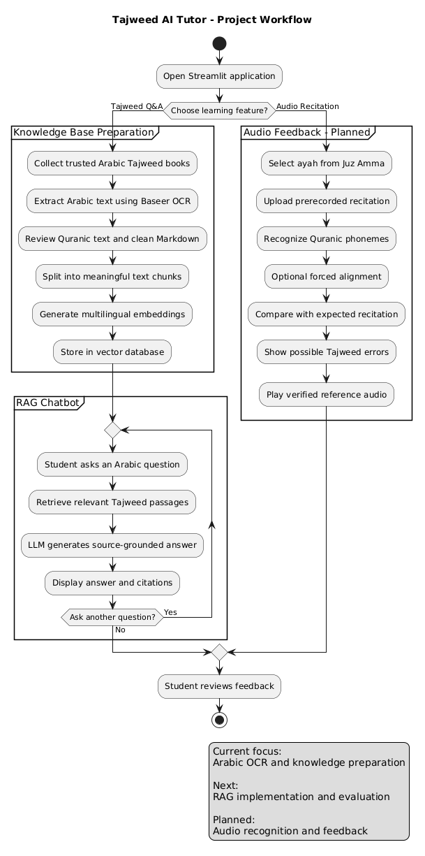
Project Workflow | UML Activity Diagram
How the proposed Tajweed AI Tutor works — two connected learning paths
01 TAJWEED Q&A
Ask Arabic questions, retrieve trusted passages, and continue the conversation.
02 AUDIO RECITATION
Upload a recording to receive possible Tajweed-error feedback and reference audio.
CURRENT PROJECT STAGE
Arabic OCR and knowledge preparation are underway. RAG and audio analysis remain planned.

Slide 6
Evaluation, Risks & Deliverable
•
Evaluate chatbot answers for correctness, citation quality, and relevance.
•
Test audio feedback on a small set of reviewed recordings; report errors and limitations.
•
Key risks: pretrained model access, phoneme mapping, and false-positive Tajweed corrections.
•
Deliverable: working Streamlit demo, sample results, and documentation; not a replacement for a qualified teacher.

Slide 7
Progress So Far
Early proof of feasibility — not a completed AI system
Completed / tested
Current work / next milestone
Defined two-part architecture: Arabic RAG + audio feedback.
Compared Arabic text extraction methods: PDF parsers, Tesseract, EasyOCR, Kraken and Gemini Vision.
Baseer produced promising Arabic OCR samples.
Extracting and verifying Arabic Tajweed textbook text.
Preparing clean UTF-8 Markdown with page references.
Next: embeddings, vector retrieval, LLM answers and citation checks.

Slide 8
The Data Challenge
Why Quranic Arabic OCR is harder than ordinary document extraction
What we encountered
How we adjusted
PDF text encoding produced corrupted Arabic.
Arabic diacritics and Quranic glyphs complicated recognition.
Footnotes, numbering and right-to-left layout sometimes broke reading order.
Benchmarked multiple OCR approaches on sample pages.
Selected Baseer as our current extraction approach.
Plan to manually verify Quranic quotations and retain page citations.

Slide 9
Next Steps
From verified source material to an evaluated educational assistant
01
Finish OCR
Verify Arabic text and Quranic quotations
02
Build RAG
Chunk → embed → retrieve → cited answer
03
Audio pilot
Short Juz Amma recordings; test phoneme feedback
04
Evaluate & demo
Review accuracy, limitations and Streamlit flow

