Slide 1
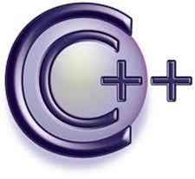
Object Oriented Programming
Nabeela Ashraf
Department of Computer Science
UAF, Faisalabad

Slide 2
C++ : Pointers
Memory Addresses
Declaration
Dereferencing a pointer
Pointers to pointer

Slide 3
Output 0x7fff5fbff8ac 0x7fff5fbff8a8 0x7fff5fbff8a4
#include <iostream> using namespace std; int main()
{
int var1 = 3;
int var2 = 15; int var3 = 29;
cout<<&var1<<endl;
cout<<&var2<<endl; cout<<&var3<<endl; return 0;
}
C++ : Pointers
Memory Addresses
A variable holds a value and that value is stored at a specific location in memory.
The memory assigned to a variable has a memory
address. That memory
address can be accessed
using ampersand &
operator.

Slide 4






C++ : Pointers
Pointer Variable
A pointer is a variable that stores the address of a memory cell.
A pointer is used to reference this memory cell.
int a = 100;
Variable a’s value 100 is stored at location 1024.
Memory Address: | 1020 | 1024 | 1032
… | … | 100 | … | 1024 | …
integer
pointer

Slide 5
C++ : Pointers
Pointer Variable Declaration
A pointer variable must be declared before it can be used. Some of the examples of pointer declarations are:
int *a; // int * a; // int* a; float *b; // float * b; // float* b; char *c; // char * c; // char* c;
An asterisk (*) before a variable tells the compiler that its a pointer variable.

Slide 6






C++ : Pointers
Pointer Variable
int a = 100;
int *p;
p = &a;
//integer variable a
//integer pointer variable p
/*assigning memory address of integer variable a to pointer variable p or simply its referencing*/
Variable a’s value 100 is stored at location 1024. And the address of a is stored in
pointer variable p at location 1032.
Memory Address: | 1020 | 1024 | 1032
… | … | 100 | … | 1024 | …
integer a
pointer p

Slide 7









C++ : Pointers
Pointer Variable
int a, b, *p;
a = 88;
b = 100;
p = &a;
Output: 88, 1020
1020, 1032
//get the value of a
//get the value of b
cout << a<< &a << endl;
cout << p<< &p << endl;
//prints the value and address of a
//prints the value and address of p
Memory Address: | 1020 | 1024 | 1032
… 88
integer a
100 … 1020 …
integer b pointer p

Slide 8
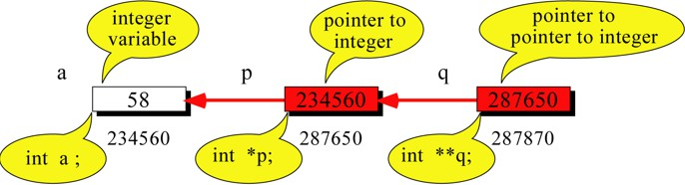

C++ : Pointers
Pointer to Pointer
int a = 58; int *p = &a; int **q = &p;
cout << a <<“ ”;
cout <<*p<<“ ”;
cout <<**q;
//integer variable a
//pointer to integer variable p
//pointer to pointer to integer variable q
Output: 58 58 58

Slide 9
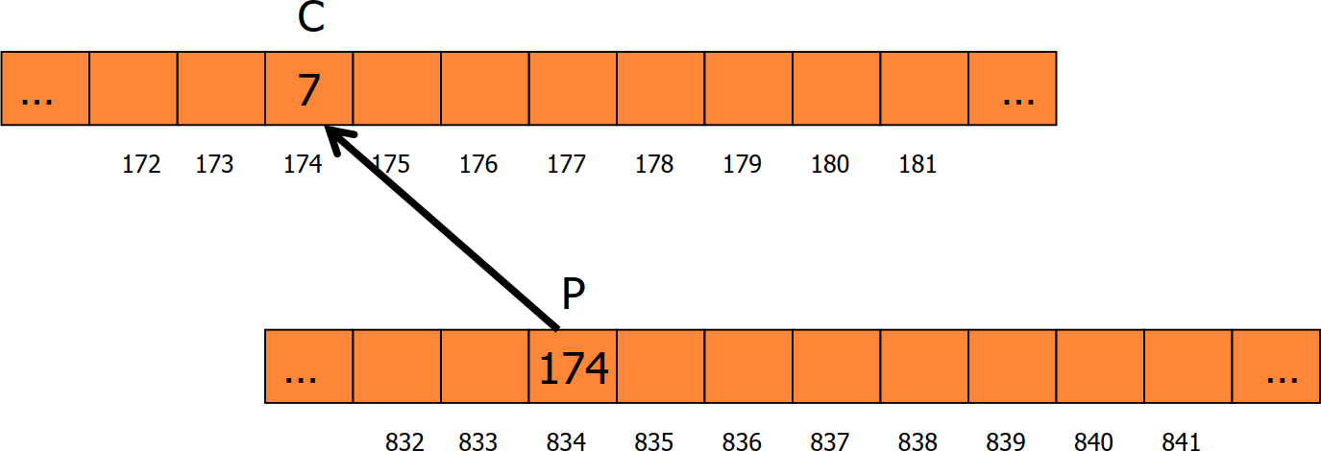
C++ : Pointers
Referencing (Reference Operator &)
Referencing means making a pointer point to a variable. int c=7;
int *p = &c; //referencing
OR
int c = 7; int *p;
p = &c;
//referencing

Slide 10
C++ : Pointers
Dereferencing (Dereference Operator *)
We can access to the value stored in a variable pointed to using the dereferencing operator.
The unary operator * is the dereferencing operator.
We may update the value of variable pointed by the pointer variable.

Slide 11
C++ : Pointers
Dereferencing (Dereference Operator *)
int a, b, *p;
Output: 88, 1020, 100
1020, 1032, 88
a = 88;
b = 100;
p = &a;
//get the value of a
//get the value of b
cout << a<< &a << b<< endl;
cout << p<< &p <<*p<< endl;
//prints the value and address of a and value of b
//prints the value and address of p and value of a
… 1020 …
integer b pointer p
Memory Address: | 1020 | 1024 | 1032
… 88 100
integer a

Slide 12
C++ : Pointers
Dereferencing (Don’t get confused)
Pointer declaration reflects only a pointer variable:
int *ptr;
Don’t mix dereferencing operator with pointer because in both we use asterisk (*). Both are different and not the same. Please see the example below:
int a = 100, b = 88, c = 8; int *p1 = &a, *p2, *p3 = &c;
p2 = &b;
p2 = p1; b = *p3;
// p2 points to b
// p2 points to a
//assign c to b
*p2 = *p3;//assign c to a cout << a << b << c;

Slide 13
C++ : Pointers
Pointer Example (Traditional)
void IndirectSwap(char *Ptr1, char *Ptr2){
char temp = *Ptr1;
*Ptr1 = *Ptr2;
*Ptr2 = temp;
}
int main() { char a = 'y'; char b = 'n';
IndirectSwap(&a, &b); cout << a << b << endl; return 0;
}

Slide 14
C++ : Pointers
Notable Points
The data is stored in memory at a specific memory location.
Each memory location has a unique address.
A pointer holds the memory address of a variable.
Asterisks (*) or Indirection Operator denotes we are accessing or storing the value in the address of the pointer.
Ampersand (&) denotes we are accessing or storing the memory address in the pointer.
If any pointer knows the address of any memory address . It can easily change its value (Virus Concept).

Slide 15
C++ : Pointers
Memory: Bits and Bytes
Memory is divided into bytes, each of which are further divided into bits.
Each bit can have a value of 0 or 1.
A byte is equal to 8 bits
Can hold any value from 0 to 255.
Memory of can be thought of as a sequence of bytes, numbered starting from 0.
 |  |  |  |  |  |  | ●●●
0 | 1 | 2 | 3 | 4 | 5 | 6

Slide 16
C++ : Pointers
ptr = NULL
1048
1044
1040
1036
1032
1028
1024
1020
Memory: Pointers and Allocation
After declaring a pointer int *ptr;
ptr doesn’t actually points to anything yet in the memory. So, its address is NULL.
We can either:
make it to something that already exists like: ptr = &c //let suppose int c=10;
or
allocate room in memory for something
new that it will point too…
1048
1044
1040
1036
1032
1028
1024
1020
10
ptr = 1036

Slide 17
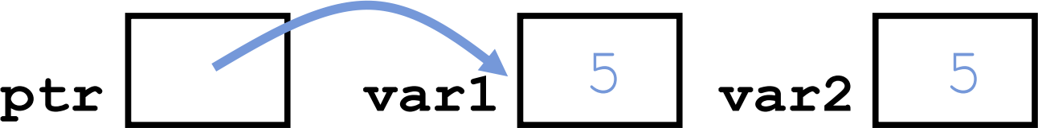
C++ : Pointers
Memory: Pointers and Allocation
Pointing to something that already exists:
int *ptr, var1, var2; var1 = 5;
ptr = &var1; var2 = *ptr;
var1 and var2 have room implicitly allocated to them.

Slide 18
C++ : Pointers
Memory: Pointers Dangers
Declaring a pointer just allocates space to hold the pointer – it does not allocate something to be pointed to!
Thus, the address is NULL.
What does the following code do?
We can’t store anything in the pointer (ptr) unless ptr contains some address.
void f ()
{
int *ptr;
*ptr = 5;
}

Slide 19
C++ : Pointers
Pointer Arithmetic
A pointer may be incremented or decremented (only address in the pointer is incremented or decremented).
An integer (can be constant) may be added to or subtracted from a pointer.
Pointer variables may subtracted from one another.
Pointer variables can be used in comparisons, but usually only in a comparison to pointer variables or NULL.

Slide 20
C++ : Pointers
Pointer Arithmetic
When an integer (n) is added to or subtracted from a pointer (ptr)
  The new pointer value (ptr) is changed by the ptr address plus (+) n multiple
(*) the bytes of ptr data data type.
  ptr + n * (bytes of pointer data type)
Example
int *ptr=1000;
ptr=ptr+2; //ptr address is now changed to 1000+2*4 = 1008 where 4 represents the bytes consumed by integer.

Slide 21
C++ : Pointers
Pointer Arithmetic
Examples double *ptr; ptr=1000;
ptr++; //ptr address is now changed to 1000+1*8 = 1008 where 8 represents the bytes consumed by double.
float *ptr; ptr=1000;
ptr+=3; //ptr address is now changed to 1000+3*4 = 1012 where 4 represents the bytes consumed by float.

Slide 22
C++ : Pointers
Pointer Arithmetic
Examples
int *ptr;
int num1=0; ptr = &num1;
ptr++; //ptr address is now changed to 1002+1*4 = 1004 where 4 represents the bytes consumed by integer.

Slide 23
C++ : Pointers
You can use a pointer not only to display a variable’s value, but also to perform any
operation you would perform on the variable directly
#include <iostream.h>
int main()
{
int var1, var2;
int* ptr;
ptr = &var1;
*ptr = 37;
var2 = *ptr;
cout << var2 << endl; return 0;
}
//two integer variables
//pointer to integers
//set pointer to address of var1
//same as var1=37
//same as var2=var1
//verify var2 is 37
Using the indirection operator to access the value stored in an address is called indirect addressing, or sometimes dereferencing, the pointer

Slide 24
C++ : Pointers
Pointer to Void: Void pointer
The address that is put in a pointer must be the same type as the pointer.
One can’t assign the address of a float variable to a pointer to int, for example:
float flovar = 98.6;
int* ptrint = &flovar; //ERROR: can’t assign float* to int*
There is a sort of general-purpose pointer that can point to any data type. This is called a pointer to void, and is defined like this:
void* ptr; //ptr can point to any data type
Such pointers have certain specialized uses, such as passing pointers to functions that operate independently of the data type pointed to.

Slide 25
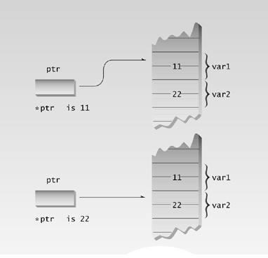
C++ : Pointers
Access via pointer

Slide 26
C++ : Pointers
Void Pointer (ptrvoid.cpp)
// pointers to type void #include <iostream.h> int main()
{
// ptrint = &flovar;
// ptrflo = &intvar; ptrflo = &flovar; ptrvoid = &intvar; ptrvoid = &flovar; return 0;
//error, float* to int*
//error, int* to float*
//ok, float* to float*
//ok, int* to void*
//ok, float* to void*
int intvar; float flovar; int* ptrint; float* ptrflo; void* ptrvoid;
ptrint = &intvar;
//integer variable
//float variable
//define pointer to int
//define pointer to float
//define pointer to void
//ok, int* to int*
}

Slide 27
C++ : Pointers
Pointers and Functions
Three ways to pass arguments to a function:
  by value,
  by reference,
  and by pointer
If the function is intended to modify variables in the calling program, then these variables cannot be passed by value, since the function obtains only a copy of the variable.
Either a reference argument or a pointer can be used in this situation.

Slide 28
C++ : Pointers
Pointers and Functions: Passing Simple Variables
// arguments passed by value
#include <iostream.h>
void swap(int, int); int main()
{
int var1, var2;
var1=10; var2 = 20; swap(var1, var2); return 0;
}
void swap(int x, int y)
{
int z = x;
x = y; y = z;
cout << x <<" "<< y <<endl;
}
//prototype
//swap the two numbers

Slide 29
C++ : Pointers
Pointers and Functions: Passing Reference Variables
// arguments passed by reference
#include <iostream.h>
void swap(int&, int&); int main()
{
int var1, var2;
var1=10; var2 = 20; swap(var1, var2);
cout << var1 <<“ ”<< var2 <<endl;
return 0;
}
void swap(int &x, int &y)
{
int z = x; x = y;
y = z;
}
//prototype
//swap the two numbers

Slide 30
C++ : Pointers
Pointers and Functions: Passing Reference Variables
// arguments passed by reference
#include <iostream.h>
void swap(int*, int*); int main()
{
int var1, var2;
var1=10; var2 = 20; swap(&var1, &var2);
cout << var1 <<“ ”<< var2 <<endl;
return 0;
}
void swap(int *x, int *y)
{
int z = *x;
*x = *y;
*y = z;
}
//prototype
//swap the two numbers

Slide 31
C++ : Pointers
Pointers and Functions: Passing Simple Variables
// arguments passed by value #include <iostream>
#include <conio.h>
using namespace std; void centimize(double); int main()
{ double var = 10.0;
cout <<"var ="<< var <<" inches"<< endl; centimize(var);
return 0;
}
void centimize(double v)
{
v *= 2.54;
cout <<"var =" << v << " centimeters" << endl;
}
//prototype
//var has value of 10 inches
//change var to centimeters
//simple variable v same as var

Slide 32
C++ : Pointers
Pointers and Functions: Passing Reference Variables
// arguments passed by reference #include <iostream.h>
void centimize(double&); int main()
{
double var = 10.0;
cout << “var = ” << var << “ inches” << endl; centimize(var);
cout << “var = ” << var << “ centimeters” << endl;
return 0;
}
void centimize(double &v)
{
v *= 2.54;
}
//prototype
//var has value of 10 inches
//change var to centimeters
//v is the same as var

Slide 33
C++ : Pointers
Pointers and Functions: Passing Pointer Variables
// arguments passed by pointer #include <iostream.h>
void centimize(double*); int main()
{ double var = 10.0;
cout << “var = ” << var << “ inches” << endl; centimize(&var);
cout << “var = ” << var << “ centimeters” << endl;
return 0;
}
void centimize(double* ptrd)
{
*ptrd *= 2.54;
}
//prototype
//var has value of 10 inches
//change var to centimeters
//*ptrd is the same as var

Slide 34
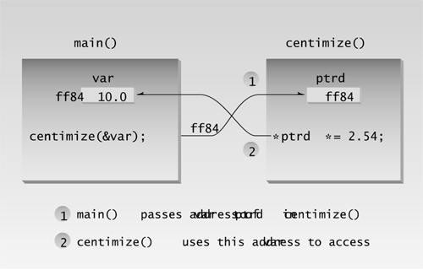
C++ : Pointers
Pointers and Functions: Passing Pointer Variables

Slide 35
C++ : Pointers
cout << “n1=” << n1 << endl; cout << “n2=” << n2 << endl; cout << “n3=” << n3 << endl; cout << “n4=” << n4 << endl; return 0;
//print out all numbers
Pointers and Functions: Ordering with Pointers
// orders two arguments using pointers #include <iostream.h>
void order(int*, int*);
int main()
{
int n1=99, n2=11; int n3=22, n4=88;
order(&n1, &n2);
order(&n3, &n4);
//prototype
}
void order(int* numb1, int* numb2)
//orders two numbers
//if 1st larger than 2nd,
//swap them
{ if(*numb1 > *numb2)
{ int temp = *numb1;
*numb1 = *numb2;
*numb2 = temp; }
//one pair ordered, one not
//order each pair of numbers
}

Slide 36

Have a Nice Day

