Slide 1
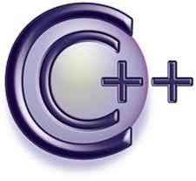
Object Oriented Programming
Nabeela Ashraf
Department of Computer Science UAF

Slide 2
C++ : Pointers
Pointers with Arrays

Slide 3
C++ : Pointers
Pointers and Arrays
// array accessed with pointer notation #include <iostream.h>
int main()
{
int intarray[5] = { 31, 54, 77, 52, 93 }; for(int j=0; j<5; j++)
cout << *(intarray+j) << endl; return 0;
}
//array
//for each element,
//print value
The expression *(intarray+j) in PTRNOTE has exactly the same effect as intarray[j]
But how do we interpret the expression *(intarray+j)?
  Suppose j is 3, so the expression is equivalent to *(intarray+3).
  Represent the contents of the fourth element of the array (52)

Slide 4
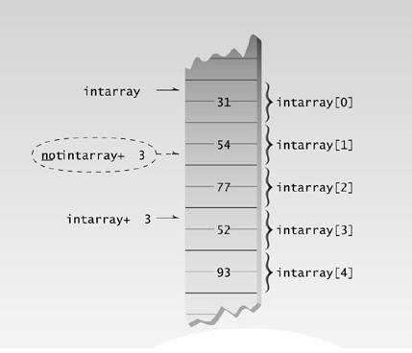
C++ : Pointers
Pointers and Arrays: Counting by integers

Slide 5
C++ : Pointers
Pointer Constant and Pointer Variable
Suppose that, instead of adding j to intarray to step through the array addresses, you wanted to use the increment operator. Could you write *(intarray++)?
The answer is no
Reason: Can’t increment a constant (or indeed change it in any way).
  The expression intarray is the address where the system has chosen to place your array, and it will stay at this address until the program terminates.
  intarray is a pointer constant.
  One can’t say intarray++ any more than you can say 7++.

Slide 6
C++ : Pointers
Pointers and Arrays
// array accessed with pointer #include <iostream.h> int main()
{
int intarray[] = { 31, 54, 77, 52, 93 };
//array
int* ptrint; ptrint = intarray;
for(int j=0; j<5; j++)
cout << *(ptrint++) << endl; return 0;
//pointer to int
//points to intarray
//for each element,
//print value
}

Slide 7
C++ : Pointers
Pointers and Functions
Three ways to pass arguments to a function:
  by value,
  by reference,
  and by pointer
If the function is intended to modify variables in the calling program, then these variables cannot be passed by value, since the function obtains only a copy of the variable.
Either a reference argument or a pointer can be used in this situation.

Slide 8
C++ : Pointers
Pointers and Functions: Passing Simple Variables
// arguments passed by value
#include <iostream.h>
void swap(int, int); int main()
{
int var1, var2;
var1=10; var2 = 20; swap(var1, var2); return 0;
}
void swap(int x, int y)
{
int z = x;
x = y; y = z;
cout << x <<" "<< y <<endl;
}
//prototype
//swap the two numbers

Slide 9
C++ : Pointers
Pointers and Functions: Passing Reference Variables
// arguments passed by reference
#include <iostream.h>
void swap(int&, int&); int main()
{
int var1, var2;
var1=10; var2 = 20; swap(var1, var2);
cout << var1 <<“ ”<< var2 <<endl;
return 0;
}
void swap(int &x, int &y)
{
int z = x; x = y;
y = z;
}
//prototype
//swap the two numbers

Slide 10
C++ : Pointers
Pointers and Functions: Array Passed by Pointer
// array passed by pointer
#include <iostream.h>
const int MAX = 5;
void centimize(double*);
//number of array elements
//prototype
int main()
{
double varray[MAX] = { 10.0, 43.1, 95.9, 59.7, 87.3 };
centimize(varray);
for(int j=0; j<MAX; j++)
//change elements of varray to cm
//display new array values
cout << “varray[” << j << “]=” << varray[j] << “ centimeters” << endl; return 0; }
void centimize(double* ptrd)
{
for(int j=0; j<MAX; j++)
*ptrd++ *= 2.54; //ptrd points to elements of varray
}

Slide 11
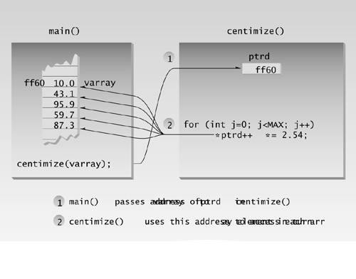
C++ : Pointers
Pointers and Functions: Array Passed by Pointer

Slide 12

Have a Nice Day

