Slide 1




ExcellentNYC
Presented by Harborview Services

Slide 2
Organizing growth for Excellent NYC
ExcellentNYC is a New York-based organization currently employing 38 employees.
Harborview Services helps businesses improve their operational efficiency through better data management.
This initiative focuses on fixing time and attendance tracking to eliminate manual errors.

Slide 3
The Problem
ExcellentNYC does not have a standardized system for recording hours and attendance.
Scheduling conflicts
Misplaced hours
Inefficient staffing
Payroll errors
These issues not only take valuable time away from managers dealing with disputes but also discourage employees from being prompt and consistent because management struggles with its system.

Slide 4
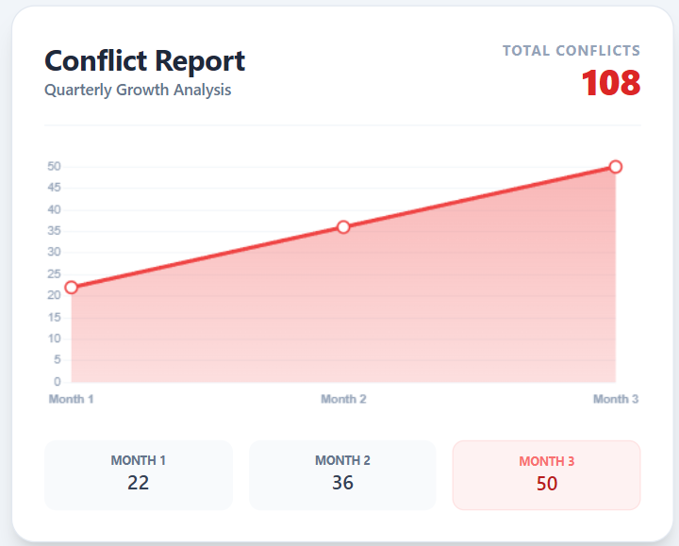
Effective Data
In a sample study done by ExcellentNYC, it revealed:
An average of 72 hours is missing every month, totaling 432 hours.
Inaccurate tracking cost the company between $9,500 and $11,000 this quarter.
Total conflicts over 3 months: 108 conflicts.
Managers spend 6–8 hours every week manually fixing records.
22% of shifts require last-minute changes.

Slide 5
Solution
The information system uses Microsoft Access to develop a timesheet and attendance management solution.
It records employee data, clock-in and clock-out times, and payroll hours. The system improves staffing efficiency and reduces scheduling conflicts.
This solution minimizes human error in payroll and time tracking, enhancing overall productivity.
It also establishes a standardized framework that can be scaled to additional locations in the future.

Slide 6
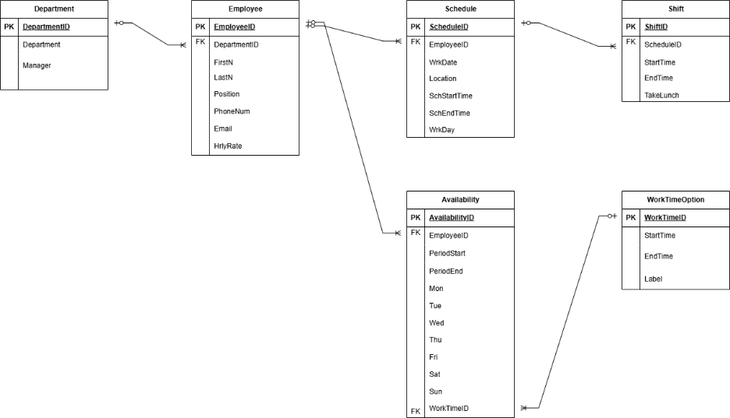
ER Diagram/Table

Slide 7
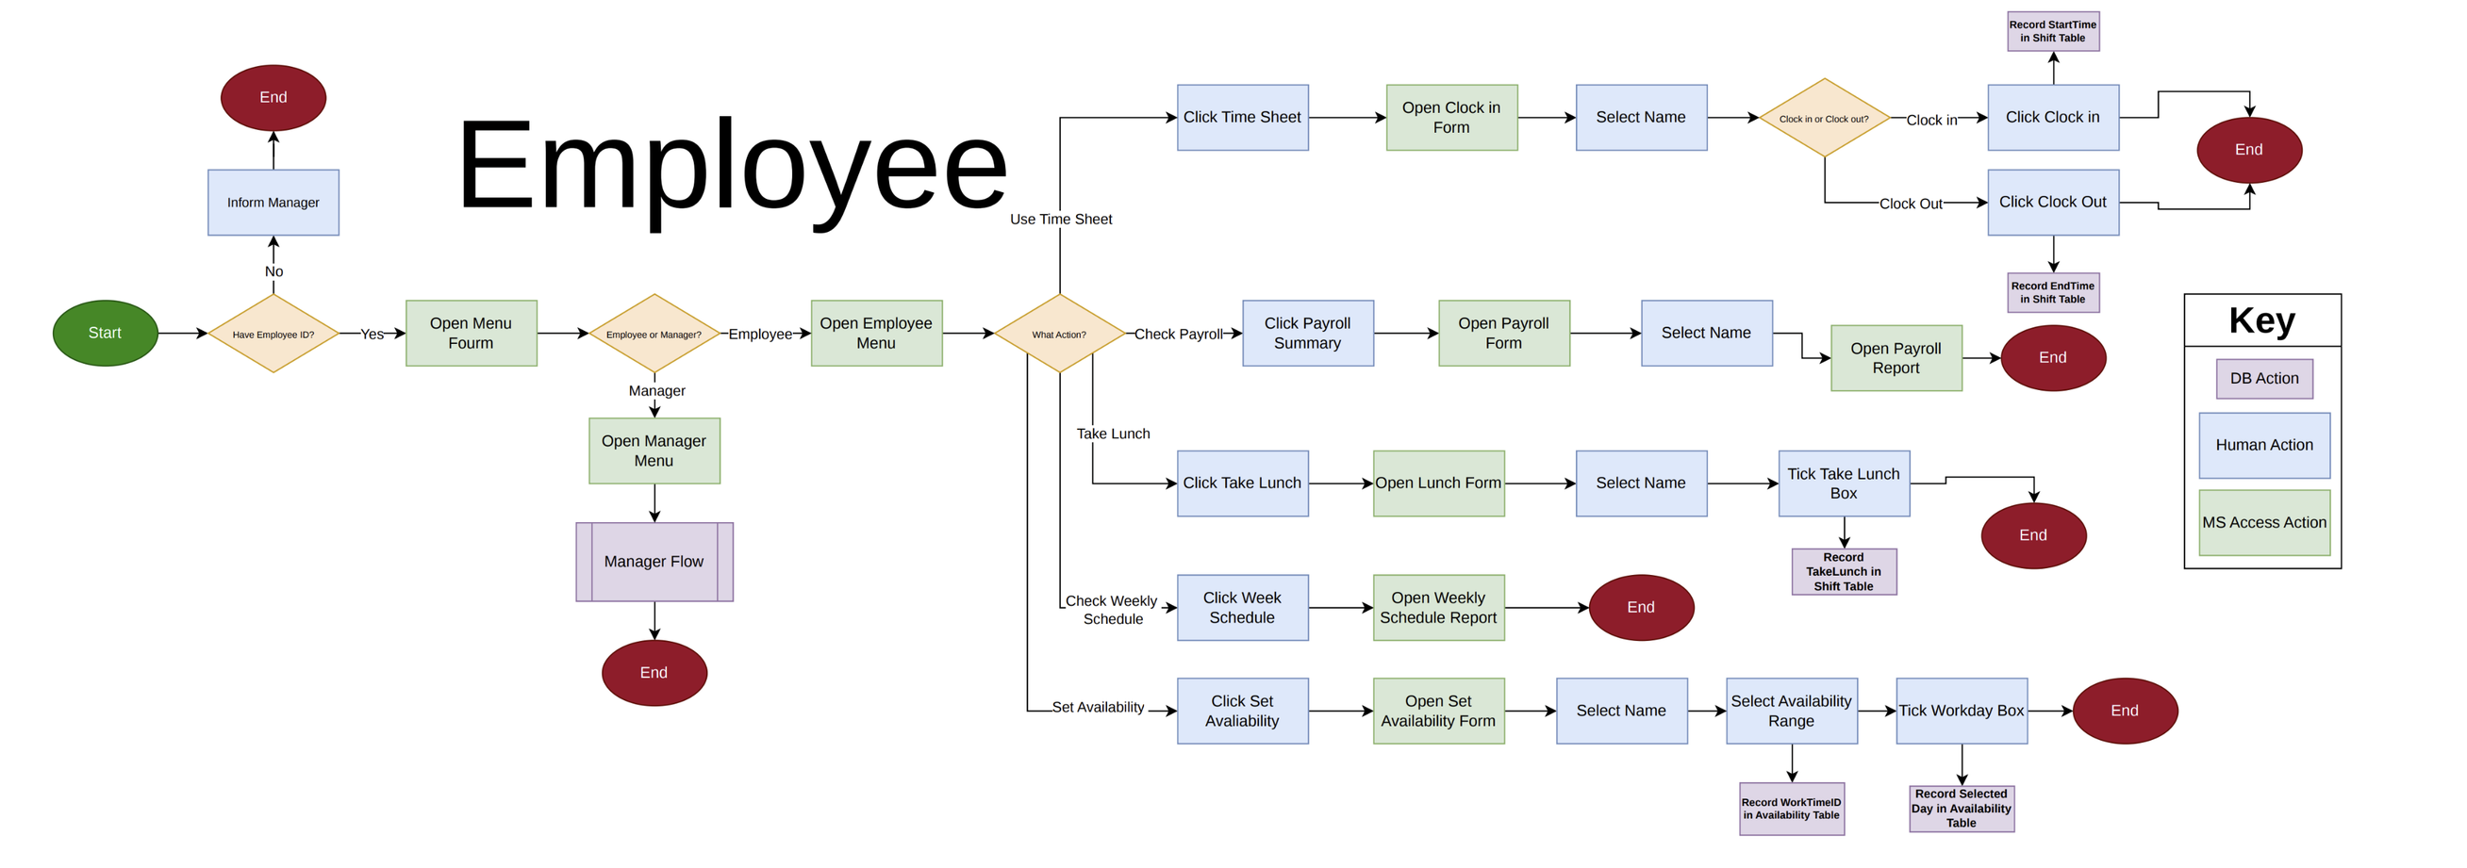
Flowchart

Slide 8
Benefit
Reduced Error & Cost: Addresses the estimated $9,500–$11,000 lost to missing hours and payroll inaccuracies over a 3-month period
Management Efficiency: Eliminates the 6–8 hours per week managers currently spend manually fixing schedules.
Improved Staffing: Targets the 22% of shifts that currently require last-minute changes due to the lack of a standardized system.
Future Growth: Replaces manual processes with a standardized Microsoft Access framework that supports future growth to additional locations.

Slide 9
DEMO

Slide 10
Future improvements
PayRoll into a Table​
Schedule and Shift relationship. Instead of rolling schedule objects, it can be set 4/16/2026 to Thursday​
Employee can choose work location ​
Create a login for Employee
Attendance & Performance Tracking​
Create an in-depth Menu​

Slide 11
Thank You
Connect with us
716-536-8660
Harborview@gmail.com
742 Evergreen Terrace Buffalo, NY 14214

