Slide 1


Slide 2
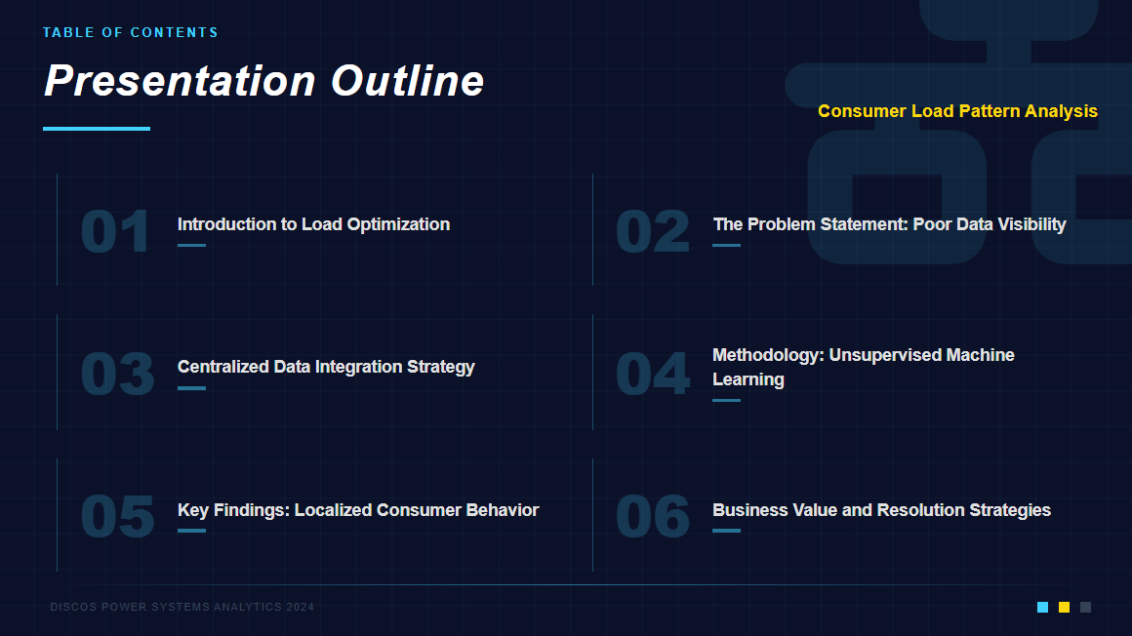

Slide 3
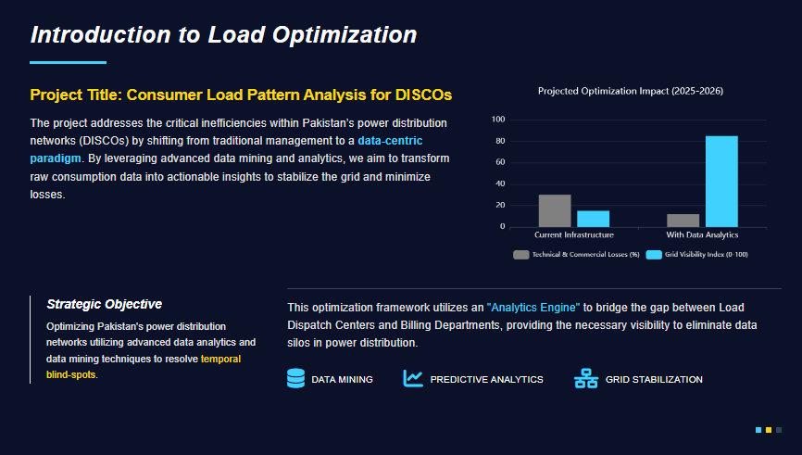
Reference: Khan, Z. A., et al. (2020). "Electricity Theft Detection Using Supervised Learning Techniques on Smart Meter Data". Sustainability, 12(19), 8023.

Slide 4
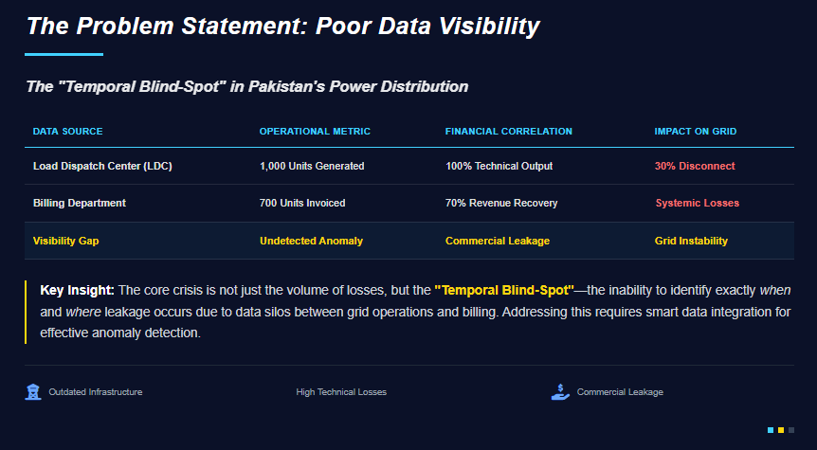

Slide 5
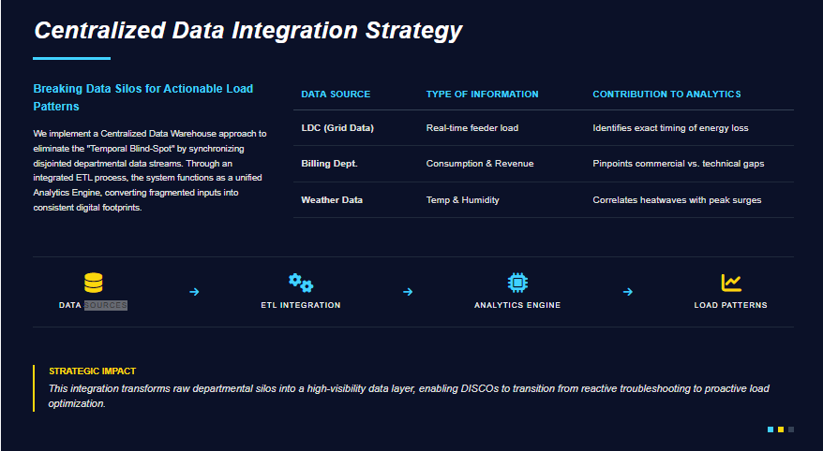

Slide 6
SOLUTION ARCHITECTURE
03
Centralized Data Warehouse & ETL Pipeline
CURRENT STATE — DATA SILOS
LDC Supply Data
Billing Records
Weather Data
▼ E T L P I P E L I N E — Extract · Transform · Load
CENTRALIZED DATA WAREHOUSE (disco_analysis)
consumption
households
weather
▼
ANALYTICS ENGINE → SQL · Weka · Power BI

Slide 7
METHODOLOGY
04
K-Means Clustering Approach
CLUSTER OUTPUT — Consumption Profiles
01
Unsupervised ML
No labels required — model autonomously discovers load behavioral groups from raw consumption data
02
K-Means Clustering (k=3)
Iterative centroid-convergence algorithm segments households into Low / Medium / High-Risk profiles
03
Feature Engineering
Input features: hour, area_group, tariff_type, weather (temp, humidity), day-of-week
Reference: Sarmas, E., Fragkiadaki, A., & Marinakis, V. (2024). "Explainable AI-Based Ensemble Clustering for Load Profiling and Demand Response". Energies, 17(22), 5559

Slide 8
KEY FINDINGS
05
Data Insights & Grid Stress Patterns
+40%
8 PM
9–5
Load spike when
temp > 30°C
Residential peak
(Nazimabad zone)
Commercial zone
peak window
HOURLY LOAD — Commercial vs Residential
TEMPERATURE-INDUCED LOAD SURGE
⚠ Overlapping peaks (8 PM Commercial + Residential) cause Phase Imbalance & PMT Overloads — highest grid stress window

Slide 9
RESOLUTION & BUSINESS VALUE
06
Data-Driven Solutions for DISCOs
Predictive Load Balancing
OPERATIONAL
Transformer-level scheduling instead of city-wide outages.
Target high-risk clusters before peak onset.
Revenue Protection
FINANCIAL
Cluster anomaly detection flags billing-consumption mismatches.
Enables targeted physical inspections — not random audits.
Smart Grid Integration
STRATEGIC
Time-of-Use (ToU) tariff framework based on cluster profiles.
SCADA + AMI integration roadmap for real-time grid visibility.
Outcome: From reactive crisis management → Proactive, data-driven grid governance

Slide 10
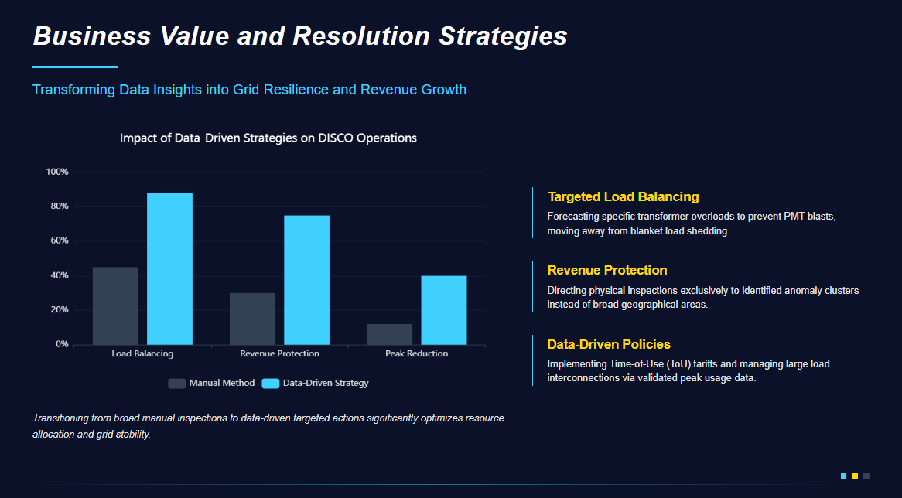

Slide 11


