Slide 1

HTML
ABDULLAH

Slide 2

HTML FUNDAMENTALS
Internet
Website
Server
Browser

Slide 3

1. Internet
The Internet is a worldwide network that connects millions of computers, mobile phones, servers, and other devices.
Think of the Internet as a huge network of roads connecting different cities.
Just like roads allow people to travel from one city to another, the Internet allows data to travel from one computer to another.
Example:
You send a WhatsApp message.
You watch a YouTube video.
You open Google.
You download a PDF.
All these activities use the Internet.
Important: The Internet itself is not a website. It is the network that allows websites and other online services to communicate.

Slide 4
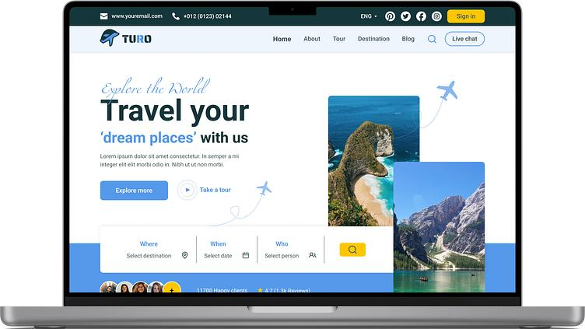
2. Website
Meaning
A website is a collection of related web pages that you can access through the Internet.
Think of a website as a shop or building.
A shop contains different sections. Similarly, a website contains different pages.
EXAMPLE
Consider Amazon.
It has different pages:
Home page
Products page
Shopping cart page
Login page
Payment page
3. All these pages are part of the Amazon website.
OTHER EXAMPLE
Google – google.com
YouTube – youtube.com
Wikipedia – wikipedia.org
Important: A website is something you access using the Internet.

Slide 5
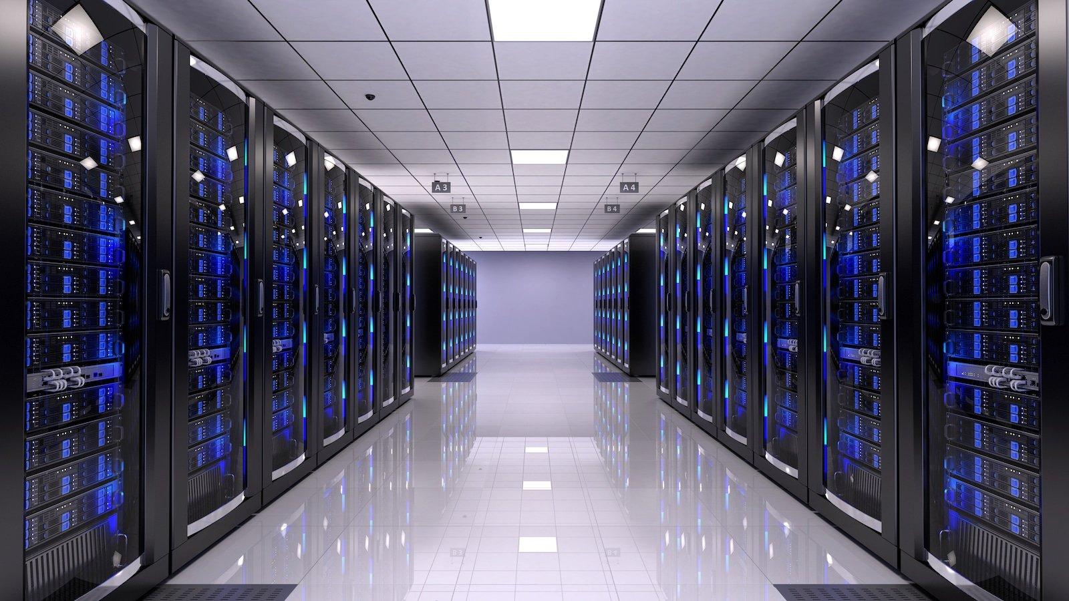
3. Server
A server is a computer or software system that provides data, services, or resources to other computers.
Example:
When you open YouTube, your browser requests information from YouTube's servers.
Those servers provide videos, images, account information and other data.
Important: A server is not necessarily a special physical machine. It can also mean software running on a computer that provides services to other computers.
Let's understand with a restaurant example.
Imagine you visit a restaurant:
You = Customer
Waiter = Person who takes your request
Kitchen = Server
Food = Requested information
2. You ask the waiter for food. The kitchen prepares it and sends it back.
Similarly, when you open a website:
Your browser requests a webpage.
The server receives your request.
The server processes the request.
The server sends the required webpage or data.
Your browser displays it.

Slide 6
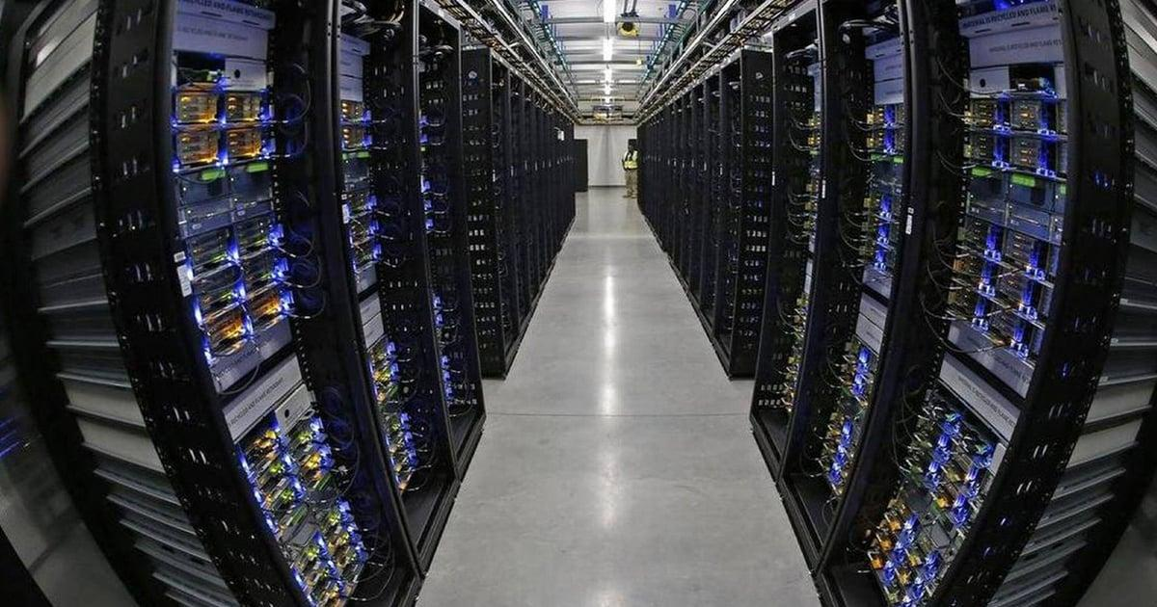
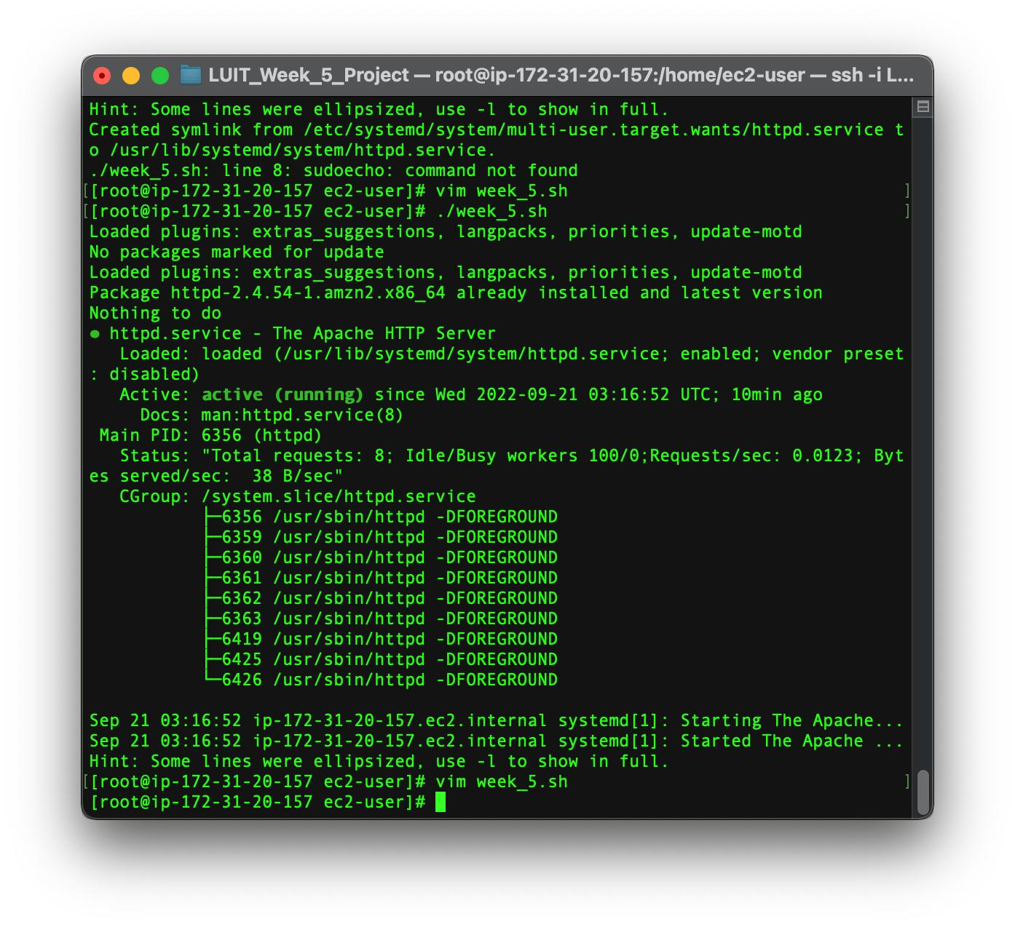
What is a Server? Physical Machine vs Software
A server is a computer or software that provides data or services to other computers.
A. Server as a Physical Computer (Hardware)
B. Server as Software

Slide 7

Company overview

Slide 8

Business Model
Research​
We based our research on market trends and software sales ​
Abstract​
We believe people need new management tools to help businesses achieve their OKRs​
Design​
Minimalist design and easy to use ​

Slide 9
Market overview
$3B
$2B
$1B
Opportunity to build​
Fully inclusive market​
Total addressable market​
Freedom to invent​
Selectively inclusive market​
Serviceable available market​
​
Few competitors​
Specifically targeted market​
Serviceable obtainable market​
​

Slide 10

Market Comparison
Opportunity to build​
Fully inclusive market​
Total addressable market​
Freedom to invent​
Selectively inclusive market​
Serviceable available market​
​
Few competitors​
Specifically targeted market​
Serviceable obtainable market​
​

Slide 11

Our competition
Contoso​
Competitors​
Our product is priced below that of other task management tools on the market​
Simple and easy to use app and website, compared to the complex tools of our competitors​
Affordability is the main draw for our consumers to our product​
Company A​
Product is more expensive​
Companies B & C ​
Product is expensive and inconvenient to use​
Companies D & E​
Product is affordable, but inconvenient to use

Slide 12
competition
Convenient
Contoso
A
Expensive​
Affordable
B
D
E
C
Inconvenient​

Slide 13
Growth strategy
How we’ll scale in the future​
Feb 20xx
May 20xx
Oct 20xx
Distribute the app to local start ups to help establish the product
Release the app to the general public and monitor press and regional market trends
Gather feedback from the start up community to expand availability of the product

Slide 14
Traction
Forecasting for success​
Key Metrics
Revenue by year
 | clients | orders | Gross avenue | Net revenue
20XX​ | 10​ | 1100​ | $10,000​ | $7,000​
20XX​ | 20​ | 200​ | $20,000​ | $16,000​
20XX​ | 30​ | 300​ | $30,000​ | $25,000​
20XX​ | 40​ | 400​ | $40,000​ | $30,000

Slide 15
Two-year action plan
Supply volunteers​
Run focus groups​
Gather feedback​
20XX
Jan
Feb
Mar
Apr
May
Jun
Jul
Aug
Sep
Oct
Nov
Dec
Test with start ups​
Regional launch​
Deliver to consumers​
20XX
Jan
Feb
Mar
Apr
May
Jun
Jul
Aug
Sep
Oct
Nov
Dec

Slide 16

Financials
 | Year 1 | Year 2 | year 3
Detailers​ | 5,000​ | 40,000​ | 160,000​ | ​
Users​ | 50,000​ | 400,000​ | 1,600,000​ | ​
Sales​ | 500,000​ | 4,000,000​ | 16,000,000​ | ​
Average Price per Sale​ | 75​ | 80​ | 90​ | ​
Revenue @ 15%​ | 5,625,000​ | 48,000,000​ | 216,000,000​ | ​
Gross Profit​ | 5,625,000​ | 48,000,000​ | 216,000,000​ | ​
Expenses​ | ​ | ​ | ​ | ​
Sales & Marketing​ | 5,062,500​ | 38,400,000​ | 151,200,000​ | ​
Customer Service​ | 1,687,500​ | 9,600,000​ | 21,600,000​ | 70%​
Product Development​ | 562,500​ | 2,400,000​ | 10,800,000​ | 10%​
Research​ | 281,250​ | 2,400,000​ | 4,320,000​ | 5%​
Total Expenses​ | 7,593,750​ | 52,800,000​ | 187,920,000​ | 2%​

Slide 17




Meet the team
Takuma Hayashi​​
Mirjam Nilsson​​
Flora Berggren​​
Rajesh Santoshi​​
President​
Chief Executive Officer​
Chief Operations Officer​
VP Marketing​

Slide 18








The Full team
Takuma Hayashi​
Mirjam Nilsson​​
Flora Berggren​​
Rajesh Santoshi​​
President​
Chief Executive Officer​
Chief Operations Officer​
VP Marketing​
Graham Barnes​
Rowan Murphy​
Elizabeth Moore​
Robin Kline​
VP Product​
SEO Strategist​
Product Designer​
Content Developer​

Slide 19
Funding
$12K
$14K
$32K
$82K
Campaigns
Angel investments
Cash
Shares
Revenue obtained from online campaigns and reorders
Amount obtained through other investors​
Liquid cash we have
on hand​
Number of shares converted into USD​

Slide 20

Summary
At Contoso, we believe in giving 110%. By closing the loop on task management and using the latest technology, we help businesses grow and nurture a consumer-first mindset. We thrive because of our market knowledge and a great team behind our product. As our CEO says, "Efficiencies will come from proactively transforming how we do business."

Slide 21

Thank you
Mirjam Nilsson​​
206-555-0146​
mirjam@contoso.com​
www.contoso.com​

