Slide 1
Machine Learning Methods
FNO
Fourier neural operators (FNO) are resolution-invariant neural surrogates that learn solution operators for partial differential equations (PDE) directly in the Fourier space. They are well-suited to emulate the large-scale, deterministic structure of turbulent flow.
Emulation of turbulence
SI
Stochastic interpolants (SI) are generative models that transport samples along a learned velocity field to bridge the gap between FNO-predicted mean field and true instantaneous field. They are well-suited to emulate the small-scale, stochastic fluctuations of cloud microphysics.
Emulation of microphysics

Slide 2



FNO + SI Model: Training
Multi-channel input. $S_{e}$ and $q_{c}$.
FNO (spectral convolution, 3D). Fourier layers. Up-sampling.
Mean $S_{e}$ and mean $q_{c}$.
MSE + spectral slope loss.
Detach mean $S_{e}$ and mean $q_{c}$.
Stochastic interpolant. $x_{1}=\left(1−t\right)x_{0}+tx_{1}$.
Velocity U-net. Predicts a new velocity.
Flow loss.
Combined loss.
Single backward step.
Optimizer step. Updates FNO and velocity nets separately.

Slide 3





FNO + SI Model: Inference
Input data. Normalized $S_{e}$ and $q_{c}$.
FNO forward. Frozen weights mean $q_{c}$.
Initialize base state. $x_{0}=\left\langle q_{c}\right\rangle +$ noise_scale*z.
Heun ODE step. $x+=0.5\left(v_{0}+v_{1}\right).$
$S_{e}$ and $q_{c}$at output resolution.
Validation against DNS.

Slide 4




FNO Architecture
Spectral convolution layers: Truncate the lowest Fourier modes. Apply learned complex weights. Transform back the core FNO operator.
Spectral zero-padding: Pads the field in Fourier space from 128³ to 192³ by filling the high-wavenumbers with zeros. It gives resolution-independent output size.
Lifting layer: Lifts [$Se$, $q_{c}$] to a higher dimensional latent space through a $1×1×1$ convolution.
Fourier layers: Applies the global spectral convolution alongside the local $1×1×1$ convolution, adds them, and passes through Gaussian error linear unit (GELU).
Projection: The local linear transformations project the high-dimensional latent features to the desired physical outputs.
Forward Pass
Input (2, 128³). $S_{e}$and $q_{c}$.
Convolution of $S_{e}$and $q_{c}$.
Spectral zero-padding. 128³ → 192³
Lifting layer. Fourier layers.
Projection.
Output (2, 192³). $\left\langle S_{e}\right\rangle$ and $\left\langle q_{c}\right\rangle$.

Slide 5
FNO Architecture : Spectral Convolution
1) Fast Fourier transform (FFT) of input data over 3 dimensions. The data is transformed from physical space to frequency space.
2) Keep only the 6³ lowest frequency modes and truncate the high frequency modes. The frequency domain has a conjugate symmetry. Because half of the data is mathematically redundant, only 4 of the 8 3D quadrants (octants) are need to capture the full picture.
3) The network applies a linear transformation (a weight matrix) directly to these low frequency modes.
4) Once the frequency data is updated by the learned weights, an inverse FFT is applied to get data in 3D physical space.
Weights per octant: 4 octants $×$ 2 layers $×$ ($4×4×6×6×6×2$) = 55296 spectral weights. Inside the parenthesis, 4 → input channels, 4 → output channels, 6³ → modes, 2 → complex number.

Slide 6

SI Architecture
The start: A small amount of noise (noise_scale*z) is added to the FNO-predicted mean to get the starting point $x_{0}$.
The target: The actual high-resolution ground truth data is the target $x_{1}$.
The path: The framework defines a straight line between the start and the target: $x_{t}=\left(1−t\right)x_{0}+tx_{1}$.
The velocity: Because the path is a straight line, the ‘velocity’ required to move from start to target is constant: $v=x_{1}−x_{0}.$
Flow Matching
The start.
The target.
The path.
The velocity.

Slide 7
SI Architecture: Velocity Network
1) Encoder: This is the left side of the U-shape and is the contracting path. The input spatial size shrinks but the number of channels (features) increases.
2) Bottleneck: This is the very bottom of the U-shape and connects encoder with decoder. It operates at the lowest spatial resolution.
3) Decoder: This is the right side of the U-shape and is the expanding path. It up-samples the abstract features, decreases the number of channels and returns the original resolution.
4) Skip connections: These are used to concatenate the up-sampled feature map (currently in the decoder) and the high-resolution feature map (saved from the encoder). The fused output is processed by the next convolution.
Time conditioning: In flow matching, the network (also called U-net) is learning a time-dependent velocity field. Hence, a time-dependent bias is added directly to the activations of encoder.

Slide 8
Joint Training and Backward Pass
The input passes through the FNO. PyTorch records the mathematical operations into a computational graph called Graph A. The FNO’s specific loss is calculated.
The .detach() command takes the numerical output of the FNO but severs its connection to Graph A. It creates a new tensor that has the exact same data but tells Python’s autograd engine (that does backpropagation) not to track gradients past this point.
During flow matching, PyTorch builds a new computational graph called Graph B for the U-net. The U-net’s specific loss is calculated.
The two separate losses are added and the total.backward() function traces the gradients from U-net’s loss perfectly backward through Graph B to update the U-net, without reaching the FNO. Similarly, the gradients from FNO’s loss are traced independently back through Graph A.
PyTorch handles the independent graphs in parallel.
[Backpropagation calculates the gradient (the direction and magnitude) of the prediction error with respect to every weight in the network, and uses these gradients to adjust the weights, minimizing future errors.]

Slide 9
Important Parameters
FNO modes = 6
FNO Parameter Count
= 55449
Noise scale = 0.1
FNO width = 4
Learning rate = 1e-3
U-net Parameter Count
= 3931
FNO layers = 2
Flow steps = 20
Input resolution
= 128³
U-net channels = 2
Epochs = 300
Output resolution
= 192³
Time dimension = 32
Slope weight = 0.3

Slide 10
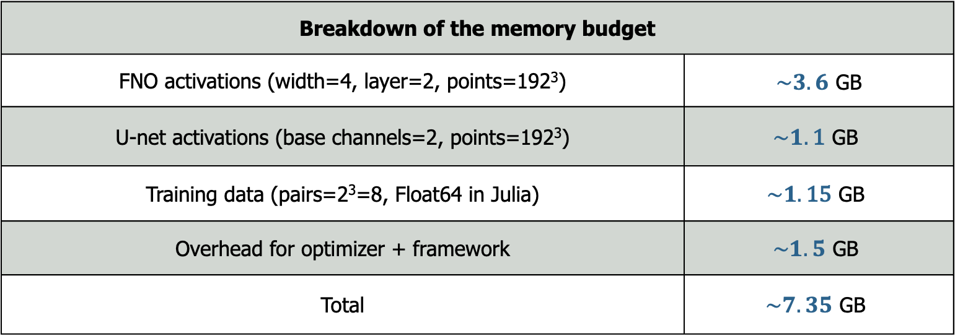
Memory Requirements
Breakdown of the memory budget
FNO activations (width=4, layer=2, points=192³) | $\sim 3.6$ GB
U-net activations (base channels=2, points=192³) | $$\sim 1.\text{1} \text{GB}$$
Training data (pairs=2³=8, Float64 in Julia) | $$\sim 1.\text{15} \text{GB}$$
Overhead for optimizer + framework | $$\sim 1.5 \text{GB}$$
Total | $$\sim 7.35 \text{GB}$$
[By design, activations are more memory-intensive than learning weights because weights are sized by the channel/mode counts, while activations scale with N³ and backpropagation needs simultaneous access to intermediate activation tensors.]

Slide 11
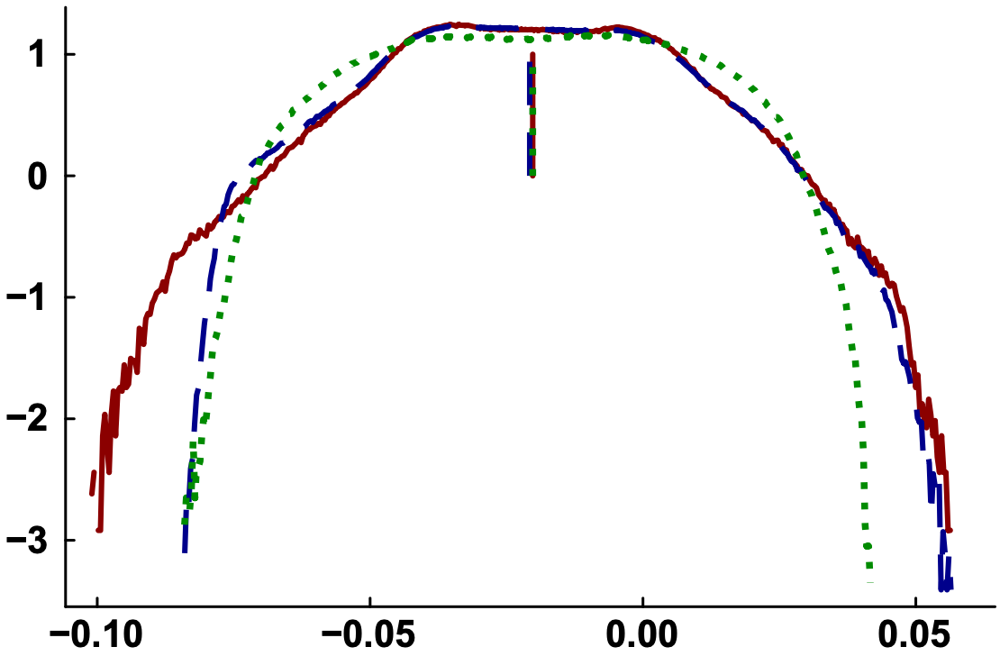
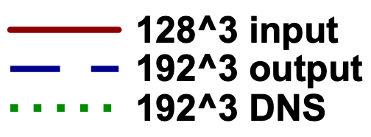
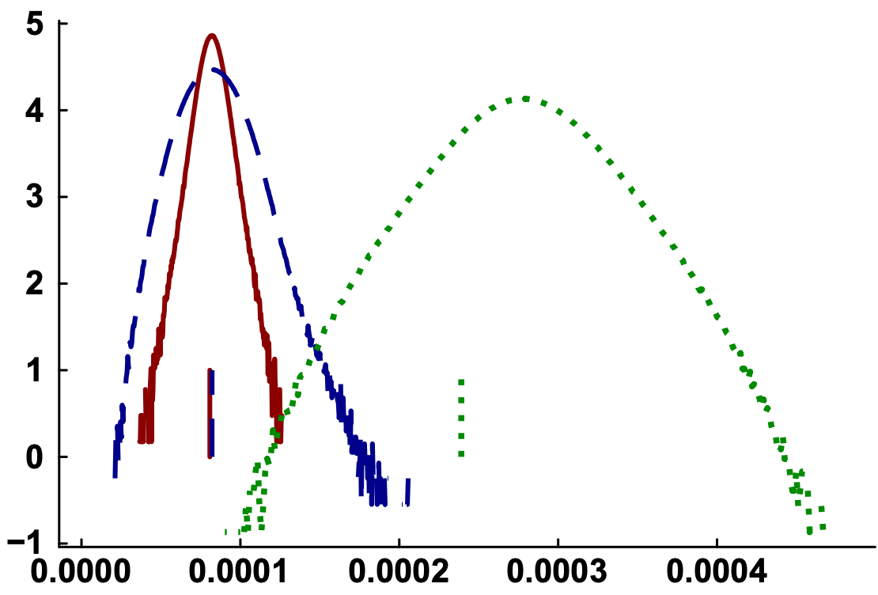
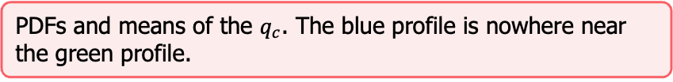
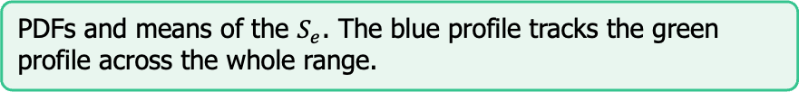
Results from Run #1
The PDFs of 192³ output are compared against the 128³ input and 192³ DNS ground truth. The vertical line segments are the respective mean values.
PDFs and means of the $S_{e}$. The blue profile tracks the green profile across the whole range.
PDFs and means of the $q_{c}$. The blue profile is nowhere near the green profile.

Slide 12
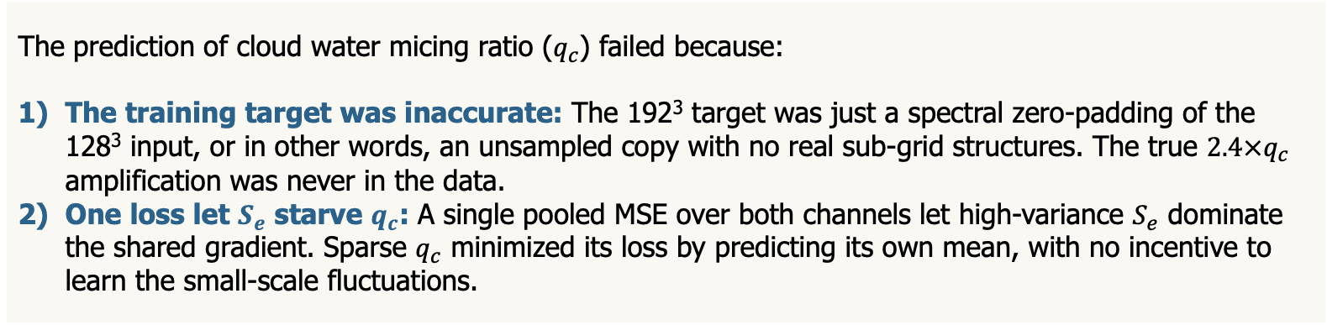
Results from Run #1
The prediction of cloud water micing ratio ($q_{c}$) failed because:
The training target was inaccurate: The 192³ target was just a spectral zero-padding of the 128³ input, or in other words, an unsampled copy with no real sub-grid structures. The true $2.4×q_{c}$ amplification was never in the data.
One loss let $S_{e}$ starve $q_{c}$: A single pooled MSE over both channels let high-variance $S_{e}$ dominate the shared gradient. Sparse $q_{c}$ minimized its loss by predicting its own mean, with no incentive to learn the small-scale fluctuations.
Neither cause is fixable by tuning the network as they are related to data and objective.

Slide 13
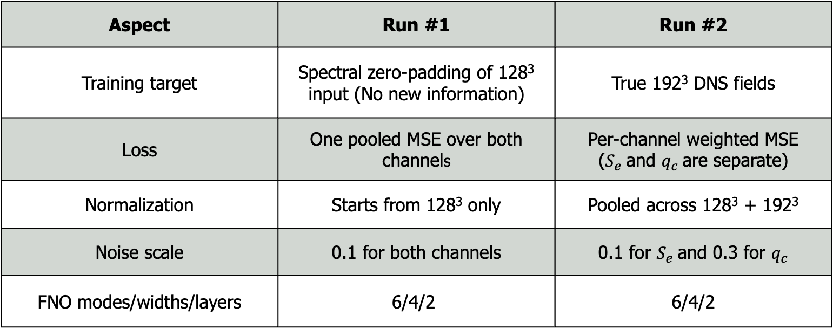
Changes Made in Run #2
Aspect | Run #1 | Run #2
Training target | Spectral zero-padding of 128³ input (No new information) | True 192³ DNS fields
Loss | One pooled MSE over both channels | Per-channel weighted MSE ($S_{e}$and $q_{c}$are separate)
Normalization | Starts from 128³ only | Pooled across 128³ + 192³
Noise scale | 0.1 for both channels | 0.1 for $S_{e}$and 0.3 for $q_{c}$
FNO modes/widths/layers | $$\text{6/4/2}$$ | 6/4/2

Slide 14
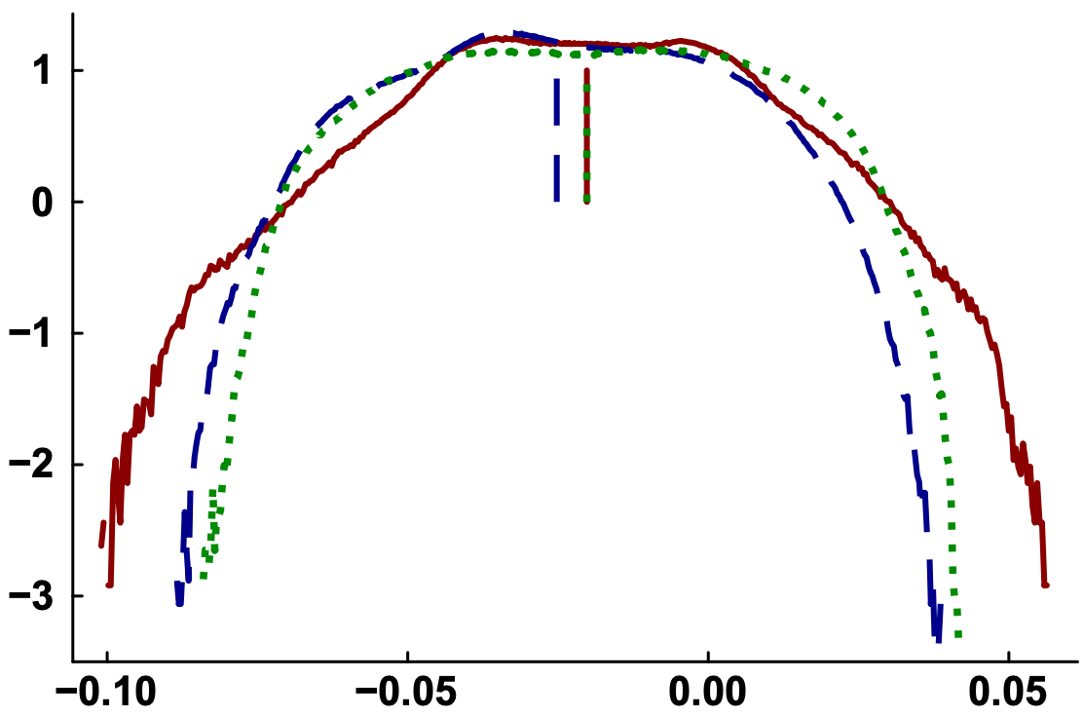
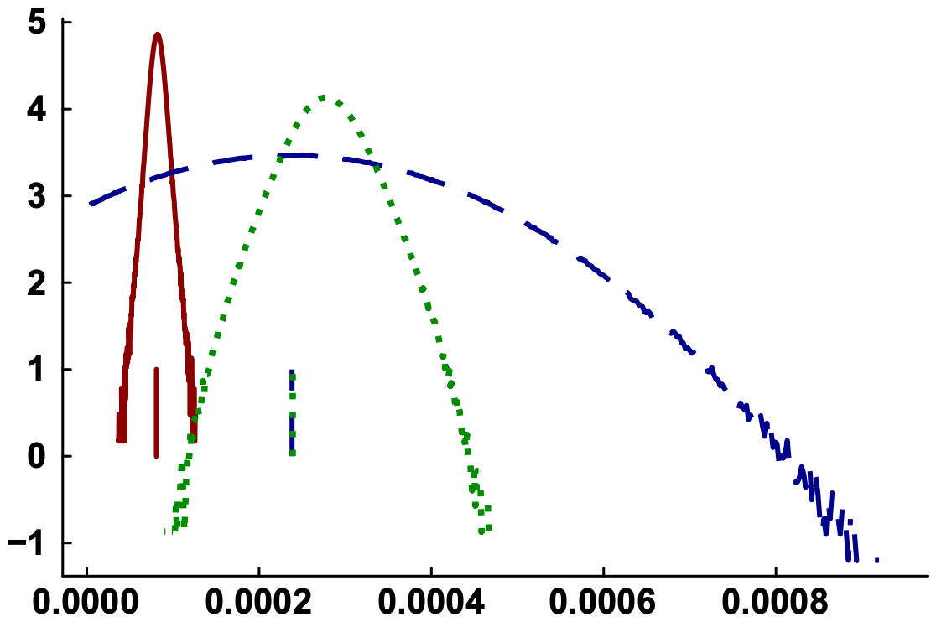


Results from Run #2
The PDFs of 192³ output are compared against the 128³ input and 192³ DNS ground truth. The vertical line segments are the respective mean values.
PDFs and means of the $S_{e}$.
PDFs and means of the $q_{c}$.

Slide 15
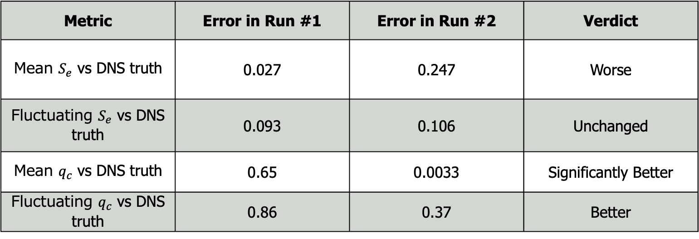
Comparison of Run #1 and Run #2
Metric | Error in Run #1 | Error in Run #2 | Verdict
Mean $S_{e}$ vs DNS truth | 0.027 | 0.247 | Worse
Fluctuating $S_{e}$ vs DNS truth | 0.093 | 0.106 | Unchanged
Mean $q_{c}$ vs DNS truth | 0.65 | 0.0033 | Significantly Better
Fluctuating $q_{c}$ vs DNS truth | 0.86 | 0.37 | Better
For future runs, the stochastic FNO model’s width/modes/layers need to be increased. This will increase the memory requirements and thus the model needs to be deployed on Perlmutter.

