Slide 1

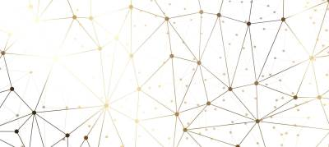
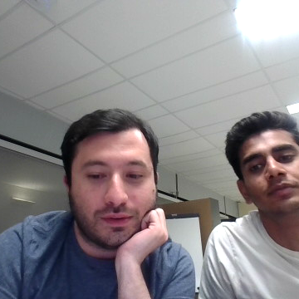
MLP-Mixer
Reproducibility challenge of :
MLP-Mixer An all-MLP Architecture for Vision
Abdullah Tauqeer
Hamed Taherkhani
Notes:
"Hello everyone, thanks for joining us today. We’re here to talk about a study called 'MLP-Mixer: An all-MLP Architecture for Vision.' This paper suggests using a type of network called multi-layer perceptrons, or MLPs, instead of the usual networks for processing pictures and visual data. We’ll share what we tried to do to recreate the study's results and what we learned from it."

Slide 2
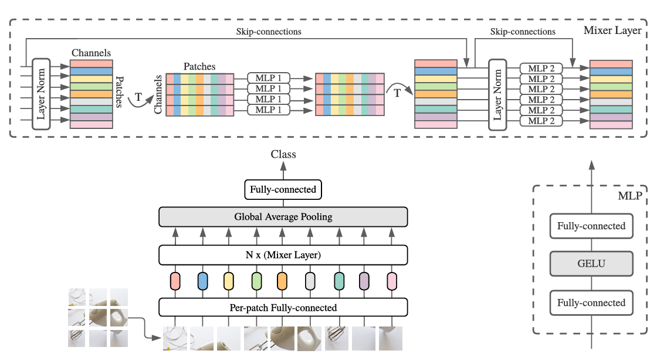
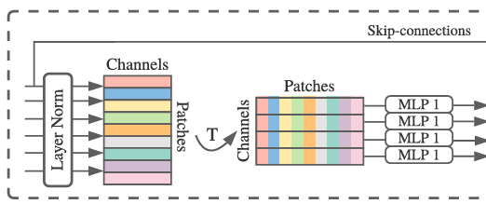
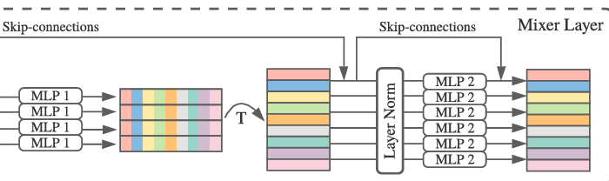

Overview of MLP-Mixer Architecture
Notes:
Let's start with what MLP-Mixer is. Unlike other networks that use complex layers for handling pictures, MLP-Mixer uses a simpler setup that just mixes information. This setup uses layers called MLPs that mix and combine data differently than usual. In this paper, they thought this could make things simpler and possibly better for handling large amounts of data

Slide 3
Model Architecture
Token-Mixing MLP Layers
Channel-Mixing MLP Layers
Notes:
The MLP-Mixer has two main parts. First, the Token-Mixing MLPs, which shuffle the picture information in one way. They rearrange the features so the network can see the picture from different angles. Next, the Channel-Mixing MLPs, which shuffle features in another way, more like mixing colors on a palette. This helps the network understand the big picture from different feature combinations

Slide 4
Project Motivation and Goals
Verification of Original Findings
Transparency and Open Science
Generalization of Results
Identifying Potential Issues and Areas for Improvement
Notes:
Verification of Original Findings: Reproducing research, like the MLP-Mixer study, is crucial for confirming the model's effectiveness in handling vision tasks without traditional neural network methods, establishing trust in the results and methodologies.
Generalization of Results: Testing the model on different datasets assesses its generalizability, ensuring its performance isn't confined to the original conditions used.
Transparency and Open Science: Reproducibility fosters open science by promoting the transparent sharing of data and methods, enhancing scientific dialogue and allowing for independent verification.
Identifying Potential Issues and Areas for Improvement: Reproduction highlights discrepancies in research, prompting investigations that refine models and experimental techniques.

Slide 5
Experimental Setup
Hardware Used
Utilization of a cluster with 2 RTX 8090 GPUs
Fine-tuning on the following datasets
ImageNet, CIFAR-10/100(50kexamples, 10/100 classes) , Oxford-IIIT Pets (3.7k examples, 36 classes), and Oxford Flowers-102 (2k examples, 102 classes)
Notes:
"For our tests, we used some powerful computers with top-notch GPUs, specifically two RTX 8090s. This setup helped us run our tests on different types of image datasets like ImageNet, CIFAR-10/100, Oxford-IIIT Pets, and Oxford Flowers-102. These datasets include everything from simple object pictures to complex scenes, so they were great for testing how well the network works."

Slide 6
Experiment
Implementation of the architecture in the pipeline
Using the pretrained weights presented in the paper
We used all the datasets described in the original paper for fine-tuning
We employed two metrics: Avg 5 top-1 and ImNet top-1

Slide 7
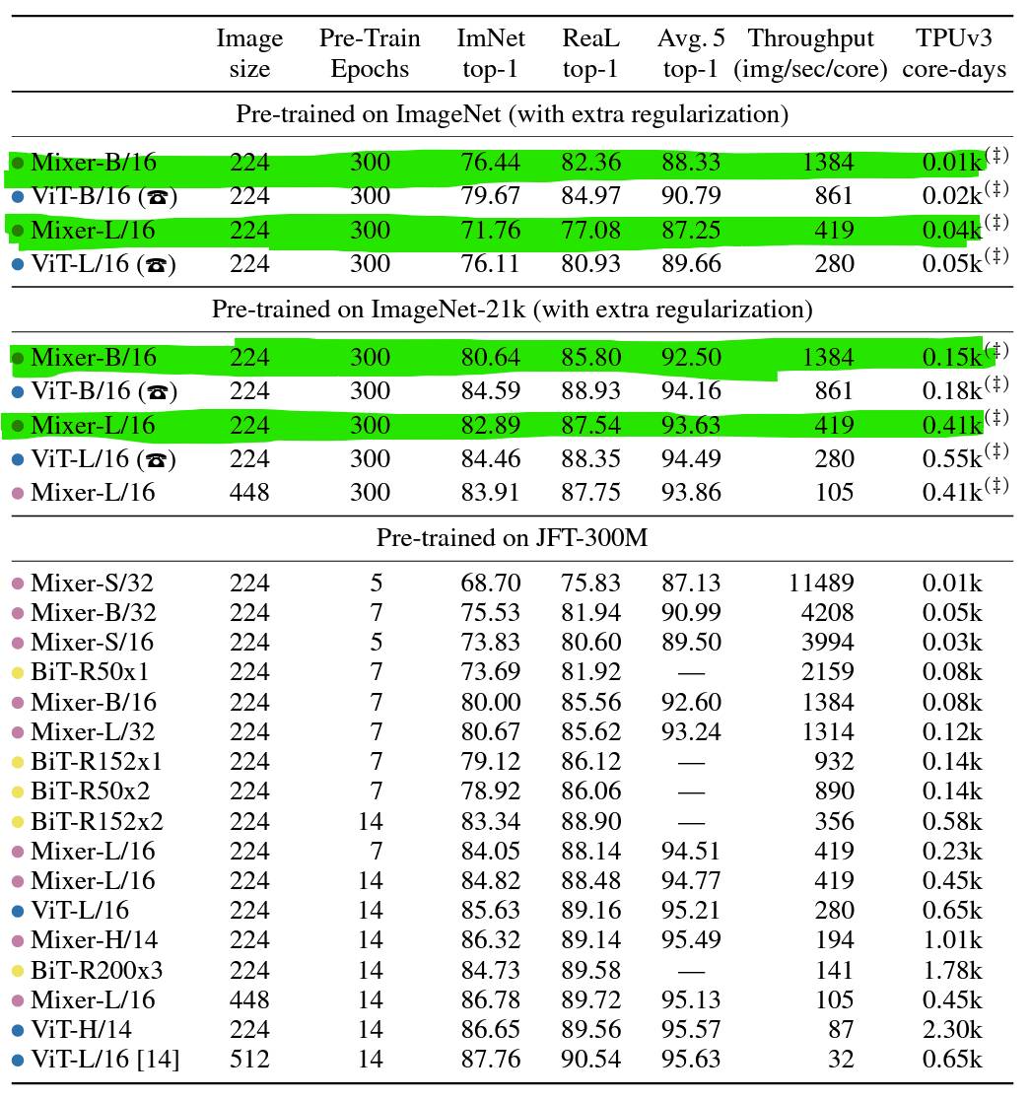
Pretraining models
We used 4 different pretrained models(out of 9) on ImageNet and ImageNet-21k
The pretrained model JFT-300M not available online
Notes:
"We made sure to follow the original study as closely as possible. We started with models that were already trained a bit (we call these pretrained models) to see how well they could learn with new data. We used the same data types mentioned in the study and watched how the network learned, making sure everything was done just right."

Slide 8
Fine-tuning and Hyperparameters
• Optimizer: Momentum SGD
• Batch Size: 512
• Learning Rate: Cosine schedule with linear
warmup
• Gradient Clipping: Global norm 1
• Weight Decay: No weight decay
Notes:
"To fine-tune our network, we used a common optimizer called Momentum SGD, set a batch size of 512, and adjusted the learning rate in a specific way to help the network learn better and more steadily. Like what they described in the paper, we also used a trick called gradient clipping to keep the training stable, which helps prevent the network from making big mistakes."

Slide 9
Results
ImageNet-1k
Model | Orig Avg.5 top-1 | Our Avg.5 top-1 | Orig ImNet top-1 | Our ImNet top-1
Mixer- B/16 | 88.33 | 84.5 | 76.44 | 73.64
Mixer- L/16 | 87.25 | 83.63 | 71.76 | 67.89
ImageNet-21k
Model | Orig Avg.5 top-1 | Our Avg.5 top-1 | Orig ImNet top-1 | Our ImNet top-1
Mixer- B/16 | 92.5 | 86.50 | 76.44 | 72.64
Mixer- L/16 | 93.63 | 88.70 | 82.89 | 78.46
Notes:
"Now, for the results. Our network did well, but it didn't match the original paper’s results perfectly. The accuracy was a bit lower, which made us think about what could be different. It could be the machines we used, the way we set up the network, or just random differences that happen when you run these experiments."

Slide 10
Discussion on Discrepancies
There is a small gap between our results and the main results. This can be due to
Fine-tuning Settings
Hardware Differences
Implementation Details
Unreported Details
Randomness in Training
Notes:
These differences are important because they show how tricky it can be to recreate experiments in this field. Small things like the type of computer or slight changes in how you run the experiment can make a big difference. This tells us we need to be very detailed when we describe our experiments so others can follow exactly."

Slide 11
Summary
Reproduction Efforts
Findings
Conclusion
Notes:
We attempted to reproduce the MLP-Mixer's performance on benchmark datasets such as CIFAR-10 and ImageNet using pre-trained weights.
The reproducibility challenge involved testing the MLP-Mixer's performance using standard metrics like ImNet top-1 Accuracy and Avg. 5 top-1 Accuracy.
The results indicated some discrepancies compared to the original findings, with a slight drop in accuracy on both ImageNet-1k and ImageNet-21k.
These discrepancies appear because of different factors such as differences in training setups, optimization techniques, hardware constraints, and potentially unreported details in the original paper.
While the reproducibility attempt did not perfectly match the original results, it provided valuable insights into the architecture's behavior and its practical application constraints.

Slide 12

Thank You
Notes:
"Thanks for listening! I'm ready for any questions you might have."

