Slide 1
Final Project Proposal
Abdullah Abdul Haleem
CL/BSCDS/CMU/09/25

Slide 2
TABLE OF CONTENTS
01
02
03
04
05
Introduction
Problem Statement & Objectives
Proposed Solution & Methodology
System Design / Framework
Expected Outcomes & Timeline

Slide 3
01
INTRODUCTION

Slide 4
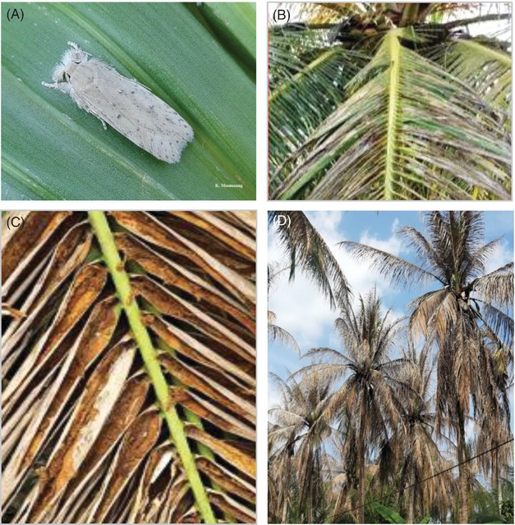
TITLE: Coconut Leaf Disease Detection and Plantation Health Monitoring System
Background of the Problem
Coconut leaf diseases reduce crop quality and plantation productivity.
Manual disease detection is slow and depends on human expertise.
Delayed identification may increase plantation and financial losses.
Importance of the Project
Supports early disease detection.
Reduces plantation losses.
Uses AI and Deep Learning for smart agriculture.
Provides a user-friendly web-based monitoring system.
AI Model
CNN with Transfer Learning
MobileNetV2 Architecture

Slide 5
02
Problem Statement & Objectives

Slide 6
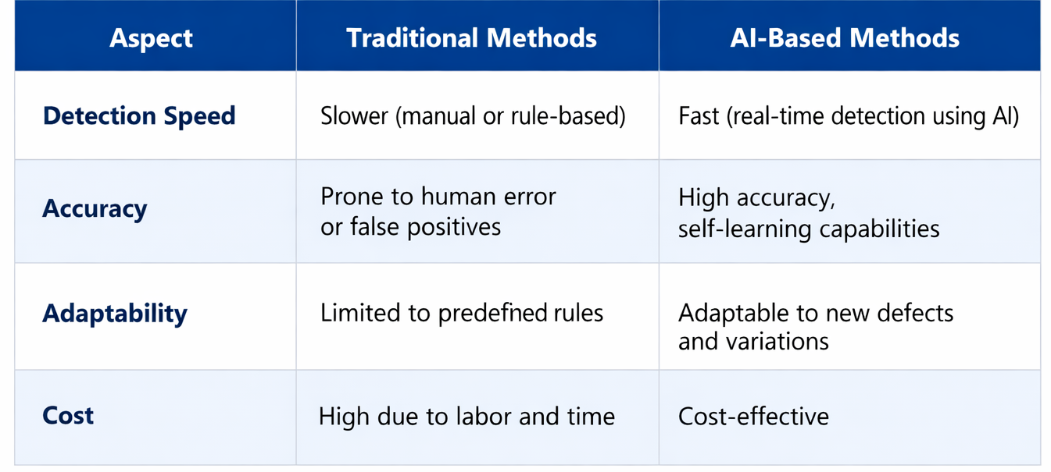
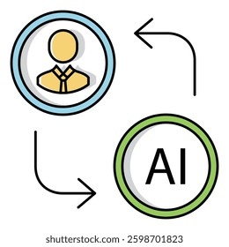
Problem Statement
Existing disease detection methods are manual and time-consuming.
Farmers may not have quick access to agricultural experts.
Traditional systems lack automated monitoring and real-time analysis.
Main Objective
Develop an AI-powered web-based system for coconut leaf disease detection and plantation monitoring.
Specific Objectives
Detect coconut leaf diseases using CNN models.
Estimate disease severity levels.
Provide treatment recommendations.
Develop a dashboard for plantation monitoring.

Slide 7
Introduction
Food wastage is a global problem in restaurants, supermarkets, and fruit shops.
Fruit freshness depends on temperature, humidity, and light.
Normal expiry labels don’t show real-time freshness.
The project creates an AI system to predict fruit expiry.
Data collected using a DSLR camera and temperature & humidity meters.
The system analyzes color, texture, and conditions to estimate freshness.
It helps reduce waste and promote sustainability.

Slide 8
03
Current Situation and Problem Identification

Slide 9
Current Situation and Problem Identification
Current Industry Practices
Environmental Factors Affecting Freshness
Freshness checked manually by color, texture, and smell.
Manual inspection is subjective and unreliable.
Internal spoilage often goes unnoticed (e.g., apples, mangoes).
Leads to economic loss and food safety issue
Temperature, humidity, and light strongly affect fruit quality.
High humidity → fungal growth.
High temperature → faster spoilage.
Excessive light → oxidation and nutrient loss.
Vendors rarely monitora conditions due to lack of tools or awareness.

Slide 10
Existing Limitations
Challenges for Businesses
Limitations of Existing Technologies
Image-only models don’t predict shelf life.
High-cost sensors not suitable for small vendors.
Lab-based systems lack real-time usability.
Poor data integration reduces accuracy.
Economic loss from early discarding or selling spoiled fruits.
Food safety risks from wrong freshness assessment.
No expiry tracking for inventory management.
Lack of affordable AI tools for daily use.

Slide 11
Problem Statement & Proposed Direction
Problem Statement
Proposed Direction
No low-cost web system combining image and environment data.
Causes inaccurate freshness prediction, waste, and health risks.
Develop an AI Fruit Expiry Prediction System
using:Fruit images (DSLR) and temperature/humidity data (meters).
Web-based dashboard showing freshness level and remaining shelf life.
Ensures accuracy, affordability, and real-time use.
Helps reduce waste and improve food safety.

Slide 12
04
Literature Review

Slide 13
Image-Based Freshness Detection
Deep learning (CNNs: ResNet, DenseNet, Inception-v3) used for fruit freshness.
Detect color, texture, surface defects with high accuracy.
Works well in controlled labs but struggles in real-world conditions.
Gap: Only classify fruits as fresh/rotten, cannot predict expiry days.
References:
Li et al., 2024; Kumar & Gupta, 2023; MDPI, 2024; ScienceDirect, 2024

Slide 14
Environmental & Hybrid Approaches
Use temperature, humidity, CO₂, ethylene to predict shelf life.
Accurate but designed for industrial cold-chain systems.
Require expensive sensors, not practical for small vendors.
Hybrid (Image + Environment) Models:
Combine image + sensor data for higher accuracy.
Examples: Zhou et al., 2024 (hyperspectral + humidity); Patel et al., 2025 (RGB + thermal).
Gap: Most rely on costly lab equipment; few use low-cost RGB + basic sensors.
References:
Zhang et al., 2023; Rahman et al., 2024; Zhou et al., 2024; Patel et al., 2025; Food Informatics, 2024–2025

Slide 15
Key Gaps & IEEE Paper
Key Gaps
Vision-only models miss internal spoilage.
Hybrid models use expensive sensors.
Most systems focus on accuracy, not usability or speed.
Few web-based, real-time, low-cost solutions exist.
Gap: No consumer-level, web-deployable hybrid AI for expiry prediction.
IEEE Paper (2024)
CNN-based fruit freshness detection (Paper ID 10891620)
Limitations:
No expiry prediction
No environmental data
References: IEEE, 2024; MDPI & IEEE Reviews, 2024–2025

Slide 16
Project Contribution
Combines RGB images + temperature + humidity for prediction.
Predicts remaining shelf-life days, not just fresh/rotten.
Web-based dashboard with real-time results (~5 s).
Admin portal allows updates and continuous learning.
Designed for retailers, restaurants, and consumers to reduce waste and improve safety.
References: IEEE, 2024; MDPI & IEEE Reviews, 2024–2025

Slide 17
Research Gaps & Solutions
Research Area | Gap in Existing Studies | Contribution | Research Area
Data Fusion | Image-only or environment-only models | Hybrid AI using both inputs | Data Fusion
Output Type | Categorical only | Adds numeric remaining days | Output Type
Platform | Mobile/industrial | Web-based dashboard | Platform
Real-Time Use | Slow, offline prototypes | ≤5 s inference | Real-Time Use

Slide 18
05
Proposed Technique/Solution

Slide 19
Overview & System Architecture
Component | Purpose
User Portal | Upload images, input environmental data, view results & history
Admin Portal | Manage datasets, retrain models, monitor performance
AI Model | CNN extracts image features + environmental data → freshness prediction
Overview
AI web app predicts fruit expiry using images + environmental data.
Reduces food waste & improves safety.
Affordable and easy-to-use for vendors, restaurants, small businesses

Slide 20
Data, Inputs & Outputs
Type | Method
Fruit Images | DSLR or phone camera
Environmental Data | Temperature & humidity meters, light sensor
Labeling | Admin portal for freshness tagging
Output
Output Type | Example
Expiry Status | Fresh / Expiring Soon / Expired
Remaining Freshness | 1.8 days
Dashboard | Shows fruit image, status, chart
Input
Fruit image (e.g., apple_day3.jpg)
Temperature (°C), Humidity (%), Light intensity (lux)

Slide 21
Overview & System Architecture
Component | Purpose
User Portal | Upload images, input environmental data, view results & history
Admin Portal | Manage datasets, retrain models, monitor performance
AI Model | CNN extracts image features + environmental data → freshness prediction
Overview
AI web app predicts fruit expiry using images + environmental data.
Reduces food waste & improves safety.
Affordable and easy-to-use for vendors, restaurants, small businesses

Slide 22
FUNCTIONAL DASHBOARD
Component | Tools / Technology
Frontend | React.js, Tailwind CSS
Backend | Flask / Django
AI Model | TensorFlow / PyTorch, Jupyter Notebook
Database | MySQL / Firebase
IDE | VS Code
Hosting | AWS / Vercel
Functional Requirements
Upload image & environmental data
Display freshness & remaining days
History tracking
Admin retraining & dataset management
Real-time dashboard updates
Non- Functional Requirements
Prediction ≤ 5 seconds
Secure: HTTPS, login
User-friendly
Scalable & maintainable
Reliable: 99% uptime

Slide 23
06
Feasibility Analysis

Slide 24
Feasibility Analysis
Operational Feasibility
Easy to use: Upload images + temperature/humidity data.
Clear dashboard: Shows expiry, freshness, recommendations.
Minimal training needed for staff

Slide 25
07
Project Description

Slide 26
Project Description- AI-Based Fruit Expiry Prediction System
Purpose:
Predicts fruit freshness and remaining shelf life
Uses fruit images + temperature & humidity data
Helps reduce food waste, improve food safety, and manage stock for vendors
High-Level Functions:
Image Capture & Labeling
Take fruit images using smartphone/camera
Label as Fresh or Expiring Soon based on color, wrinkles, spots
Environmental Data Integration
Record temperature (°C) & humidity (%) for each fruit
AI learns how environment affects spoilage

Slide 27
Feasibility Analysis
Technical Feasibility
Uses TensorFlow for AI model & OpenCV for image processing.
Works on laptop/PC with GPU and smartphone/camera.
Backend: Python (Flask/Django), Frontend: React.js, Database: MySQL/Firebase
Economic Feasibility
Low-cost setup: Free GPU platforms (Google Colab, Kaggle).
Local data collection: Fruit shops → no expensive datasets.
Saves money: Reduces fruit waste for vendors/restaurants

Slide 28
Model & Dashboard
Model Training & Optimization
CNN using TensorFlow & Keras identifies spoilage patterns
Processes images under 5 seconds for fast predictions
Real-Time Dashboard
Upload images + environmental data
Shows fruit condition, remaining days, and recommendations
Use Case Example:
Apples → Expiring Soon (1.8 days left)
Bananas → Fresh (3.5 days left)
Mangoes → Expired (0 days left)
Helps prioritize sales, reduce waste, and maximize profit

Slide 29
08
Deliverables

Slide 30
Project Deliverables (AI Model & Dataset)
1. Trained AI Model
2. Dataset of 500+ Fruit Images
3. Integrated Environmental Data
CNN-based deep learning model.
Predicts fruit freshness and expiry categories.
Uses RGB images + environmental data
Collected from local fruit shops
Includes apples, bananas, mangoes, oranges, etc.
Covers various freshness levels
Paired with temperature & humidity readings
Each image linked with temperature & humidity.
Supports multimodal learning → better prediction accuracy

Slide 31
Dashboard & Documentation
4. Web-Based Dashboard
Responsive & interactive web application
Users can upload images and view predictions
Shows visual charts and freshness summaries
5. Comprehensive Documentation
Details data collection, model architecture, evaluation metrics
Includes results & usage guidelines
Supports reproducibility and future improvements

Slide 32
09
Resources Required

Slide 33
System Requirements (Hardware & Data)
Hardware | Purpose
Laptop/PC (≥8GB RAM) | Model training & testing
Camera/Smartphone | Fruit image capture
Thermometer & Hygrometer | Environmental data collection
Data Collection & Storage
Environmental data recorded manually from fruit shops
Each image paired with temperature & humidity readings
Storage: Local or Cloud (Google Drive, Firebase)
External Collaboration:
Partnership with 5 local fruit shops to collect real-world data

Slide 34
Software & Tools
Software/Tool | Purpose
Python | Programming
TensorFlow / Keras | Deep learning model
OpenCV, Pandas, NumPy | Image & data processing
Flask / Django | Backend & API
React.js | Dashboard
Jupyter Notebook | Prototyping/testing
VS Code | Development
GitHub | Version control & collaboration
Development & Collaboration Tools
Jupyter Notebook – prototyping & testing
VS Code – code development
GitHub – version control & collaboration

Slide 35
10
Expected Output and Outcome

Slide 36
Expected Output and Outcome
Expected Output (Tangible Results)
Trained AI model predicting fruit expiry and remaining freshness days
Functional web dashboard for uploading images and viewing predictions
Dataset combining fruit images with environmental data
Visual analytics & graphs showing freshness trends over time
Expected Outcome (Impact & Benefits)
Reduced Food Wastage – act before fruits spoil
Improved Stock Management – better storage and sales decisions
Cost Savings – minimize losses from unsold/spoiled fruits
Sustainability & Awareness – eco-friendly, waste-conscious handling
Practical AI Implementation – real-life solution for food quality monitoring

Slide 37
11
Time Plan for Implementation

Slide 38
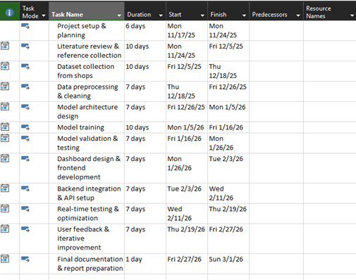
Time Plan for Implementation
12-week project divided into phases: data collection, model development, testing, and reporting for organized progress and proper time management.

Slide 39
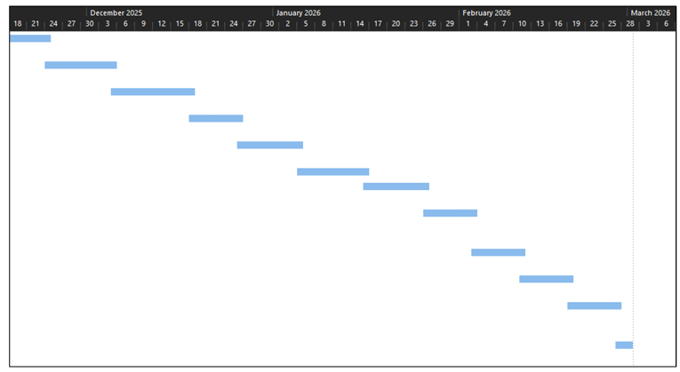
Gann chart

Slide 40
12
Limitations, Risks, and Critical Evaluation

Slide 41
Limitations & Risks
Limitations
Limited Dataset Size: Small or unbalanced datasets reduce model accuracy
Environmental Variation: Manual temperature/humidity recording may have small errors
Image Quality Dependency: Blurry or low-light images may cause misclassification
Limited Fruit Variety: Initial focus on few fruits; adding more requires retraining
Hardware Constraints: Training on standard laptops may be slow without GPU
Risks
Data Collection Challenges: Scheduling/permission issues with fruit shops
Model Overfitting: Small datasets may fail in real-world scenarios
Integration & Usability Risks: Dashboard integration may face technical issues
Environmental Inconsistency: Incorrect data could mislead predictions

Slide 42
Critical Evaluation Plan
Continuous Model Testing: Evaluate with unseen data and real fruit samples
Performance Metrics: Use accuracy, precision, recall, F1 score; retrain if needed
User Feedback Evaluation: Collect feedback on usability, dashboard clarity, and prediction reliability
Iteration & Improvement: Expand dataset, re-optimize model, refine dashboard for better accuracy and user experience

Slide 43
THANKS
F.R.Althaf Hussain
CL/BSCDS/CMU/08/26

Slide 44
References
Engelbart, E. (2023). How to Extend the Shelf Life of Fruits and Vegetables with Science. University of Texas News. Available at: https://cns.utexas.edu/news/features/how-extendshelf-life-fruits-and-vegetables-science [Accessed 1 Nov. 2025].
FoodInformatics Review (2024). Challenges in AI-Based Food Shelf-Life Prediction. University of Hohenheim. Available at: https://www.uni-hohenheim.de/ [Accessed 1 Nov. 2025].
Hoffmann, T.G. (2023). Fresh food shelf-life improvement by humidity regulation in storage environments. ScienceDirect. Available at: https://www.sciencedirect.com/science/article/pii/S1877050922023572 [Accessed 1 Nov. 2025].
IEEE Paper (2024). Deep Learning-Based Fruit Freshness Detection Using Convolutional Neural Networks (Paper No. 10891620). IEEE Xplore. Available at: https://ieeexplore.ieee.org/document/10891620 [Accessed 1 Nov. 2025].
Kuhl, E. (2025). AI for food: accelerating and democratizing discovery and innovation. Nature. Available at: https://www.nature.com/articles/s41538-025-00441-8 [Accessed 1 Nov. 2025].
Kumar, R. & Gupta, S. (2023). Fruit Quality Detection using Ensemble CNNs. ScienceDirect. Available at: https://www.sciencedirect.com/ [Accessed 1 Nov. 2025].
Li, Y. et al. (2024). Deep Learning Approaches for Fruit Freshness Classification. MDPI. Available at: https://www.mdpi.com/ [Accessed 1 Nov. 2025].
Liu, H. (2023). Virtual Cold Chain Method to Evaluate the Effect of Rising Temperatures on Fruit Quality. PMC. Available at: https://pmc.ncbi.nlm.nih.gov/articles/PMC10297325/ [Accessed 1 Nov. 2025].
MDPI (2025). AI Applications in Food Quality Control. MDPI. Available at: https://www.mdpi.com/ [Accessed 1 Nov. 2025].
Mulla, A. & Dhamal, A. (2025). AI-based food spoilage detection (Computer Vision + Sensor Data). IJPREMS. Available at: https://www.ijprems.com/uploadedfiles/paper/issue_4_april_2025/39563/final/fin_ijprems1743712616.pdf [Accessed 1 Nov. 2025].

Slide 45
References
Patel, V. et al. (2025). RGB-Thermal Hybrid Learning for Vegetable Decay Prediction. MDPI. Available at: https://www.mdpi.com/ [Accessed 1 Nov. 2025].
Purdue University News (2025). Consumers mostly support AI tools to improve food and agriculture. Purdue Agriculture. Available at: https://ag.purdue.edu/news/2025/09/consumers-mostly-support-ai-tools-to-improve-food-and-agriculture.html [Accessed 1 Nov. 2025].
Rahman, H. et al. (2024). IoT-Based Monitoring of Mango Freshness in Cold Chain Systems. IEEE Access. Available at: https://ieeexplore.ieee.org/ [Accessed 1 Nov. 2025].
ScienceDirect (2024). AI and Environmental Modeling in Food Supply Chains. Elsevier. Available at: https://www.sciencedirect.com/ [Accessed 1 Nov. 2025].
Sonwani, E. (2022). An Artificial Intelligence Approach Toward Food Spoilage. PMC. Available at: https://pmc.ncbi.nlm.nih.gov/articles/PMC8802332/ [Accessed 1 Nov. 2025].
Sowmiya, R., Chanstar, S., Banu, S. & Kumar, R. (2024). Predicting Shelf-Life of Fruits: A Multifactorial Approach using Intrinsic and Extrinsic Determinants. IJRASET. Available at: https://www.ijraset.com/research-paper/predicting-shelf-life-of-fruits-a-multifactorial-approach-using-intrinsic [Accessed 1 Nov. 2025].
Torres-Sánchez, R. (2020). Real-Time Monitoring System for Shelf Life Estimation of Fruit. PMC. Available at: https://pmc.ncbi.nlm.nih.gov/articles/PMC7180900/ [Accessed 1 Nov. 2025].
University of Maine Extension (n.d.). Storage Conditions: Fruits and Vegetables, Bulletin #4135. Cooperative Extension. Available at: https://extension.umaine.edu/publications/4135e/ [Accessed 1 Nov. 2025].
Zhang, L. et al. (2023). Predicting Banana Shelf-Life using Temperature and Humidity Models. ScienceDirect. Available at: https://www.sciencedirect.com/ [Accessed 1 Nov. 2025].
Zhou, J. et al. (2024). Multimodal Sensor Fusion for Apple Freshness Estimation. IEEE Access. Available at: https://ieeexplore.ieee.org/ [Accessed 1 Nov. 2025].

