Slide 1
AICON'26 · BUILD WITH AI · EDTECH & WORKFORCE
Find where your essay
SAMPLE PASSAGE · NOT A REAL ANALYSIS
loses marks.
Pakistan faces many problems, and water is one of them.
Before the examiner does.
The Indus Basin Irrigation System loses roughly a third of its water before it reaches a field.
2.77%
Everybody knows something must be done.
of 12,792 candidates passed the CSS 2025 written exam.
FPSC to the Senate: most fail English Essay. Arguments lack logical structure.
OFF-TOPIC OR UNSUPPORTED
A claim with no sentence that backs it up. Tap any mark to see why.
Sources: Daily Pakistan, 22 Aug 2025 (results). ProPakistani, 5 Jun 2025 (FPSC to the Senate).
Photograph a handwritten essay. Get every mark explained.
Strong
Weak or generic
Off-topic
GALTI PAKAR · github.com/Abdullah-creator-alt/galti-pakar
1 / 5
Notes:
The problem. Only 2.77 percent of CSS candidates passed the written exam in 2025, and FPSC officials told the Senate that most fail English Essay because their arguments lack logical structure. Feedback today means a tutor or an academy: slow, expensive, mostly in big cities. Galti Pakar reads a photo of a handwritten essay and shows exactly where each mark is lost. On the right is the idea in one picture: every passage is marked, and every mark has a reason. This is a labelled sample, not a real analysis.

Slide 2
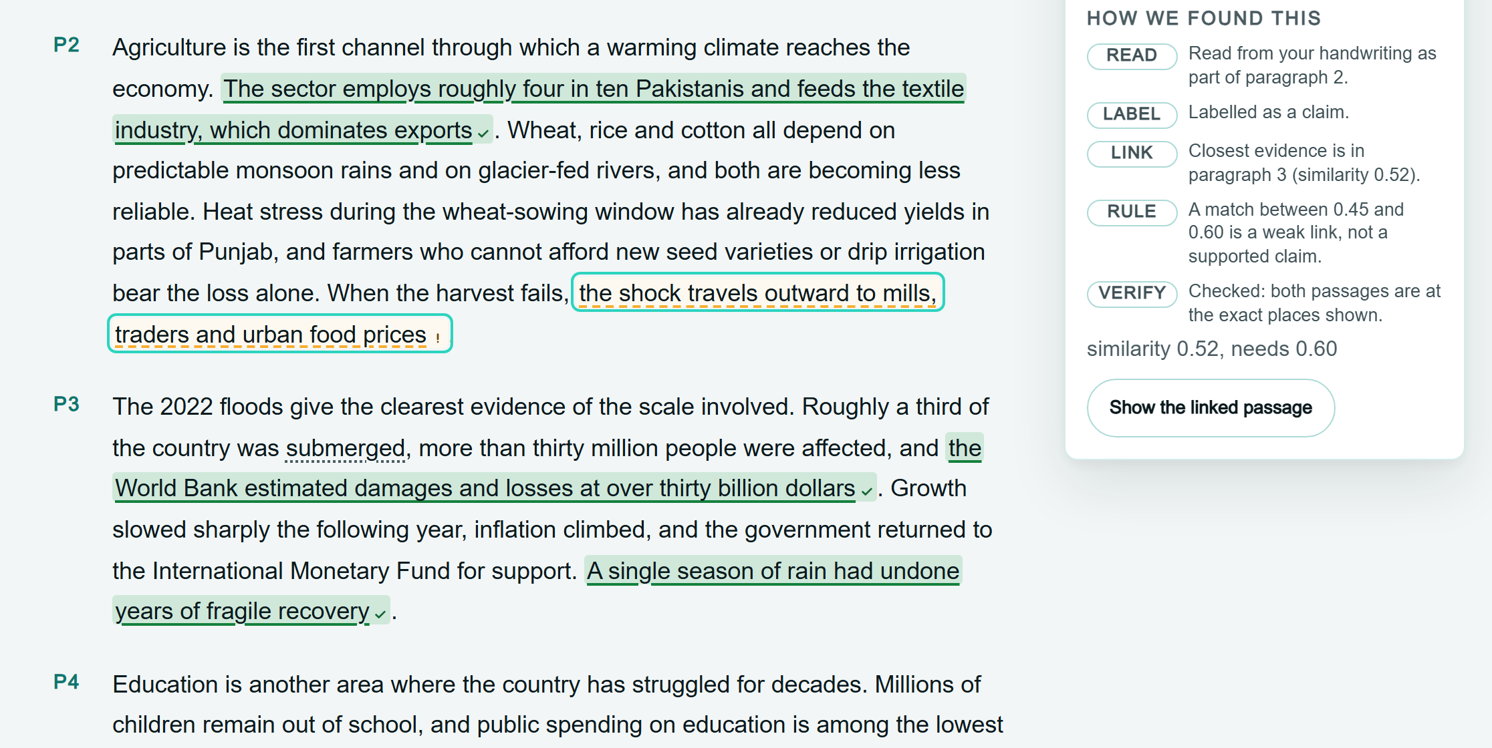
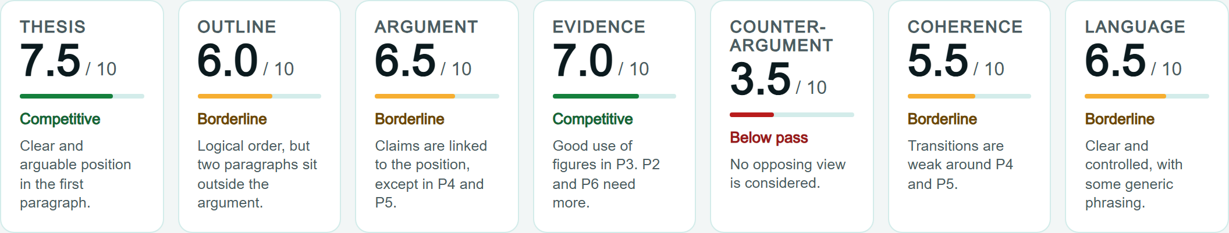
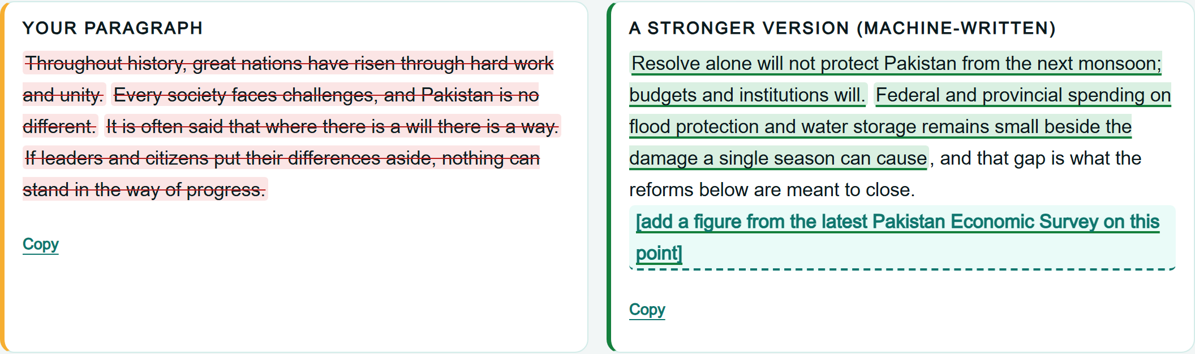
THE SOLUTION · PROBLEM → INPUT → AI → OUTPUT → IMPACT
A photo in. Explained marks out.
PROBLEM
Essays fail on argument structure
INPUT
Phone photos of handwriting
AI
Reads, measures, examines, coaches
OUTPUT
Marked essay, 7 scores, fixes
IMPACT
Specific feedback in about a minute
WHERE EXACTLY
WHY
WHAT TO FIX
Real screenshots of the running app, using the built-in example report (sample data, labelled as such in the app).
GALTI PAKAR · AICON'26 BUILD WITH AI · EDTECH & WORKFORCE
2 / 5
Notes:
The solution, in the structure the rulebook asks for: problem, input, AI component, output, impact. The input is just phone photos. The AI step is the heart, which the next slide opens up. And the output is what you see here: every highlight opens its reason and how it was found, seven rubric scores, and a before-and-after for every weak paragraph. These are real screenshots of the running app, using the example report, which is labelled as sample data.

Slide 3
HOW THE AI IS INTEGRATED
Six AI steps. Every answer checked by code.
PHOTOS + TOPIC →
→ REPORT
AI
proposes
1 Read
Vision turns photos into paragraphs and flags words it is unsure of.
gemini-3.6-flash
2 Embed
Meaning vectors for the topic, paragraphs and sentences.
gemini-embedding-001
3 Measure
Sentence roles, genericness and topic drift, in parallel.
flash + our classifier
4 Examine
Two runs score 7 rubric dimensions and must quote the essay.
gemini-3.6-flash ×2
5 Blend
No model here. Rules blend measured and examiner scores.
plain code
6 Coach
Explains 3 fixes, rewrites up to 3 weak paragraphs.
gemini-3.6-flash
Code
verifies
Schema check. Unsure words shown with a dotted underline.
One shared cache. Max 95 texts; extras shown as unassessed.
Rules link claims to evidence and colour each sentence.
A quote not in the essay is dropped. Band computed in code.
40% measured + 60% examiner. Every conflict is listed.
Code picks the paragraphs. Invented figures become slots.
If a step fails, the report says which check was unavailable. It never guesses.
GALTI PAKAR · AICON'26 BUILD WITH AI · EDTECH & WORKFORCE
3 / 5
Notes:
This is the core. Six AI steps, and under each one, the code that checks it. One: Gemini vision reads the handwriting and flags the words it is unsure of. Two: embeddings turn the topic, paragraphs and sentences into meaning vectors. Three, in parallel: Gemini labels each sentence's role, our own trained classifier scores how generic each sentence is, and the vectors measure topic drift. Four: two separate examiner runs score seven rubric dimensions, and every quote must exist in the essay or it is dropped. Five is plain code, not a model: it blends measurement and examiner, and lists every disagreement. Six: the coach explains the three most important fixes and rewrites up to three weak paragraphs, but code decides which ones. If any step fails the report says which check was unavailable. It never guesses.

Slide 4
WHY IT IS MEANINGFUL, NOT GENERIC
AI that has to prove its work.
ONE HIGHLIGHT, TRACED END TO END
2 independent examiner runs
Where they disagree, the report shows it instead of averaging it away.
…the shock travels outward to mills, traders and urban food prices
1 of 11 quotes invented
Caught and removed in one test run. A quote must exist in the essay.
READ
Handwriting read as part of paragraph 2
LABEL
Labelled as a claim
LINK
Nearest evidence by meaning: 0.52
RULE
0.45 to 0.60 counts as a weak link
VERIFY
Both passages exist in the essay
Our own trained classifier
Scores generic sentences. 550 synthetic sentences, and we say so.
teal = AI · outlined = code · example report, sample data
AMBER Weak link: the evidence is only loosely connected to the claim.
Remove the AI and the product is gone: no handwriting reading, no measuring of meaning.
The AI never sets the band, picks what to fix, or invents a figure.
GALTI PAKAR · AICON'26 BUILD WITH AI · EDTECH & WORKFORCE
4 / 5
Notes:
Why this is meaningful AI, not a chatbot on an app. On the left is one highlight traced end to end: the passage, how it was read, labelled, linked to evidence by meaning, which rule turned it amber, and the verification that both passages exist. Teal steps are AI, outlined steps are code. On the right, proof that the AI is checked: two independent examiner runs with disagreements shown; in one test run one of eleven quotes was invented and caught; and a genericness classifier we trained ourselves, on synthetic data, which we say plainly. The AI never sets the band, never picks what to fix, and never invents a figure. Remove the AI and the product is gone: no handwriting reading, no measuring of meaning.

Slide 5
IMPACT · WHAT WE BUILT · WHAT IT CANNOT DO YET
Built to help. Honest about its limits.
IMPACT
BUILT AT AICON'26
NOT YET
SDG 4 Quality education: feedback on the exact skill examiners say is missing.
Pipeline Six AI steps, each with a code check, behind one API.
Scores Not calibrated against real FPSC marks.
SDG 10 Reduced inequalities: a phone photo, no academy, no fee.
Interface Every highlight explains itself. Works on a phone.
Data Our evaluations use synthetic sentences.
SDG 16 A fairer start for a merit-based civil service.
Tests 263 unit and 93 browser tests. None call the AI.
Structure Gemini labels plus rules; no separate trained model.
Cost Gemini calls and tokens are logged per run: cost per essay is measured.
Disclosed Design system from an earlier product (Verchek). Data is synthetic, and labelled.
Quota The free tier allows few full runs a day.
Measure first. Judge second. Verify everything.
github.com/Abdullah-creator-alt/galti-pakar
GALTI PAKAR · AICON'26 BUILD WITH AI · EDTECH & WORKFORCE
5 / 5
Notes:
Impact. This serves SDG 4, quality education, and SDG 10, reduced inequalities, because it works from a phone photo with no academy and no fee. SDG 16 for a fairer path into a merit-based civil service. Every run logs its Gemini calls and tokens, so the cost per essay is measured, not guessed. What we built during AICON'26: the whole pipeline, the interface, and 263 unit tests plus 93 browser tests, none of which call the AI. Pre-existing and disclosed: the design system from an earlier product. And the honest limits: scores are not calibrated against real FPSC marks, our test data is synthetic, there is no separately trained structure model, and the free tier allows few full runs a day. Next step: calibrate against teacher-marked essays. Measure first, judge second, verify everything.

