Slide 1


Visualization of wireless network status information with SQL DB
Dr: Zoltan Gal Abdullah Metwaly

Slide 2

Problem posing
Keeping the devices under monitoring is more hustle
Number of devices are getting larger
Managing the device’s objects
Status information
Representation and visualization
The use of SNMP

Slide 3
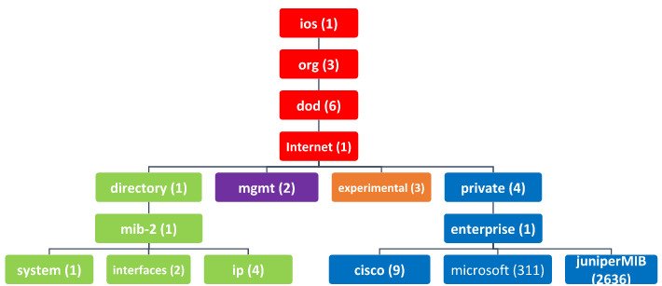
The solution
Tracking the managed devices using (SNMP)
Get the status information in use OID
Store this information in DB
Live-table from the requests
Drawing a graph of perform

Slide 4
Principles and technologies
The thesis development is mainly two stages
Graphical user interface (GUI) development (PyQt5)
The SNMP protocol implementation
Request implementations and its (API) in (PySNMP)
The database for network interfaces records (SQLite browser)(Pandas)
Data plotting or network interfaces performance (Matplotlib)

Slide 5
GUI and plotting
DesignerQt 5
Hardcoding the elements
Drag and drop technique
Functionality for elements
Integration for PyQT5 and Matplotlib

Slide 6
Development and Database
Request implementations in (PySNMP)
Database creature in Python and Pandas

Slide 7
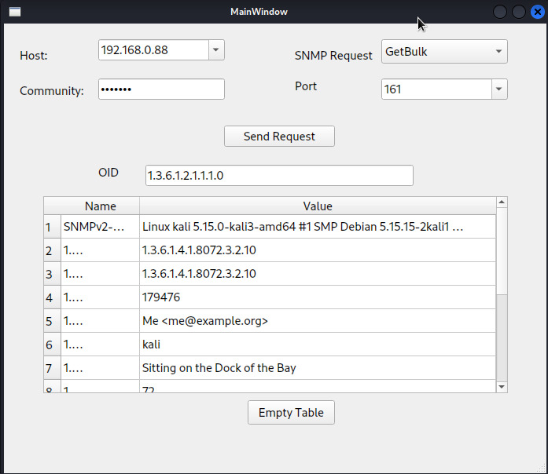
SNMP request process

Slide 8
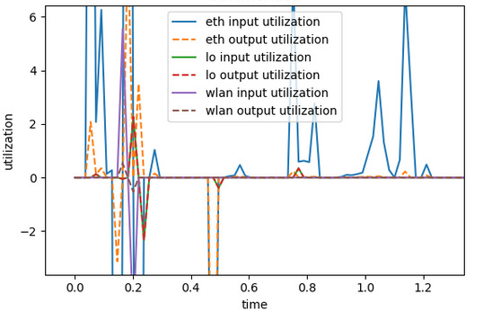
Performance graph

Slide 9
Conclusion and Acknowledgment
More objects monitoring
Sending information
More requests implementations
Grow the database
First and foremost, I want to express my gratitude to everyone who has supported along this journey including special heartful for my supervisor DR Zoltan. We have been meeting weekly to get the work done and submitted in its shape now, many thanks to his help.

Slide 10
Thank you!
Preferences
https://pysnmp.readthedocs.io/en/latest/
https://matplotlib.org/
https://datatracker.ietf.org
https://pypi.org/project/PyQt5/
https://sqlitebrowser.org/
https://pandas.pydata.org/

