Slide 1
Automatic Street Light System
By:
Abdullah Alotaibi , 16273835

Slide 2
Type of Project
The aim of this project is to implement a smart street light system to automatically turn on and turn off the street lights. Different methodologies will be used to implement this idea and it will require many components.

Slide 3
Motivation
Automatically turning on the light during night time and turning it off during day time.
Having this system will help to save energy and time taken during manual operation of the lights.

Slide 4
Objective
Using solar panel and light sensor to develop an efficient system to automatically turn on and off the street light. As a result, that can be beneficial for people travelling during night time as well as reducing the amount of energy we tend to consume.

Slide 5
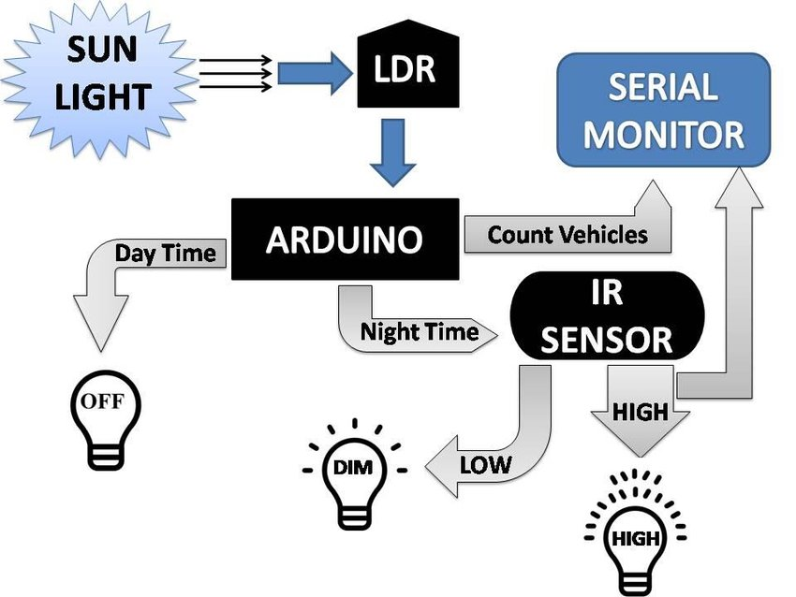
Project Architecture

Slide 6
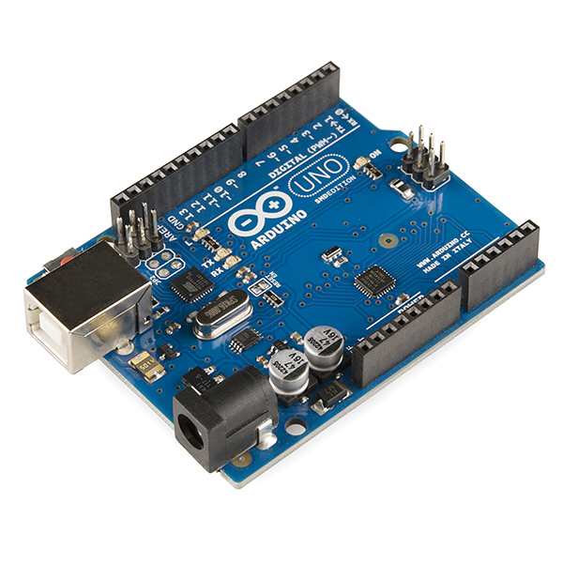
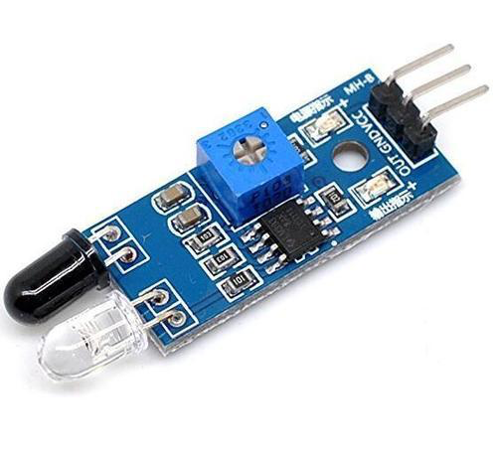


Tools, languages, platform
Arduino
IR sensor
HTML
Java script

Slide 7
Project Outcome
The project will provide an automated approach to turn off and on the street light
It will help reduce the energy cost
It will provide help for people travelling in the night time

Slide 8
Learning Outcomes
This project will help us to demonstrate what we have studied during this course.
It will polish my development skills and enable me to be familiar with such tools with a hand-on experience.
From this project, we will learn to work on Arduino and how to implement it.

Slide 9

Any questions? feel free to ask

