Slide 1
DBMS COURSE PROJECT - SQL SERVER
Lost & Found
Campus System
A relational database that lets students report lost or found items, automatically surfaces likely matches, and routes claims through admin approval.
SUBMISSION
25 July 2026
PRESENTATION
26 July 2026
ENGINE
Microsoft SQL Server
Nabia Sajid - Group Leader
Muhammad Abdullah
Maryam Muazzam
Sathya Narayan

Slide 2
01 / 10
THE PROBLEM
Campus items go missing. Recovery is left to chance.
There is no shared system to report a lost item, register a found one, or verify who it actually belongs to - so most items never make it back.
Today, without a system
What the database solves
A found item sits at a front desk. A student who lost it has no way to know it was ever handed in - reports live in group chats, notice boards, or nowhere at all.
One shared source of truth: every lost and found report, every candidate match, every claim and its approval - all queryable, all auditable.
Lost & Found Campus System
SQL Server / T-SQL

Slide 3
02 / 10
CORE FEATURES
Five features, one schema
Every feature below maps directly onto a table, a join, a trigger, or a stored procedure - nothing here is UI-only.
Report Lost Item
Report Found Item
Match Similar Items
Student logs title, category, location and date of a lost item.
Same structure, filed by whoever found it.
Engine auto-suggests Lost/Found pairs by category, location, date window.
Claim Requests
Admin Approval
Student requests ownership of a found item with proof details.
Admin approves or rejects; approval finalizes the hand-over.
Lost & Found Campus System
Core Features

Slide 4
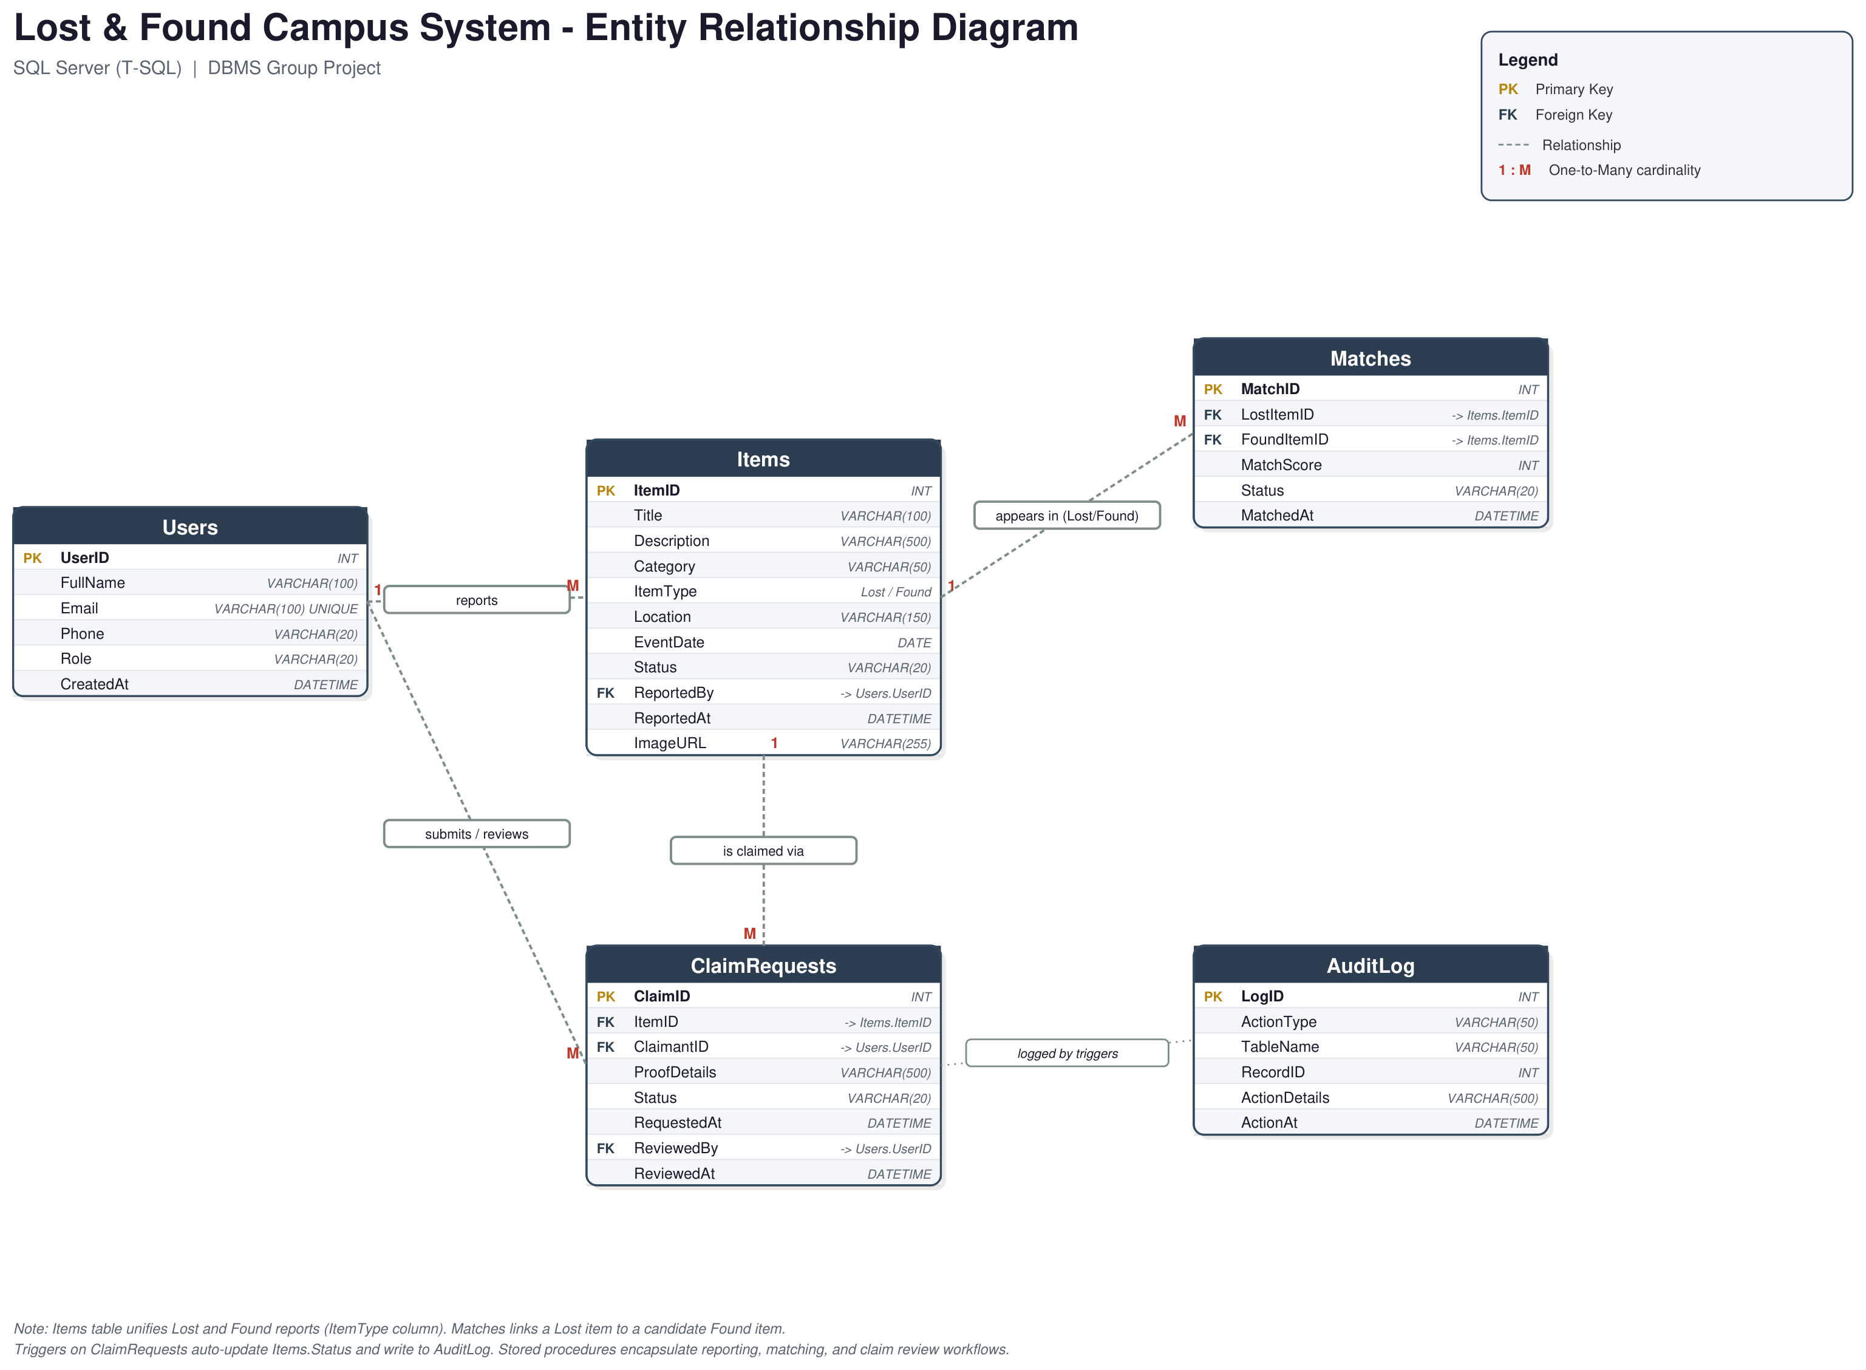
03 / 10
DATA MODEL
Entity-Relationship Diagram
Five tables. One unified Items table for both Lost and Found rows, distinguished by an ItemType column.
Lost & Found Campus System
ER Diagram

Slide 5
04 / 10
SCHEMA
Table by table
Primary keys in gold, foreign keys in teal - every FK enforces referential integrity back to its parent table.
Users
Items
Matches
PK UserID
PK ItemID
PK MatchID
FullName, Email
Title, Category
FK LostItemID -> Items
Phone, Role
ItemType, Status
FK FoundItemID -> Items
FK ReportedBy -> Users
MatchScore, Status
ClaimRequests
AuditLog
PK ClaimID
PK LogID
FK ItemID -> Items
ActionType, TableName
FK ClaimantID -> Users
ActionDetails, ActionAt
Status, ProofDetails
Lost & Found Campus System
Schema

Slide 6
05 / 10
CONCEPT 1 - JOINS
Lost items with reporter details
Joining Items to Users turns a raw ReportedBy number into a name and email an admin can actually act on.
SELECT i.ItemID, i.Title, i.Category, i.Location, i.EventDate,
u.FullName AS ReportedBy, u.Email
FROM Items i
JOIN Users u ON i.ReportedBy = u.UserID
WHERE i.ItemType = 'Lost';
ITEMID | TITLE | CATEGORY | LOCATION | REPORTED BY | EMAIL
1 | Black Wallet | Wallet | Library | Ali Raza | ali.raza@campus.edu
2 | iPhone 13 | Electronics | Cafeteria | Sara Khan | sara.khan@campus.edu
3 | Blue Water Bottle | Bottle | Sports Ground | Bilal Ahmed | bilal.ahmed@campus.edu
Output captured from SQL Server Management Studio
Lost & Found Campus System
Joins

Slide 7
06 / 10
CONCEPT 2 - TRIGGERS
Status updates itself
When an admin approves a claim, trg_ClaimRequest_Approved fires automatically - no application code has to remember to update the item.
-- fires AFTER UPDATE on ClaimRequests
UPDATE i SET i.Status = 'Claimed'
FROM Items i JOIN inserted ins ON i.ItemID = ins.ItemID
WHERE ins.Status = 'Approved';
-- auto-reject any other pending claim on the same item
UPDATE cr SET cr.Status = 'Rejected'
FROM ClaimRequests cr JOIN inserted ins ON cr.ItemID = ins.ItemID
WHERE ins.Status = 'Approved' AND cr.ClaimID <> ins.ClaimID;
OPEN
->
CLAIMPENDING
->
CLAIMED
VERIFIED IN SSMS
Lost & Found Campus System
Triggers

Slide 8
07 / 10
CONCEPT 3 - STORED PROCEDURES
sp_MatchItems - auto-matching
One call scans every open Lost and Found item and inserts every plausible pair into Matches, scored by location.
INSERT INTO Matches (LostItemID, FoundItemID, MatchScore, Status)
SELECT l.ItemID, f.ItemID,
CASE WHEN l.Location = f.Location THEN 80 ELSE 50 END, 'Suggested'
FROM Items l
JOIN Items f ON l.Category = f.Category
AND l.ItemType = 'Lost' AND f.ItemType = 'Found'
AND f.EventDate BETWEEN l.EventDate AND DATEADD(DAY, 7, l.EventDate)
WHERE l.Status = 'Open' AND f.Status = 'Open';
MATCHID | LOST ITEM | FOUND ITEM | SCORE | STATUS
1 | #1 Black Wallet | #4 Wallet Found | 80 | Suggested
2 | #2 iPhone 13 | #5 Phone Found | 80 | Suggested
3 | #3 Blue Water Bottle | #6 Water Bottle Found | 80 | Suggested
Lost & Found Campus System
Stored Procedures

Slide 9
08 / 10
VERIFICATION
End-to-end test, traced live
Every row below was captured directly from SSMS while running 06_demo.sql - not simulated.
COMPONENT | RESULT | EVIDENCE
Schema + constraints | PASS | 5 tables, all FKs enforced
Join queries | PASS | 6/6 returned correct combined data
sp_MatchItems | PASS | 3/3 lost items correctly matched
trg_ClaimRequest_Insert | PASS | Item status -> ClaimPending on claim
sp_ReviewClaim + approval trigger | PASS | Item status -> Claimed on approval
AuditLog | PASS | INSERT + UPDATE both logged automatically
Lost & Found Campus System
Testing

Slide 10
THANK YOU
Questions?
Lost & Found Campus System - a working SQL Server database demonstrating joins, triggers, and stored procedures end to end.
SQL Server / T-SQL
5 Tables
6 Joins
3 Triggers
4 Procedures

