Slide 1
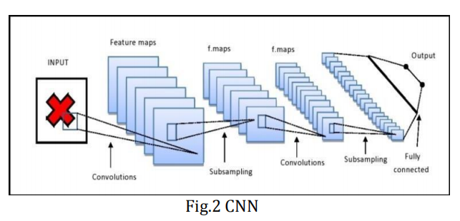
Architecture used in paper
A- Input Image.
B- Convolution Layer:- Convolution is the first layer to extract features from the given input image.
Ex : image matrix and a filter.
C. Pooling Layer:- The section of pooling layers reduces the number of parameters when the images are too large without changing the important information.
D. Fully Connected Layer:-The layer we call as FC layer, we flattened our matrix into vector and feed it into a fully connected layer like neural network.
E. Output:- The output image provides the result of the model. On the basis of the fully connected layer the output is carried out.
Result:- The performance of a model for object detection is evaluated using the precision and recall across each of the best matching bounding boxes for the known objects in the image.

Slide 2
Dataset details.
Dataset Link : https://www.kaggle.com/datasets/thiagolermen/dataset-face-mask-detection.
Dataset Name : Face Mask Object Detection
The dataset has 3081 image separated into two distinct categories:
- With mask (1526 images)
- Without mask (1555 images)
The dimension of image is (224,224,3)
Implementation details:-
 | Training | Validation | Testing
Ratio | 65% | 15% | 20%
Number of images | 2464 image | 617 image | 760 image

Slide 3
Implementation details.
1- import packages.
2- Initialize the initial learning rate, number of epochs to train for, and batch size (INIT_LR = 1e-4 , EPOCHS = 20 , BS = 32.)
3- Gathreing the list of images in our dataset directory, then initialize the list of data
and class images.
4- Perform one-hot encoding on the labels.
5- Construct the training image generator for data augmentation.
6- Load the MobileNetV2 network, ensuring the head FC layer sets are left off.
7- construct the head of the model that will be placed on top of the base model.
8- place the head FC model on top of the base model.
9- loop over all layers in the base model and freeze them so they will *not* be updated during the first training process.
10- compile our model.
11- Train the head of the network.
12- Make predictions on the testing set.
13- Find the index of the label with the corresponding largest predicted probability.
14- serialize the model to disk.

Slide 4
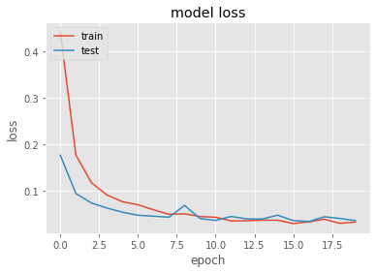
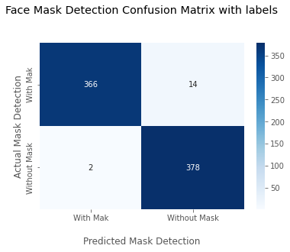
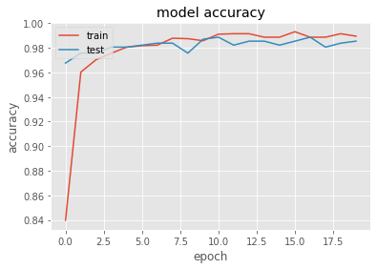
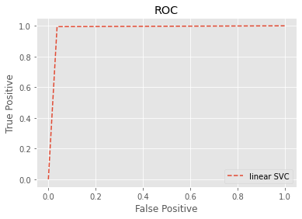
Results and visualizations.
Loss : 0.07 %
Accuracy : 98.2 %

