Slide 1

Kadada-X: An AI-Powered Rice Leaf Disease Detection and Recommendation System
BY:
Abdullahi Isa AHMED
3MTT Fellow ID: FE/23/39125017
Yobe State - AI/ML - Cohort 3
Notes:
Hello everyone,

Slide 2
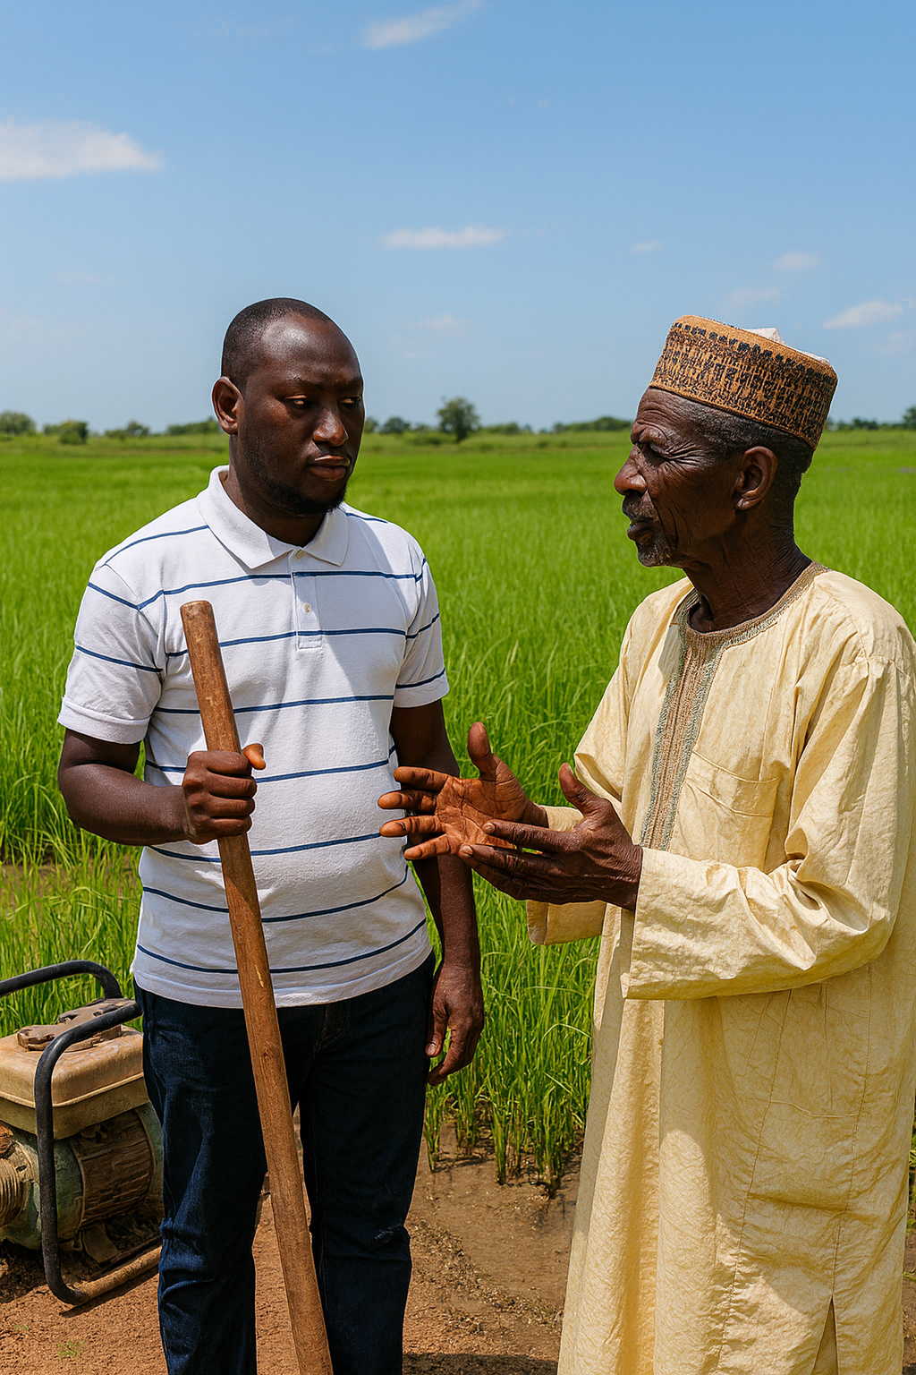

Motivation
Increasing focus on rice cultivation
Urgent need to detect and address rice leaf diseases (a case study from the local farmers
Providing practical, localized solutions for farmers, delivered in their native languages.

Slide 3
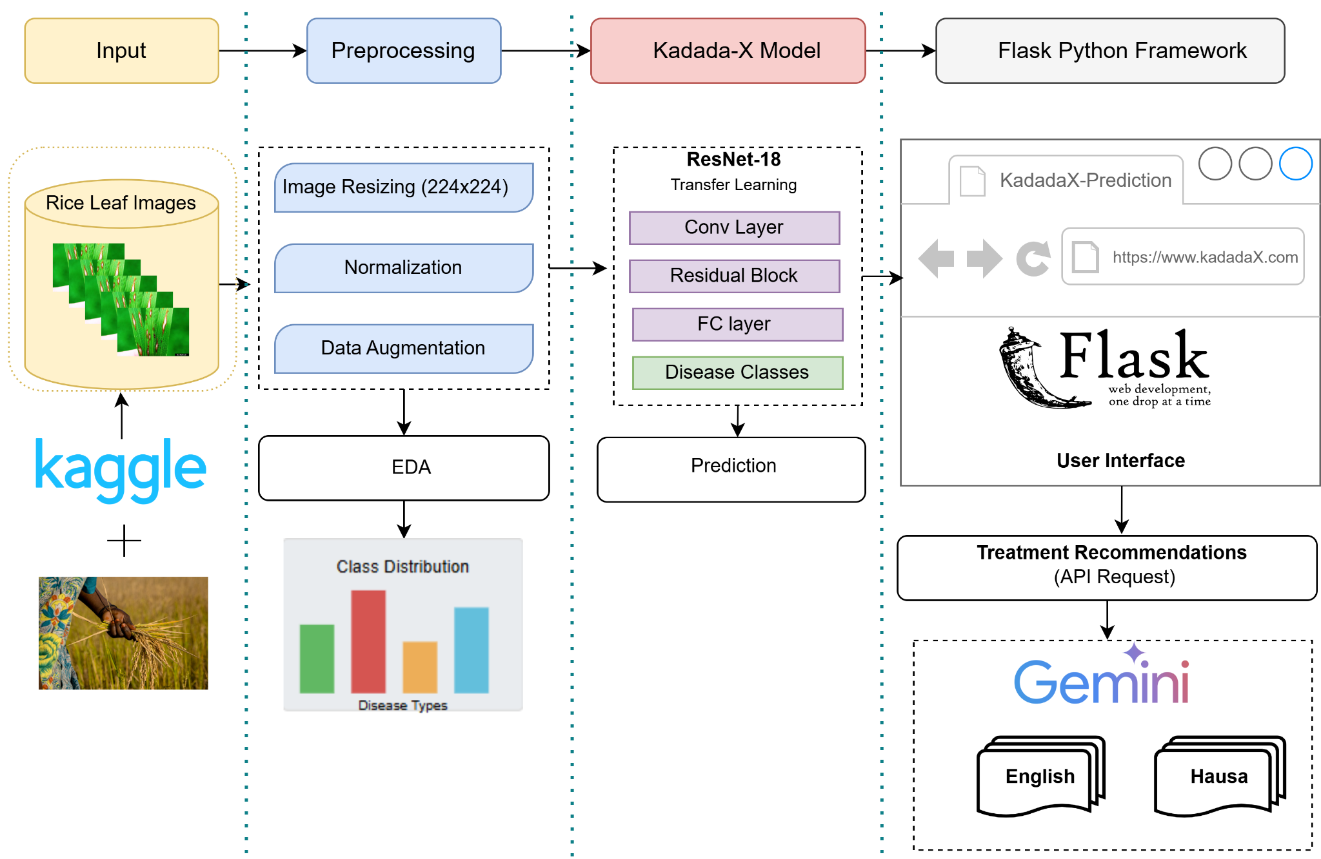
System Model: Kadada-X

Slide 4
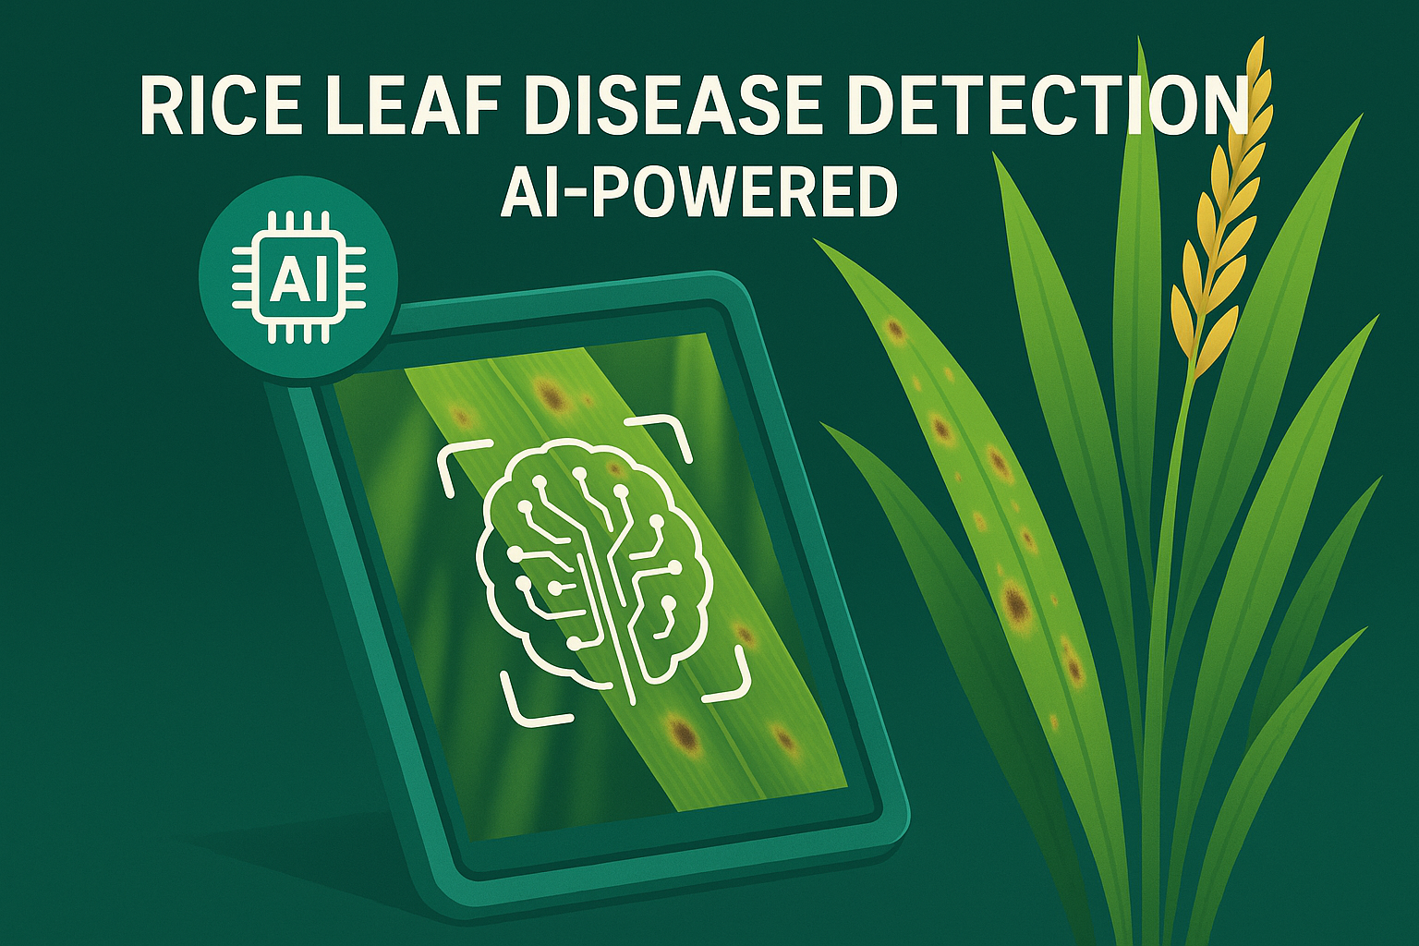
KadadaX Demo

