Slide 1

TEACHER PORTAL USING C++
Presented By:
Abdullah Javed (210760)
Fazeel Jahan (210736)
Submitted To:
Sir Umer Farooq

Slide 2
Presentation Overview
Introduction
Problem Statement
Detailed Methodology
Results
Conclusion
References

Slide 3
Introduction
Teachers face time-consuming manual grading of quizzes, assignments, and exams.
Human errors in calculations lead to unfair grades and rework.
Managing large student data in CSV/Excel files is complex and inefficient.
Reads student data from CSV files.
Calculates grades using custom weightages (quizzes, exams, projects).

Slide 4
Generates reports instantly (on-screen or CSV)
Allows search by roll number for quick access
Saves hours of manual work
Ensures accuracy and fairness in grading
Simple, no-installation-needed tool for teachers

Slide 5
Problem Statement
Manually calculating student grades consumes excessive teacher time and often leads to errors. Current methods struggle to efficiently process large classes with multiple assessment types like quizzes, exams, and projects. Teachers face difficulties when working with CSV/Excel grade data and maintaining consistent grading standards. There's a lack of simple, customizable tools for automated grade calculation and analysis. Our C++ Teacher Portal solves these issues by automating weighted grade calculations, enabling quick student lookups, and generating accurate reports instantly.

Slide 6
Detailed Methodology
.
1. We Start with a File:
A file that has student marks in it. It’s like a table with names, roll numbers, and marks for quizzes, assignments, exams, and project.
2. Our Program Reads the File:
We use C++ to open and read this file. Our code goes through each student’s row and picks out their marks and saves them properly in our program.
3.Teacher Tells the Importance:
Next, the teacher tells the computer how important each part is. For example, quizzes might be 10%, assignments 20%, exams 30%, etc. All of them together must add up to 100%.
4. We Calculate Total Marks:
Our code adds up all the marks using the rules. For example, it checks quiz marks, finds an average, and then calculates how much that counts in the total.

Slide 7
5. We Give Grades:
After finding total marks, the computer finds the class average. It then gives each student a grade (like A, B, C, or F) based on how well they did compared to the average.
6.We Show a Menu:
The program gives the teacher 4 choices:
See all students’ results.
Save all results in a new file.
Search for a student by their roll number.
Exit the program.
7. It Works for Any Class:
Our project works even if the number of students or quizzes changes. The teacher just needs to give a new file, and the code will still work.

Slide 8
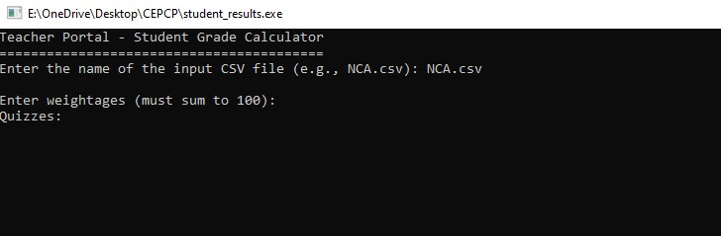
Results and Discussions
This section includes the loading of the csv file where students data is stored it is done by calling the name of the csv file in the console we have to make sure that the csv file should be kept in the same folder as the c++ file of the code is stored.

Slide 9
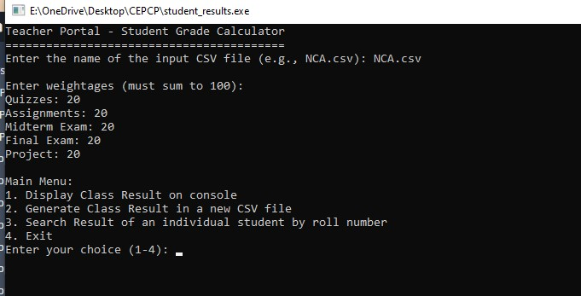
Results and Discussion
Teachers can set flexible weights for quizzes, assignments, exams, and projects, ensuring the total equals 100% (invalid sums trigger errors). After input, a menu offers options to display results, export CSV, search students, or exit.

Slide 10
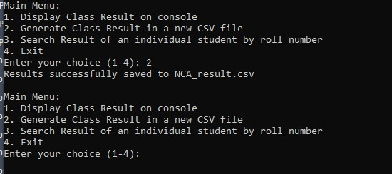
Results and Discussion
The user can save the entire result to a new CSV f ile by choosing Option 2. This is handled in the backend by the generate CSV Result() method, which is likewise activated by a switch case. The application uses of stream to open the file and automatically creates a new filename by attaching result.csvtotheoriginalfile name

Slide 11
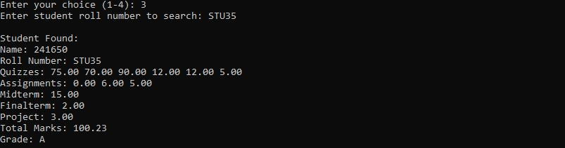
Results and Discussion
Option 3 lets teachers search results by roll number. The system scans student records and displays full details (scores, total, grade) if found, or a "not found" message. This provides quick access without reviewing all results.

Slide 12
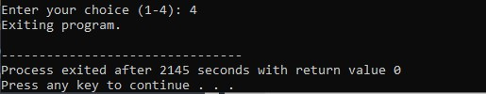
Results and Discussion
The main() function uses a do-while loop that only terminates when Option 4 is selected, triggering a controlled exit without additional function calls.

Slide 13
Conclusions
The project demonstrates how C++ can automate academic tasks like reading student data, calculating grades with customizable weights, and generating results in both console and file formats.
It ensures accurate and fair grading while reducing human errors, saving teachers significant time in manual calculations.
Core C++ concepts like file handling, structures, vectors, and functions were applied to build a well-organized and efficient system.
The menu-driven design enhances usability, allowing teachers to easily navigate options like displaying results, exporting files, or searching by roll number.
Features like dynamic weight adjustments and relative grading based on class averages make the tool adaptable to different course requirements.
By combining automation with user-friendly controls, the program provides a practical solution for managing student evaluations in educational institutions.

Slide 14
References
1.https://www.scribd.com/document/434628462/c-school-management
2.https://github.com/Mubeen-Channa/Student-Grade-Calculator

