Slide 1

Project on:
Online Advising Portal
Software Engineering and Information System
CSE411
Section: 2
Spring 2021
Group Members: Md Abdullah Al Mamun (ID : 2017-3-60-085)
Md. Shamsul Arafine (ID : 2017-2-60-012)

Slide 2
What is the problem ?
The project addresses advising - an important issue that is often not give enough attention
by students and advisors alike. Student advising is one of the most important challenges faced in academics, but direct consultation between advisor and students is another problem entirely. Many students do not take the time and effort to see their advisors to plan their timetable and occurs long queues for advising. This creates issues ranging from students not being able get desired courses to wasting valuable time that both parties could have been using doing other important work.

Slide 3
The Solution at hand
To resolve complications surrounding physical advising, an online based system will be much more hassle-free and appreciated by advisors and students alike.
In this project, we will present a system that accesses students' transcript records and generates a report for each student that must indicate the course so that he or she can enroll in the next semester based on the rules described in the next in the project. This will enable the admin to decide the courses and sections to be offered and prepare the timetable, allocate building and rooms for the students and the advisor also be informed in all ways throughout the online advising portal website.
The proposed system will be help students in advising at the comfort of their home.

Slide 4
Requirements
Functional Requirements:
1. User will have to login through their Email and Password.
2. After login, students will be able to see their CGPA, Term GPA of all completed
semester, completed courses and grades of those courses.
3. Students will not be able to add or drop any course after the advising period.
4. The system must allow the admin panel to do all the administrative work.
Non-Functional Requirements:
1. System should not collapse during the advising.
2. Data must not be leaked.
3. The system must be able to protect all the information.
4. The system will be capable of improvement continuously in order to maintain system.
5. Advising schedule will be set by the admin.

Slide 5
Feasibility of the Project
Technical Feasibility
Our project is technically feasible, as the current technologies are sufficient to implement and complete as far as our needs to accomplish university authority’s requirements within the time. Since programming languages such as SQL, HTML and CSS and server hosting are a commonplace nowadays, a functional and dynamically modular website creation happens to be in the realm of possibilities.
Operational Feasibility
Our project addresses all the operational problems regarding a functional advising system to come up with a solution as per our needs.

Slide 6
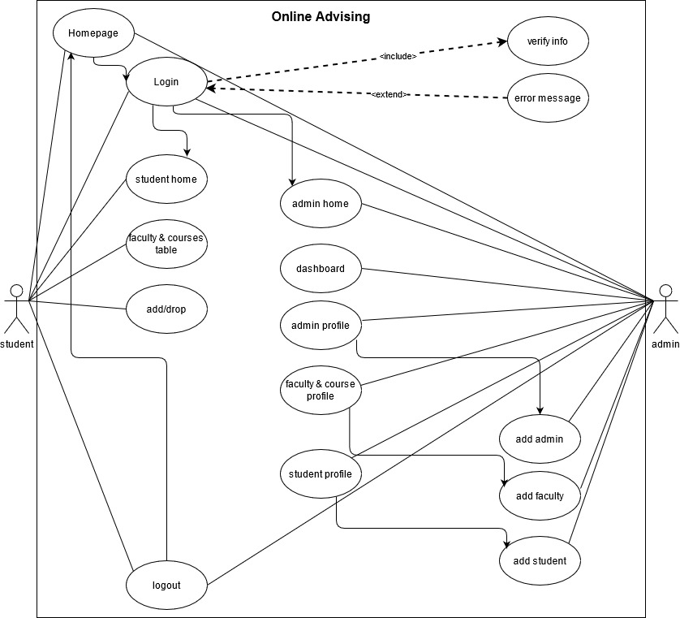
Use Case Diagram

Slide 7
Some Use Case Description
Student Profile:
After the admin has logged in, he/she can view the student profile page where they can further manipulate the data as they see fit using the given options of actions on the aforementioned page.
Add Faculty:
After logging in, admin can use this page to add additional faculty information that includes the name of the instructor, the course and sections, class schedule and building no.

Slide 8
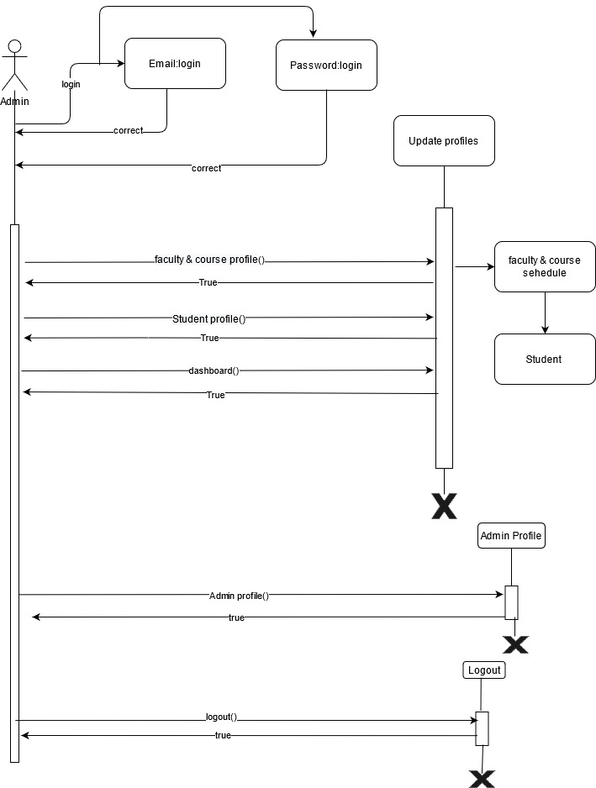
Sequence Diagram (Admin)

Slide 9
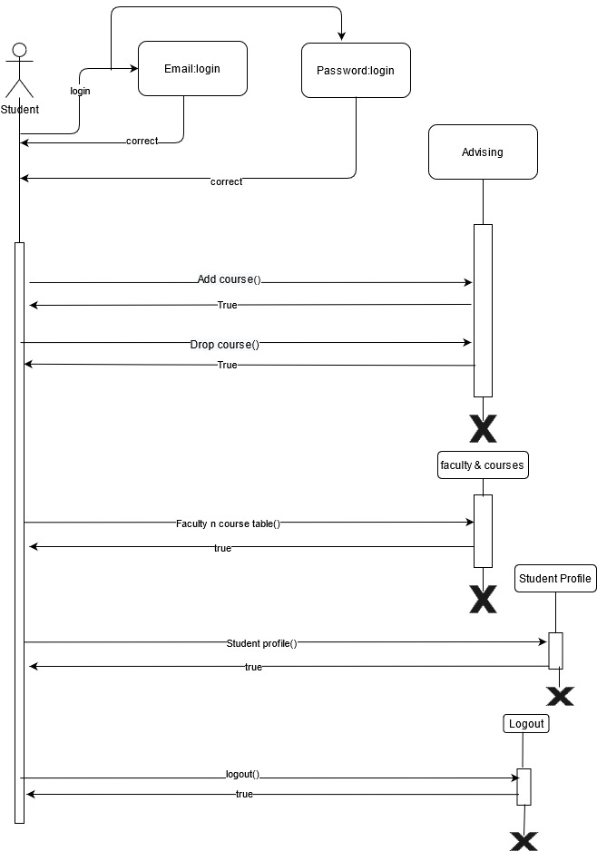
Sequence Diagram (Student)

Slide 10
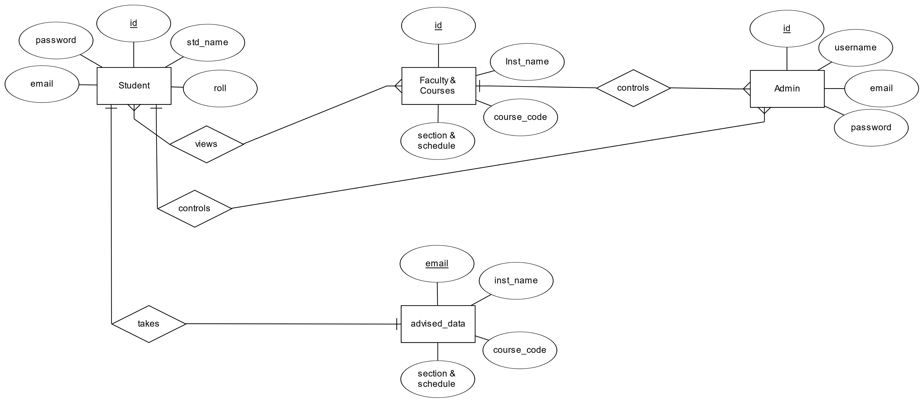
ER Diagram

Slide 11
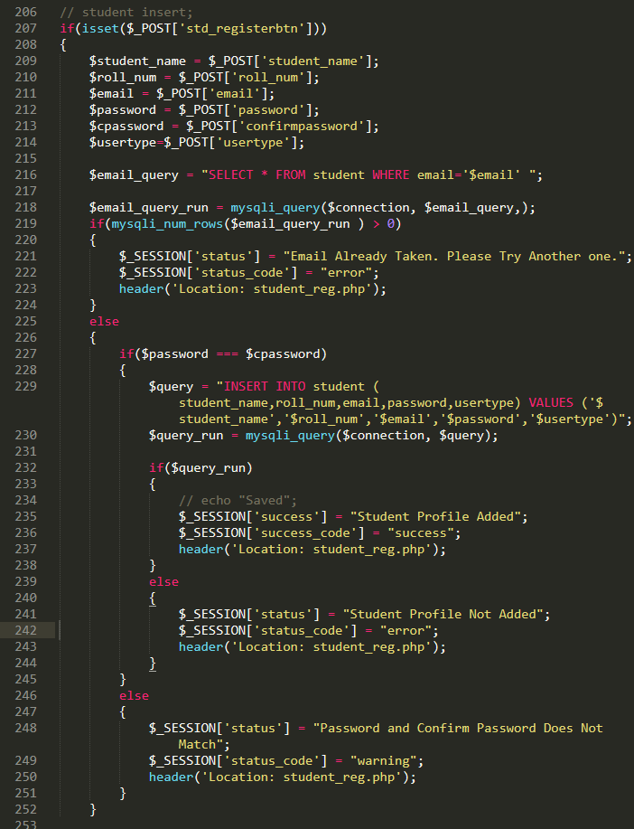
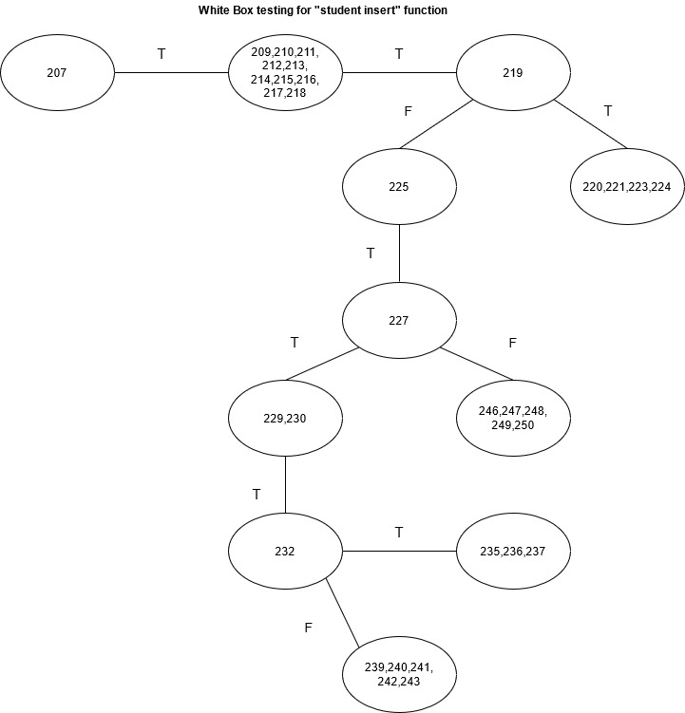
Test Case (source code) White Box Testing

