Slide 1
Walmart Sales Analysis
Automated Report Generated by Python
(Charts & Insights)

Slide 2
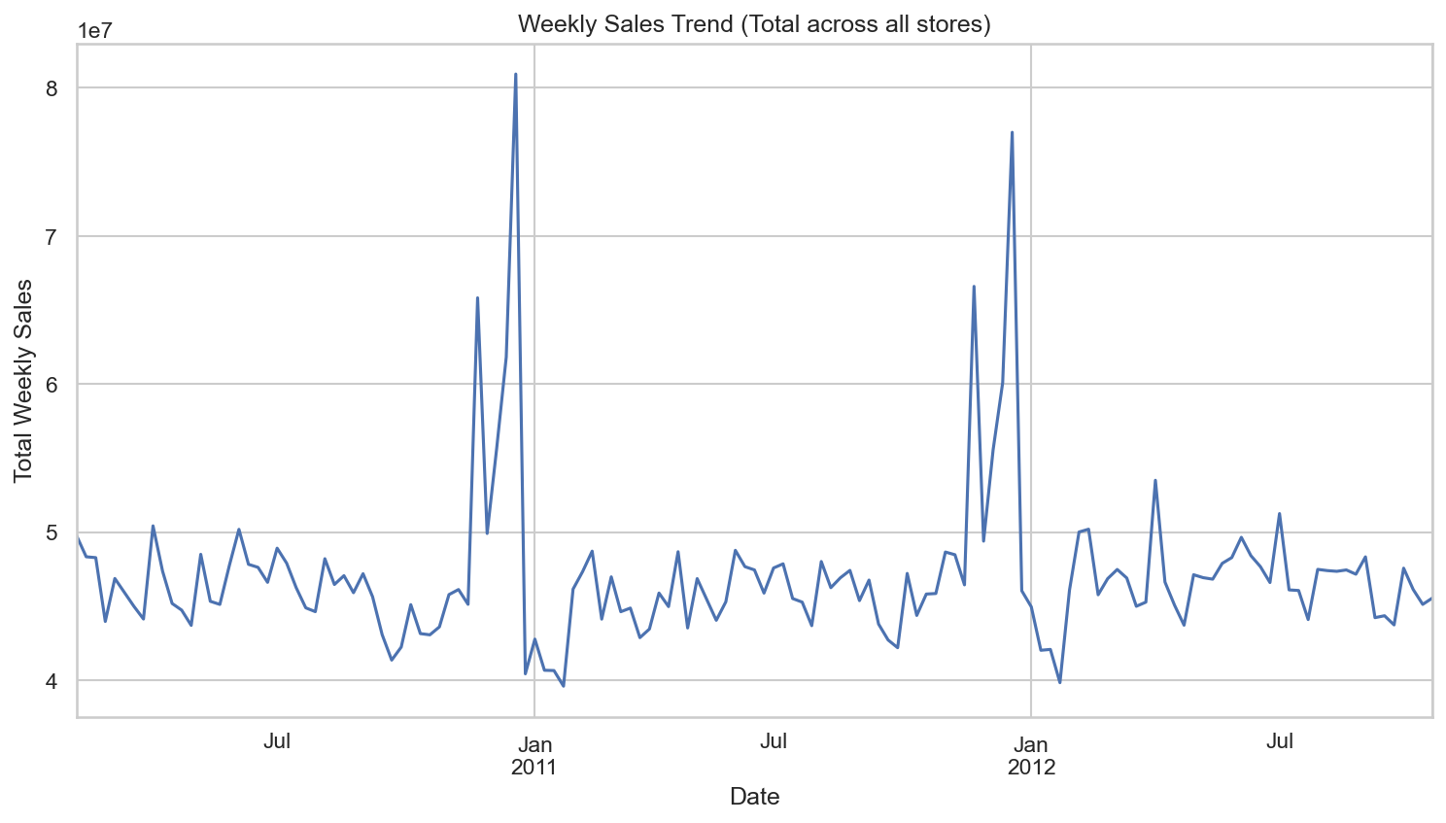
Weekly Sales Trend

Slide 3
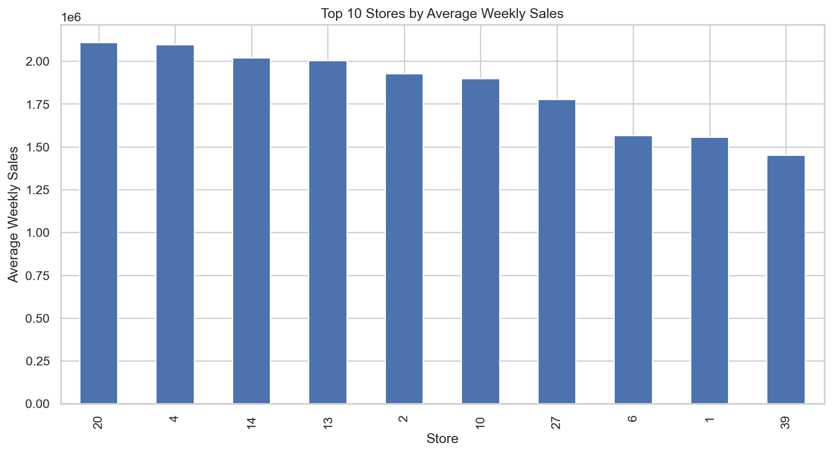
Top 10 Stores

Slide 4
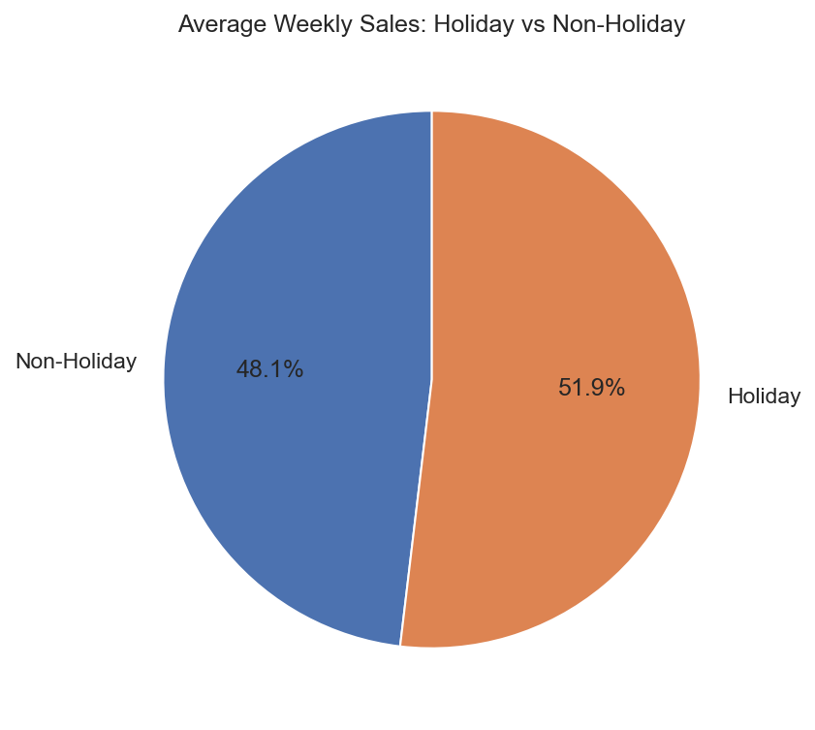
Holiday vs Non-Holiday Sales

Slide 5
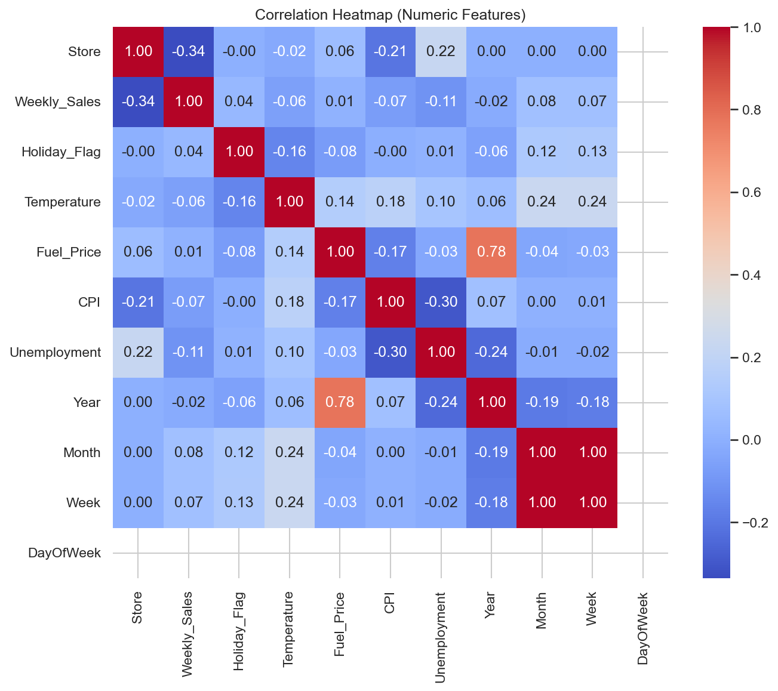
Correlation Heatmap

Slide 6
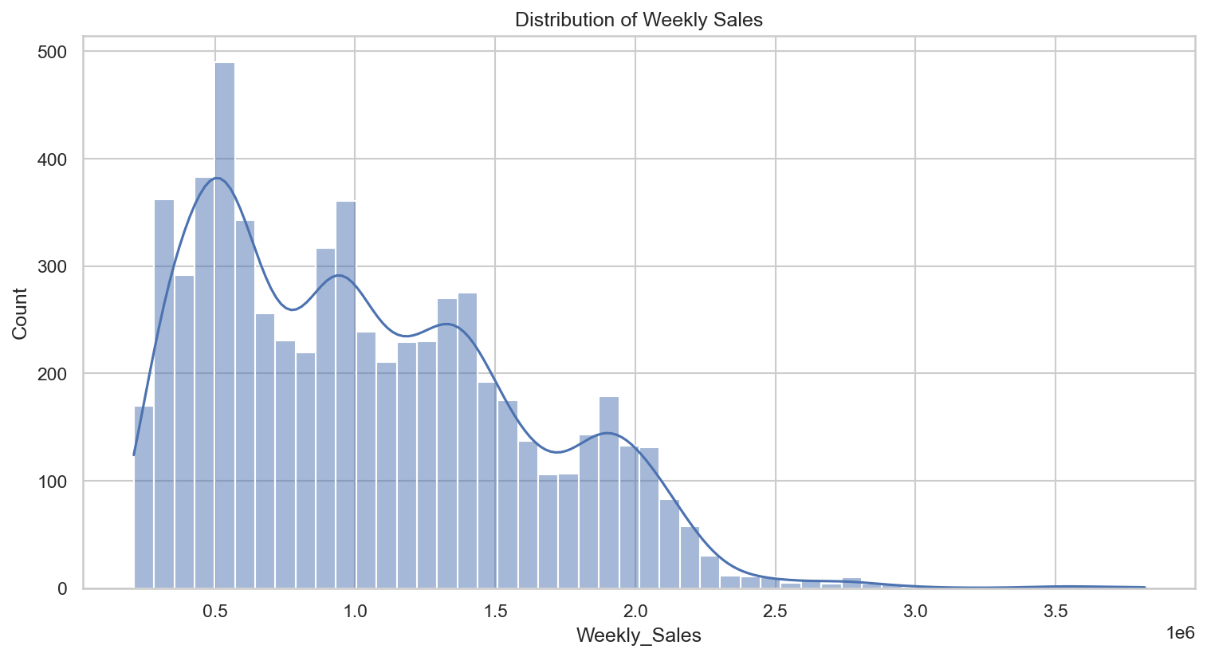
Sales Distribution

Slide 7
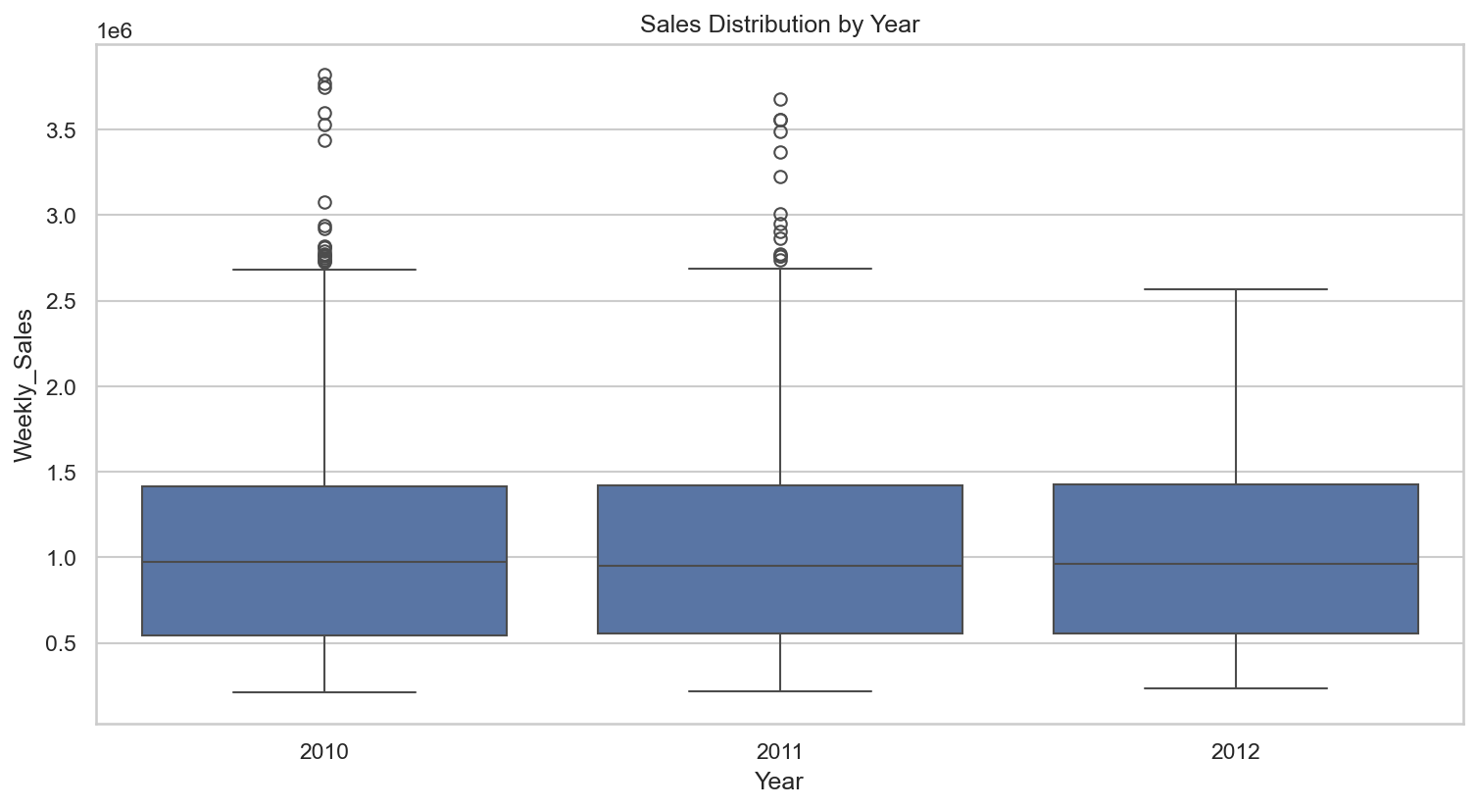
Sales by Year

Slide 8
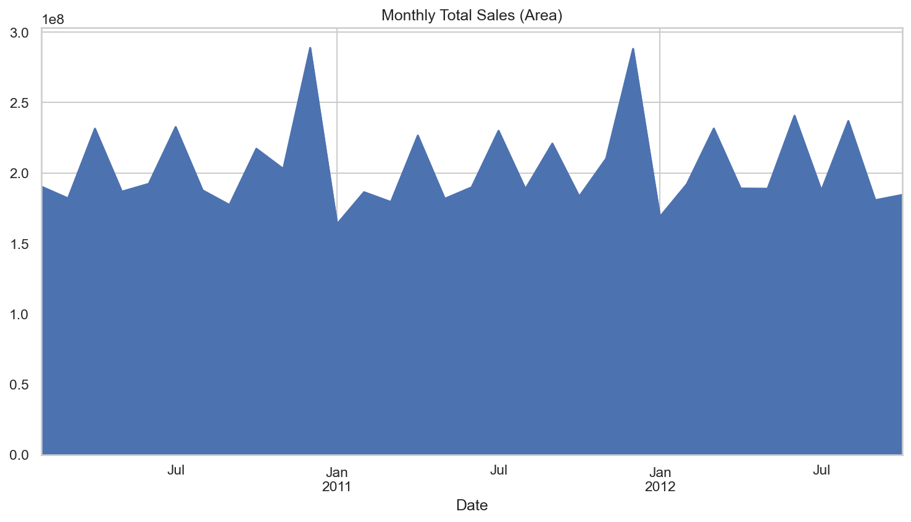
Monthly Sales

Slide 9
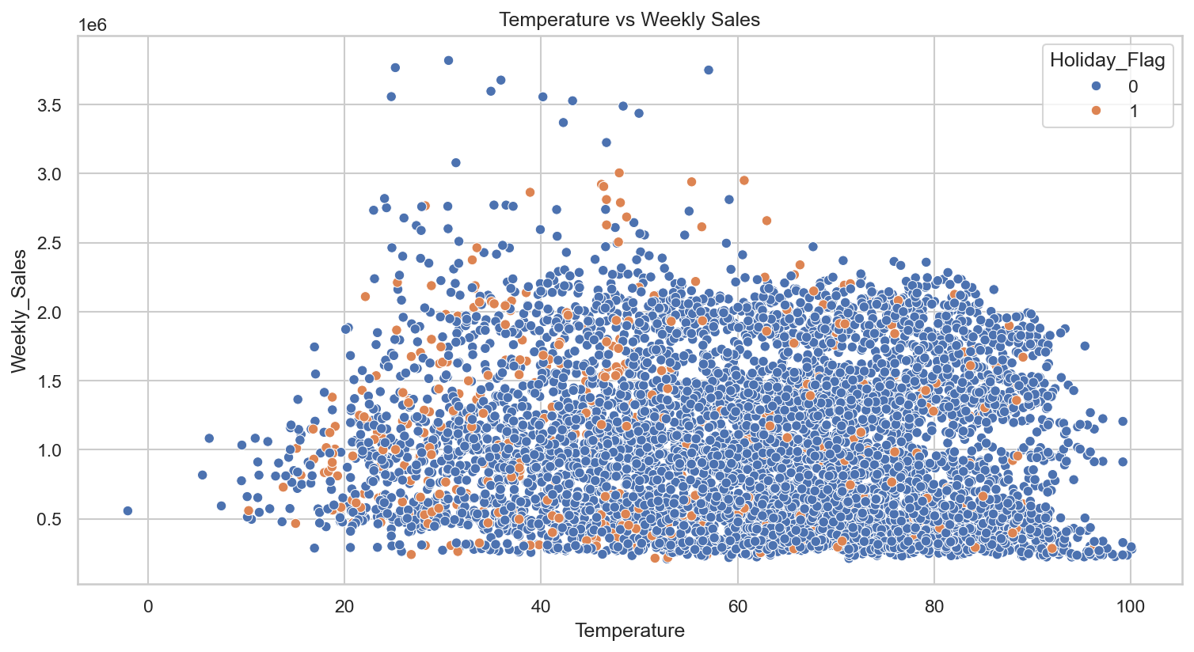
Temperature vs Sales

Slide 10
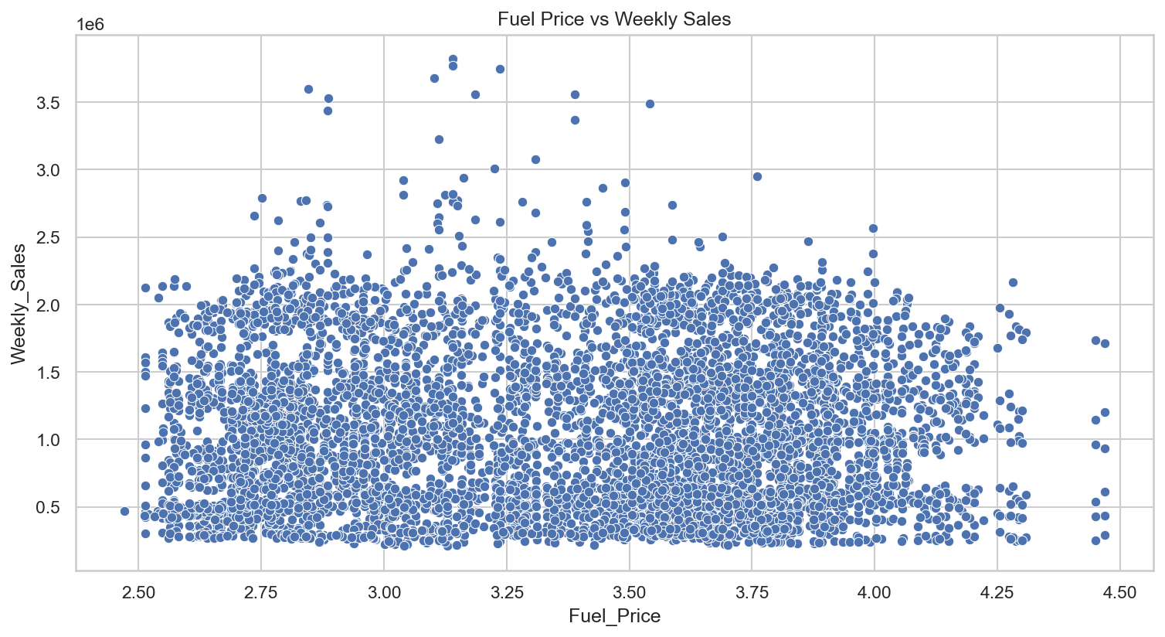
Fuel Price vs Sales

Slide 11
Key Insights & Recommendations
1. Total sales (dataset): 6,737,218,987.11
2. Average weekly sales: 1,046,964.88
3. Median weekly sales: 960,746.04
4. Top store by total sales: Store 20 with 301,397,792.46
5. Top store by average weekly sales: Store 20 with 2,107,676.87
6. Holiday vs Non-Holiday average weekly sales: Non-Holiday 1,041,256.38, Holiday 1,122,887.89
7. Highest monthly sales observed in: 2010-12 with 288,760,532.72

