Slide 1
Final Project
Obaid Alnaqbi

Slide 2
Content Management System (CMS)
What Does It Do?
The CMS is a web application that allows for managing, displaying, and organizing various types of content like books, recipes, events, projects, and movies.
Key Features:
Authentication System: Secure user signup, login, and logout functionality.
Role-based Access: Admins manage content; members can view content and add records but cannot edit or delete them.
CRUD Operations: Admins can create, update, and delete content.
Public Area: Visitors can browse books, recipes, and events.
Modern Design: Clean and visually appealing theme applied across the site.
Objective: Create a simple yet functional CMS that demonstrates database integration, security, and responsive design.

Slide 3
The ER Diagram
Entity-Relationship (ER) Diagram
Tables and Relationships:
Users (Admin/User roles) manages content.
Books, Recipes, Events, Projects, and Movies entities store various types of content.
Genres table relates to Books and Movies for categorization.
Diagram Highlights:
Users (1:N) -> Books, Recipes, Events, Projects, Movies
Genres (1:N) -> Books, Movies

Slide 4
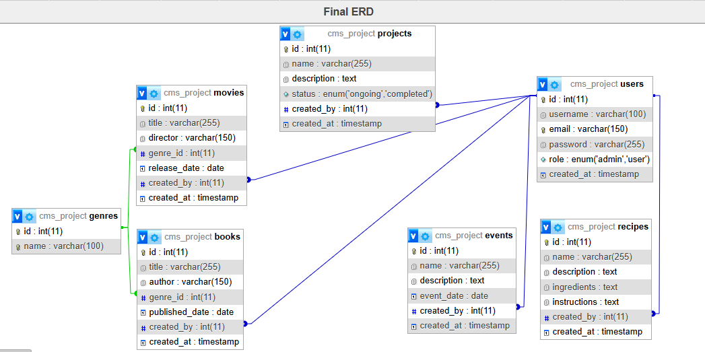
ER Diagram

Slide 5
Team Members and Contribution
Team Contribution
Project Developer: Individual project.
Key Responsibilities:
Design and Development: Implemented full-stack development of the CMS, including frontend and backend.
Database Design: Created and populated the database with normalized tables and meaningful relationships.
Theme Integration: Designed a clean and responsive theme for all pages.
Authentication and Security: Built secure user authentication with role-based access.
Testing and Debugging: Ensured the CMS is bug-free and functional across different scenarios.

