Slide 1

LankaBangla Securities Done by Team Registration Squad
NAME | ID
Kawshik Rahman Kabbo | 2022650
Ashrafur Rahman Asem | 2021771
Md.Al-Mahamudur Rahman Rafi | 2022164
Istiak Rahman | 2010151
Fatema Akter Bonna | 2022134
Muzahidul Islam | 2010465

Slide 2
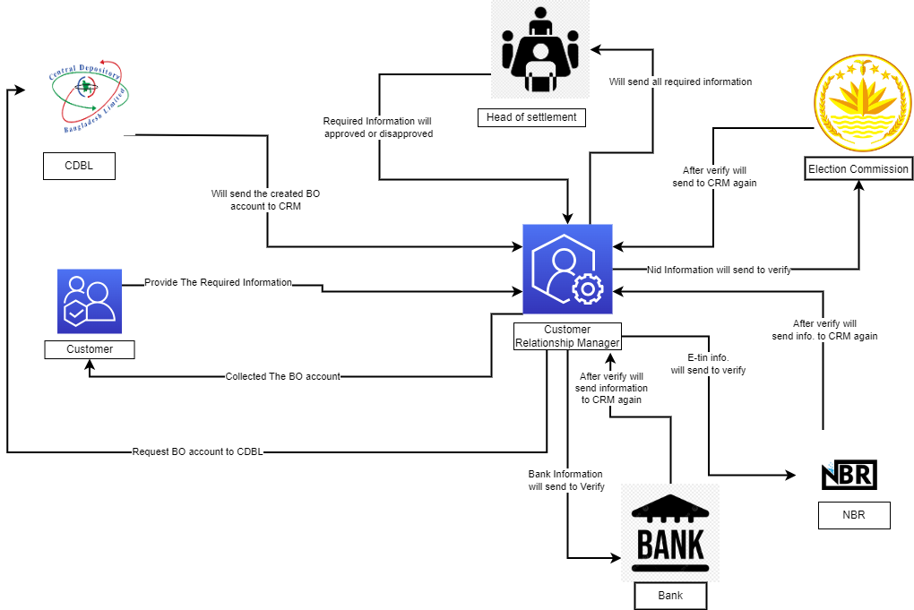
Rich Picture (AS IS)

Slide 3
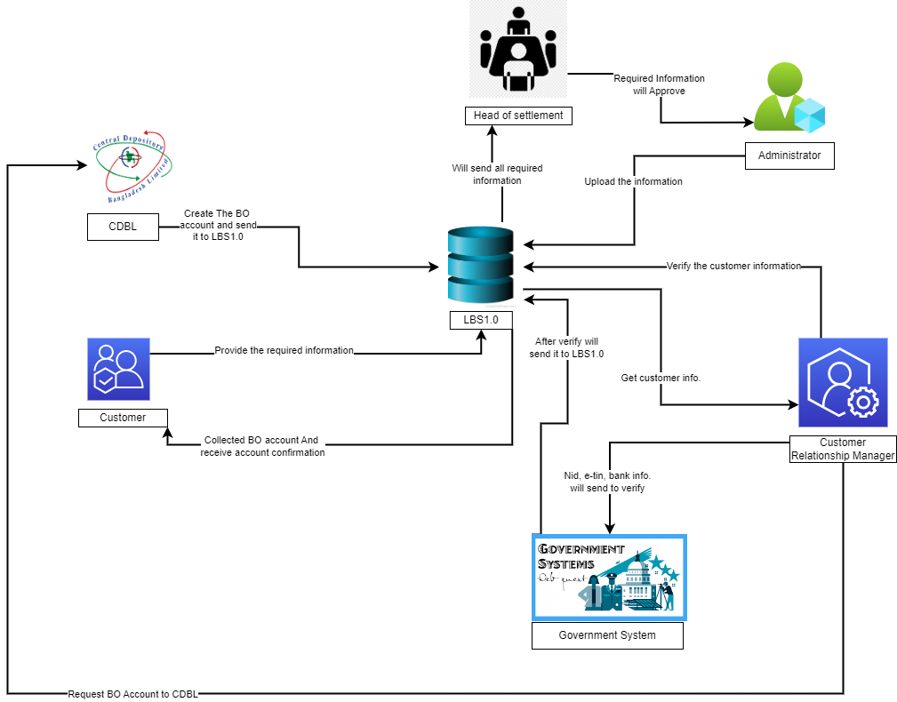
Rich Picture (TO BE)

Slide 4
Existing Problem & Analysis of the Problem
PROCESS NAME | EXISTING SYSTEM PROBLEMS | PROPOSED SOLUTION
Customer Account Opening | Manual data input for client account creation in the present system causes mistakes, inconsistencies, and inefficiencies. Unintegrated departments and systems delay client data verification and increase errors. Customer onboarding without strong identity verification risks data breaches | Integrate digital forms to reduce manual data entry mistakes. Centralised Database: Create a centralised database for real-time data exchange across departments to streamline verification and improve accuracy. Biometric or two-factor authentication for client identification verification.
Trade Execution | Latency and delays in the trade execution system cause lost trading opportunities and poor execution pricing. Traders sometimes lack real-time insight into market circumstances, order status, and execution performance, making decision-making difficult. | Reduce latency using high-speed infrastructure and optimised algorithms. Provide traders with market trends, order status, and execution indicators to improve decision-making. Unified
Data Backup and Security | The current system lacks effective backup methods, putting data at risk from hardware failures, human mistakes, and cyberattacks. Unsecured data leads to breaches and privacy violations. | Implement an automatic backup solution that backs up vital data to secure offsite locations. Protect sensitive data using encryption, access restrictions, and intrusion detection.
Customer Support | Customers get impatient and dissatisfied owing to long wait times for customer service. Customer support agents provide conflicting information, confusing consumers and undermining confidence. Without self-service capabilities. | Integrate AI-powered chatbots to handle common inquiries and provide instant responses, reducing wait times and improving overall efficiency.Develop a comprehensive knowledge base accessible to all agents, ensuring consistent and accurate information.

Slide 5
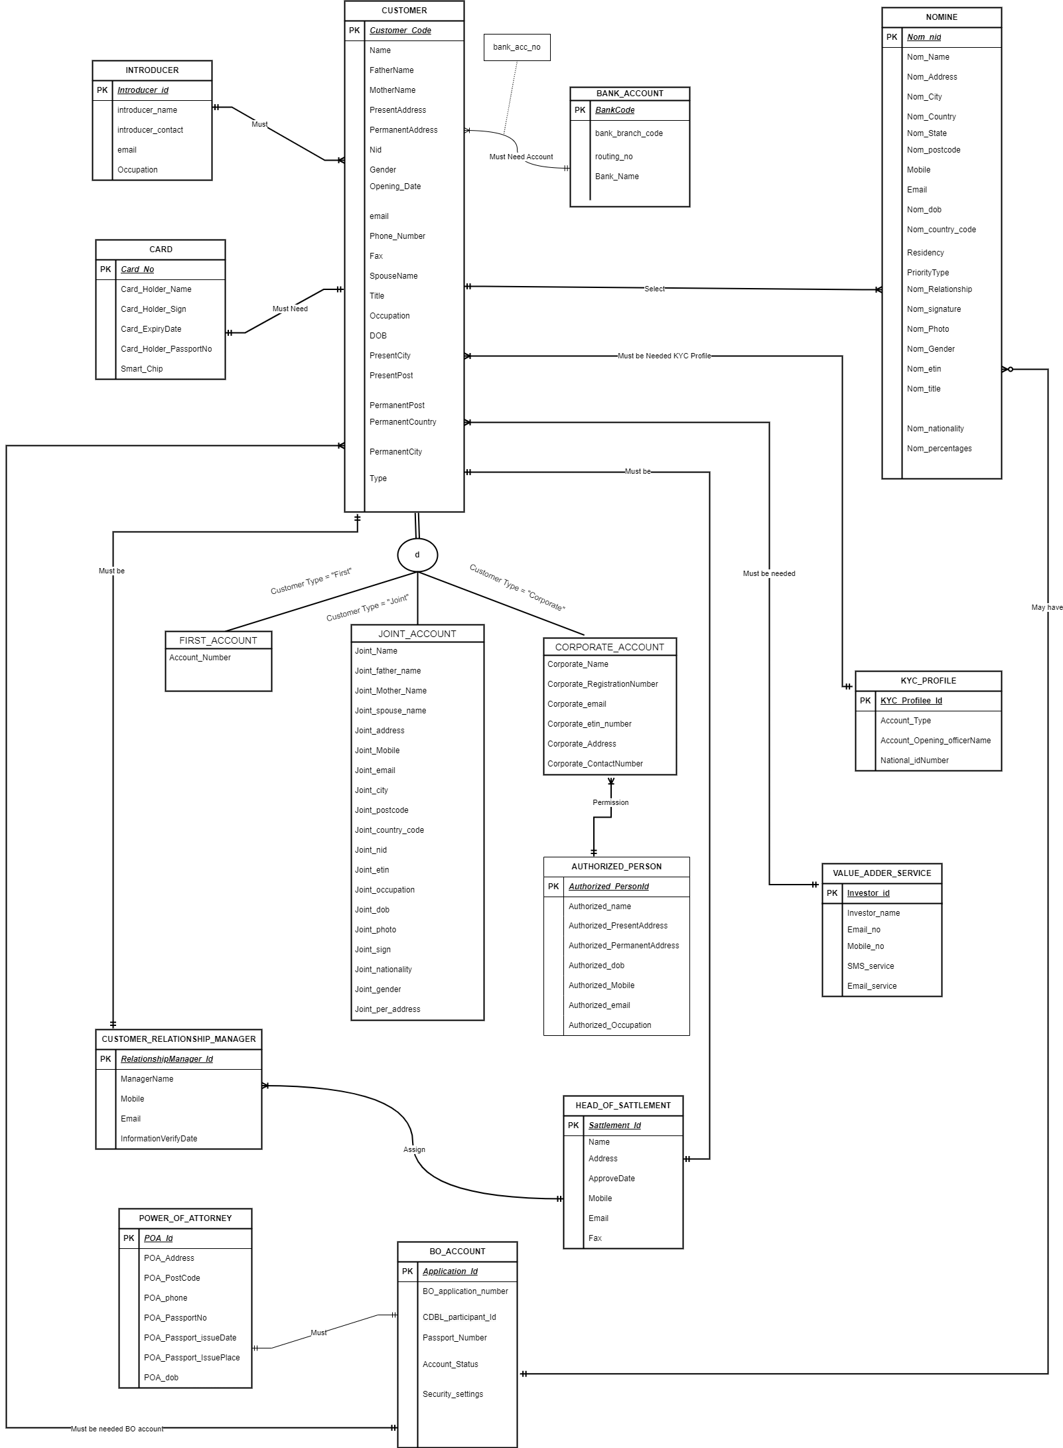
EERD

Slide 6
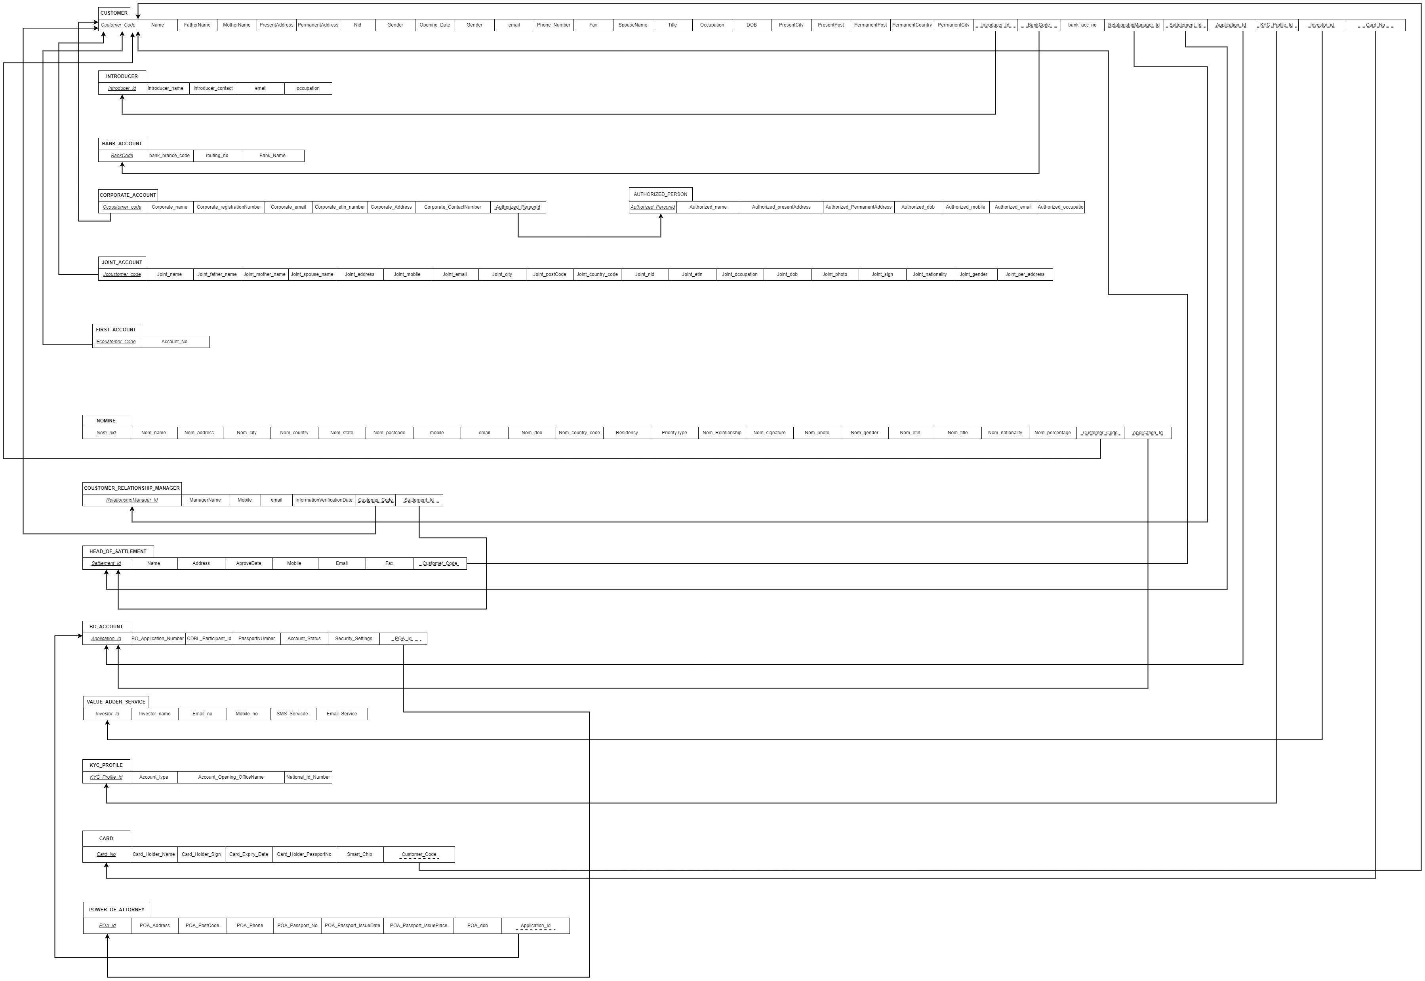
Relational Schema

Slide 7
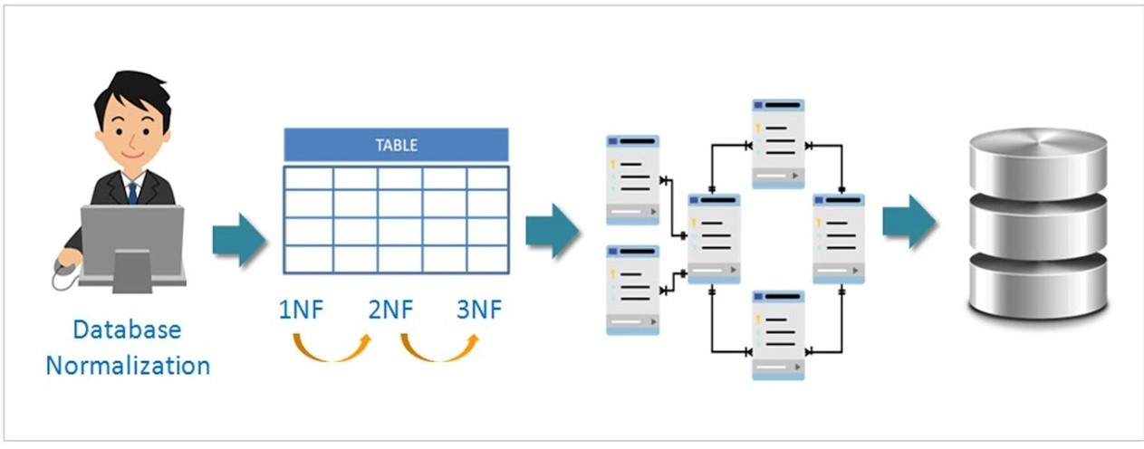
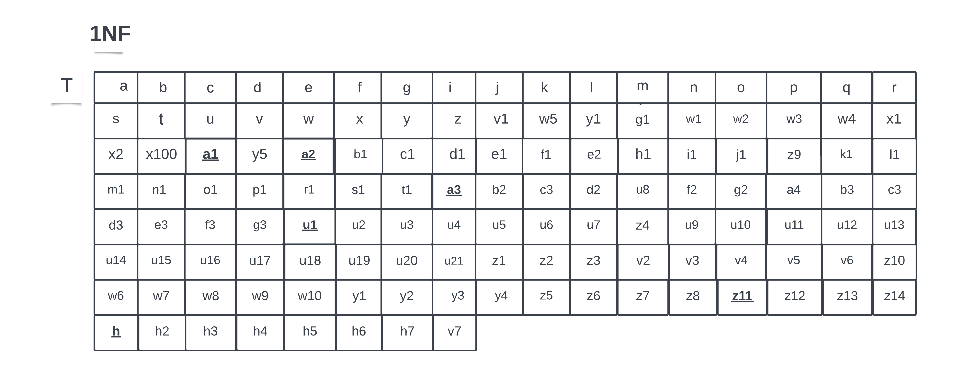
Normalization

Slide 8
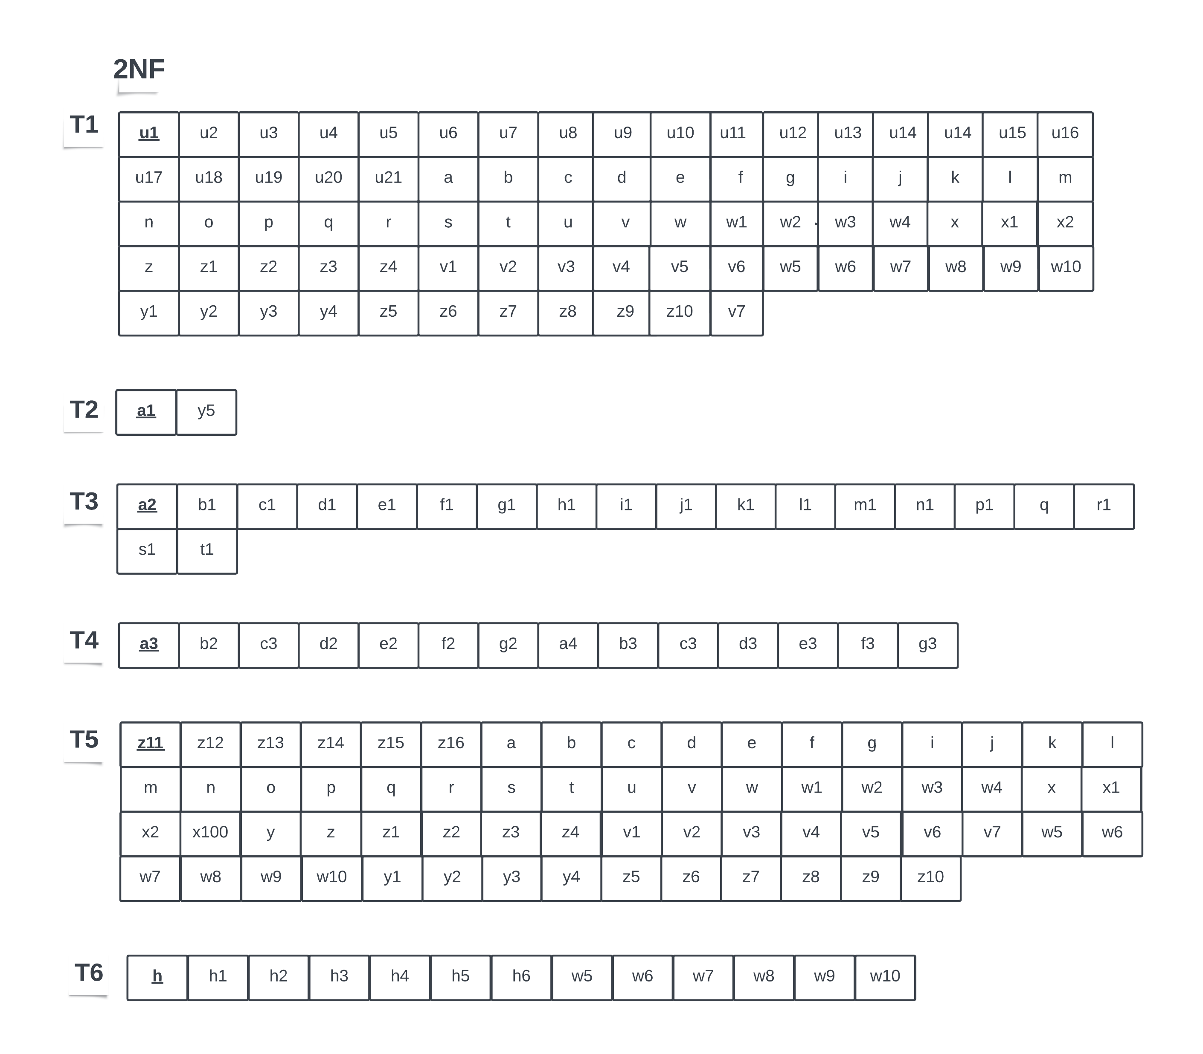
Normalization (Continued)

Slide 9
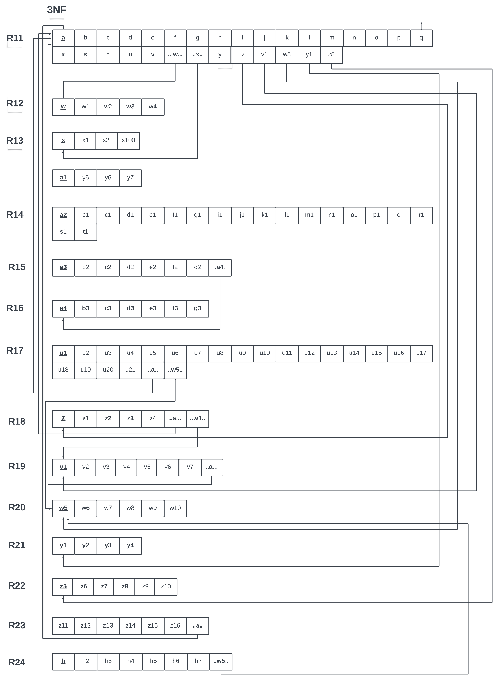
Normalization (Continued)

Slide 10
Data Dictionary
Name | Data Type | Size | Remarks
nCustomerCode | INTEGER | 11 | This is the primary key for the Customer Table. E.g. : 0123456
cName | VARCHAR | 50 | This is the name of the Customer. E.g : Rahim
cFatherName | VARCHAR | 50 | This is the name of the customer's father. E.g: Abdullah
cMotherName | VARCHAR | 50 | This is the name of the customer's mother.E.g: Nasrin
cPresentAddress | VARCHAR | 40 | This is the Present address of the customer.E.g; badda,dhaka1212
cPermanentAddress | VARCHAR | 40 | This is the Permanent Address Of the customer.E.g:cantonment,Dhaka
nNid | INTEGER | 13 | This is the national ID of the customer.E.g.:1234567891012
dOpeningDate | DATE | DD MM YYYY | This is the opening date of the customer.E.g.:26/03/2020
cGender | VARCHAR | 8 | Gender of the customer. E.g: Male
cEmail | VARCHAR | 25 | This is the email address of the customer. E.g.:asdf@gmail.com
nPhoneNumber | INTEGER | 11 | This is the phone number title of the customer. .E.g.:12345678910
cFax | VARCHAR | 40 | This is the FAX of the customer. E.g: +880
cSpouseName | VARCHAR | 50 | This is the name of the Spouse. E.g: Hanifa
cTitle | VARCHAR | 50 | This is the title of the customer. E.g: Customer Information
cOccupation | VARCHAR | 10 | This is the name of the occupation. E.g: Product Supplier
dDOB | DATE | DD MM YYYY | This is the date of birth of the customer.E.g: 23/05/1993
cPresentCity | VARCHAR | 8 | This is the name of the present city. E.g: Dhaka
nPresentPost | VARCHAR | 4 | This is the name of the present post. E,g: Salesman
nPermanentPost | VARCHAR | 4 | This is the name of the permanent post. E.g: Employer
cPermanentCountry | VARCHAR | 15 | This is the name of the permanent country. E.g: Bangladesh
cPermanentCity | VARCHAR | 15 | This is the name of the permanent city. E.g: Barishal
nIntroducerId | INTEGER | 15 | This is the foreign key from table Introducer. E.g: 208467
nBankCode | INTEGER | 20 | This is the foreign key from table Bank_Account.E.g: 126784
nbank_accno | INTEGER | 20 | This is the number of the bank account.E.g.:1234 1568 1529 1258 12
nRelationshipManagerId | INTEGER | 15 | This is the foreign key from table Customer_Relatlonship_Manager.E.g.:558899
nSattlementId | INTEGER | 15 | This is the foreign key from table Head_OF_Sattlement.E.g.:154236
nApplicationId | INTEGER | 10 | This is the foreign key from table BO_Account.E.g.:654321
nKYCProfileid | INTEGER | 20 | This is the foreign key from table KYC_Profile.E.g.:115566
nInvestorId | INTEGER | 20 | This is the foreign key from table Value_Addder_Service.E.g.:12345
Customer_T

Slide 11
Data Dictionary (Continued)
Introducer_T
Bank_Account_T
Introducer_T
Name | Data Type | Size | Remarks
nIntroducerId | INTEGER | 15 | This is the primary key for the Introducer table.E.g: 208467
cIntroducername | VARCHAR | 50 | This is the name of the introducer.E.g:
nIntroducercontact | INTEGER | 11 | This is the Introducer contact of the introducer.E.g.:12345678910
cEmail | VARCHAR | 25 | This is the email address of the introducer. E.g.:asdf@gmail.com
cOccupation | VARCHAR | 15 | This is the Occupation of the introducer.
Name | Data Type | Size | Remarks
nBankCode | INTEGER | 20 | This is the primary key for the Bank Account table.E.g: 126784
nBankBranchcode | INTEGER | 15 | This is the Bank Branch code of the bank Account customer.Eg: LBS12345
nRoutingno | INTEGER | 13 | This is the Routing number of the bank Account customer.E.g: LBSC123456

Slide 12
Data Dictionary (Continued)
Name | Data Type | Size | Remarks
nFcustomerCode | INTEGER | 11 | This is the primary key for the First Account table. E.g: 53693
cFirstname | VARCHAR | 50 | This is the first name of the First Account customer. E.g: Khalil
cFirstcontactNumber | INTEGER | 11 | This is the First contact Number of Account customers.E.g.12345678910
cFirstAddress | VARCHAR | 15 | This is the First Address of the First Account customer.E.g; A,B1212
First_Account_T

Slide 13
Data Dictionary (Continued)
Name | Data Type | Size | Remarks
nJcustomercode | INTEGER | 11 | This is the primary key for the Joint Account table. E.g: 135946
cJointname | VARCHAR | 50 | This is the name of the joint Account customer. E.g: Mostak
cJointfathername | VARCHAR | 50 | This is the name of the joint Account customer's father. E.g: Abdul
cJointmothername | VARCHAR | 50 | This is the name of the joint Account customer's mother. E.g: Sabera Khatun
cJointaddress | VARCHAR | 40 | This is the address of the joint account customer.E.g; A,B1212
cJointemail | VARCHAR | 25 | This is the email address of the joint account customer.E.g.:asdf@gmail.com
cJointcity | VARCHAR | 15 | This is the Joint city of the joint account customer.E.g.:”Dhaka”.
nJointpostCode | INTEGER | 4 | This is the postCode of the joint account customer.E.g: 1205
nJointcountrycode | INTEGER | 4 | This is the country code of the joint account customer.E.g: +880
nJointnid | INTEGER | 13 | This is the nid number of the joint account customer. E.g: 12345678901234567
nJointetin | INTEGER | 15 | This is the etin number of the joint account customer. E.g: 123456789012
cJointoccupation | VARCHAR | 50 | This is the occupation of the joint account customer.E,g: Business Man
dJointdob | DATE | DD MM YYYY | This is the date of birth of the joint account customer.E.g: 23/05/1993
bJointphoto | BLOB | 100 | This is the photo of the joint account customer.
cJointsign | VARCHAR | 20 | This is the sign of the joint account customer.E.g: Mostak
cJointnationality | VARCHAR | 15 | This is the nationality of the joint account customer.E.g: Bangladesh
cJointgender | VARCHAR | 8 | This is the gender of the joint account customer. E.g: Male
cJointpersentaddress | VARCHAR | 15 | This is the present address of the joint account customer. E.g: Barishal sadar
Joint_Account_T

Slide 14
Data Dictionary (Continued)
Corporate_Account_T
Name | Data Type | Size | Remarks
nCcustomercode | INTEGER |  | This is the primary key for the Corporate Account table. E.g: 46492724
nCorporateregistrationNumber | INTEGER |  | This is the Corporate registration Number of the Corporate Account customer.E.g: ABC123456789
cCorporateemail | VARCHAR | 25 | This is the email address of the Corporate Account customer.E.g.:asdf@gmail.com
nCorporateetinnumber | INTEGER | 50 | This is the Corporate etin number of the Corporate Account customer. E.g: BFST56
cCorporateAddress | VARCHAR | 15 | This is the Corporate Address of the Corporate Account customer.E.g; A,B1212
nCorporateContactNumber | INTEGER | 11 | This is the Corporate Contact Number of the Corporate Account customer.E.g.:12345678910
cAuthorizedPersonId | VARCHAR | 11 | This is the foreign key from the table Authorized_Person..E.g.:1123356

Slide 15
Data Dictionary (Continued)
Name | Data Type | Size | Remarks
nAuthorizedPersonId | VARCHAR | 13 | This is the primary key for the Authorized Person table.E.g.:1123356
cAuthorizedname | VARCHAR | 50 | This is the name of the authorized person.E.g.:”Halim”.
cAuthorizedPresentAddress | VARCHAR | 15 | This is the Present Addressof the authorized person.E.g; A,B1212
dAuthorizeddob | DATE | DD MM YYYY | This is the date of birth of the Authorized Person.E.g.:24/2/1971
nAuthorizedmobile | INTEGER |  | This is the mobile number of the authorized person.E.g.:12345678910
cAuthorizedemail | VARCHAR | 25 | This is the email address of the authorized person.E.g.:asdf@gmail.com
cAuthorizedoccupation | VARCHAR |  | This is the occupation of the authorized person.
Authorized_Person_T

Slide 16
Data Dictionary (Continued)
Name | Data Type | Size | Remarks
nNomnid | INTEGER | 13 | This is the primary key for the Nominee table.E.g.:5624892
cNomname | VARCHAR | 50 | This is the name of the nominee.E.g.:”kamal”.
cNomaddress | VARCHAR | 15 | This is the address of the nominee.E.g; A,B1212
cNomcity | VARCHAR |  | This is the city of the nominee.E.g.:”cumilla”
cNomCountry | VARCHAR |  | This is the Country of the nominee.E.g.:”bangladesh”
cNomstate | VARCHAR |  | This is the state of the nominee.E.g.:”Bangla”
nNompostcode | INTEGER |  | This is the postcode of the nominee.E.g.:26594
nmobile | INTEGER | 11 | This is the mobile number of the nominee.E.g.:12345678910
cemail | VARCHAR | 25 | This is the email address of the nominee. E.g.:asdf@gmail.com
dNomdob | DATE |  | This is the date of birth of the nominee.E.g: 23/05/1993
n Nomcountrycode | INTEGER |  | This is the country code of the nominee.E.g.:088
cResidency | VARCHAR |  | This is the Residency Of the nominee. E.g: Resident
cPriorityType | VARCHAR |  | This is the PriorityType of the nominee. E,g: Platinum
cNomRelationship | VARCHAR |  | This is the Relationship Of the nominee. E.g: Married
cNo signature | VARCHAR |  | This is the signature of the nominee.E.g.:”arif”
nNomphoto | BLOB | 100 | This is the photo of the nominee.
cNo gender | VARCHAR | 8 | This is the gender of the nominee.E.g.:”male”
nNometin | INTEGER |  | This is the etin number of the nominee.E.g.:265461
cNomnationality | VARCHAR |  | This is the nationality of the nominee.E.g.:”Bangladeshi”
cNo percentage | INTEGER |  | This is the percentage of the nominee.
nCustomerCode | INTEGER |  | This is the foreign key from the table Customer.E.g. : 0123456
nApplicationId | INTEGER |  | This is the foreign key from table BO_Account.E.g.:654321
Nominee_T

Slide 17
Data Dictionary (Continued)
Name | Data Type | Size | Remarks
nSattlementId | INTEGER | 15 | This is the primary key for the Head OF Sattlemen table.E.g.:154236
cName | VARCHAR | 50 | This is the name of the head of settlement.E.g.:”Kamrul”
cAddress | VARCHAR | 15 | This is the address of the head of settlement .E.g; A,B1212
dApproveDate | DATE |  | This is the date of approval of the head of settlement. E.g.: 22/3/2020
nMobile | INTEGER | 11 | This is the mobile number of the head of settlement. E.g.:12345678910
cEmail | VARCHAR | 25 | This is the email address of the head of settlement. E.g.:asdf@gmail.com
cFax | VARCHAR | 25 | This is the FAX of the head of settlemen. E.g: +880
nCustomerCode | INTEGER | 20 | This is the foreign key from the table Customer.E.g. : 0123456
Head_OF_Sattlement_T

Slide 18
Data Dictionary (Continued)
Customer_Relatlonship_Manager_T
Name | Data Type | Size | Remarks
nRelationshipManagerId | INTEGER | 15 | This is the primary key for the Customer Relationship Manager table..E.g.:558899.
cManagerName | VARCHAR | 50 | This is the name of the C.R.Manager.E.g.:”abdul karim”
nMobile | INTEGER | 11 | This is the mobile number of the Customer Relationship Manage.E.g.12345678910
cEmail | VARCHAR | 25 | This is the email address of the Customer Relationship Manage. E.g.:asdf@gmail.com
Information Verification Date | DATE |  | This is the date of birth of the Information Verification.E.g.:22/03/2020
nCustomerCode | INTEGER | 15 | This is the foreign key from the table Customer.E.g. : 0123456
nSattlementId | INTEGER | 15 | This is the foreign key from the table Head_OF_Sattlement.E.g: 154236

Slide 19
Data Dictionary (Continued)
Name | Data Type | Size | Remarks
nApplicationId | INTEGER | 15 | This is the primary key for the BO Account table.E.g.:654321
nBOApplicationNumber | INTEGER | 10 | This is the BO Application Number of the BO_Account.E.g.:115496
nCDB Participantid | INTEGER | 15 | This is the CDBLParticipantid of the BO_Account.E.g.:4486259
nPassportNumber | INTEGER | 8 | This is the passport number of the BO_Account.E.g.:25761983
cAccountStatus | TEXT | 100 | This is the Account Status of the BO_Account. E.g:
cSecuritySettings | VARCHAR | 20 | This is the Security Settings of the BO_Account.
BO_Account_T

Slide 20
Data Dictionary (Continued)
Name | Data Type | Size | Remarks
KYC Profile id | INTEGER | 20 | This is the primary key for the KYC_Profile table.E.g.:115566
cAccountType | VARCHAR | 15 | This is the Account Type of the KYC Profile.E.g.:”Premium”
cAccountOpeningOfficerName | VARCHAR | 50 | This is the Account Opening Officer Name of the KYC Profile.E.g.:”Kuddus”
nNationalIdNumber | INTEGER | 13 | This is the National Id Number of the KYC ProfileE.g.:1864925731648
KYC_Profile_T

Slide 21
Data Dictionary (Continued)
Name | Data Type | Size | Remarks
nInvestorId | INTEGER | 20 | This is the primary key for the Value_Addder_Service table.E.g.:12345
cInvestorname | VARCHAR | 50 | This is the name of the value adder.E.g.:”yusuf”
cEmail | VARCHAR | 25 | This is the email address of the value adder. E.g.:asdf@gmail.com
nMobileno | INTEGER | 11 | This is the mobile number of the value adder. E.g.:12345678910
cSMSService | VARCHAR | 50 | This is the SMS Service of the value adder.
cEmailService | VARCHAR | 50 | This is the Email Service of the value adder. E.g.:
Value_Addder_Service_T

Slide 22
Data Dictionary (Continued)
Name | Data Type | Size | Remarks
Card_No | INTEGER | 20 | This is the primary key for the Card table. E.g.:456239
nCard_Holder_Name | VARCHAR | 50 | This is the name of the Card_Holder.E.g.:”Jalil”
cCard_Holder_Sign | VARCHAR | 25 | This is Sign of the Card_Holder E.g.:Jalil
nCard_Expiry_Date | DATETIME |  | This is the Card_Expiry_Date of Card_Holder E.g.:23/7/2021
cCard_Holder_PassportNo | INTEGER | 20 | This is the PassportNo of the Card_Holder E.g: 74244728
nSmartChip | INETEGER | 50 | This is the SmartChip of the Card_Holder E.g.: 1234-5678-9012-3456
nCustomer_Code | INTEGER | 50 | This is the foreign key of the Customer table. E.g: : 0123456
Card_T

Slide 23
Data Dictionary (Continued)
Name | Data Type | Size | Remarks
POA_Id | INTEGER | 20 | This is the primary key for the Power_Of_Attorney Table. E.g.:73483
nPOA_Address | VARCHAR | 50 | This is the Address of the Power Of attorney, E.g.:”Banani, Rd. no. 6.”
cPOA_PostCode | VARCHAR | 25 | This is the post code of the power of attorney. E.g.: 1213
nPOA_Phone | VARCHAR | 35 | This is the phone number of the Power of attorney E.g.:019635223**
cPOA_Passport_No | INTEGER | 20 | This is the passport number of the Power Of attorney E.g: 93224727
nPOA_passport_IssueDate | DATETIME | 50 | This is issue date of the Power of attorney Passport E.g.: 8-5-2022
nPOA_Passport_IssuePlace | INTEGER | 50 | This is the issue place of the Power of attorney passport. E.g: : Mohakhali
cPOA_dob | DATETIME |  | This is the birthdate of the Power of attorney E.g: 01-05-1985
nApplication_Id | INTEGER |  | This is the Application ID of the BO account table. E.g: :654321
Power_Of_Attorney_T

Slide 24

THANK YOU

