Slide 1
HTML
HYPER TEXT MARKUP LANGUAGE

Slide 2
HTML VERSIONS
VERSIONS YEARS
1. HTML 1991
2. HTML 2.0 1995
3. HTML 3.2 1997
4. HTML 4.01 1999
5. XHTML 2000
6. HTML-5 (Latest). 2014

Slide 3
INTRODUCTION
1. Hyper Text Markup Language (HTML): HTML is the standard markup language used to create web pages. It provides a structure for content on the web.
2. Markup: HTML uses markup tags to describe the structure of web documents. Tags are enclosed in angle brackets `< >`, and most tags come in pairs: an opening tag and a closing tag. For example, `<p>` is the opening tag for a paragraph, and `</p>` is the closing tag.
3. Elements: Tags, along with their content, form HTML elements. Each element can have attributes that provide additional information about the element. For instance, the `<a>` tag creates a hyperlink, and its `href` attribute specifies the URL the link points to.
.

Slide 4
CONTIN…..
4. Document Structure: HTML documents have a hierarchical structure. They typically start with a `<!DOCTYPE html>` declaration to specify the HTML version, followed by an `<html>` element that contains `<head>` and `<body>` sections.
5. Head Section: The `<head>` section contains meta-information about the document, such as the page title, character encoding, stylesheets, scripts, and metadata.
6. Body Section: The `<body>` section contains the content visible to users, including text, images, links, multimedia elements, and more.

Slide 5
CONTIN…..
7. Attributes: Attributes provide additional information about elements and are specified within the opening tag. Common attributes include `class`, `id`, `src`, `href`, `alt`, `style`, etc.
8. Comments: HTML allows developers to add comments within the code using `<!-- -->` tags. Comments are ignored by browsers and are useful for documenting code or temporarily excluding parts of code from rendering

Slide 6
DIFFERENCE BETWEEN PAIRED & UNPAIRED TAGS
Paired Tags (or Opening and Closing Tags):
Paired tags come in pairs, consisting of an opening tag and a closing tag.
The opening tag is used to indicate the beginning of an element and contains the element name enclosed in angle brackets < >.
The closing tag is used to indicate the end of the element and consists of the element name preceded by a forward slash / and enclosed in angle brackets < >.
Paired tags enclose content between the opening and closing tags, defining a specific element and its content within the document.
Example: <p> is the opening tag for a paragraph, and </p> is the closing tag.

Slide 7
DIFFERENCE BETWEEN PAIRED & UNPAIRED TAGS
Paired Tags (or Opening and Closing Tags):
Paired tags come in pairs, consisting of an opening tag and a closing tag.
The opening tag is used to indicate the beginning of an element and contains the element name enclosed in angle brackets < >.
The closing tag is used to indicate the end of the element and consists of the element name preceded by a forward slash / and enclosed in angle brackets < >.
Paired tags enclose content between the opening and closing tags, defining a specific element and its content within the document.
Example: <p> is the opening tag for a paragraph, and </p> is the closing tag.

Slide 8
DIFFERENCE BETWEEN PAIRED & UNPAIRED TAGS
Unpaired Tags (or Self-Closing Tags):
Unpaired tags, also known as self-closing tags, do not require a separate closing tag.
They consist of a single tag that stands alone and does not enclose any content.
Unpaired tags typically end with a forward slash / before the closing angle bracket < >.
These tags are used for elements that do not contain content or do not require separate opening and closing tags.
Example: <img> is a self-closing tag used to insert an image into a document. It does not require a closing tag because it does not enclose any content.

Slide 9
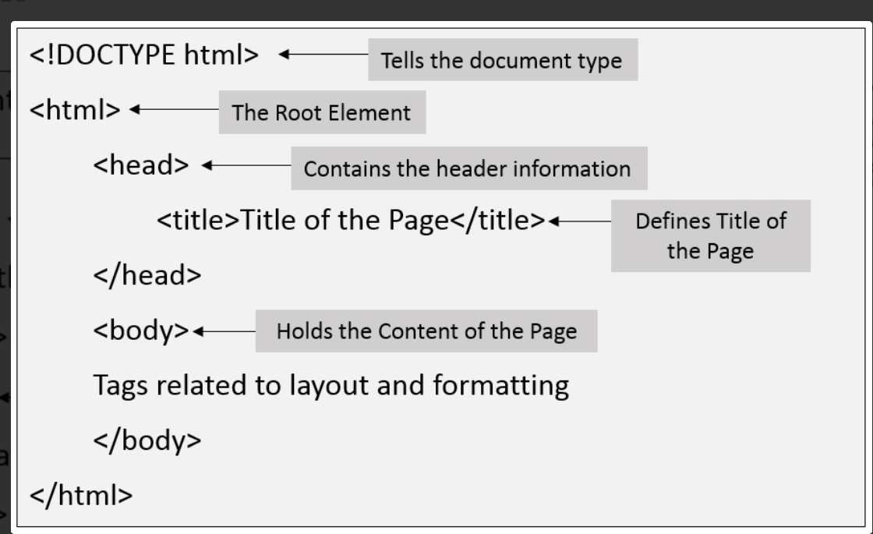
HTML BASIC STRUCTURE

Slide 10
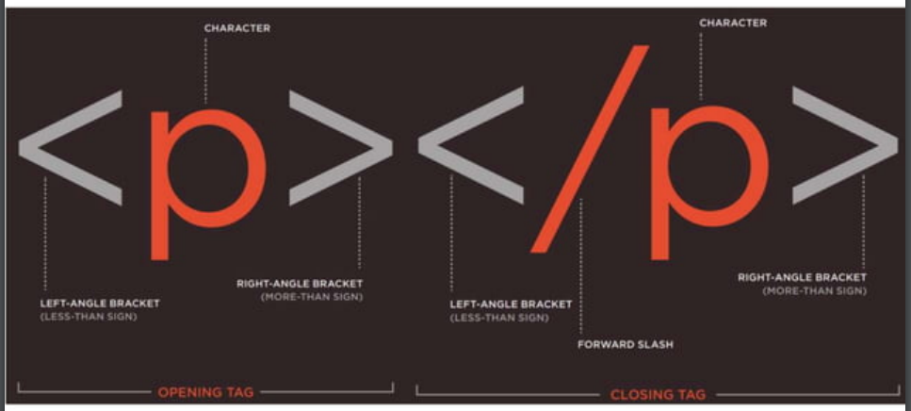
TAGS OR ELEMENTS

Slide 11
HTML EDITORS
Visual Studio Code: Visual Studio Code (VS Code) is a free and open-source code editor developed by Microsoft. It has built-in support for HTML, CSS, and JavaScript, along with a wide range of extensions that enhance its functionality for web development.
Sublime Text: Sublime Text is a sophisticated text editor known for its speed and ease of use. It offers powerful features such as multiple selections, syntax highlighting, and a customizable interface. Sublime Text has a large community of users and supports various plugins for HTML development.
Notepad++: Notepad++ is a free and open-source text editor for Windows. While it is a general-purpose editor, it offers features like syntax highlighting, auto-completion, and plugin support, making it suitable for HTML coding.

Slide 12
INSTALL VS CODE BY THE GIVE LINK
https://code.visualstudio.com/download

Slide 13
HTML FORMATTING TAGS
<b> - Bold text
<strong> - Important text
<i> - Italic text
<em> - Emphasized text
<mark> - Marked text
<small> - Smaller text
<del> - Deleted text
<ins> - Inserted text
<sub> - Subscript text
<sup> - Superscript text
<BR>- For line break
bg color= “Anycolor” for background color

Slide 14
HTML HEADING TAGS
<h1>Heading 1</h1>
<h2>Heading 2</h2>
<h3>Heading 3</h3>
<h4>Heading 4</h4>
<h5>Heading 5</h5>
<h6>Heading 6</h6>

Slide 15
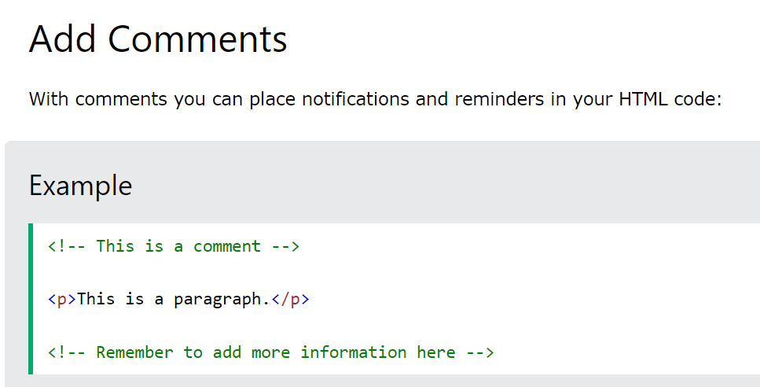
HTML COMMENTS

Slide 16
HTML PARAGRAPH TAGS
<p> This paragraph
contains a lot of spaces
in the source code,
but the browser
ignores it.
</p>

Slide 17
HTML PARAGRAPH TAGS
<p> This paragraph
contains a lot of spaces
in the source code,
but the browser
ignores it.
</p>

Slide 18
SOLUTION.....
<pre>This paragraph
contains a lot of spaces
in the source code,
but the browser
ignores it.
</pre>

Slide 19
SOLUTION.....
<pre>This paragraph
contains a lot of spaces
in the source code,
but the browser
ignores it.
</pre>

Slide 20
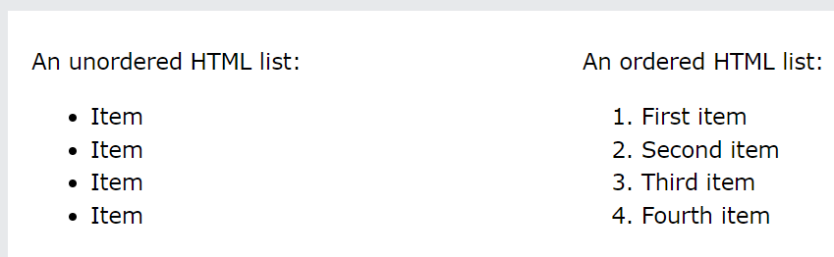
HTML LIST

Slide 21
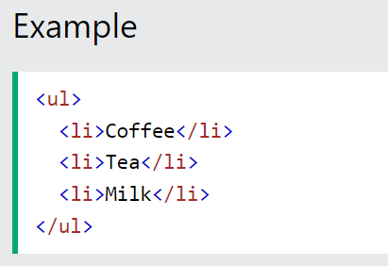
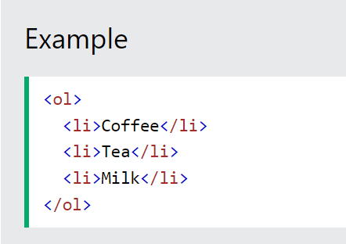
LIST CONTINUE...

Slide 22
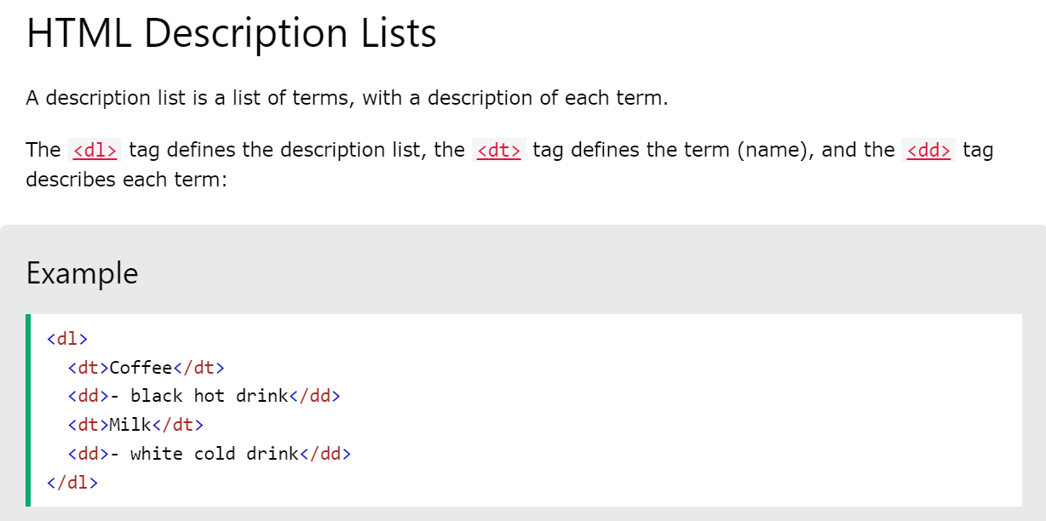
LIST CONTINUE...

