Slide 1
Chapter 2
Characteristics of Entrepreneurs
Knowledge
Skills required
Dark Side

Slide 2
Characteristics of Successful Entrepreneurs
Vision
Possess a clear vision that allows them to identify opportunities and foresee potential challenges.
Conceptualize the future and create innovative solutions to problems.
Passion
Passion refers to the intense enthusiasm and commitment entrepreneurs have towards their business and its mission.
This drive fuels their efforts and resilience in the face of challenges.
Passion helps entrepreneurs persevere through setbacks and maintain motivation, especially during difficult times

Slide 3
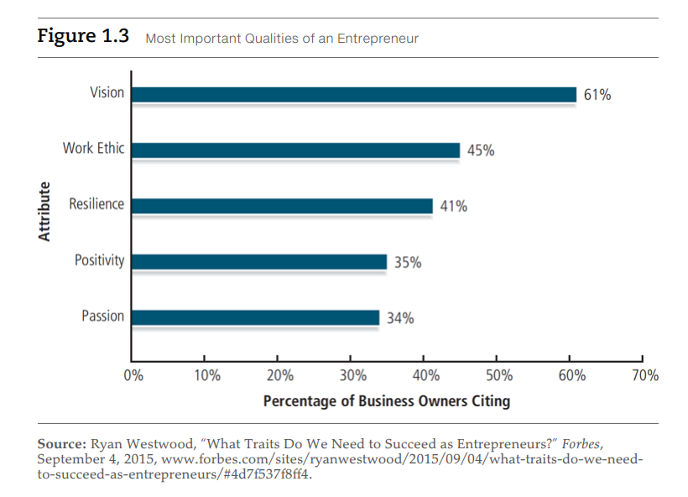

Slide 4
Adaptability
is the ability to adjust to changing circumstances and environments.
Successful entrepreneurs are flexible and can pivot their strategies based on market demands or unforeseen challenges.
In a rapidly changing business landscape, adaptability allows entrepreneurs to stay relevant and responsive to customer needs, ensuring long-term success
Resilience
is the capacity to recover quickly from difficulties and setbacks.
Entrepreneurs often face failures, and those who are resilient can learn from their experiences and continue moving forward.
is crucial for overcoming obstacles and maintaining a positive outlook

Slide 5
Risk-Taking
Being an entrepreneur requires taking calculated risks. Entrepreneurs must be willing to step out of their comfort zone and embrace uncertainty while managing risk smartly.
Innovation
Successful entrepreneurs innovate by identifying gaps in the market and developing unique solutions. Creativity and a forward-thinking approach are key.
Customer-Centric Approach
Building a business around the needs and preferences of the customer is essential. Entrepreneurs must understand their target audience and provide value to them consistently.

Slide 6
Strong Work Ethic
Entrepreneurship often requires long hours and dedication. A strong work ethic, discipline, and time management skills are critical in ensuring sustained effort and progress.
Financial Management
Managing finances efficiently, including budgeting, controlling costs, and understanding cash flow, is essential for the survival and growth of a business.
Networking and Relationship Building
Successful entrepreneurs build strong networks of mentors, partners, investors, and customers. These relationships can open doors to opportunities, collaborations, and resources.

Slide 7
Leadership and Team Building
Entrepreneurs often lead teams, and effective leadership skills are important to inspire and manage employees, foster a positive culture, and drive business objectives.
Problem-Solving
Problem-solving skills are crucial for overcoming daily business challenges. Entrepreneurs must think critically, assess situations, and develop solutions efficiently.
Value Creation
Successful entrepreneurs focus on creating value for their customers and stakeholders. This is the key to building a business that thrives and makes a lasting impact.

Slide 8
last but not the least
Continuous Learning
Entrepreneurship is a continuous learning process. Entrepreneurs need to stay updated on market trends, technology, and industry developments while improving their own skills and knowledge.
Ethical Conduct
Maintaining high ethical standards in business operations builds trust with customers, employees, and stakeholders. Integrity and honesty are essential for long-term success.

Slide 9


Slide 10


Slide 11


Slide 12
Knowledge of Entrepreneurship
Why Entrepreneurial Knowledge Matters:
Informs decisions and strategies.
Reduces risks through better planning.
Empowers entrepreneurs to navigate challenges effectively.

Slide 13
Types of Entrepreneurial Knowledge
Business Knowledge:
Market understanding, customer needs, competition.
Financial literacy: budgeting, forecasting, accounting.
Industry-Specific Knowledge:
Trends, opportunities, and threats within a particular sector.
Networking with key industry stakeholders.
Regulatory Knowledge:
Legal structures, tax regulations, intellectual property.
Licensing, compliance, and ethics in business.

Slide 14
Sources of Entrepreneurial Knowledge
Formal Education:
Business degrees, MBA programs, entrepreneurship courses.
Experiential Learning:
Learning by doing: starting businesses, internships.
Mentorship and Networking:
Learning from experienced entrepreneurs, industry professionals.
Continuous Learning:
Keeping up with market trends, reading, attending conferences.

Slide 15
Importance of Knowledge in Business Success
Informed Decision-Making: Better problem-solving with strong business acumen.
Risk Mitigation: Understanding challenges and preparing for them.
Competitive Advantage: Gaining insights into market needs and outperforming competitors.
Innovation and Adaptation: Knowledge fosters creativity, enabling entrepreneurs to innovate and adapt to changing market conditions.

Slide 16
Skills Required for Entrepreneurs
Entrepreneurship involves a broad range of technical and soft skills.
Key areas:
Management,
Communication,
Creativity,
Leadership.

Slide 17
Managerial and Technical Skills
Financial Management:
Budgeting, managing cash flow, understanding profits and losses.
Marketing and Sales:
Branding, digital marketing, product positioning.
Customer relationship management (CRM).
Operations Management:
Efficient resource allocation, supply chain management.
Technical Skills (especially in tech startups):
Knowledge of the technology stack, product development, software tools.

Slide 18
Leadership and People Management Skills
Team Leadership:
Motivating and managing diverse teams.
Fostering innovation and collaboration.
Conflict Resolution:
Mediating disputes and maintaining a positive work environment.
Delegation:
Assigning tasks effectively to optimize productivity.

Slide 19
Communication and Networking Skills
Communication Skills:
Verbal and written communication for pitching ideas, leading teams, negotiating deals.
Negotiation Skills:
Securing partnerships, deals, and favorable contracts.
Networking:
Building relationships with investors, customers, and industry peers.

Slide 20
Creativity and Problem-Solving Skills
Creativity:
Generating innovative solutions and products.
Adapting to changing market needs with new ideas.
Critical Thinking:
Analyzing problems, evaluating options, and making strategic decisions.
Adaptability:
Responding to uncertainty and pivoting when necessary.

Slide 21
Entrepreneurial Resilience
Risk Management:
Assessing and managing risks in volatile business environments.
Stress Management:
Coping with pressure, uncertainty, and potential failure.
Persistence:
Overcoming setbacks and continuing toward business goals.

Slide 22
The Dark Side of Entrepreneurship
Entrepreneurship offers freedom and rewards, but it also has significant challenges.
High-pressure
financial risk
and personal sacrifices can create negative effects.

Slide 23
High-Stress Environment
Constant Pressure:
Meeting deadlines, achieving growth targets, and managing a business 24/7.
Work-Life Imbalance:
Long hours, leading to neglect of personal life and relationships.
Burnout:
Emotional and physical exhaustion from overwork.

Slide 24
Financial Risk and Uncertainty
Personal Financial Risk:
Entrepreneurs often invest their own savings; high failure rate of startups.
Cash Flow Issues:
Managing unpredictable income streams, especially in early stages.
Debt and Bankruptcy:
Risk of business failure leading to significant debt.

Slide 25
Social and Emotional Isolation
Isolation:
Entrepreneurs can feel isolated due to unique pressures and responsibilities.
Strain on Personal Relationships:
Work demands affecting family and friendships.
Mental Health Challenges:
Anxiety, depression, and high levels of stress.

Slide 26
Ethical Dilemmas
Merciless Competition:
Entrepreneurs may face moral dilemmas in competitive industries.
Shortcuts and Unethical Practices:
Pressure to succeed may lead to cutting corners or engaging in unethical practices.
Impact on Society:
Entrepreneurs must consider the social and environmental impacts of their businesses.

Slide 27
Managing the Dark Side
Work-Life Balance:
Importance of setting boundaries and taking breaks.
Seeking Support:
Building a support system through mentors, networks, or mental health professionals.
Stress Management:
Practices like meditation, exercise, and time management to reduce burnout.

Slide 28
Conclusion
Knowledge of entrepreneurship is crucial for informed decision-making and innovation.
Essential skills include leadership, communication, financial literacy, problem-solving, networking, time management, and adaptability.
Awareness of the dark side of entrepreneurship is important for maintaining mental health and achieving a balanced life.

