Slide 1
Strategic Analysis: SWOT, I/O Model, and RBV Model:
Understanding Strategic Tools for Competitive Advantage

Slide 2
Today’s Topics
Introduction to SWOT Analysis.
Overview of the I/O Model.
Overview of the RBV Model.
Applying SWOT with I/O and RBV perspectives.

Slide 3
SWOT Analysis
What is SWOT Analysis?
Strengths: Internal attributes that support success.
Weaknesses: Internal factors that may hinder success.
Opportunities: External factors that offer potential growth.
Threats: External factors that may harm the organization.
Example: For a tech company, a strength might be having a highly skilled R&D team, while a threat could be the fast pace of technological obsolescence in the industry.

Slide 4
Why Use SWOT Analysis?
Benefits of SWOT:
Helps in strategic planning and decision-making.
Assesses both internal and external factors.
Provides a clear picture of current and future business potential.
Example: A renewable energy firm might find an opportunity in the increasing demand for green energy, while recognizing a weakness in their outdated battery storage technology.

Slide 5
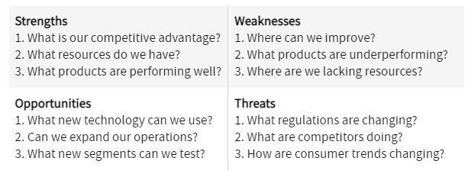

Slide 6
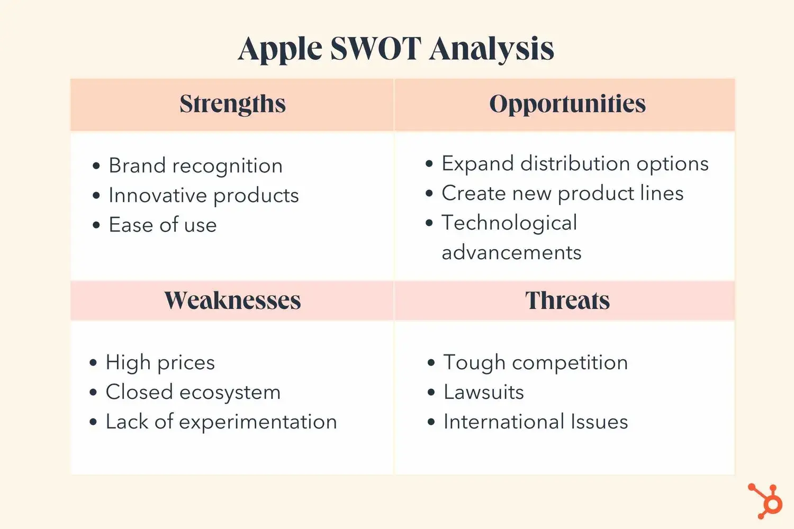

Slide 7
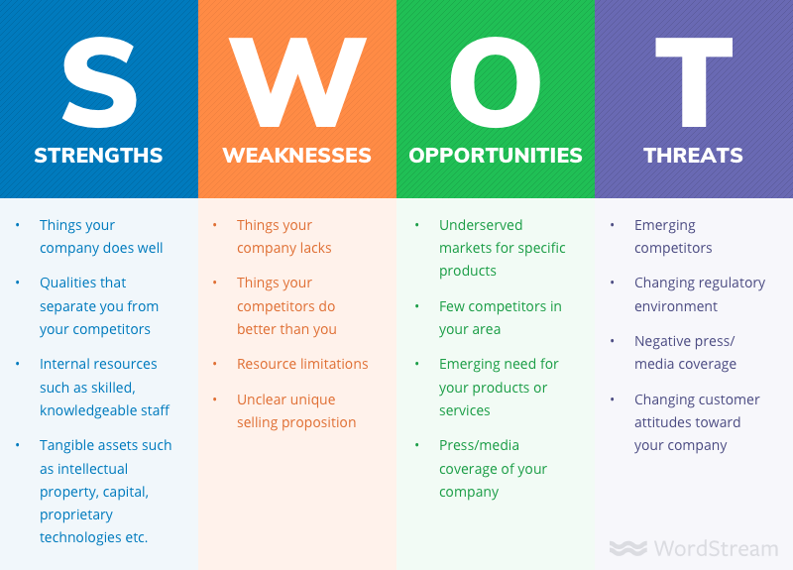

Slide 8
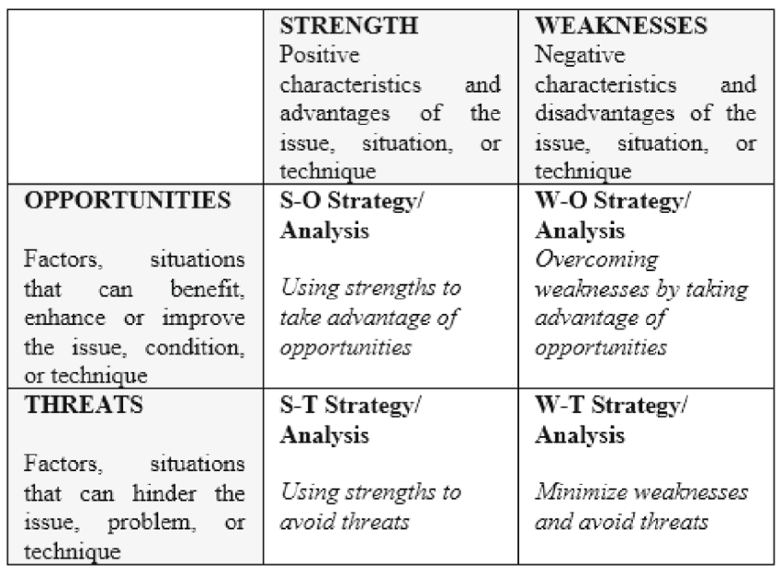

Slide 9
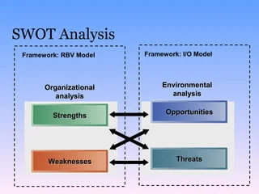

Slide 10
The Industrial Organization (I/O) Model
What is the I/O Model?
Focuses on the external environment as the primary determinant of strategy
Emphasizes the importance of industry structure.
Suggests that external factors influence profitability more than internal capabilities.

Slide 11
Key Components of the I/O Model
Understanding the I/O Model
External Environment: Key drivers include competition, market trends, and regulations.
Five Forces Analysis: Competitive rivalry, supplier power, buyer power, threat of new entrants, and threat of substitutes.
Positioning Strategy: Finding the most advantageous position within the industry.
Example: A retail business might use the Five Forces framework to analyze how customer buying power and supplier competition impact their pricing and market strategy.

Slide 12
Applying the I/O Model in SWOT Analysis
I/O Model and External Factors in SWOT
Opportunities: Identifying favorable industry trends (e.g., technological shifts).
Threats: Assessing competitive pressures or market saturation.
Strategy Development: Aligning strengths with external opportunities and addressing threats.
Example: A telecom company might see 5G technology as an opportunity (external environment) but face threats from increased competition from new entrants in the same space.

Slide 13
Resource-Based View (RBV) Model
What is the RBV Model?
Resource-Based View (RBV) Explained
Focuses on internal resources and capabilities.
Suggests that a firm’s unique resources are the key to sustained competitive advantage.
Emphasizes the importance of valuable, rare, inimitable, and non-substitutable (VRIN) resources.
Example: A software company with proprietary AI algorithms that are difficult for competitors to replicate has a strong competitive advantage.

Slide 14
Key Components of the RBV Model
Understanding the RBV Model
Resources: Tangible and intangible assets (e.g., patents, brand reputation).
Capabilities: Skills or abilities that allow the firm to deploy resources effectively.
VRIN Framework: Ensuring resources are valuable, rare, inimitable, and non-substitutable.
Example: A luxury brand in fashion may have a rare and valuable resource in its strong brand reputation, which is hard for competitors to imitate.

Slide 15
Applying the RBV Model in SWOT Analysis
RBV Model and Internal Factors in SWOT
Strengths: Identifying unique internal resources (e.g., technology, skilled workforce).
Weaknesses: Addressing internal gaps that limit competitiveness.
Sustainable Advantage: Leveraging strengths that meet the VRIN criteria.
Example: A biotech company might use its patent portfolio (strength) to pursue new drug development while recognizing a lack of marketing capabilities (weakness).

Slide 16
Integrating I/O and RBV Models with SWOT
Combining I/O and RBV with SWOT
Strategic Integration of SWOT with I/O and RBV
Use the I/O model to assess external factors (Opportunities and Threats).
Use the RBV model to evaluate internal resources (Strengths and Weaknesses).
Develop strategies that align internal capabilities with external opportunities.
Mitigate risks by strengthening weaknesses and addressing external threats.
Example: A tech company could use its internal strength in R&D (RBV) to capitalize on an industry trend (I/O) such as the growing demand for artificial intelligence applications.

Slide 17
Case Study Example
Case Study: Tech Company X
Strengths: Proprietary AI technology (RBV).
Weaknesses: Lack of strong distribution channels (RBV).
Opportunities: Growing demand for AI-driven solutions in healthcare (I/O).
Threats: Competition from larger firms with better distribution (I/O).

Slide 18
https://quantive.com/resources/articles/swot-analysis
https://www.investopedia.com/terms/s/swot.asp
https://www.techtarget.com/searchcio/definition/SWOT-analysis-strengths-weaknesses-opportunities-and-threats-analysis
https://www.linkedin.com/pulse/mitigating-top-5-emerging-risks-engineering-industry-rajendran-m/

Slide 19
Conclusion
The I/O model focuses on external factors that shape strategy.
The RBV model emphasizes internal resources as the key to long-term success.
Integrating both models in SWOT provides a balanced approach to strategic planning.

