Slide 1
Social Challenges Faced by Entrepreneurs and Scope of Operations
Key Considerations for Entrepreneurial Success

Slide 2
Main Points:
Social challenges faced by entrepreneurs.
Navigating social dynamics in business.
Understanding the scope of operations.
Strategies for overcoming challenges and maximizing operational success.

Slide 3
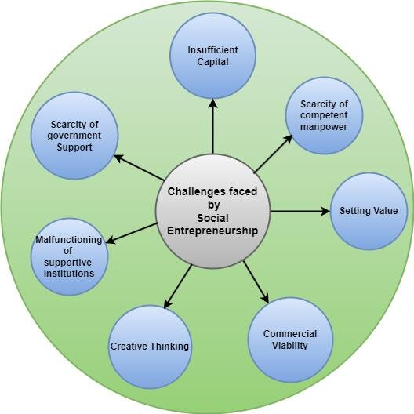

Slide 4
What Are Social Challenges?
Social challenges refer to the external pressures that entrepreneurs face from society, which can range from economic disparities to societal perceptions that influence business success. These challenges are often shaped by local cultural, social, and economic environments.

Slide 5
Introduction to Social Challenges
Difficulties arising from societal norms, cultural expectations, and community perceptions.
Influence of economic inequality, access to resources, and social mobility.
Barriers related to gender, race, or class in entrepreneurial ecosystems.
Example:
A female entrepreneur in a traditionally male-dominated industry, such as tech or manufacturing, might face biases that limit her access to funding or mentorship opportunities.

Slide 6
Key Social Challenges for Entrepreneurs
Cultural Differences:
Navigating diverse cultures in global markets.
Social Responsibility:
Balancing profit and societal impact.
Networking and Relationships:
Building trust and meaningful connections.
Public Perception:
Managing brand image and reputation.
Work-Life Balance:
Dealing with social expectations and pressures.

Slide 7
Cultural Differences
Globalization: Expanding to international markets requires understanding local cultures, languages, and customs.
Cultural Misunderstandings: This can lead to failed business deals or miscommunication with partners and customers.
Adaptability: Entrepreneurs need to adapt their products or services to fit cultural norms and consumer preferences.
Example: A U.S.-based food startup entering the Middle Eastern market must consider dietary restrictions such as halal certification, in addition to local customs around eating habits. Failing to recognize these differences can lead to a disconnect with the target audience.

Slide 8
Social Responsibility
Balancing Profit and Social Responsibility
Environmental and Social Impact: Pressure to minimize environmental harm and address social inequalities.
Corporate Social Responsibility (CSR): Expectations from society to contribute to positive change.
Sustainable Practices: Balancing short-term profits with long-term sustainability goals.
Example: An entrepreneur in the fashion industry may face criticism if their supply chain involves sweatshops or unsustainable materials. By adopting ethical practices such as fair trade and eco-friendly production, the business can improve its brand image while contributing positively to society.

Slide 9
Networking and Building Relationships
Building Trust: Developing strong relationships with customers, investors, and business partners.
Access to Networks: Entrepreneurs from underrepresented groups may have difficulty accessing powerful networks.
Collaboration: Building partnerships that contribute to business growth and innovation.
Example: A female entrepreneur in a male-dominated tech industry may struggle to gain the trust and recognition of investors or clients. To overcome this, networking with supportive communities or industry-specific networks (like Women in Tech) can help build credibility and expand connections.

Slide 10
Public Perception and Branding
Reputation Management: Ensuring the brand is viewed positively by the public.
Crisis Management: Handling negative publicity or social media backlash effectively.
Authenticity: Consumers expect businesses to align with their values and act with transparency.
Example: A startup that faced backlash for a controversial social media post must issue a timely apology and take steps to rectify the situation to maintain a positive public image.

Slide 11
Work-Life Balance
Personal Sacrifices: Entrepreneurs often work long hours, sacrificing personal time and relationships.
Social Expectations: Balancing the pressure to succeed with maintaining a healthy lifestyle.
Mental Health: Entrepreneurial stress can lead to burnout and mental health challenges.
Example: A young entrepreneur working on a tech startup may work 80-hour weeks, neglecting personal relationships and self-care. Over time, this can lead to burnout, making it harder to maintain the energy and passion needed to drive the business forward.

Slide 13
Access to Funding and Capital
Gender and Racial Disparities: Women and minority entrepreneurs often face more difficulty securing loans or venture capital.
Bias in Investor Networks: Investors may favor entrepreneurs from familiar socio-economic backgrounds.
Economic Inequality: Entrepreneurs from lower-income areas often lack access to financial resources and networks.
Example: A minority-owned small business may face challenges in obtaining loans due to a lack of connections in the traditional banking sector. In contrast, their counterparts from wealthier backgrounds may find easier access to investors and networks that accelerate business growth.

Slide 14
Navigating Regulatory and Bureaucratic Challenges
Complex Regulations: Navigating business regulations, taxes, and licensing requirements can be challenging, especially for new entrepreneurs.
Bureaucratic Red Tape: In many regions, starting a business involves slow processes and corruption, which can stifle growth.
Lack of Support Systems: Lack of adequate government support in the form of mentorship, grants, or training for new entrepreneurs.
Example: In many developing countries, entrepreneurs face lengthy bureaucratic procedures to register their businesses, slowing down innovation and growth.

Slide 15
Scope of Operations for Entrepreneurs
The scope of operations refers to everything an entrepreneur manages to keep their business running.
This includes
Supply chain management
Customer service
Logistics
Business Activities
Internal and External Functions
Strategic and Tactical Decisions

Slide 16
Core Areas of Operations Management
Supply Chain Management: Coordinating suppliers, manufacturers, and distributors to ensure timely delivery of products or services.
Customer Service: Ensuring customer satisfaction through responsive service and addressing feedback.
Marketing and Sales: Driving business growth through strategic promotion, pricing, and customer acquisition.
Logistics: Managing the movement of goods or services from supplier to consumer.
Example: An e-commerce business must efficiently manage warehousing, packaging, shipping, and customer returns as part of its operational scope to ensure customer satisfaction and cost-effectiveness.

Slide 17
Example: A food delivery startup needs to manage delivery logistics, supplyer relationships, customer service, and marketing operations as part of its scope of operations.
Business Activities:
The scope of operations encompasses all the activities required to run a business.
Internal and External Functions:
Includes procurement, production, marketing, sales, logistics, and customer service.
Strategic and Tactical Decisions:
Operational scope also involves long-term planning (e.g., expansion) and day-to-day decisions (e.g., resource allocation).

Slide 18
Operational Challenges Entrepreneurs Face
Operations management becomes more complex as the business grows. Entrepreneurs face challenges in balancing costs with service quality, scaling up their operations, and integrating new technology to stay competitive.
Scaling:
Difficulty in expanding operations efficiently as the business grows.
Cost Management:
Balancing cost-efficiency while maintaining quality of service.
Technology Integration:
Staying up-to-date with evolving technology to improve operational efficiency.
Workforce Management:
Hiring, training, and retaining skilled employees

Slide 19
Strategies for Expanding the Scope of Operations
Automation: Implementing software or machinery to streamline operations and reduce human error.
Outsourcing: Hiring third-party services for non-core activities such as payroll, logistics, or customer support.
Lean Operations: Adopting lean practices to minimize waste and maximize efficiency.
Customer Feedback: Leveraging customer input to refine processes and improve service offerings.
Example: An apparel brand might outsource its shipping and logistics to a third-party provider while focusing its internal operations on design, marketing, and customer service to ensure quality and scalability.

Slide 20
Last but not least
Entrepreneurs face significant social challenges such as bias, inequality, and societal pressures.
Operations management plays a critical role in business success, from supply chain management to scaling.
Strategies like automation, lean management, and outsourcing can help entrepreneurs optimize their operations.
Overcoming social challenges requires resilience, strategic networking, and often working with specialized support networks.

