Slide 1
Kerberos, Token and Hadoop MIT Kerberos Day (2014)
Intel Big Data Technologies
kai.zheng@intel.com

Slide 2
Outline
Kerberos and Hadoop
Token and Hadoop
Token and Kerberos
Kerberos, Token and Hadoop
Future work

Slide 3
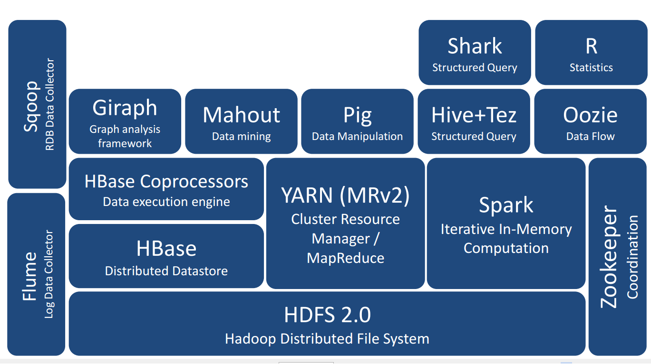
Apache Hadoop

Slide 4
When Hadoop adding security
Initially no authentication at all
Kerberos or SSL/TLS?
Adding security should not impact performance much
Kerberos is used to authenticate users, GSSAPI/SASL is used between C/S, encryption on wire could be optional

Slide 5
Kerberos authentication
End users to services, using password
Services to services, using service credentials/keytabs
Services to services, delegating users, using service credentials
MR tasks to services, delegating users, using delegation token

Slide 6
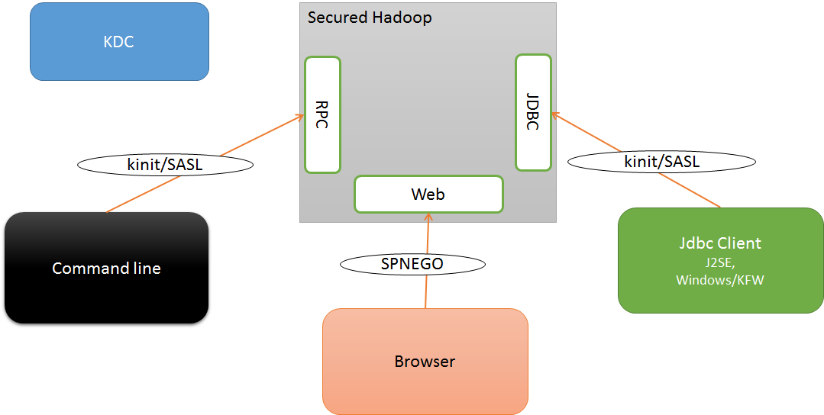
Client authentication

Slide 7
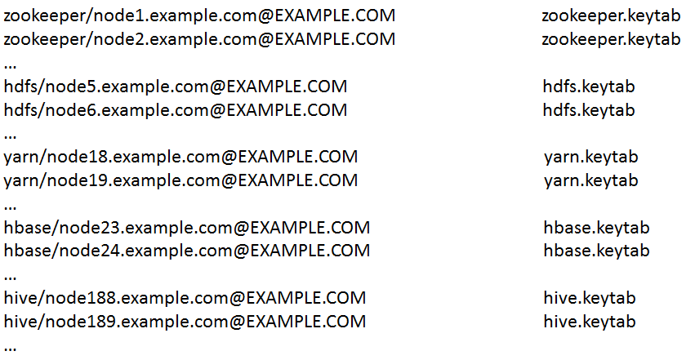
Deploying Kerberos
Provisioning service credentials/keytabs

Slide 8
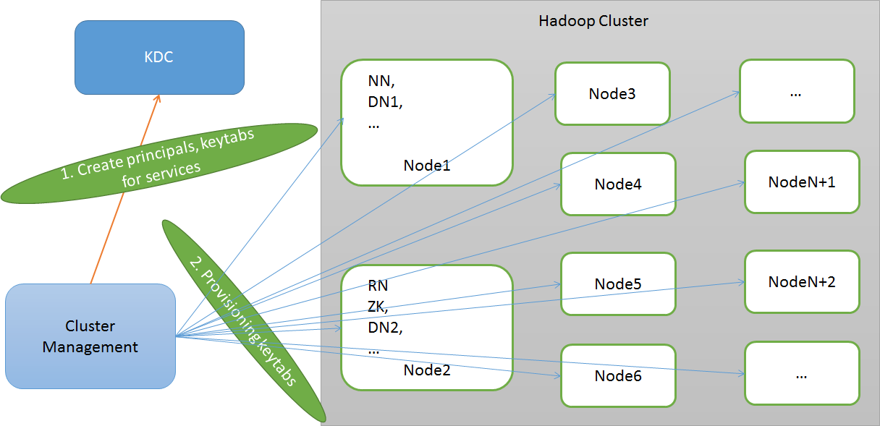
Deploying Kerberos (cont'd)

Slide 9
Strengths
Symmetric encryption, mutual authentication
Flexible SASL QoP, authentication (privacy) by default
Command line (kinit, SSO) + Browser (SPNEGO)
Mature, available in Linux/Windows + J2SE

Slide 10
Challenges
Hadoop ecosystem is large and still fast evolving, other authentication solutions are desired
Hadoop cluster can be large, the traffic can be huge
Services are dynamically provisioned and relocated on demand
Applications are to run in containerized environment, and can be dynamically scheduled and relocated to other nodes automatically
Different deployment environments and scenarios, with different requirements

Slide 11
Problems
Lagged Kerberos feature support in Java (PKINIT, S2U only added recently, etc.)
Lacking fine-grained authorization support
Lacking strong delegation support in Kerberos/Java stack
Inconvenient and limited browser access via SPNEGO, for work around to bypass Kerberos exposing internal delegation token
Encryption not set in SASL via (QoP) by default, and might involve performance impact (benchmark and optimization?)
AES 256 isn’t supported by Java by default
Just get it work, allow_weak_crypto is used;
kinit –R issue

Slide 12
Outline
Kerberos and Hadoop
Token and Hadoop
Token and Kerberos
Kerberos, Token and Hadoop
Future work

Slide 13
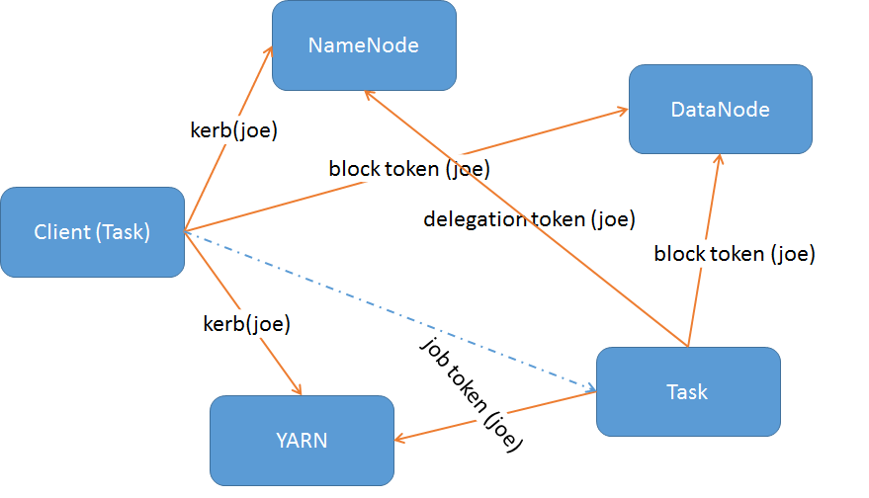
Hadoop tokens
Existing Hadoop tokens for internal authentication: delegation token, job token, block access token …

Slide 14
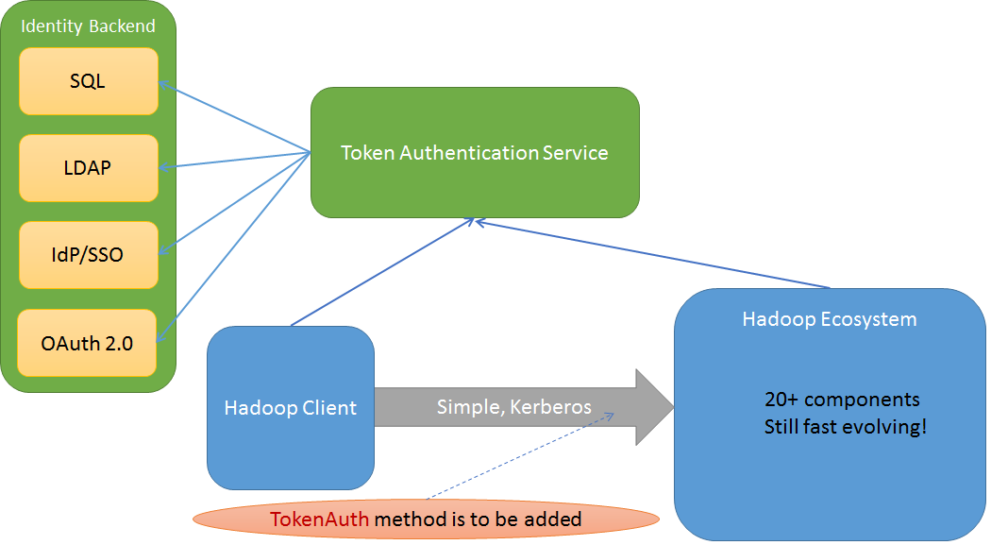
TokenAuth effort
Proposed token for primary/initial authentication

Slide 15
Requirements
Allow to integrate 3rd party authentication solutions
Help enforce fine-grained authorization
Supporting OAuth 2.0 token and work flow is desired for cloud deployment

Slide 16
Challenges
Involve great change over the ecosystem
May break existing applications built on the platform
Over complex, involving both Identity Token and Access Token with related services, the work flow is quite complex. (Reinvent Kerberos?)
Big impact for performance or security concerns
We either use TLS/SSL to protect token or don’t care about it at all. The former involves performance impact, the latter suffers security consideration.

Slide 17
Outline
Kerberos and Hadoop
Token and Hadoop
Token and Kerberos
Kerberos, Token and Hadoop
Future work

Slide 18
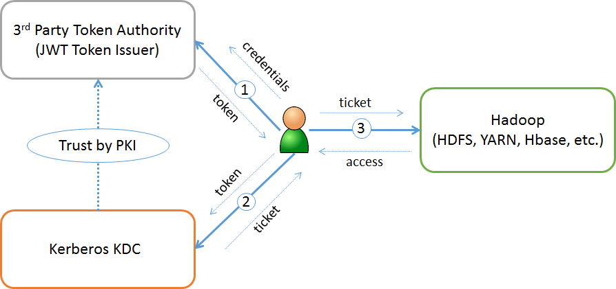
TokenPreauth mechanism
Allows user to authenticate to KDC using 3rd party tokens instead of password

Slide 19
TokenPreauth mechanism (cont’d)
Defines required token attribute values based on JWT token, reusing existing attributes
Support Bearer Token and allows to support Holder-of-Key Token in future
Support Identity Token (or ID Token) and allows to support Access Token in future

Slide 20
TokenPreauth mechanism (cont’d)
Client principal may exist or not during token validating and ticket issuing
kinit –X token=[Your-Token], by default ref. ~/.kerbtoken
How token being generated may be out of scope, left for token authority
Identity Token -> Ticket Granting Ticket, Access Token -> Service Ticket
Ticket lifetime derived from token SHOULD be in the time frame of the token
Ticket derived from token may be not renewable

Slide 21
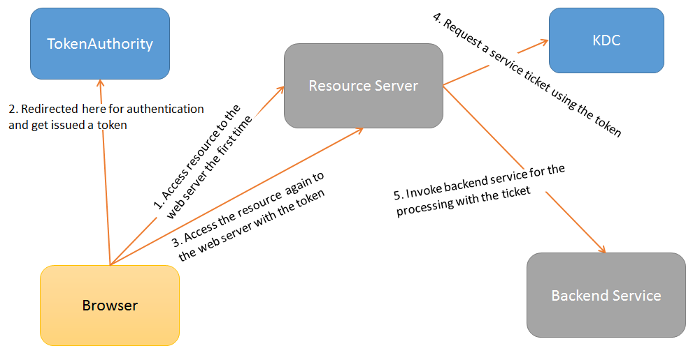
Access Token profile
Based on TokenPreauth, allow Access Token to be used to request Service Ticket directly in AS exchange
Should be useful to support OAuth 2.0 Web flow in Kerberized Resource Server with backend service

Slide 22
Why it matters
Token and OAuth are widely used in Internet, cloud and mobile, more and more popular
It allows Kerberized systems to be supported in token’s world
Also allows Kerberized systems to integrate other authentication solutions thru token and Token Authority, without modification of existing codes.
May help Kerberos evolve in both cloud and big data platform
Make extra sense for Hadoop, supporting token across the ecosystem without performance impact

Slide 23
How it is going
We’re collaborating with MIT to standardize
Initial drafts, under MIT team’s review
Should be submitted to KITTEN WG soon
PoC done targeting for Hadoop

Slide 24
Outline
Kerberos and Hadoop
Token and Hadoop
Token and Kerberos
Kerberos, Token and Hadoop
Future work

Slide 25
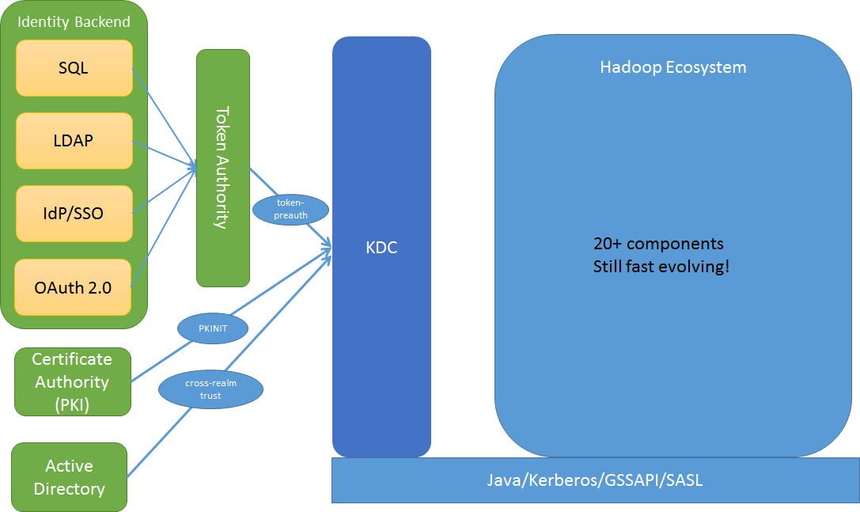
Kerberos + Token for Hadoop
Let’s combine all of these together

Slide 26
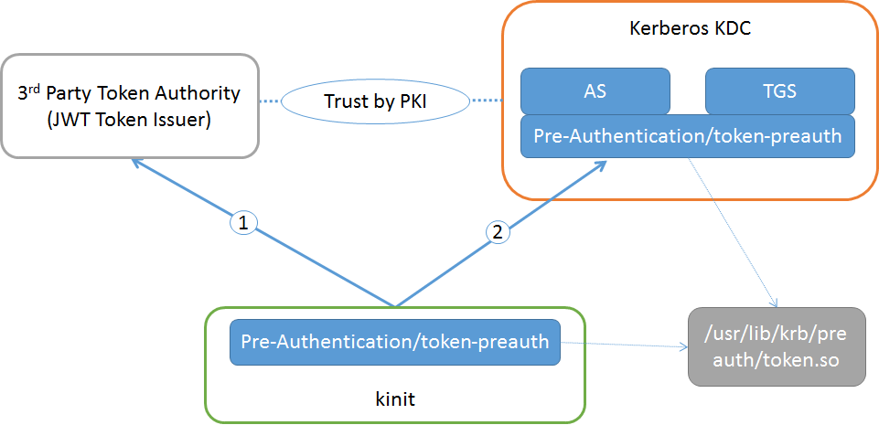
PoC: TokenPreauth plugin

Slide 27
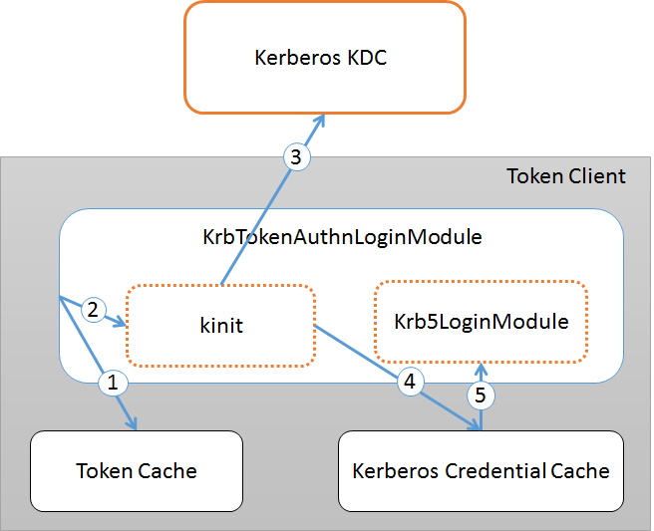
PoC: Token authentication JAAS module

Slide 28
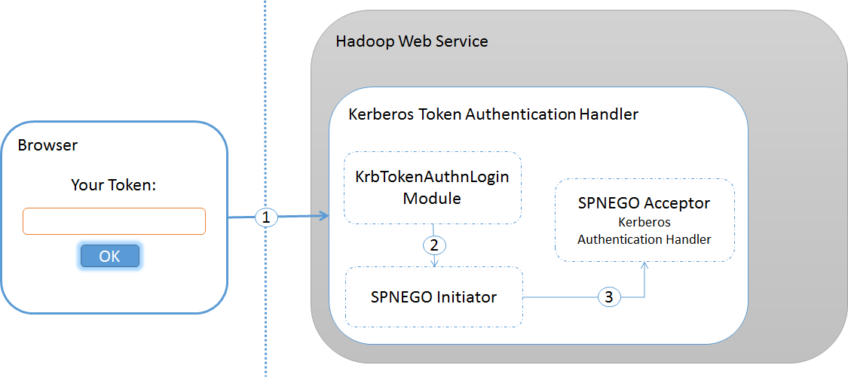
PoC: Browser and Web support

Slide 29
Next step
Implement the mechanism and have it included in next MIT Kerberos release, collaborating with MIT team
Or at least, provide the plugin binary download and source codes repository for public usage and review
Make a complete token solution based on Kerberos for Hadoop

Slide 30
Backup
Haox project
A Java Kerberos binding
(https://github.com/drankye/haox)

Slide 31
The initiatives
Haox aims for a Java Kerberos binding, and provides richful, intuitive and interoperable implementation, library and various facilities that integrate Kerberos, PKI and token (OAuth) as desired in modern environments such as mobile, cloud and Hadoop.

Slide 32
The goals
Aims as a Java Kerberos binding, with richful and integrated facilities for both client and server sides.
Provides client APIs in Kerberos protocol level to interact with a KDC server thru AS and TGS exchanges.
Provides an embedded KDC server that applications can easily integrate into products, unit tests or integration tests.
Supports FAST/Preauthentication framework to allow popular and useful authentication mechanisms.

Slide 33
The goals (cont’d)
Supports PKINIT mechanism to allow clients to request tickets using x509 certificate credential.
Supports Token Preauth mechanism to allow clients to request tickets using JWT tokens.
Provides support for JAAS, GSSAPI and SASL frameworks that applications can leverage.
Least dependency, the core part is ensured to depend only on JRE, for easy use and maintain.

Slide 34
Status
ASN-1 (done)
Kerberos core spec types (done)
Kerberos Crypto (done)
Embedded KDC (partially done)
KrbClient (partial APIs done and available)
Preauth/FAST framework (partially done)
Token Preauth (ongoing)
PKINIT (ongoing)
Keytab util (done)
Credential Cache (done)

Slide 35
Future work
Combining all of these effort together, make a complete authentication solution for Hadoop
Additionally, we’d also like to make Kerberos deployment be more easily and readily even for large Hadoop clusters
It’s Intel’s mission that makes Hadoop more enterprise-grade security ready
We’re also interested in evolving Kerberos for cloud platform, particularly, how Kerberized services and applications can be dynamically scheduled to nodes and bootstrap

Slide 36
Thanks!
You feedback are very welcome
Please contact kai.zheng@intel.com for update.

