Slide 1
NSU RDS Mobile App
Abdullah Al Mahfuj Shaan
1721275042
CSE299.2
Fall 2020

Slide 2
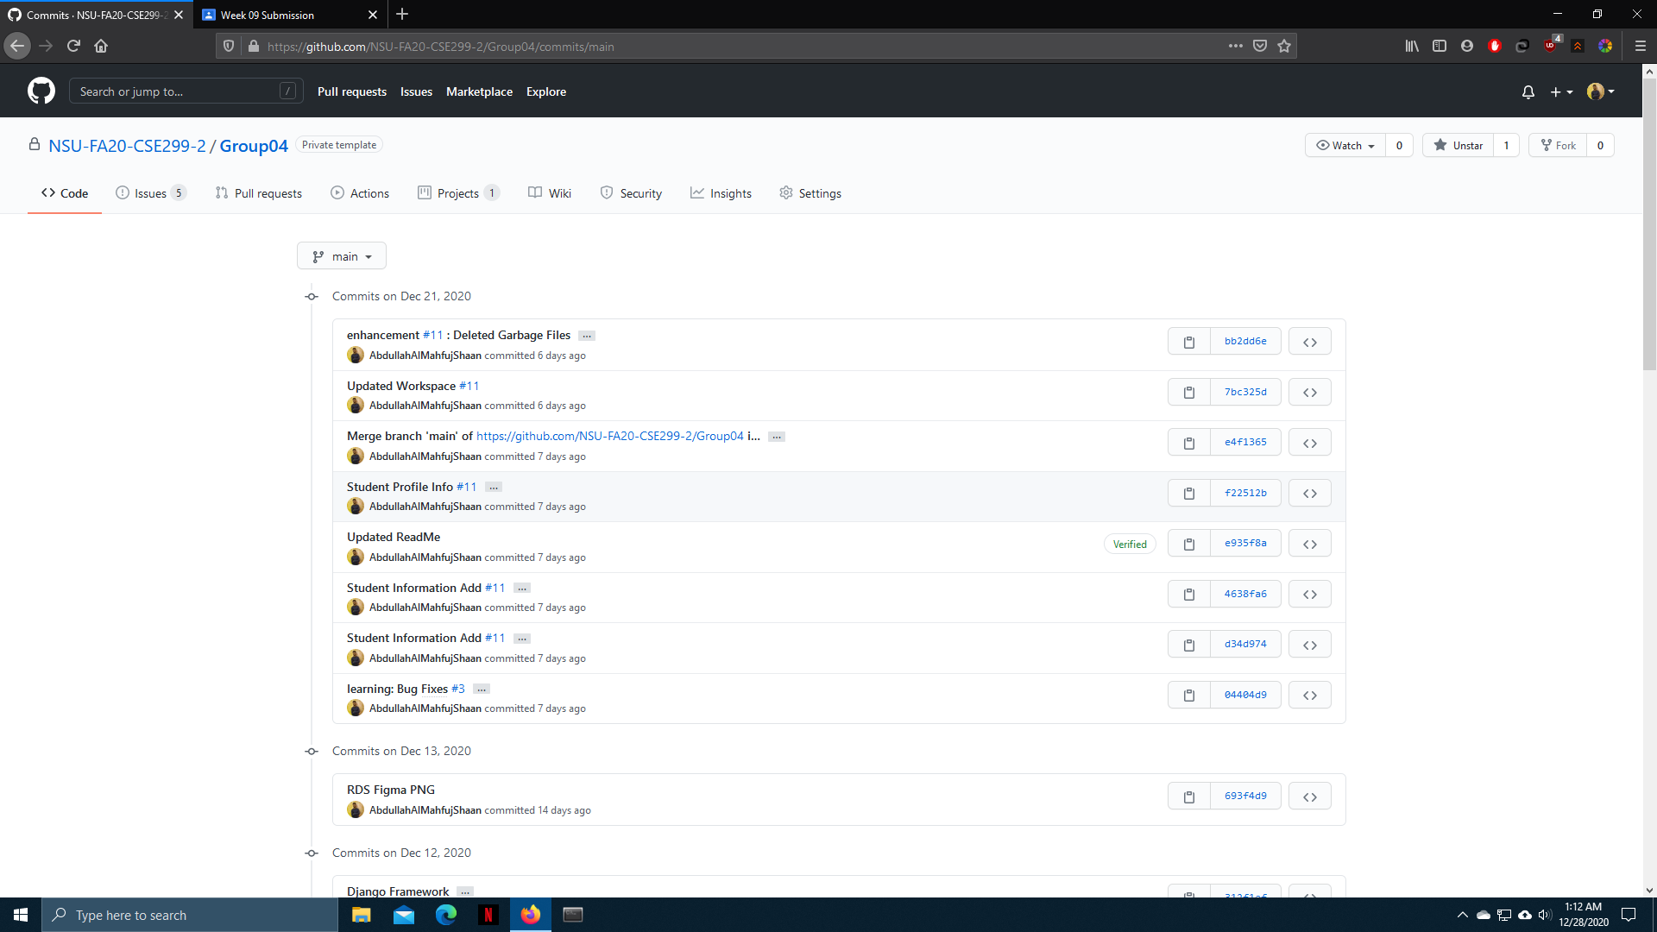
Commits

Slide 3
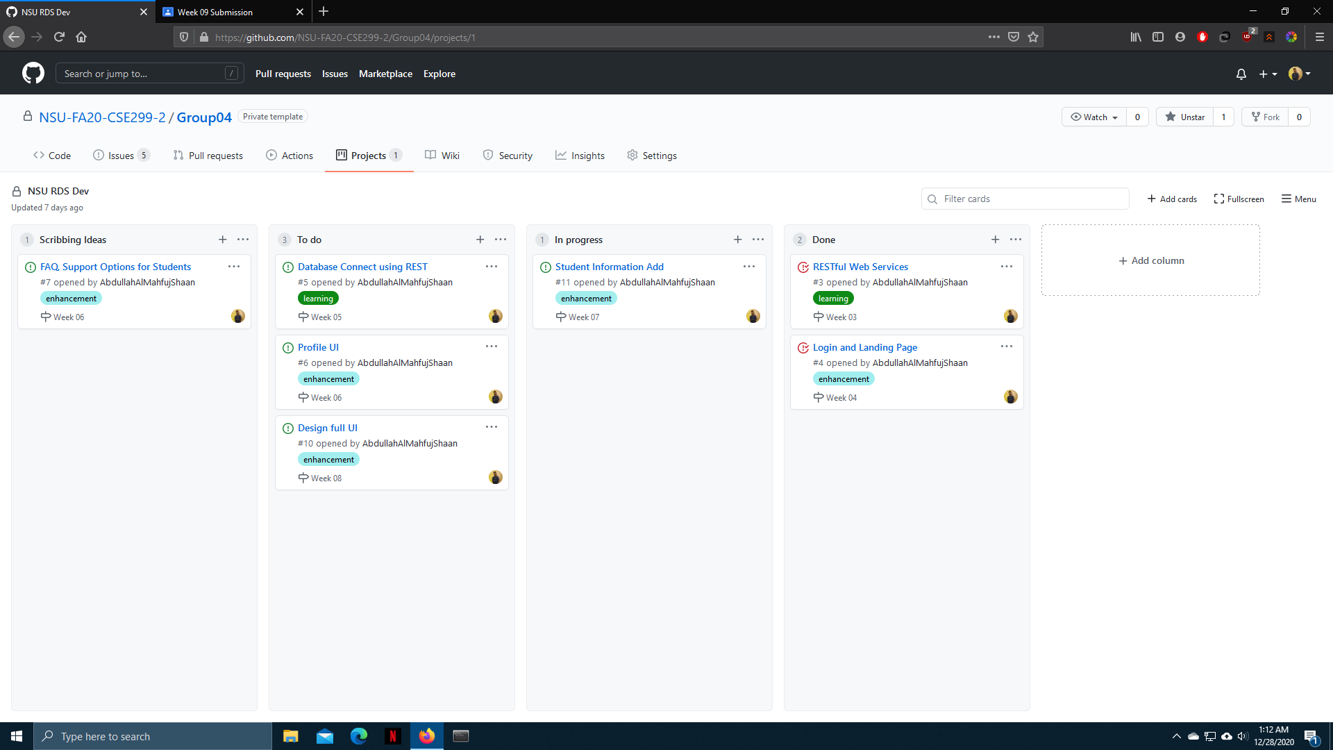
Kanban Board

Slide 4
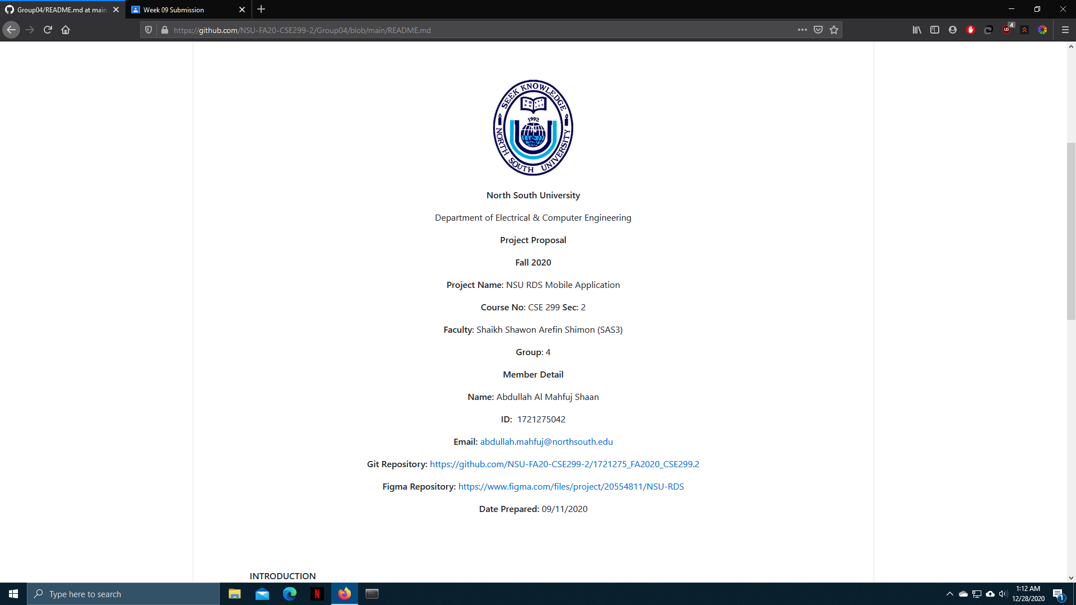
Readme.md

Slide 5
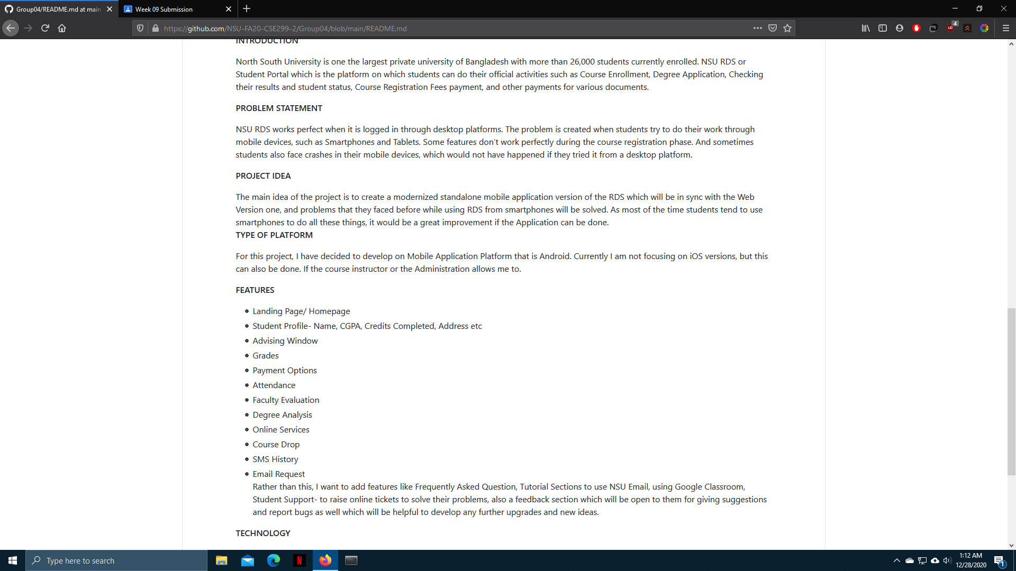
Readme.md

