Slide 1
”The Pharmacy”
Tareq Al-Ahdal Abdullah Al-Solaiman

Slide 2

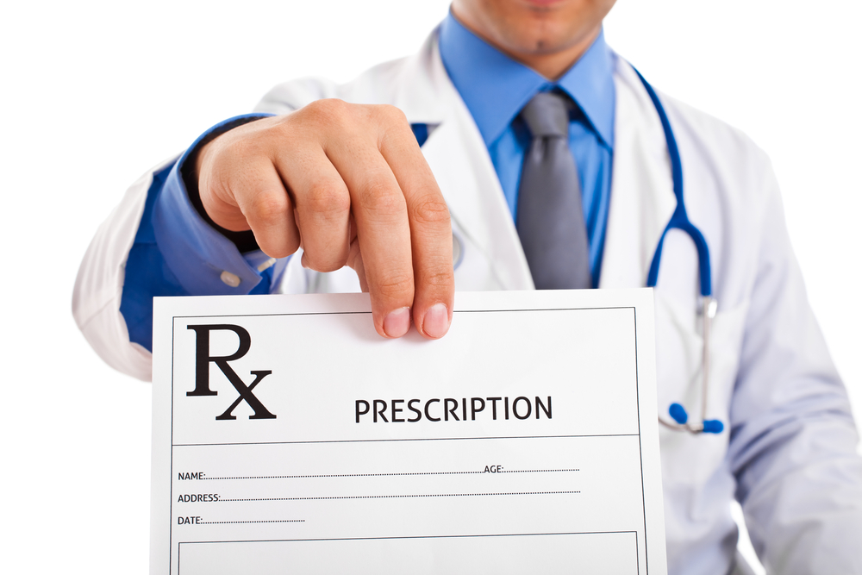
Problem Background

Slide 3

Takes Time
Not Efficient
Wastes a considerable amount of papers
Hard to find details about patients
Current Paper-Based System

Slide 4
Objectives And Scope
We decided to make a system that has a solution for the previous problems.
1. Will Make it easy to use
2.Will Save the Doctor’s & Patient’s Time
3. Will stop using papers as they’re no longer needed

Slide 5
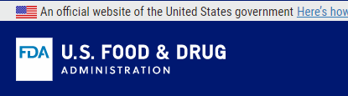
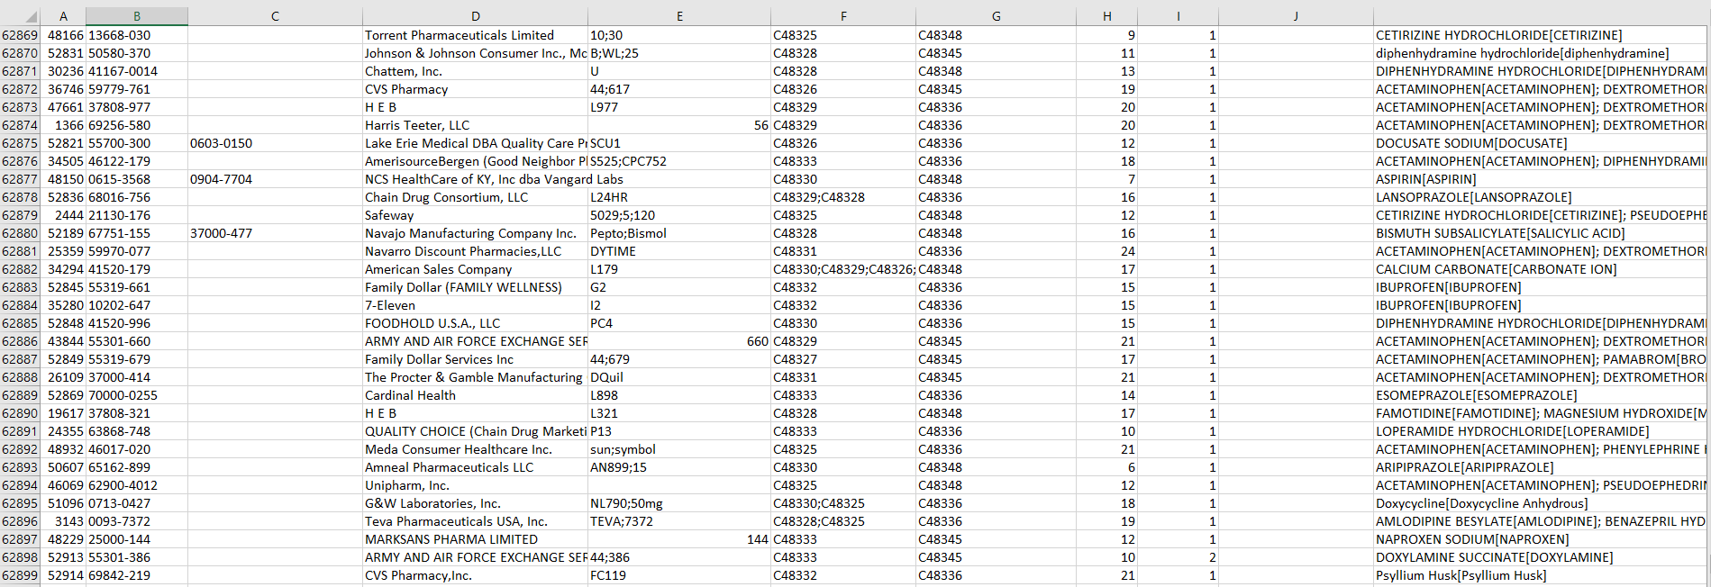
62,898!!!

Slide 6
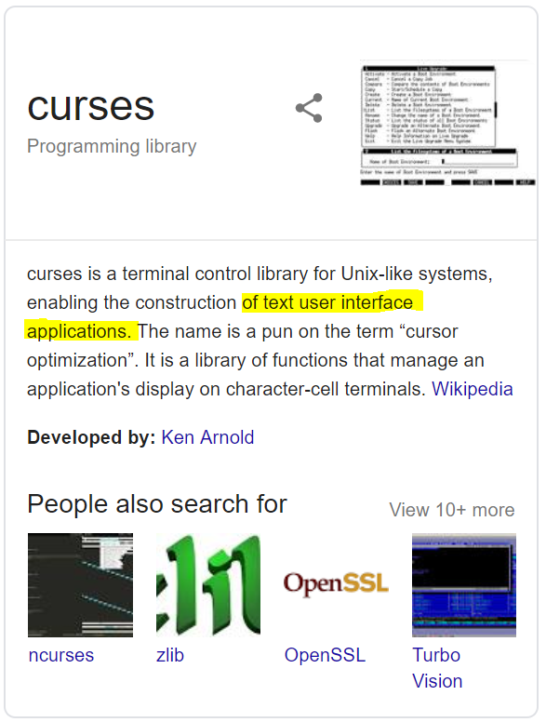
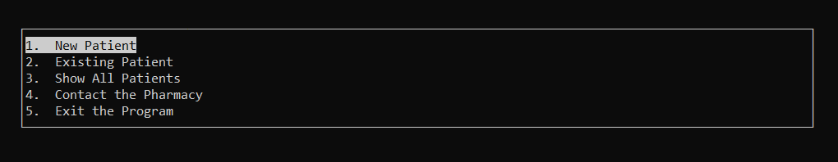
<curses>
Via Static Linking

Slide 7
Applied OOP Concepts

Slide 8

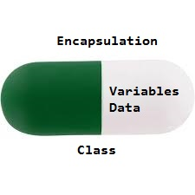
Encapsulation

Slide 9
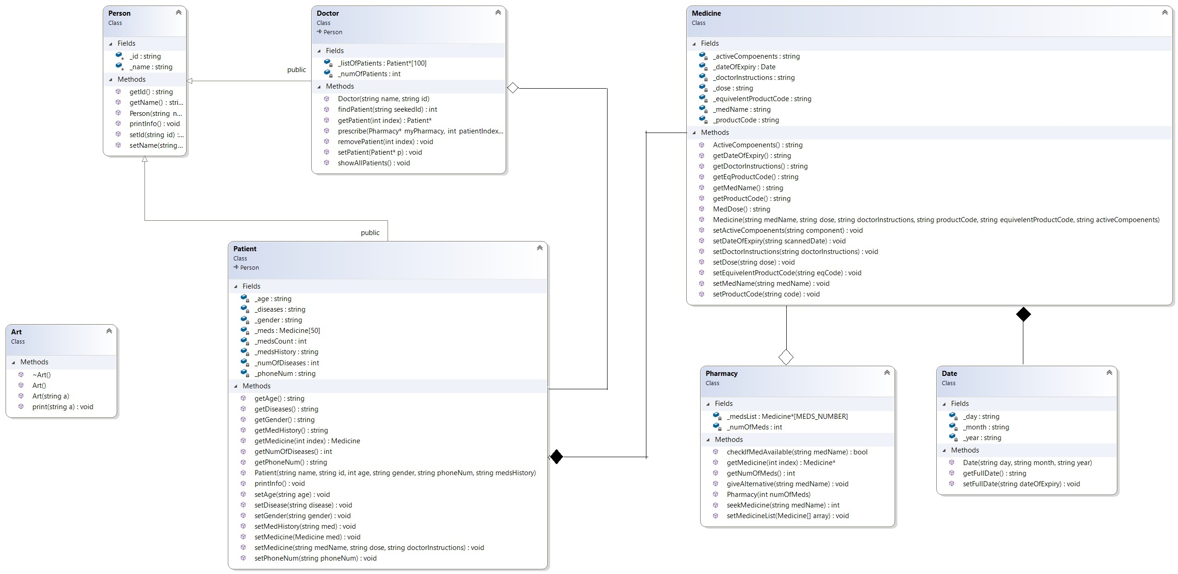

Slide 10
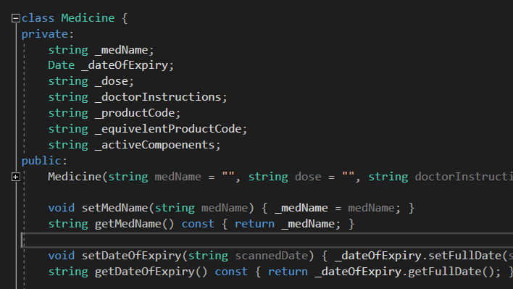
EASILY GATHERED

Slide 11
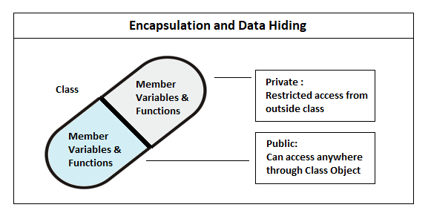

Slide 12
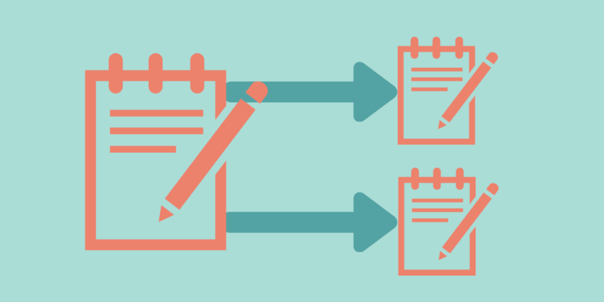
Association

Slide 13
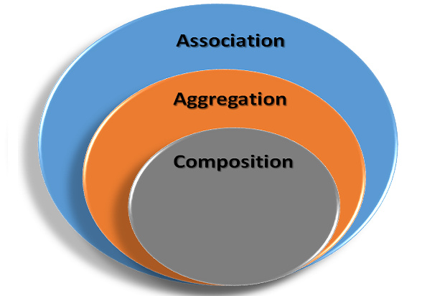

Slide 14
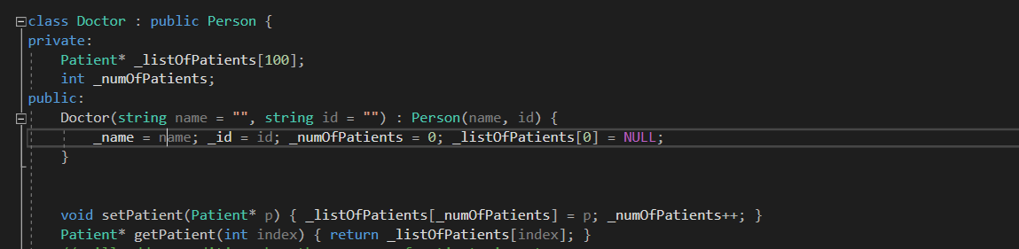

Slide 15
Why we used aggregation in Doctor?
Because aggregation is mainly about the life span of the objects, if the Doctor object get’s destroyed, we don’t want the person and his all details to be destroyed as well, so we make the aggregation where Dr will point to the patients

Slide 16
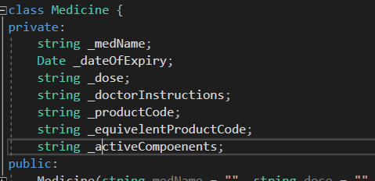
Another example: Composition

Slide 17
We used composition because the object Date depends on Medicine, if we delete the medicine, we can’t have its expiry date, hence, the composition where date will be destroyed whenever the Medicine is destroyed

Slide 18
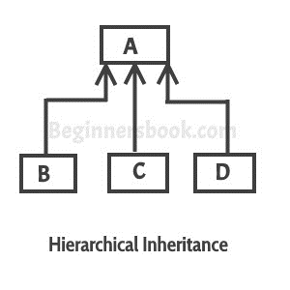
Inheritance

Slide 19
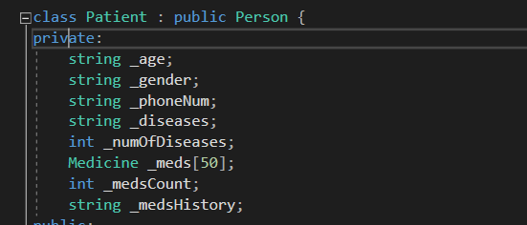
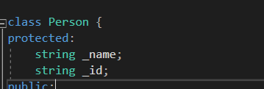
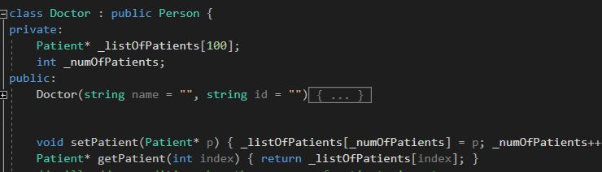

Slide 20
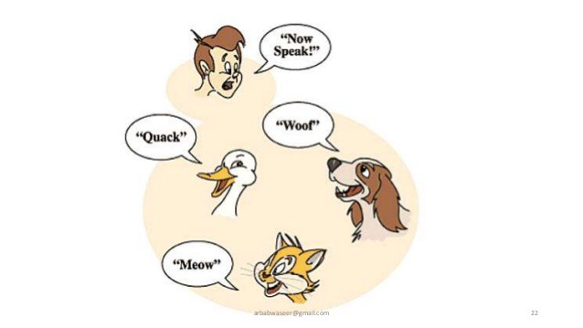
Polymorphism

Slide 21
Polymorphisms
We used that concept here because we would like to call one function from the parent class, yet the information we want to yield from each class is different, hence the polymorphism concept where the same function can act differently according to the class it came from.

Slide 22
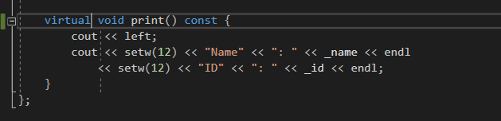
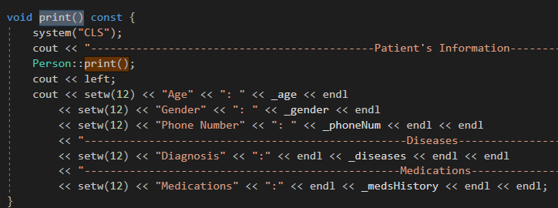
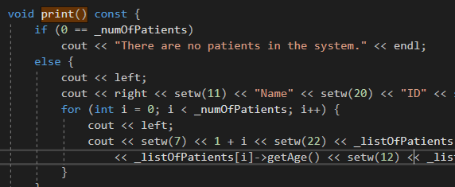
Parent Class
Person
Child Class Patient
Child Class Doctor

Slide 23
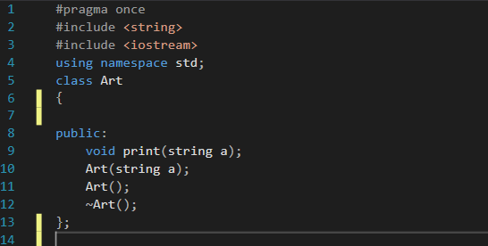
The “Side-Dishes” ☺
Class Art to convert string to
ASCII art and print it

Slide 24
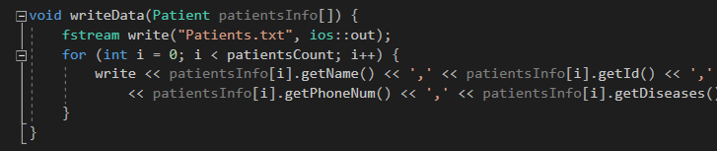
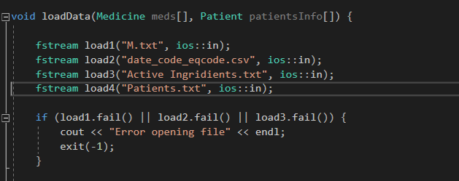
The “Side-Dishes” ☺

Slide 25
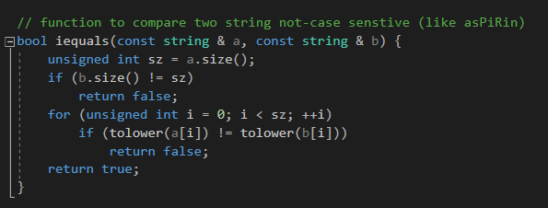
The “Side-Dishes” ☺
An In-Case Sensitive
Comparing Function.

Slide 26
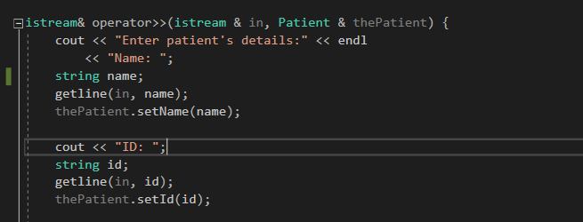
The “Side-Dishes” ☺
An Overloaded
Operator for the
Class Patient, it’s
Job is to read the
Attributes of the
The class.

Slide 27
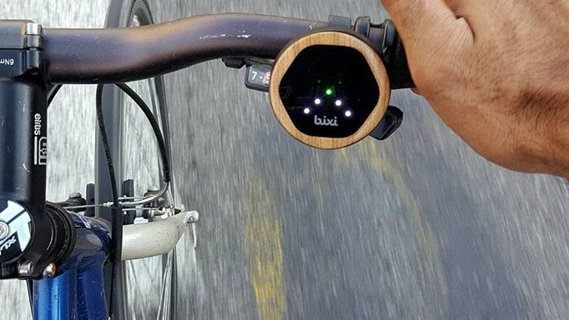

LET”S DO IT LIVE….

