Slide 1

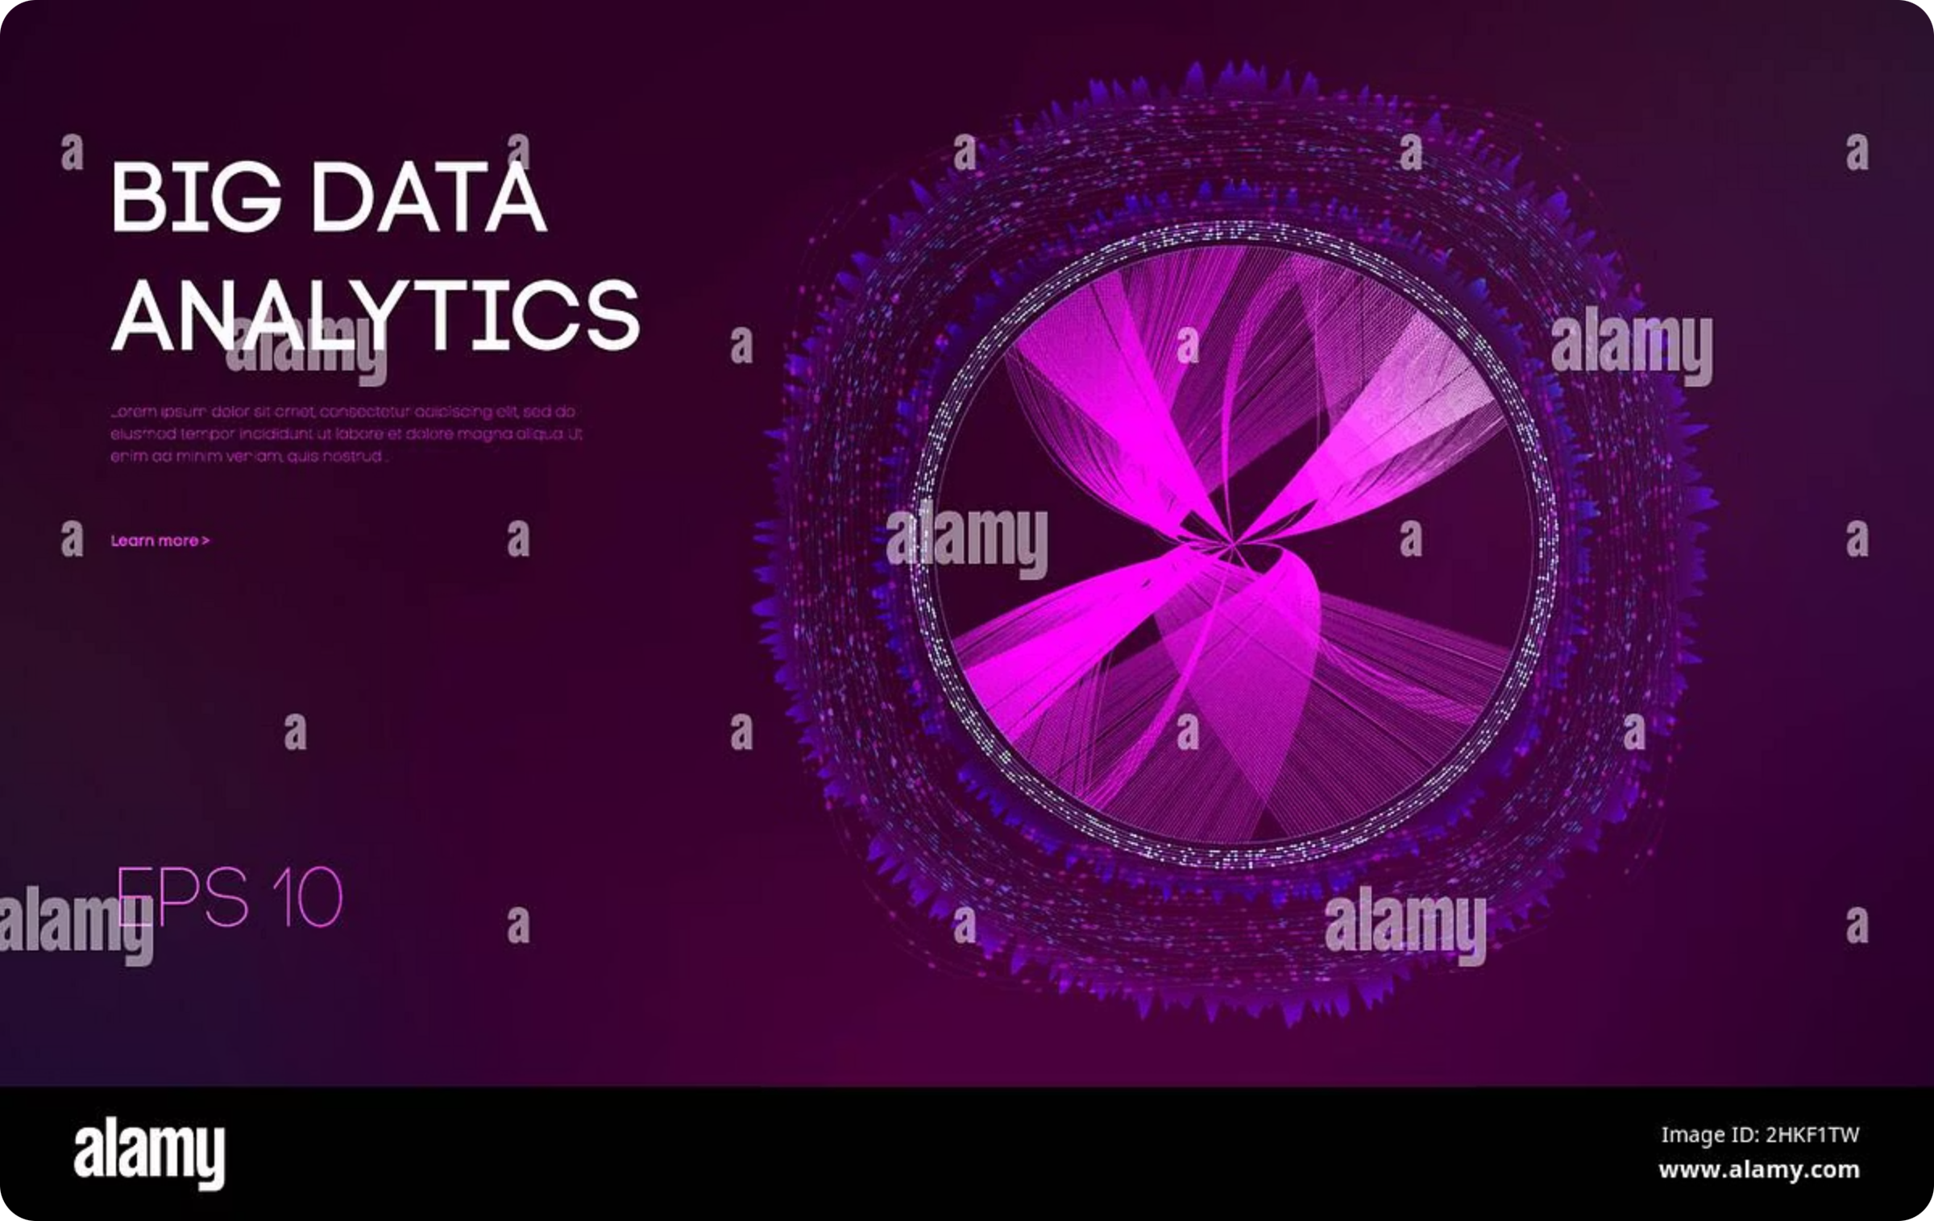
Big Data & Why Hadoop Exists
Introduction to Big Data challenges and how Hadoop addresses them.
Presented by: Abdullah Ali — Date: March 2026

Slide 2
Learning Objectives
Understand Big Data
Database Limits
Scaling Strategies
Define the 5 Vs and why they matter operationally.
Why traditional RDBMS struggle with modern scale and variety.
Compare vertical vs horizontal approaches and trade-offs.
Core Concepts
Hadoop Overview
GFS and MapReduce fundamentals that inspired Hadoop.
HDFS, YARN, and MapReduce — how they fit together.

Slide 3

What is Big Data? — The 5 Vs
Volume
Velocity
Variety
Veracity
Massive scale: petabytes to exabytes (e.g., social platforms, logs).
High ingest and processing rates — streaming & near‑real‑time needs.
Structured, semi-structured, unstructured (logs, images, JSON, video).
Trust, noise, and quality issues require validation & cleansing.
Value
Turning raw data into actionable insights drives ROI.
Diagram: five interlinked concepts emphasizing interdependence of the Vs.

Slide 4

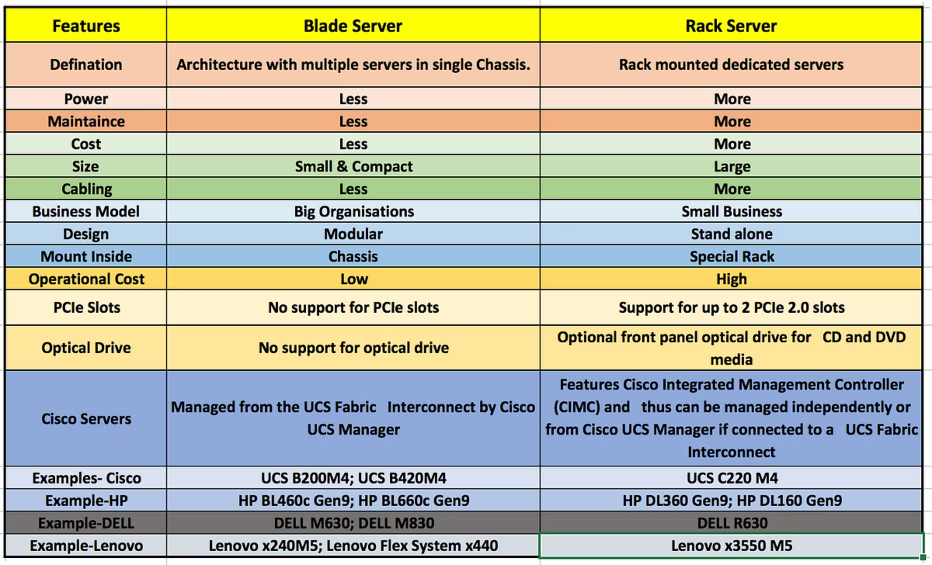
Problems with Traditional Databases
- Built for structured schemas and transactional consistency.
Typical Bottleneck
- Vertical scaling dependence: single-machine limits and high cost.
Single I/O, CPU, or memory boundary.
- Performance degrades with high write/ingest velocity and huge volumes.
- Hard to store & process unstructured data efficiently.
Scaling Cost
Expensive upgrades and license limits.
- Limited fault tolerance across many failures.
Visual: classic DB server with a red bottleneck icon to show single-point strain.

Slide 5
Vertical vs Horizontal Scaling
Vertical Scaling
Horizontal Scaling
Upgrade CPU, RAM, disk on one machine
Simple to implement but limited by hardware ceiling
Higher single-unit cost and downtime for upgrades
Add commodity nodes to a cluster
Near-linear capacity growth and redundancy
Better fault tolerance and cost-effective at scale
Vertical
Horizontal
Single powerful machine
Many commodity machines
Limited by hardware max
Nearly unlimited scale
Expensive upgrades
Cost-effective expansion

Slide 6

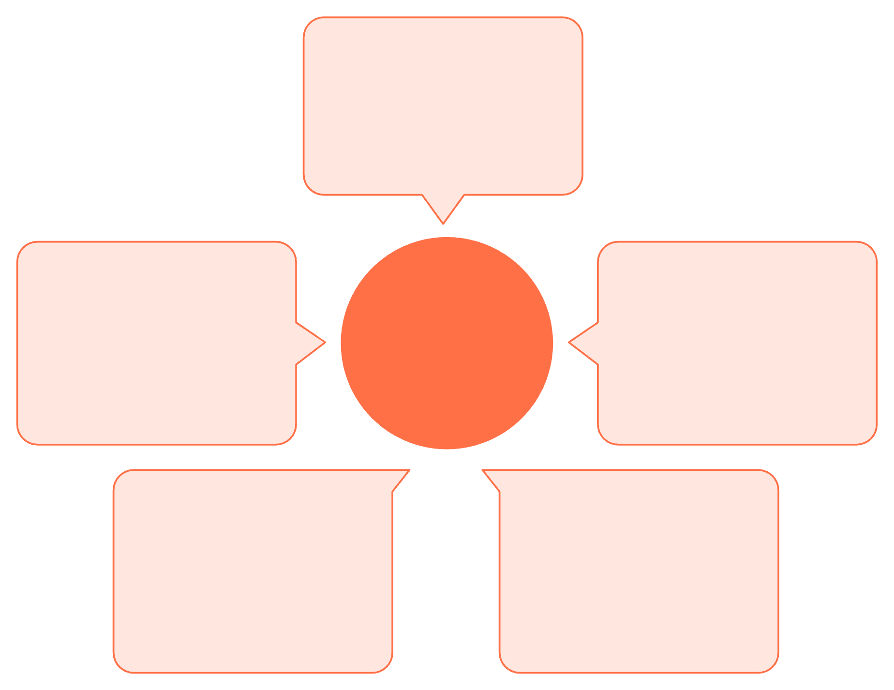

Large file chunking
Files split into fixed-size chunks
Data locality for compute
Google File System (GFS)
Central master metadata
Compute moves to data
Tracks namespaces and chunk locations
Replication for fault tolerance
Chunkservers store chunks
Chunks replicated across servers
Multiple servers hold chunk data
GFS essentials: chunking large files, replication for fault tolerance, single master for metadata and chunk location, and data locality enabling compute-to-data.

Slide 7

Map Phase
Reduce Phase
Shuffle/Sort
MapReduce pattern:
Map: Independent tasks process input splits → emit (key, value).
Shuffle/Sort: System groups values by key and moves data across nodes.
Reduce: Aggregate or combine grouped data into final results.
Designed for parallelism, simplicity, and failure recovery (re-run failed map/reduce tasks).

Slide 8

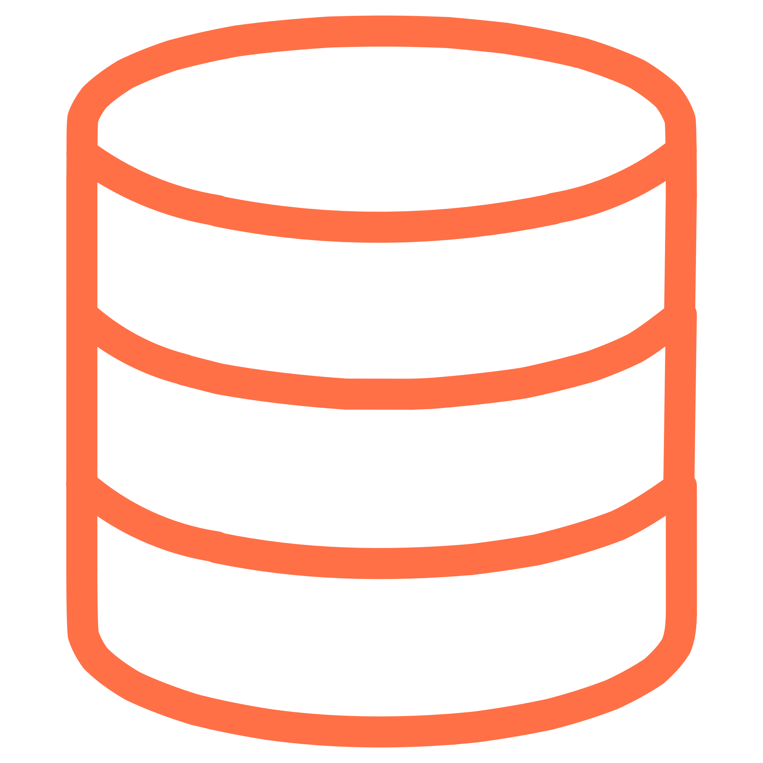



What Hadoop Is
HDFS (Storage)
Distributed file system that splits data into blocks (default 128MB), replicates blocks across nodes for durability.
YARN (Resource Manager)
Schedules containers and manages cluster resources for diverse workloads (MapReduce, Spark, etc.).
MapReduce (Processing)
Batch processing engine that runs jobs in parallel using the Map→Shuffle→Reduce model.
Hadoop = scalable, fault-tolerant framework inspired by GFS & MapReduce — built for horizontal scale on commodity hardware.

Slide 9
Summary
Core Points
- Big Data (5 Vs) outgrew single-node RDBMS models. Distributed systems are necessary.
- Horizontal scaling + replication enable resilience and capacity.
- GFS and MapReduce introduced practical patterns for storage and compute.
- Hadoop packages these ideas: HDFS for storage, YARN for resource management, MapReduce for processing.
Discussion Questions
Which industries gain the most from Hadoop-style architectures and why?
How does Hadoop detect and recover from node failures?
What are modern limitations of Hadoop and common alternatives (e.g., cloud object stores, stream processors)?

Slide 10

Thank You!
Questions?
Learn more: hadoop.apache.org

