Slide 1

Hadoop – What It Is & Core Architecture
Understanding the distributed framework powering big data processing at scale

Slide 2
What Hadoop Really Is
Distributed Framework
Commodity Hardware
Batch-oriented processing for big data workloads. According to the 2024 Cloudera report, Hadoop clusters process over 150 petabytes of data daily across enterprise environments.
Runs on affordable, off-the-shelf servers rather than expensive specialized equipment. Typical deployment: 30-40 servers per rack with 3 Gbps uplink and 1 Gbps intra-rack connectivity.

Slide 3


The Three Pillars of Hadoop
YARN
MapReduce
HDFS

Slide 4

HDFS – Distributed Storage Engine
Files are split into 64 MB blocks (default size) and replicated 3 times for fault tolerance
Rack awareness strategy: replica 1 on local node, replica 2 on different rack, replica 3 on another node in that remote rack
Metadata stored in memory on NameNode; DataNodes send block reports every 30 seconds
Scales to 10+ PB and 10,000 nodes (Hadoop 3.4.0 benchmark)

Slide 5
MapReduce – Parallel Batch Processing
01
02
03
Map Phase
Shuffle & Sort
Reduce Phase
Input data is split into key/value pairs and processed in parallel across worker nodes
Framework automatically transfers intermediate data from mappers to reducers
Results are aggregated and combined; common use cases include word counting and log aggregation
Each MapReduce job is executed as a single application managed by YARN's ApplicationMaster.

Slide 6

YARN – Resource Management & Scheduling
ResourceManager
Master daemon that makes global decisions about CPU, memory, and container allocation across the entire cluster
NodeManager
Per-node agent that launches containers, monitors resource usage, and sends heartbeats every 3 seconds to ResourceManager
Supports multiple schedulers (Capacity, Fair, FIFO) for multi-tenant workloads. Enables non-MapReduce engines like Spark and Flink to share the same cluster infrastructure.

Slide 7
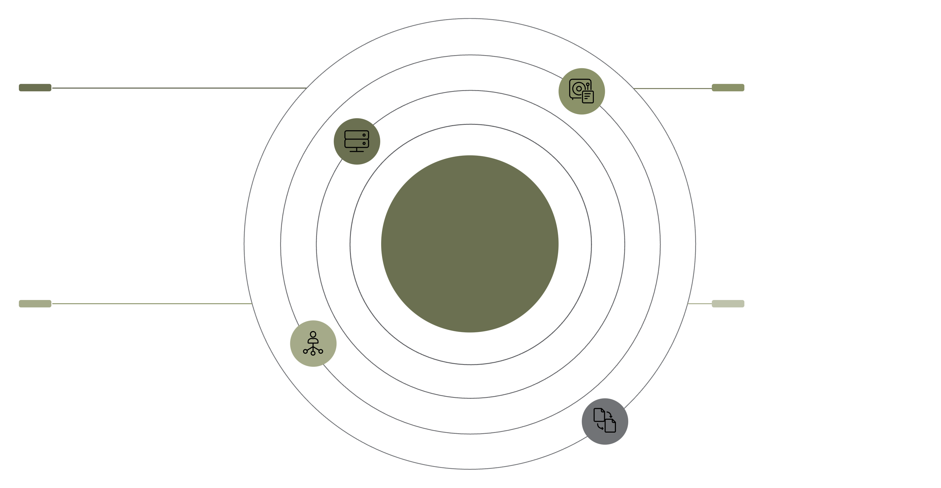
Architecture Concepts
Master-Slave, Cluster, Nodes, and Rack Awareness
Master Node
Slave Nodes
NameNode and ResourceManager coordinating metadata and cluster resources
Multiple DataNode and NodeManager instances storing data and running tasks
Hadoop Cluster Architecture
Three-Rack Topology
Replica Placement
Replicas placed across racks to ensure availability if a rack fails
Rack symbols show distribution across three racks for fault isolation

Slide 8
Four Core Node Roles
NameNode
DataNode
Master of HDFS metadata. Maintains the filesystem namespace and block location map in RAM. Single point of coordination for all file operations.
Stores actual block data on disk. Sends periodic heartbeats and block reports. Serves client read and write requests directly.
ResourceManager
NodeManager
Global scheduler for the entire cluster. Tracks available resources, launches ApplicationMasters, and makes allocation decisions.
Per-node daemon managing local resources. Launches containers, monitors CPU/memory usage, and reports to ResourceManager.

Slide 9

Secondary NameNode – NOT a Backup
Common misconception: The Secondary NameNode is often mistaken for a backup or failover node. This is incorrect.
What It Actually Does
High Availability Setup
Performs periodic checkpointing: merges the EditLog (transaction log) into a new FsImage (filesystem snapshot) every hour by default. This reduces startup time after a NameNode restart.
True HA requires an Active + Standby NameNode pair coordinated by Zookeeper. Losing the Secondary NameNode doesn't endanger data; losing the active NameNode without a standby does.

Slide 10
Quick Quiz
1
2
3
Resource Allocation
Rack-Aware Replication
Secondary NameNode
Which Hadoop component is responsible for resource allocation across the cluster?
In default rack-aware replication, where are the three replicas placed?
True or False: The Secondary NameNode acts as a live backup for the NameNode.

