Slide 1
Screen Sketches
KK_09
Brady Synstelien, Ricky Abdullah, Richard Gonzalez, and Jack Kinser
SportsLeague

Slide 2
List of Requirements:
Functional
Actor 1 – Nittin Smith
23 years old
Tech savvy
Novice Gamble
Full access to SportsLeague features
Actor 2 – James Abdullah
45 years old
Moderate tech skills
Frequent Gambler
Full access to SportsLeague features
Actor 3 – Susan Purdy
51 years old
Limited tech skills
Sports Fan
Full access to SportsLeague features
Actor 4 – Emily Richardson
68 years old
No tech skills
Was referred by relative
Full access to SportsLeague features
Non-Functional
Response Time
Users need to be able to play in real time
Users need to be able receive game information and view leaderboard status
Scalability
There needs to be no limit to how many users can create an account
Previous game stats need to be saved
Usability
A user who has never bet on sports games should be able to play
Anyone should be able to use SportsLeague effectively

Slide 3
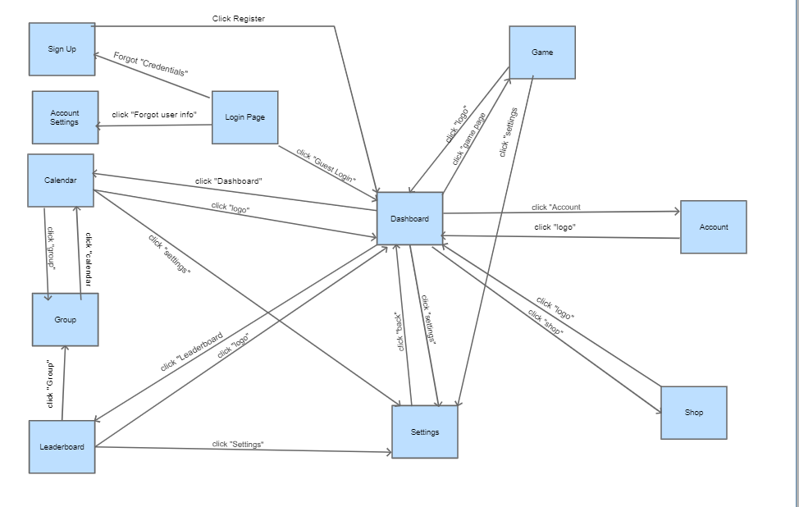
Flow Chart:

Slide 4
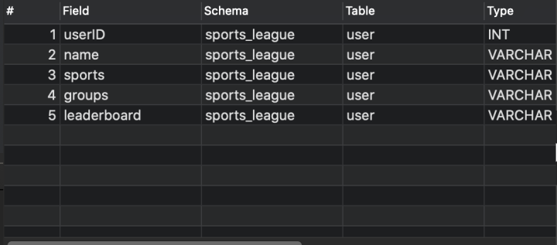
Data Table:

Slide 5
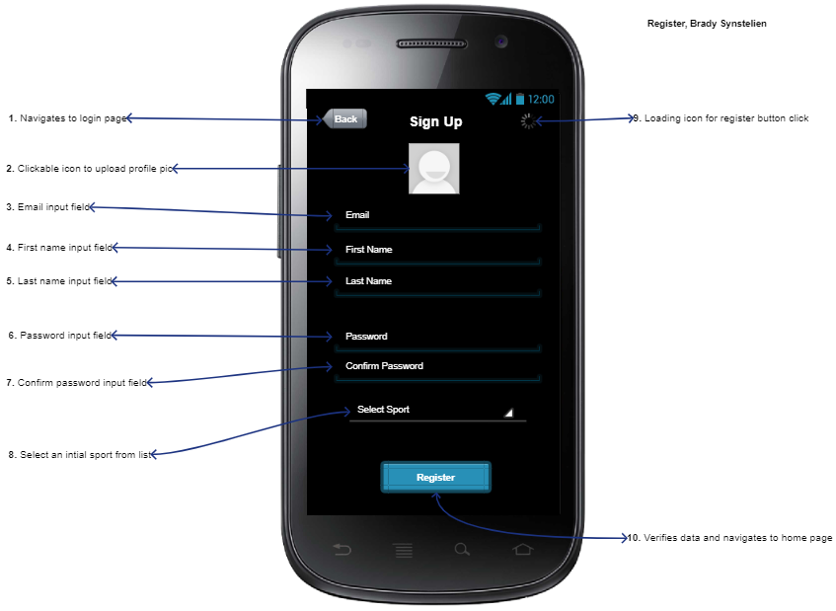
The register page will be the basis of our user data fields stored in the backed. When you initially navigate to this page there will be the option of going back to the login (1). This screen will allow a user to upload a jpeg or png file as a profile picture (2). They will then enter an email (3). Followed by there first name (4). Then last name (5). Finally, they will create a password which they will then need to confirm (6 & 7). The user will need to select an initial sport that will set the framework of following pages (8). When all fields have valid entries the user will click the ‘Register’ button (10), there will be an icon in the top right that will show the verification process occurring (9).

Slide 6
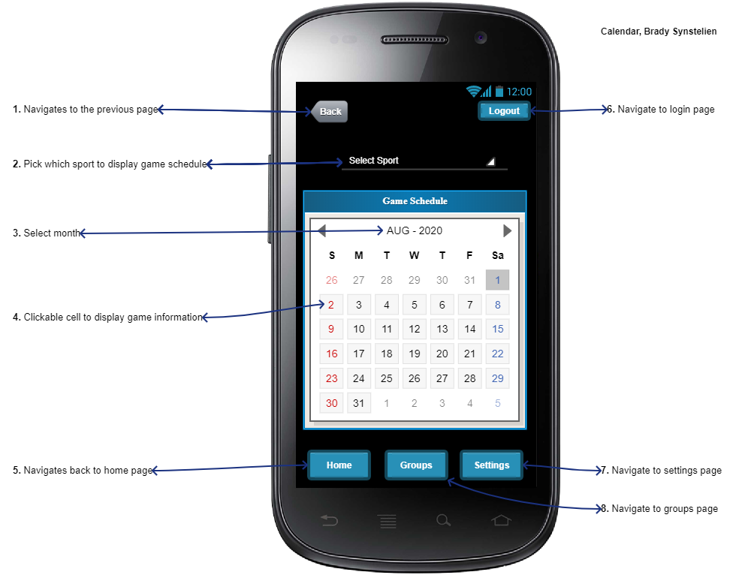
The calendar page will allow a user to view game schedule and other information. When you initially navigate to this page there will be the option of going back to the previous page (1). This screen will allow a user to select a sport from a given list to view game schedule information for the given sport (2). They can then choose the specific month to view (3). The user will then be able to interact with each date cell that will pop up game information for the given day (4). The user will be able to navigate to the Home, Groups, and Settings Page (5, 7, and 8). The user will also be able to logout of the application by clicking the ‘logout’ button in the top right corner (6).

Slide 7
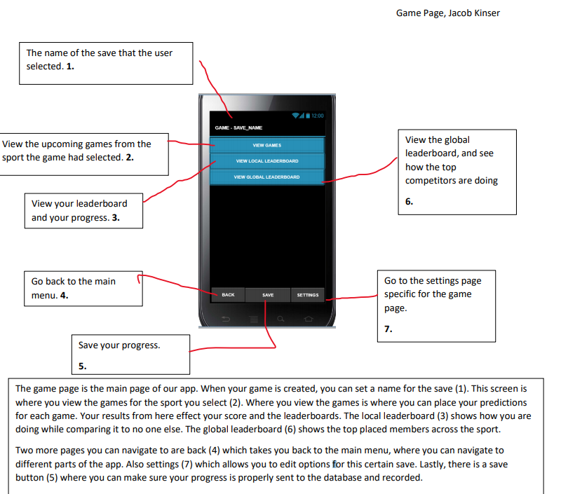

Slide 8
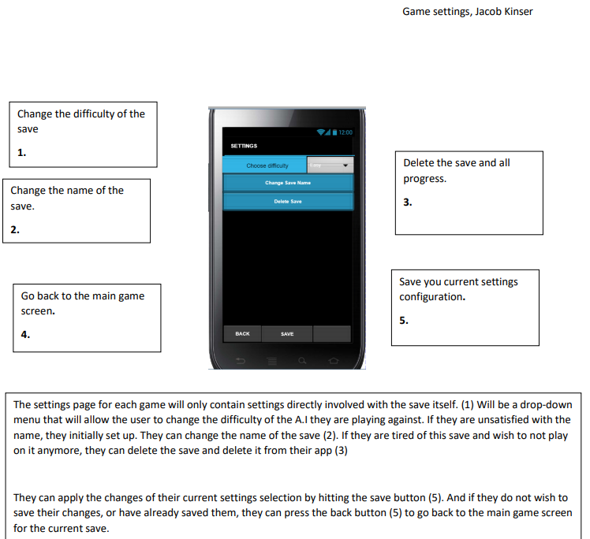

Slide 9
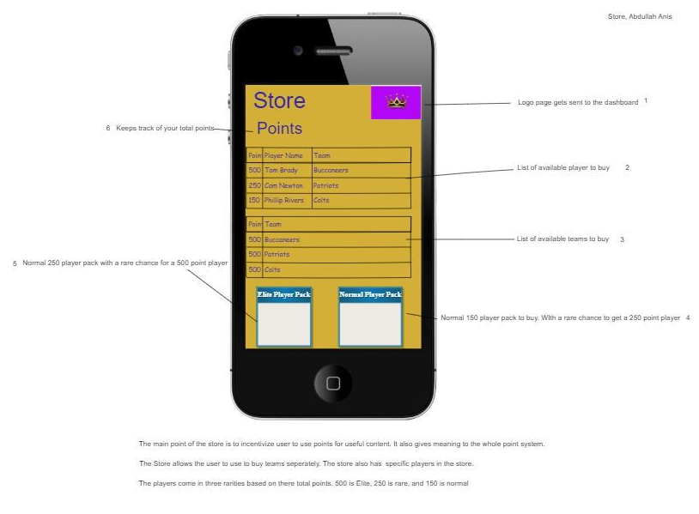

Slide 10
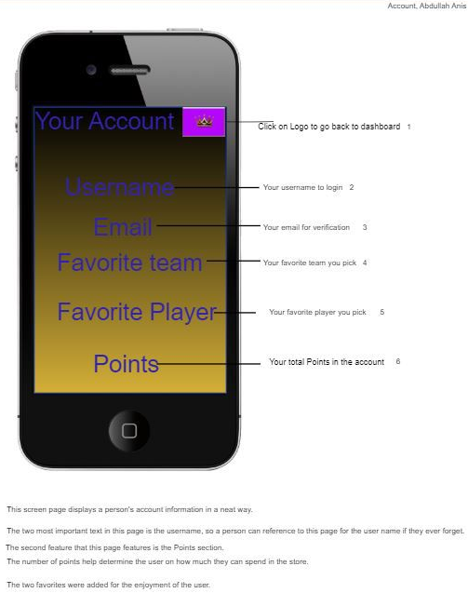

Slide 11
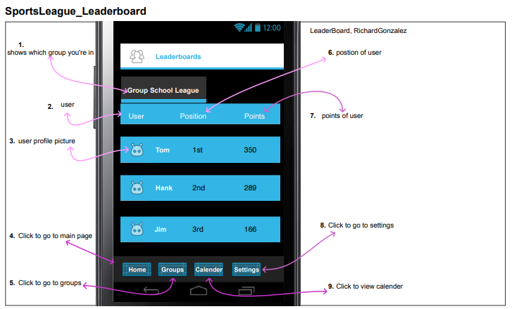
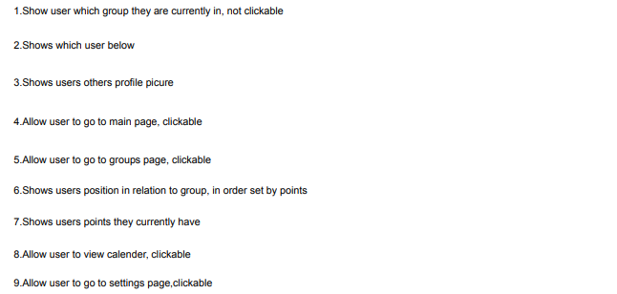

Slide 12
