Slide 1


Slide 2

Online Discussion Forums
Mobile Application / MERN Stack Development
CS519
Associate Degree Program (ADP)

Slide 3
Introduction
Abdullah Ansari Bc220212964

Slide 4

INTRODUCTION OF PROJECT
Objective:
  Design and implement a robust online forum system with an emphasis on security and user roles.
User Roles:
  Admin, Moderator, Normal User – each with distinct responsibilities to ensure a balanced and secure forum environment.
Security Focus:
  Prioritizing secure access, content moderation, and keyword filtering to create a safe digital space.

Slide 5
Key Features:
User Access Control:
  Admin governs user roles, approving Normal User accounts and managing Moderator permissions.
Content Curation:
  Admin regulates discussions by adding, updating, or deleting inappropriate keywords.
Automated Content Filter:
  Scrutinizes content posted by Normal Users, removing inappropriate language in real-time.
Moderator Authority:
  Moderators can delete topics and impose temporary bans, maintaining order within the forum.
Profile Management:
  All users enjoy basic profile management, fostering individuality within the digital community.
Project Essence:
This project aims to redefine online interactions by combining security, accessibility, and community dynamics in a seamless online forum experience.

Slide 6
Project Schedule

Slide 7
Use Case Diagram

Slide 8
Entity-Relationship Diagram

Slide 9
Relational Schema

Slide 10
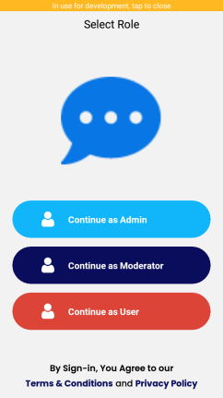
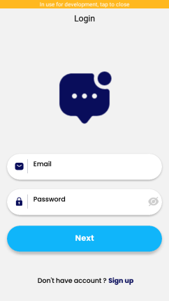
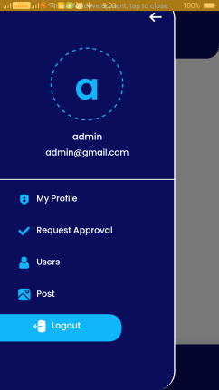
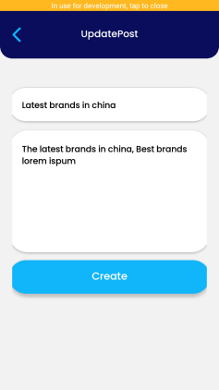
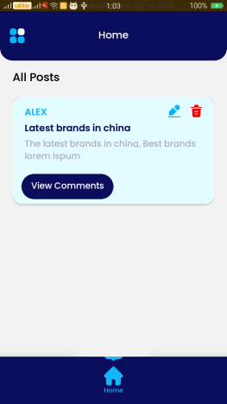
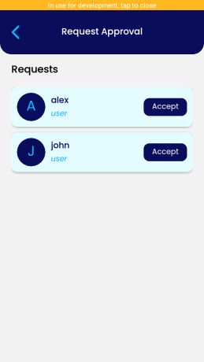
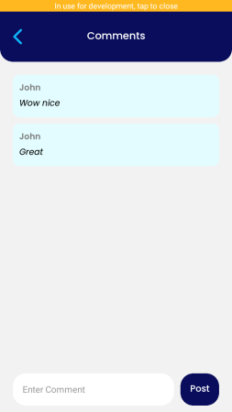
User Interfaces

Slide 11
Results
I’m using mongoDB database

Slide 12
Tools
Frontend Technologies:
React Native, React Navigation, Redux.
Backend Technologies:
NodeJs, ExpressJs, MongoDB.
IDE & Software:
Visual Studio Code, Postman, Ms Word, Ms Visio, Ms Power Point.

Slide 13
Thank you

