Slide 1
Predictive Analysis and Techniques on Iowa Housing Data
By: Abdullah Arshad
ID: 500503498

Slide 2
Problem
Create a working prototype that helps home buyers determine the price of a home given a selection of attributes.

Slide 3
Potential Application
Home buyers
Predict price of home
Investors
Help investors gauge what type of homes are beneficial for investing (i.e. Location, Structure, size)
Builders
Determine what criteria's influence house prices
Developers
Help city or local developers gauge what kind of local amenities might be of interest to home owners in a particular area
Notes:
Home buyers:
Predict price of home

Slide 4
Dataset
Data format: .csv
Iowa Housing
1500 observations
81 Attributes

Slide 5
R Studios
Tools used
Weka
Excel

Slide 6


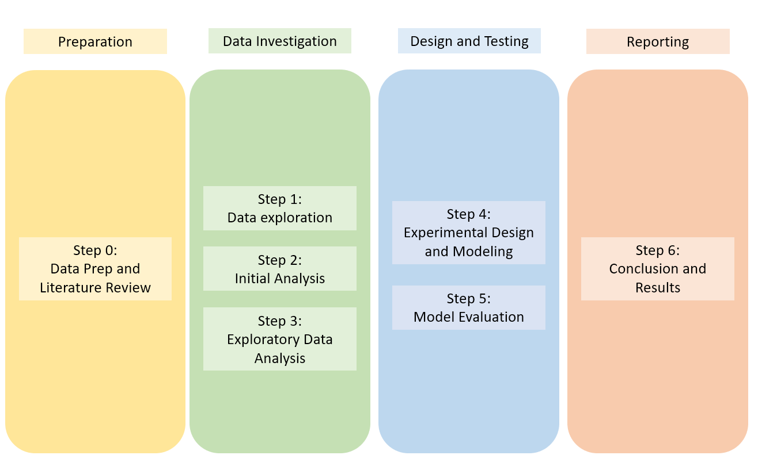



Game plan

Slide 7

Preparation
Reading relevant Literature

Slide 8
Data Investigation
Data Exploration
Initial Analysis
Exploratory Analysis
Identifying attributes and data types
Identifying dependent and independent variables
Finding min, max, std dev for each quantitative attribute
Normality testing
Determining and handling outliers
Addressing missing values
Fixing Data types
Organizing Categorical levels
Feature Selection: Low variance Filter and outlier
Cluster analysis
Correlation testing
Bi-variant and multi-variant analysis

Slide 9
Data Investigation
Data Exploration
Initial Analysis
Exploratory Analysis
Identifying attributes and data types
Identifying dependent and independent variables
Finding min, max, std dev for each quantitative attribute
Normality testing
Determining and handling outliers
Addressing missing values
Fixing Data types
Organizing Categorical levels
Feature Selection: Low variance Filter and outlier
Cluster analysis
Correlation testing
Bi-variant and multi-variant analysis

Slide 10
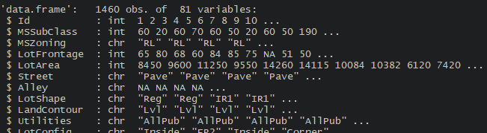
Data Investigation Data Exploration
Ordinal
Quantitative
Nominal
Dependent variable
Sale Price

Slide 11
Data Investigation Data Exploration
ID
LOTCONFIG
YEARBUILT
FOUNDATION
Quantitative
MSSUBCLASS
LANDSLOPE
YEARREMODADD
BSMTQUAL
Nominal
MSZONEING
NEIGHBORHOOD
ROOFSTYLE
BSMTCOND
Ordinal
LOTFRONTAGE
CONDITION1
ROOFMAT1
BSMTEXPOSURE
LOTAREA
CONDITION2
EXTERIOR1ST
BSMTFINTYPE1
STREET
BLDGTYPE
EXTERIOR2ND
BSMTFINSF1
ALLEY
HOUSETYPE
MASVNRTYPE
BSMTFINTYPE2
LOTSHAPE
OVERALLQUAL
MASVNRAREA
BSMTFINSF2
LANDCONTOUR
OVERALLCOND
EXTERQUAL
BSMTUNFSF
UTILITIES
MISCVALUE
EXTERCOND
TOTALBSMTSF

Slide 12
Data Investigation Data Exploration
HEATING
FULLBATH
GARAGEYRBUILT
X3SSNPORCH
Quantitative
HEATINGQC
HALFBATH
GARAGEFINISH
SCREENPORCH
Nominal
CENTRALAIR
BEDROOMABVGR
GARAGECAR
POOLAREA
Ordinal
ELECTRICAL
KITCHENABVGR
GARAGEAREA
POOLQC
X1STFLRSF
KITCHENQUAL
GARAGEQUAL
FENCE
X2STFLRSF
TOTRMSABVGRD
GARAGECOND
MISCFEATURE
LOWQUALFINSF
FUNCTIONAL
PAVEDDRIVE
MOSOLD
GRLIVAREA
FIREPLACES
WOODDECKSF
YEARSOLD
BSMTFULLBATH
FIREPLACESQU
OPENPORCHSF
SALETYPE
BSMTHALFBATH
GARAGETYPE
ENCLOSEDPORCH
SALECONDITION

Slide 13
Data Investigation
Data Exploration
Initial Analysis
Exploratory Analysis
Identifying attributes and data types
Identifying dependent and independent variables
Finding min, max, std dev for each quantitative attribute
Normality testing
Determining and handling outliers
Addressing missing values
Fixing Data types
Organizing Categorical levels
Feature Selection: Low variance Filter and outlier
Cluster analysis
Correlation testing
Bi-variant and multi-variant analysis

Slide 14
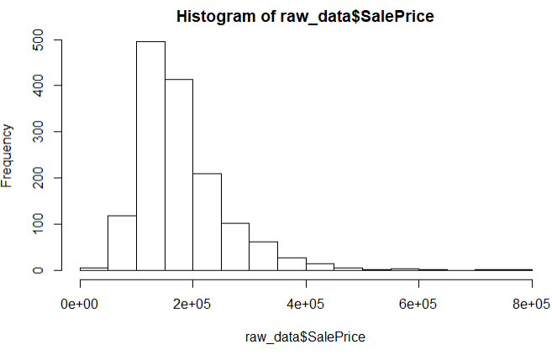
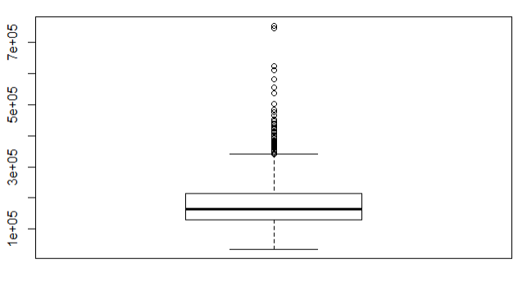
Data Investigation Initial Analysis

Slide 15
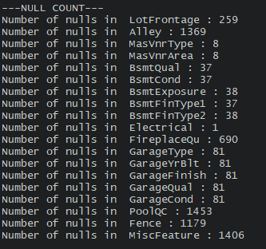
Data Investigation Initial Analysis

Slide 16
Data Investigation Initial Analysis
Handling Missing values

Slide 17
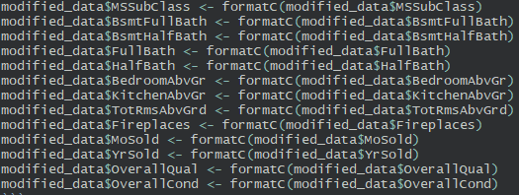
Data Investigation Initial Analysis
Fixing Data types

Slide 18
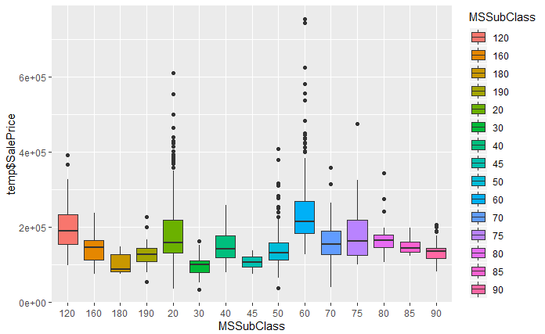
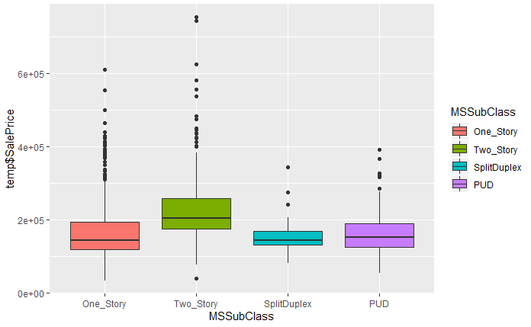
Data Investigation Initial Analysis

Slide 19
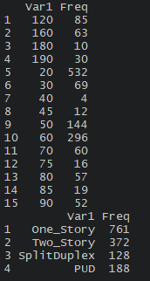
Data Investigation Initial Analysis

Slide 20
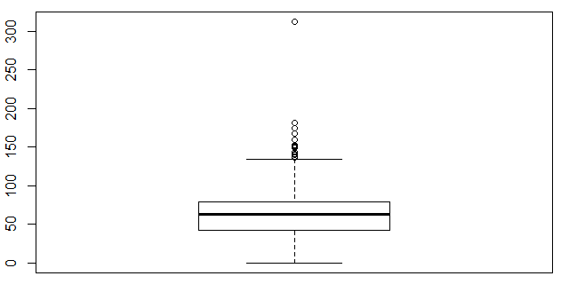
Data Investigation Initial Analysis
Handling Outliers

Slide 21
Data Investigation Initial Analysis
Categorical variables
ruleset
Quantitative variables
If one factor contains >55% observations
drop attribute
If two factors contains >65% observations
drop attribute
If three factors contains >75% observations
drop attribute
Assign outliers to attribute
Specific array

Slide 22
Data Investigation
Data Exploration
Initial Analysis
Exploratory Analysis
Identifying attributes and data types
Identifying dependent and independent variables
Finding min, max, std dev for each quantitative attribute
Normality testing
Determining and handling outliers
Addressing missing values
Fixing Data types
Organizing Categorical levels
Feature Selection: Low variance Filter and outlier
Cluster analysis
Correlation testing
Bi-variant and multi-variant analysis

Slide 23
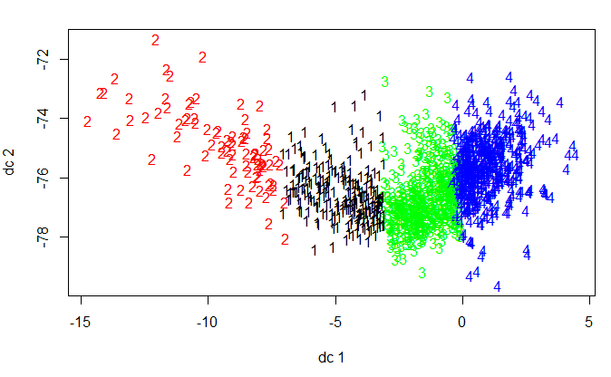
Data Investigation Exploratory Data Analysis

Slide 24
Data Investigation Exploratory Data Analysis
Average Homes
 | Year Built | Overall Quality | Exterior Quality | Total Area | Pool QC | Neighbor-hood | Sale Price +/-10k
Low end | 1929 | 4 | 5 | 2000 | No_Pool | IDOTRR | 130 000
Average | 1967 | 6 | 6 | 2900 | TA | GILBERT | 180 000
High end | 1993 | 8 | 8 | 4200 | Ex | NRIDGHT | 210 000

Slide 25
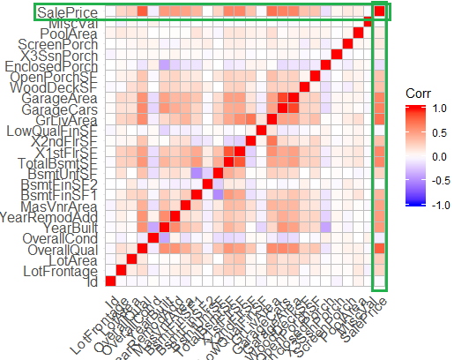
Data Investigation Exploratory Data Analysis
Feature Engineering
Bath = FullBath + 0.5 HalfBath +
BsmtFullBath + 0.5 BsmtHalfBath
TotalArea = TotalBmstSF + 1stflrSF + 2ndflSF +
PoolArea

Slide 26
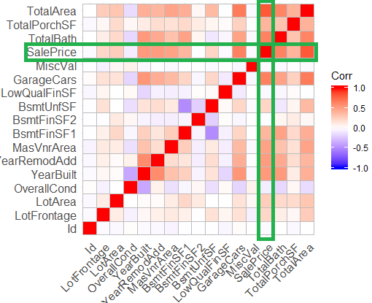
Data Investigation Exploratory Data Analysis

Slide 27
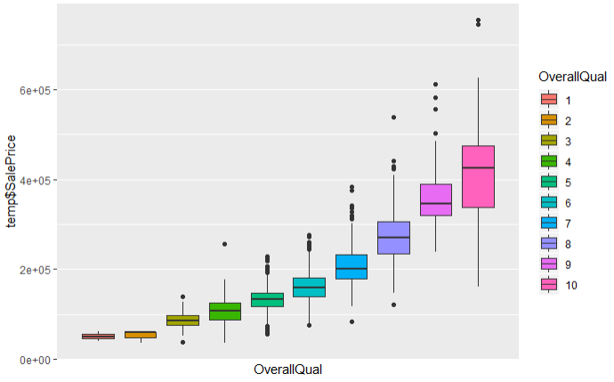
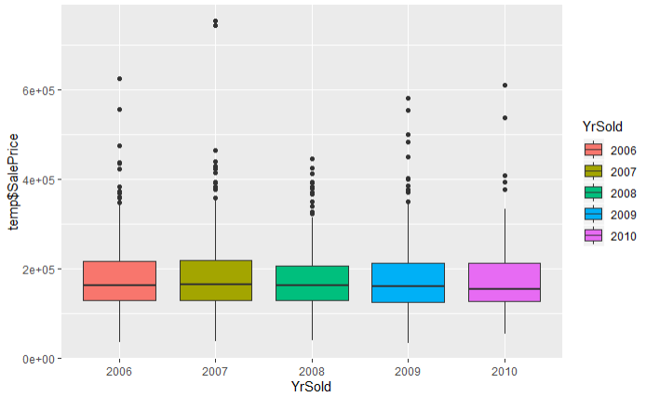
Data Investigation Exploratory Data Analysis

Slide 28
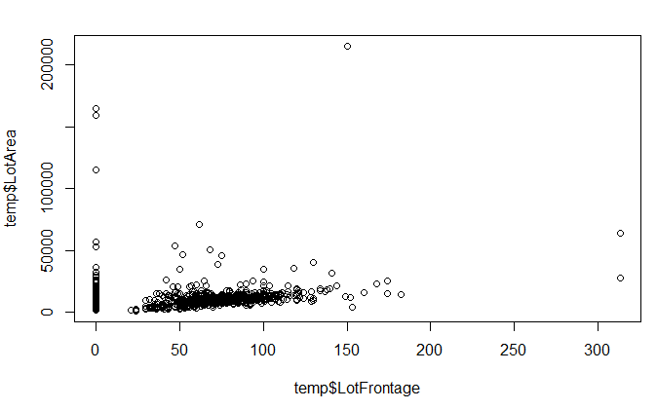
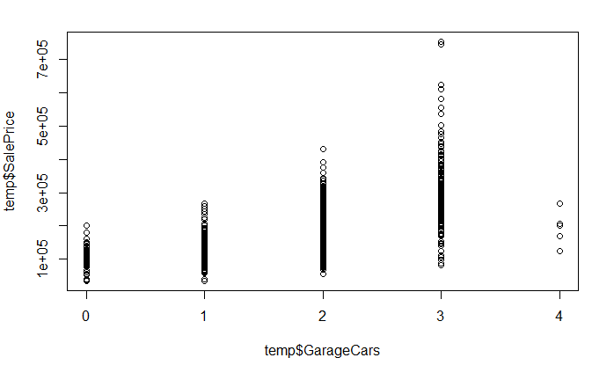
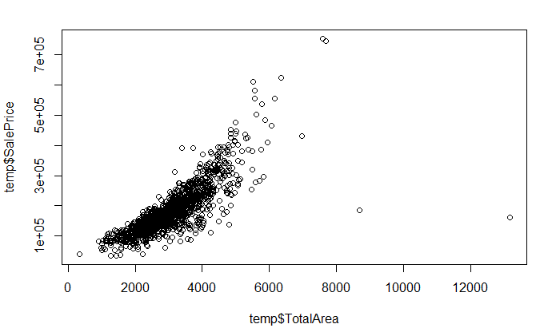
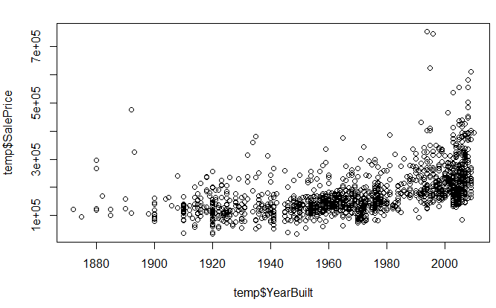
Data Investigation Exploratory Data Analysis
Patterns

Slide 29
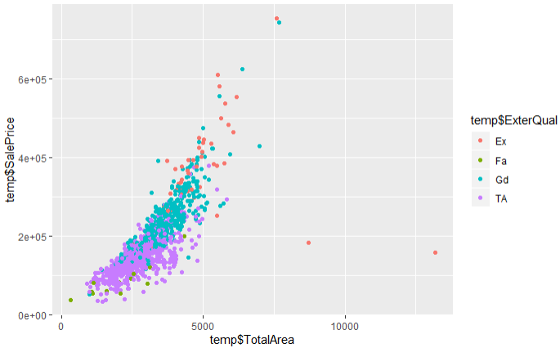
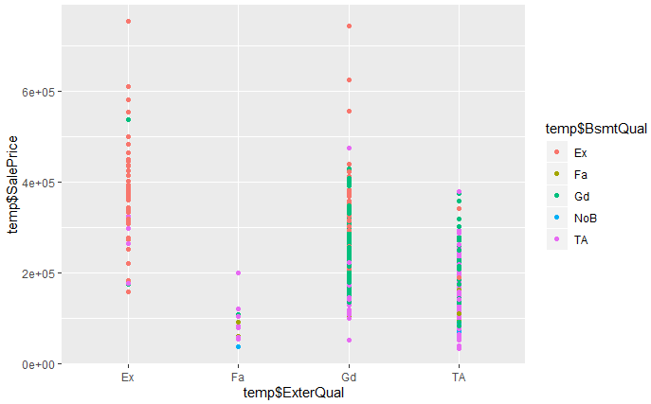
Data Investigation Exploratory Data Analysis
All Excellent Exteriors had average or
better basements
Larger homes with better Exteriors
Sold for higher prices
Only some homes with fair or average
Exteriors had no basements

Slide 30
Data Investigation Data Exploration
MSSUBCLASS
EXTERIOR1ST
HEATINGQC
GARAGEFINISH
Quantitative
LOTFRONTAGE
EXTERIOR2ND
BEDROOMABVGR
GARAGECAR
Nominal
LOTAREA
MASVNRTYPE
KITCHENABVGR
MOSOLD
Ordinal
LOTSHAPE
EXTERQUAL
KITCHENQUAL
YEARSOLD
NEIGHBORHOOD
BSMTQUAL
TOTRMSABVGRD
TOTALBATH
HOUSETYPE
BSMTEXPOSURE
FUNCTIONAL
TOTALPORCHSF
OVERALLCOND
BSMTFINTYPE1
FIREPLACES
TOTALAREA
YEARBUILT
BSMTFINSF1
FIREPLACESQU
YEARREMODADD
BSMTFINTYPE2
GARAGETYPE
Dependent variable
Sale Price
ROOFSTYLE
BSMTUNFSF
GARAGEYRBUILT

Slide 31
Design and Testing Experimental Design and Modeling
Normalization
ONLY for Quantitative attributes
[x – min(x)] / [max(x) – min(x)]
Training and Test set
Training set: 80% random observations
Test set: 20% random observations

Slide 32
Design and Testing Experimental Design and Modeling
Normalization
ONLY for Quantitative attributes
[x – min(x)] / [max(x) – min(x)]
Training and Test set
Training set: 80% random observations
Test set: 20% random observations
Training and Test set (Stratified Twist)
Training set: 1 observation of each factor plus
80% of remaining random observations
Test set: 20% of remaining random observations

Slide 33
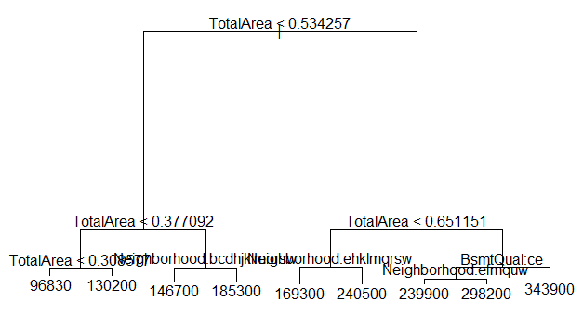
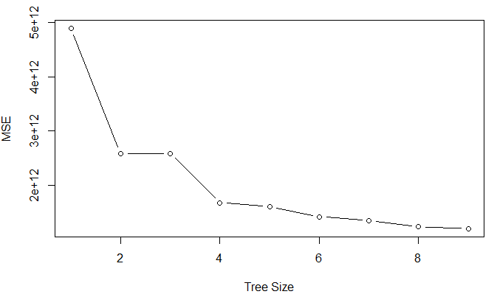
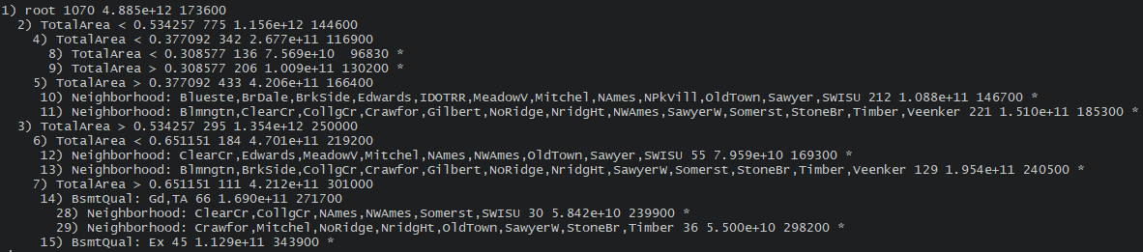
Design and Testing Experimental Design and Modeling
Decision tree model 1

Slide 34
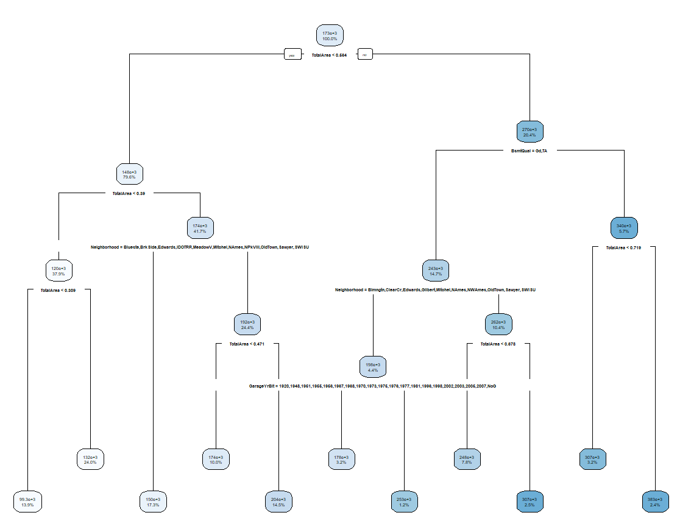
Design and Testing Experimental Design and Modeling
Decision tree model 2

Slide 35
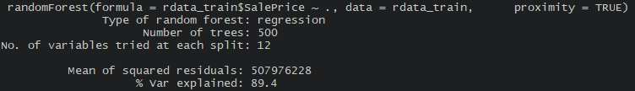
Design and Testing Experimental Design and Modeling
Random Forest

Slide 36
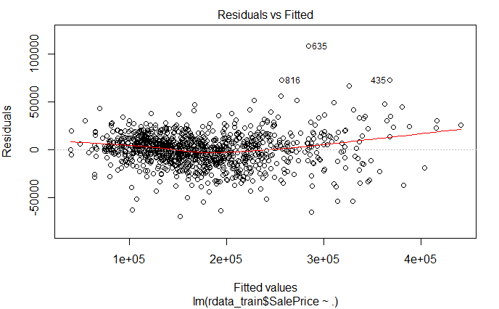
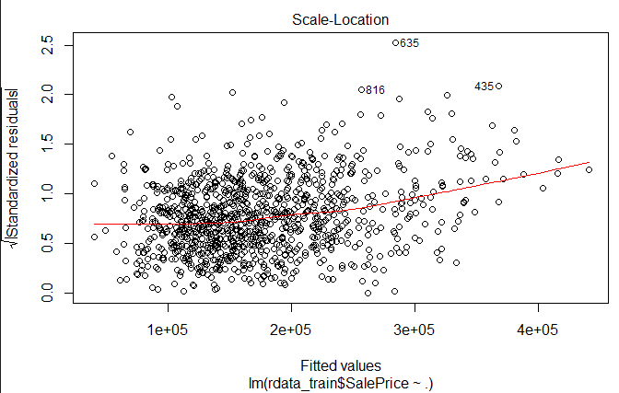
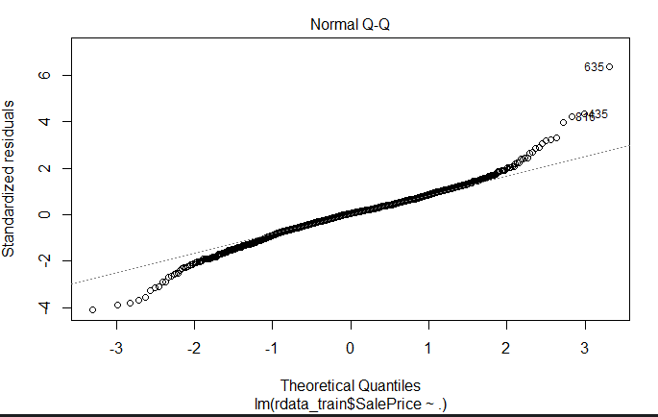
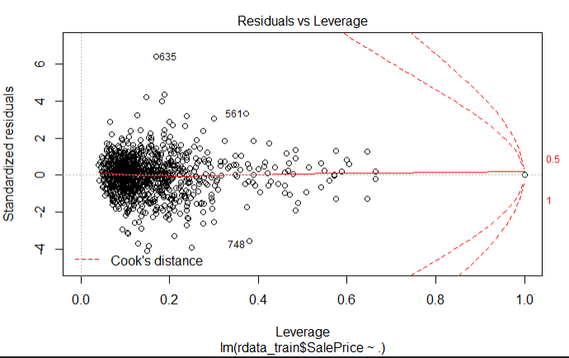
Design and Testing Experimental Design and Modeling
Regression

Slide 37
Design and Testing Experimental Design and Modeling
Elastic Net Regression
Elastic Net Regression
Starting with a slightly worse initial fit can provide
better long term predictions by adding a penalty
→ Good at combating overfitting
→ Essentially desensitizing the model to the training data
→ Good if you have small training set (less factors, variation)
LASSO REGRESSION
→ You know you have useless attributes
RIDGE REGRESSION
→ You know your variables are mostly useful

Slide 38
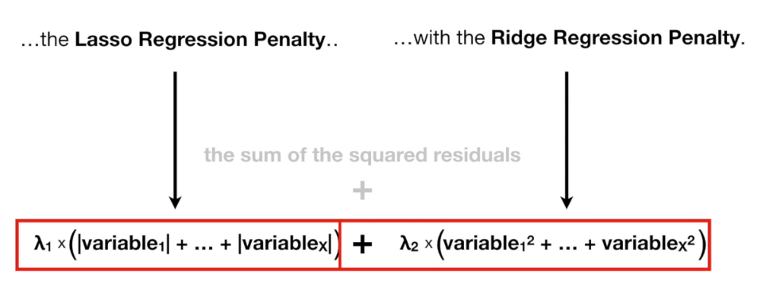
Design and Testing Experimental Design and Modeling
Elastic Net Regression

Slide 39
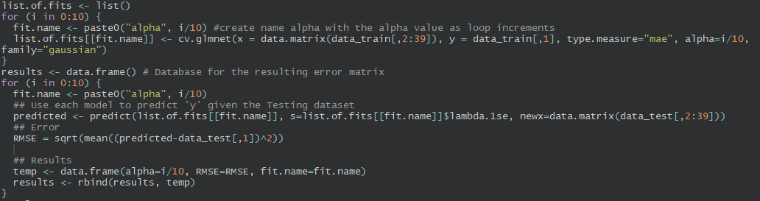
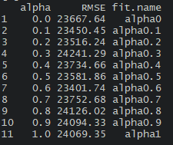
Design and Testing Experimental Design and Modeling
Elastic Net Regression

Slide 40


Design and Testing Model Evaluation
$$=mean(abs(predicted−actual))$$
RMSE and MAE
$$= \sqrt{{mean(predicted−actual)}^{2}}$$

Slide 41
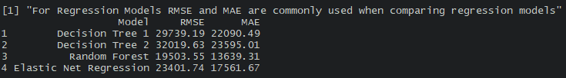
Design and Testing Model Evaluation

Slide 42

Design and Testing Model Evaluation
9000/173000= 5.2%
6500/173000= 3.7%
20300/173000= 11.7%

Slide 43
Reporting Conclusion
Final attributes: MSSubClass,LotFrontage,LotArea,LotShape,Neighborhood,
HouseStyle,OverallCond,YearBuilt,YearRemodAdd,RoofStyle,Exterior1st,Exterior2nd,
MasVnrType,ExterQual,ExterCond,Foundation,BsmtQual,BsmtExposure,BsmtFinType1,
BsmtFinSF1,BsmtFinType2,BsmtUnfSF,HeatingQC,BedroomAbvGr,KitchenAbvGr,KitchenQual,
TotRmsAbvGrd,Fireplaces,FireplaceQu,GarageType,GarageYrBlt,GarageFinish,GarageCars,
MoSold,YrSold,TotalBath,TotalPorchSF,TotalArea,SalePrice.
Recommend using Random Forest, however Net Elastic Regression also give good results. Algorithms were compared by their RMSE

Slide 44
Thank you !!!

Slide 45
Thank you !!!
Questions???

