Slide 1
Freelance Job Portal
Software Engineering Course Project
Abdullah, Aaqib Ansari, Zainab Ali Khan
April 2025

Slide 2
Project Introduction
• A MERN Stack-based web application.
• Connects freelancers with clients.
• Enables job postings, bidding, project tracking, and communication.
• Ensures secure payment and robust profile management.

Slide 3
Functional Requirements
• User authentication and authorization
• Job posting/editing/deleting
• Freelancers can bid and bookmark jobs
• Notifications, dashboard, and dispute management
• Profile management and job history

Slide 4
Non-Functional Requirements
• Performance: Supports 500 concurrent users; 2s response time
• Security: HTTPS for secure communication; GDPR compliant
• Multilingual support (English, Urdu)
• Uses external APIs for notifications and payments

Slide 5
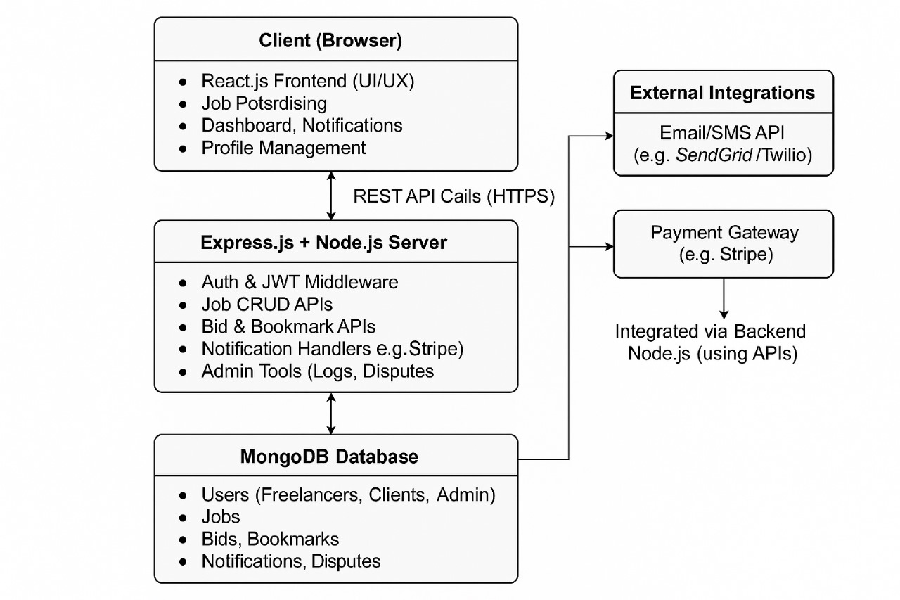
Design - Architecture

Slide 6
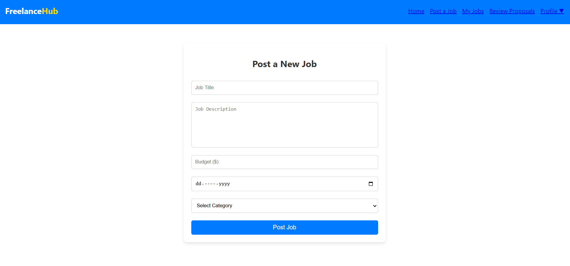
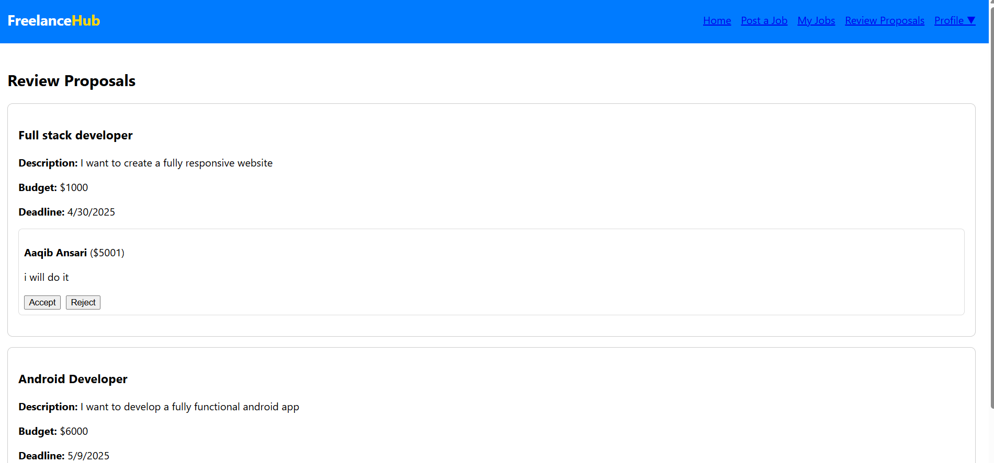
Implementation Screenshots
Screenshots of frontend/backend UI to be added here.

